Slide 1
HTTP

Slide 2
Agenda
What is HTTP protocol?
Advantages of HTTP protocol.

Slide 3
HyperText Transfer Protocol (HTTP)
Protocol
Standard procedure for defining and regulating communication.
e.g. TCP, UDP, HTTP ect
HTTP
Foundation of data communication for www.
web's application layer protocol for
transferring various forms of data between
server and client like plaintext, hypertext, image, videos and sounds.

Slide 4
Terminologies in HTTP
IP Address
numerical label assigned to each device in a Internet protocol based communication
Port number
16 bit number associated with IP address.
completes destination address of a communication session.
Socket
Combination of IP and port number.
End point for communication.
TCP: Transmission control protocol
IP: Internet protocol

Slide 5
Internet Protocol (IP)
Multiple versions
Assignment of IP address. How to identify and locate them.
IPv6 is very different from IPv4
with in tcp/ip controls routing of information with in different computers and servers
deals with
ip address
subnet mask
default gateway
ect
Node discovery
Routable protocol
Divide network into multiple sub networks
(non routable means - all computers can talk to the other)
With in subnet computers can talk to each other.
Outside subnet they can talk through routers.
IP is in Layer 3 in OSI model.

Slide 6
Transmission control protocol (TCP)
Once the computers have found using IP, now how do you talk?
Following are decided by TCP
which language?
how fast?
created for a military.
windowing
how data is transmitted from one comp. to another.
data divided to packets.
transmitted to other.
since comp1 doesn't know the quality of network.
it sends 1 packet - comp2 sends a acknowledgement to comp1.
now comp1 is confident - it sends 2 (say 2,3) packets
comp2 acks.
comp1 sends 4 packets (say 4,5,6,7)
as long as the ack is received, comp1 keeps increasing (may be double the number of packets).
At some point if comp2 gets only 3 packets in order, it will ack that it got only 3 packets in order.
- now comp1 starts sending only a single packet and keeps increasing.
- This is why our downloads starts slow and then there is a sudden increase in our downloads.
So there are windows of packets.
- TCP is layer 4 of OSI - transport layer.
####

Slide 7
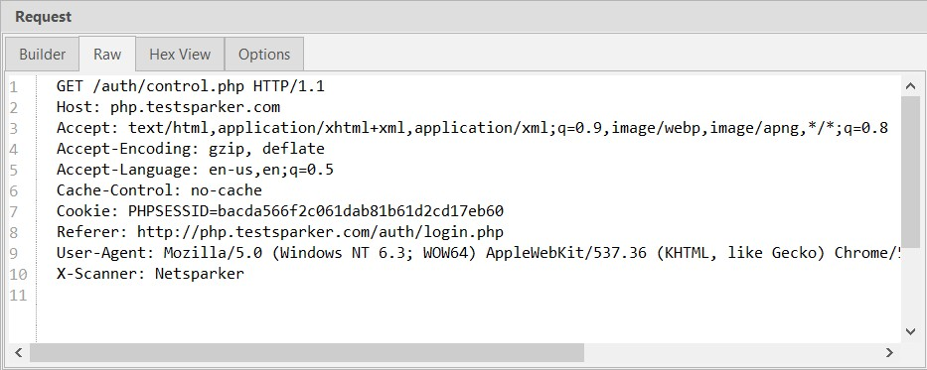
HTTP- REQUEST METHODS

Slide 8
HTTP- REQUEST METHODS
GET: Retrieve document identified by URLDELETE: Deletes specified URL.
POST: Give information to server. Used for add.
PUT: Store document under specified URL. Used for update.
DELETE: Delete a document on the server.
TRACE: Loopback request message.
Invokes a remote application layer feedback of the request message.
Useful for testing what is being received at the server.
Also possible to forward to intermediaries for debugging purposes.
CONNECT: For use by proxies.
HEAD: Retrieve metadata information about document identified by URL.

Slide 9
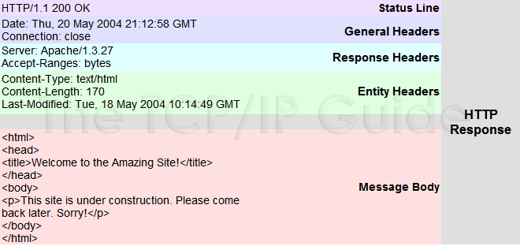
HTTP RESPONSE

Slide 10
HTTP RESPONSE
HTTP RESPONSE MESSAGE
html, xml, json ect..
json growing in popularity.
Response
Headers
Message Length
Date
Content type
Status code
Non human client needs better way to understand the status of a request
Around 40 standard status code.
Numerical code: short description.

Slide 11
HTTP RESPONSE
Has three sections
Status line: Has three fields
Protocol version field
A status code
Status message.
Header line
Entire body
Containes the requested object itself.

Slide 12
HTTP RESPONSE
Has three sections
Status line: Has three fields
Protocol version field
A status code
Status message.
Header line
Entire body
Contains the requested object itself.

Slide 13
Common Status Code
Code | Type | Example | Reason
1xx | Informational | Request received continuing process | Not Done Yet
2xx | Success | Action successfully received, understood and accepted. | You win
3xx | Redirection | Further action must be taken to complete the request | You lose, but try again.
4xx | Client error | Request contains bad syntax or cannot be fulfilled. | You lose, your fault
5xx | Server error | Server failed to fulfill an apparently valid request. | You lose, my bad.

Slide 14
Common Status Code
Status | Message | Description
200 | OK | Request succeeded and the information is returned in the response.
301 | Moved Permanently | Requested object has been permanently moved; the new URL is specified in location: header of the response message. The client software will automatically retrieve the new URL.
400 | Bad Request | This is a generic error code indicating that the request could not be understood by the server.
404 | Not Found | The requested document does not exist on this server
505 | HTTP Version not supported | The requested HTTP protocol version is not supported by the server.

Slide 15
Relatively less used Status Code
Status | Message
201 | Created
202 | Accepted
204 | No content
302 | Moved temp.
304 | Not modified
401 | Unauthorized
403 | Forbidden
501 | Not implemented
502 | Bad gateway
503 | Service not available.

