Slide 1
Day 3 - Agenda
Introduction to Service Discovery
Client side service discovery
Eureka service
Implementing the service discovery with Eureka
Client side load balancing
server side service discovery
Docker/Kubernetes
How Docker/Kubernetes does server side service discovery
Testing patterns: Service Component Test and Service Integration Contract Test
Junit with Mockito
Write a simple test using Mockito
API Gateway Pattern
Zuul
Security
Discuss security best practices for Docker and Microservices

Slide 2
Service Discovery
What is Service Discovery and why do you need the same?
Without service discovery
Service URL changes require code changes
Cloud - has dynamic URLs
Load balancing
Multiple instances
Service registration and discovery
dedicated server is responsible to maintain the registry
of all the Microservice that has been deployed and removed.
Will act like a phone book of all other applications/microservices

Slide 3
Service Discovery
Client Side Service Discovery
Eureka
Server Side Service Discovery
Kubernetes

Slide 4
Server Side Service Discovery
Kubernetes: Server side service discovery.
Relatively less efficient
But very reliable.
When env. go down, the servers are always aware.
Client always gets the latest active service.
Both has it's own adv. and disadv.

Slide 5
Client Side Service Discovery - Eureka
Like a lookup service where
microservices (clients) can register themselves
discover other registered microservices.
When a client microservice registers with Eureka
it provides metadata such as host, port, and health indicator
This allows other microservices to discover it.
The discovery server expects
a regular heartbeat message from each microservice instance.
If an instance doesn't send heartbeat consistently,
the discovery server will remove the instance from his registry.

Slide 6
Advantages of Eureka Service
Disclaimer: Not in comparison with Service Side Service Discovery
Creates very stable ecosystem of Microservices collaborating among each other,
Clients doesn't need to maintain address of other Microservice,
Facilitate scale-out/scale-in
Does load balancing (Kuberentes is the master of this)..
Eureka 2.0 is a
Service discovery framework
Designed for cloud deployments.
Evolution of the original 1.0 version,
Aims to be much more scalable,
Replace the pull based model with fine grain subscription model.

Slide 7
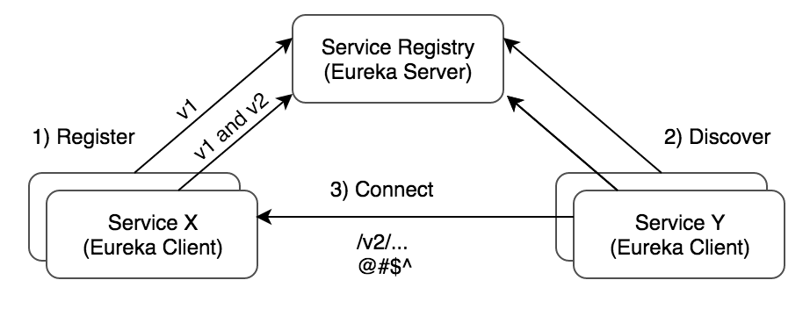
Simple working model

Slide 8
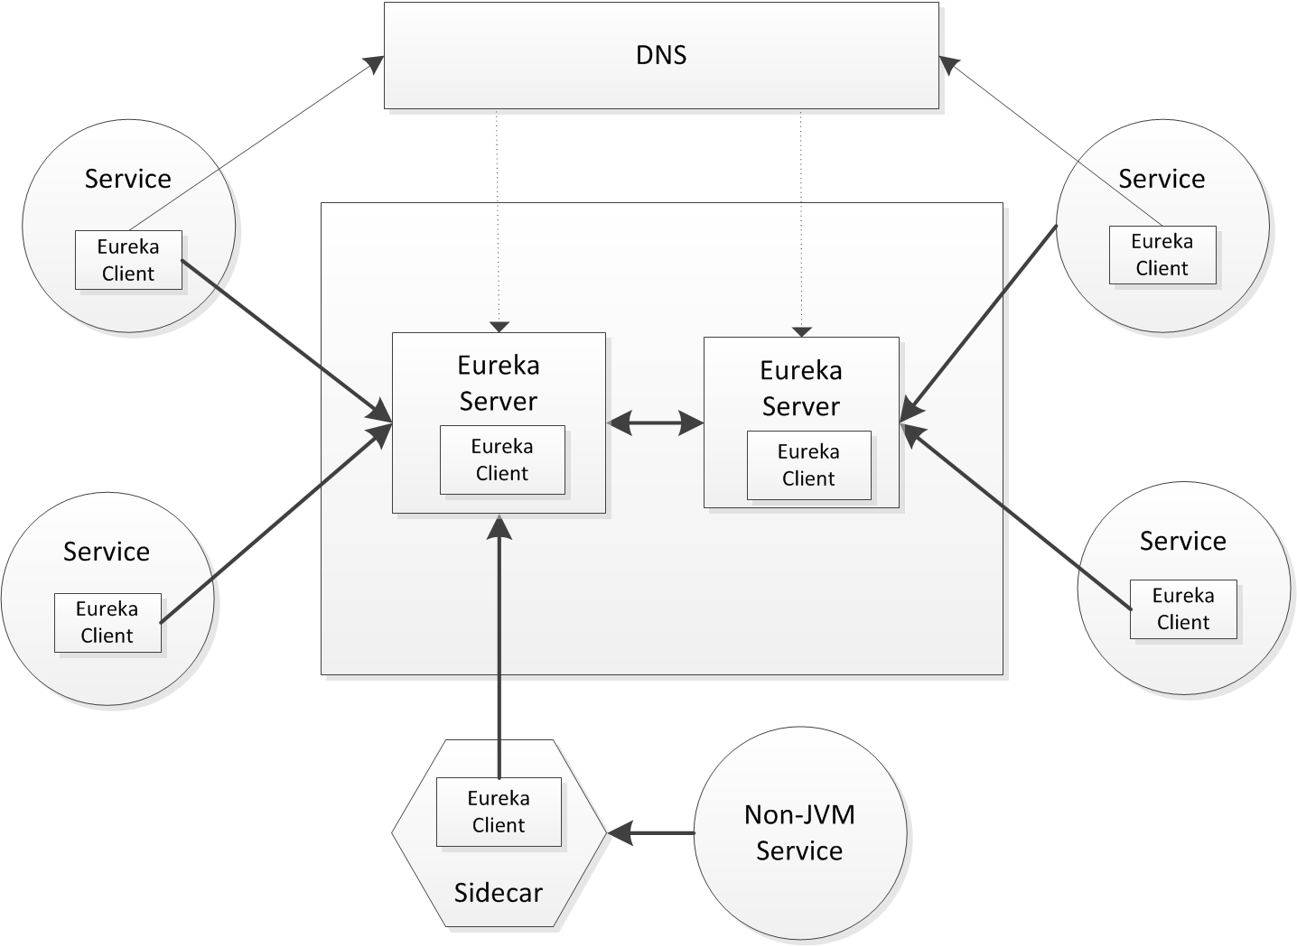

Slide 9
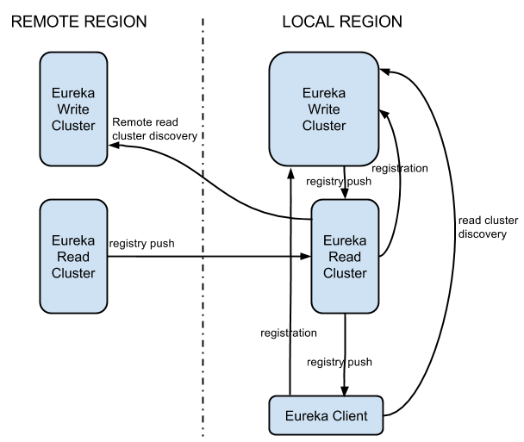
Architecture

Slide 10
Architecture
Eureka system
consists of a write and read cluster.
The write cluster
stateful subsystem,
which handles client registrations
maintains internal service registry.
The registry content
replicated between the all write server nodes in an eventually consistent manner.
The write cluster's registry content is read by the read cluster
ultimately is used by the Eureka clients.
Read cluster
is a cache layer,
can be easily, and rapidly scaled out/in
The write cluster
should be pre-scaled with a capacity enough to handle the peek/busy hour traffic.
Scale out requires re-balancing (eventually balanced)
Scale down will force terminated clients to re-register

Slide 11
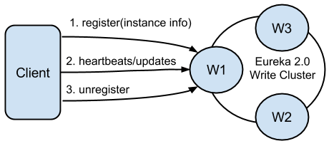
Client Registration
asd

Slide 12
Client Registration
Eureka clients
register themselves to be discoverable.
Registrations include
discoverable identifiers
service status,
optional freeform metadata.
A single client
can register multiple service instances/times.
Each registration is handled over a separate connection to the write server
As the connection status itself denotes the service liveness.
Software heartbeats at the Eureka level is used to determine connection liveness
as network stacks in virtualized environments are not 100% trustworthy.

Slide 13
Client Registration
If a connection is lost
the registration entry in the write cluster registry is put into the eviction queue
and ultimately remove from the registry.
Well behaving clients should always send unregister request prior to disconnecting.
This will result in immediate removal of the service from the registry.
After the registration,
the client can send any number of update requests,
changing its instance data.
For e.g. scale out/in update requests.

Slide 14
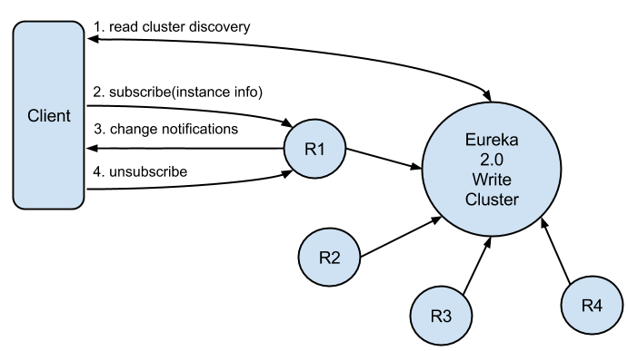
Service Discovery

Slide 15
Testing Microservices
Many applications are designed for eventual consistency.
QE Vs QA
Build Simulators.
Testing microservices is even more challenging.
Pay special attention to loosely coupled tests.
Isolate services for loosely coupled tests
Include tests that resemble production
Make security testing a first-class citizen

Slide 16
Testing Challenges
Cannot share a single environment
Environment is going to very dynamic.
Some testing in Java, Scala, Python, .Net ect.
Full ecosystem unsuitable for local testing
Lack of control over third party dependencies.
Functional change impact needs to be analyzed in detail.
Many calls could be asynchronous.
Asynchronous exception handling.

Slide 17
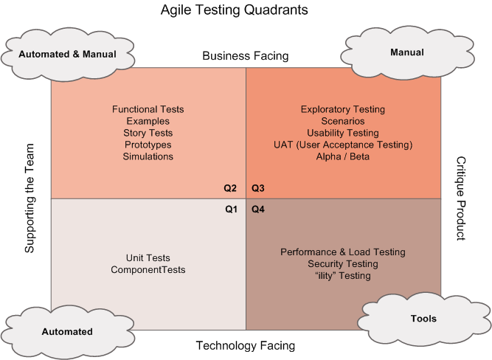
Agile Testing Quadrants

Slide 18
Testing Strategy
Isolate parts and ensure the contracts are not broken.
Lot of automated testing should ensure the contracts are good.
No isolations
Customer sees no isolations.
Ensure what customer want works the way they want.
Unowned components.
Isolate I own Vs. I don't own Vs Nobody owns.

Slide 19
Test Doubles
Dummy objects
passed around but never actually used.
Fake objects
working implementation not suitable for production
Stubs
provide canned answers to calls made during tests
Spies
Stubs that also record information based on how they were called.
Mocks
Objects pre-programmed with exceptions

Slide 20
Testing Strategy
Isolate parts and ensure the contracts are not broken.
Lot of automated testing should ensure the contracts are good.
No isolations
Customer sees no isolations.
Ensure what customer want works the way they want.
Unowned components.
Isolate I own Vs. I don't own Vs Nobody owns.

Slide 21
Testing Strategy
Isolate parts and ensure the contracts are not broken.
Lot of automated testing should ensure the contracts are good.
No isolations
Customer sees no isolations.
Ensure what customer want works the way they want.
Unowned components.
Isolate I own Vs. I don't own Vs Nobody owns.

Slide 22
Junit 5
Junit 5
Junit 4 was there for a long time.
Not up-to date with the latest in testing.
Mindset how people approach has not evolved
Java has evolved
Monolithic architecture
Bugs and features requests piled up.
Open source
Crowd funding.
Junit 5 came up.
Not an update to Junit 4
Cannot easily upgrade from Junit 4 to Junit 5

Slide 23
Junit 5
Broken down
Platform
library of Junit
Running tests
Providing a way to run TestRunner
Dev./We don't directly interact with.
Junit API - Jupiter
@Test, Assert ect are all part of Jupiter
We interact with Jupiter
Wintage
using when you run older Junit code.
Way to make it backword compatible with Junit4
Old tests should use this.
Extension
Third party library plugin should be done through Extension.
A test case that we write can
work with Jupiter or Wintage or Extension.

Slide 24
Maven Setup
maven
two dependencies atleast
Platform + what you want.
e.g. Platform + Jupiter
or
+ Wintage
or
+ Extension
IDE based
add dependency
junit-jupiter-engine
junit-jupiter-api
junit-vintage-engin # if you have old version test cases...

Slide 25
Junit 5 methods
@BeforeEach
run before each @Test, @RepeatedTest, @ParameterizedTest, or @TestFactory
Similar to @Before in junit4
@AfterEach
run after each @Test, @RepeatedTest, @ParameterizedTest, or @TestFactory
Similar to @After in junit4
@Test
This is a test method
@TestMethodOrder
Define test method order

Slide 26
Junit 5 methods cntd.
@BeforeAll
method should be executed before all @Test, @RepeatedTest, @ParameterizedTest, and @TestFactory methods
Similar to @BeforeClass in junit4
@AfterAll
method should be executed after all @Test, @RepeatedTest, @ParameterizedTest, and @TestFactory methods
Similar to @AfterClass in junit4
@Tag
Define key value pair tags.
Can be used to filter and run specific set of test cases.
Documentation: https://junit.org/junit5/docs/current/user-guide/

Slide 27
Implement an Integration Test
training\day3\Testing\InstrcutionsForTesting.txt

Slide 28
API Gateway - Zuul
With Microservices we can soon end up with having somany different url's all pointing to different IP.
User's need not be aware of the internal architecture and microservices design ect.
Need to provide a unique gateway to the client applications of your system.
Open-sourced Zuul solves this.
Edge service that proxies requests to multiple backing services.
Provides a unified “front door” to your ecosystem hosted on different computers.
Can execute various functions during the followign lifecycle
- Before forwarding
- While forwarding
- After forwarding
- In case of an error

Slide 29
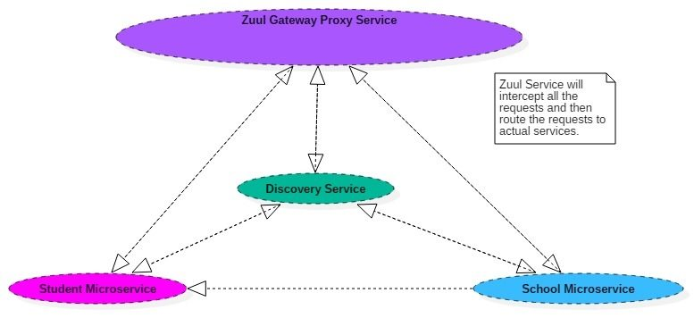
API Gateway

Slide 30
Advantages of Zuul
Netflix Uses Zuul for the following
Provide a unified entry point
Apply microservice authentication and security
Can implement a single unified monitoring.
Implement Dynamic Routing can route requests to different backend clusters as needed.
Do runtime stress testing by gradually increasing the traffic
We can do dynamic load shedding
e.g. dropping requests that go over the limit.
Apply static response handling
e.g. while upgrading the system.
Can enable dynamic routing, monitoring, resiliency, and security.

Slide 31
Zuul - lab
training\day3\APIGateway\InstructionsForAPIGateway.txt

Slide 32
Security
11 Patterns for Security
Be Secure by Design
Scan Dependencies
Use HTTPS Everywhere
Use Access and Identity Tokens
Encrypt and Protect Secrets
Verify Security with Delivery Pipelines
Slow Down Attackers
Use Docker Rootless Mode
Use Time-Based Security
Scan Docker and Kubernetes Configuration for Vulnerabilities
Know Your Cloud and Cluster Security

Slide 33
Be secure by Design
Design code for security.
Removing malicious characters is tricky
Malicious character depends on the context
For e.g. Ensure no malicious characters in an HTML context
There could be other injection attacks (i.e. JavaScript, SQL, etc).
Many time ' is a malicious character,
but Business requires it.
What should be done then?
Generally engineers concentrate on good design but not on security
Fight back when security issues are raised.
OWASP top 10 hasn't changed much.

Slide 34
Be secure by Design
Developers need to
Thinking about security vulnerabilities
Have to be security experts and know to use validateForXSS()
Person writing the code can identify potential weakness that might occur now or in the future

Slide 35
Scan Dependencies
Transitive dependencies
You use 3rd party s/w
They use other 3rd party s/w
You may not be even aware of this dependency.
Their could be vulnerabilities anywhere
Be aware of all dependencies.
Reduce dependencies to the extend possible.
Use exclude where ever required.
e.g. wintage
Keep dependencies updated.

Slide 36
Use HTTPS Everywhere
HTTPS requires certificates for 2 way authentication.
Let’s Encrypt offers free certificates, and you can use its API to automate renewing them.
Let’s Encrypt
Recommends you use Certbot to obtain and renew your certificates.
is a free,
open-source software tool
Generate automatically using Let’s Encrypt certificates on manually-administrated websites .
The Electronic Frontier Foundation (EFF) created and maintains Certbot.
CertbotsThe Certbot website lets you choose your web server and system,
then provides the instructions for automating certificate generation and renewal.
Force HTTPS.
Often, forcing HTTPS
Uses an HTTP Strict-Transport-Security response header
Tell browsers they should only access a website using HTTPS.
Why HTTS inside our network
Phishing and guessing people’s credentials are incredibly effective techniques to hack.

Slide 37
Use Access and Identity Tokens
Oauth and JWT are really famous token systems. Use them.
oAuth
Tocken based authorization
Delegate access without user/pwd
Grant access to a client to perform certain operation on behalf of user.
Not authentication of user.
Only authorization
3rd party oAuth providers such as Google, fb, github ect..
JWTs are JSON data, encoded as a string, and cryptographically signed.
Unquely identify a resource using JWT
Assume I’m blind and hard of hearing.
Last week you bought me lunch,
Now I need your paytm address to pay you back.
If I ask you for your paytm address in person,
someone else calls me and share their paytm address,
I might accidentally send them the money I owe you.
Instead if I gave you a unique number when i bought you lunch.
Now you need to share the unique number along.

Slide 38
Encrypt and Protect Secrets
Generally microservices authenticates using an API key / tokens (JWT, PASTEO)
Rule 1
Don’t check key into even private source control.
Encrypt secrets
Store in Hashicorp Vault or Spring Vault or Amazon KMS
Amazon KMS
You generate a master key using KMS
You want to encrypt data,
You ask AWS to generate a new data key for you.
A data key is a unique encryption key AWS generates for each piece of data you need to encrypt.
You then encrypt your data using the data key
Amazon will then encrypt your data key using the master key
You merge the encrypted data key with the encrypted data to create an encrypted message.
The encrypted message is your final output,
which is what you would store as a file or in a database.
Alternatively you can use Azure Key Vaults

Slide 39
Verify Security with Delivery Pipelines
Dependency and container scanning should be part of your source control monitoring system
Execute security tests when executing CI/CD.
security unit tests,
static analysis security testing (SAST),
dynamic analysis security testing (DAST).

Slide 40
Slow Down Attackers
If someone tries to attack your APIs with hundreds of gigs of username/password combinations,
It could take a while for them to authenticate successfully.
Detect this attack and slow down your service,
Most likely the attacker will go away.
Simply not worth their time.
You can implement rate-limiting (API rate limiting, email rate limiting etc)in your code
(often with an open-source library) or
your API Gateway or third party software.

Slide 41
Use Docker Rootless Mode
?

Slide 42
Use Time-Based Security
System is never fully secure—
Someone will break in.
Preventing intruders is only one part of securing a system;
Detection and reaction are essential, too.
Use multi-factor authentication to slow down intruders,
But also to help detect when someone with elevated privilege authenticates into a critical server
Send an alert to your network administrator team whenever there’s a successful login.
Implement solutions like the above.
Another e.g. extemely critical login can happen only from a single machine.

Slide 43
Scan Docker and Kubernetes Configuration for Vulnerabilities
Prefer minimal base images
Use the USER directive to make sure the least privileged is used
Sign and verify images to mitigate attacks
Find, fix, and monitor for open-source vulnerabilities (Snyk offers a way to scan and monitor your Docker images too)
Don’t leak sensitive information to Docker images
Use fixed tags for immutability
Use COPY instead of ADD
Use metadata labels like maintainer and securitytxt
Use multi-stage builds for small and secure images
Use a linter like hadolint

Slide 44
Know Your Cloud and Cluster Security
Use TLS Everywhere
Enable RBAC with Least Privilege, Disable ABAC, and use Audit Logging
Use a Third-Party Auth provider (like Google, GitHub - or Okta!)
Separate and Firewall your etcd Cluster
Rotate Encryption Keys
Use Linux Security Features and a restricted PodSecurityPolicy
Statically Analyse YAML
Run Containers as a Non-Root User
Use Network Policies (to limit traffic between pods)
Scan Images and Run IDS (Intrusion Detection System)
Run a Service Mesh

Slide 45
JWT - lab
training\day3\Security\JWT\InstructionJWT.txt

