Slide 1
Day 3 - Agenda
Introduction to Service Discovery
Client side service discovery
Eureka service
Implementing the service discovery with Eureka
Client side load balancing
server side service discovery
Docker/Kubernetes
How Docker/Kubernetes does server side service discovery
Testing patterns: Service Component Test and Service Integration Contract Test
Junit with Mockito
Write a simple test using Mockito
API Gateway Pattern
Zuul
Security
Discuss security best practices for Docker and Microservices

Slide 2
Service Discovery
What is Service Discovery and why do you need the same?
Without service discovery
Service URL changes require code changes
Cloud - has dynamic URLs
Load balancing
Multiple instances
Service registration and discovery
dedicated server is responsible to maintain the registry
of all the Microservice that has been deployed and removed.
Will act like a phone book of all other applications/microservices

Slide 3
Service Discovery
Client Side Service Discovery
Eureka
Server Side Service Discovery
Kubernetes

Slide 4
Server Side Service Discovery
Kubernetes: Server side service discovery.
Relatively less efficient
But very reliable.
When env. go down, the servers are always aware.
Client always gets the latest active service.
Both has it's own adv. and disadv.

Slide 5
Client Side Service Discovery - Eureka
Like a lookup service where
microservices (clients) can register themselves
discover other registered microservices.
When a client microservice registers with Eureka
it provides metadata such as host, port, and health indicator
This allows other microservices to discover it.
The discovery server expects
a regular heartbeat message from each microservice instance.
If an instance doesn't send heartbeat consistently,
the discovery server will remove the instance from his registry.

Slide 6
Advantages of Eureka Service
Disclaimer: Not in comparison with Service Side Service Discovery
Creates very stable ecosystem of Microservices collaborating among each other,
Clients doesn't need to maintain address of other Microservice,
Facilitate scale-out/scale-in
Does load balancing (Kuberentes is the master of this)..
Eureka 2.0 is a
Service discovery framework
Designed for cloud deployments.
Evolution of the original 1.0 version,
Aims to be much more scalable,
Replace the pull based model with fine grain subscription model.

Slide 7
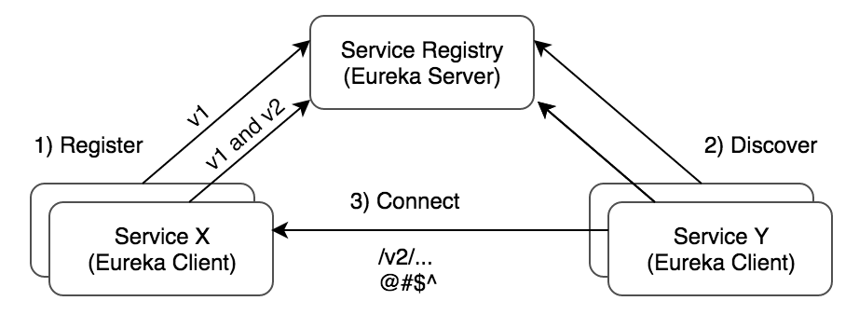
Simple working model

Slide 8
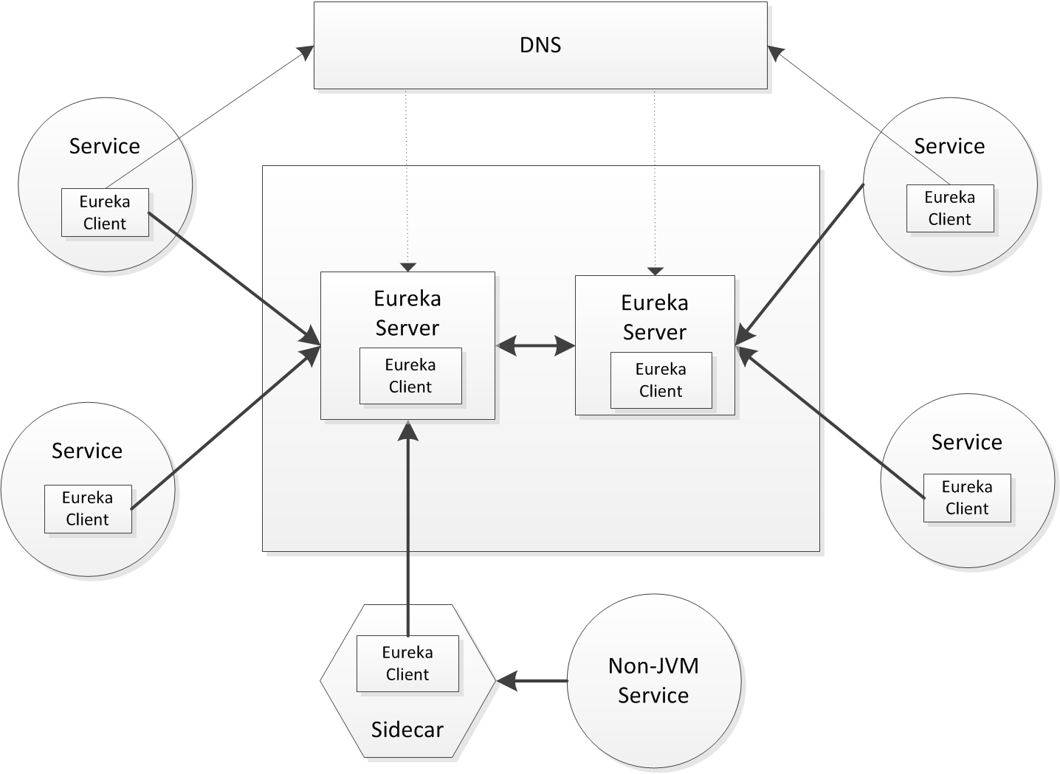

Slide 9
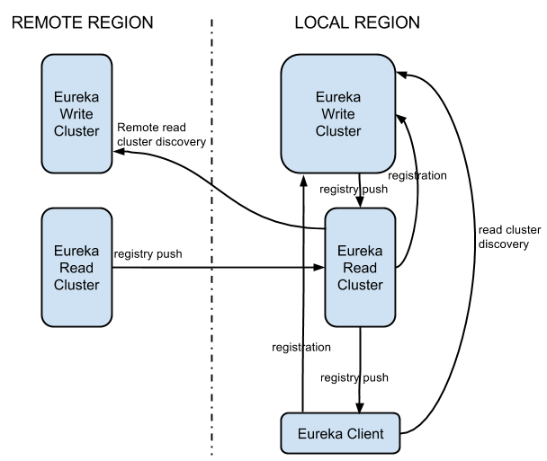
Architecture

Slide 10
Architecture
Eureka system
consists of a write and read cluster.
The write cluster
stateful subsystem,
which handles client registrations
maintains internal service registry.
The registry content
replicated between the all write server nodes in an eventually consistent manner.
The write cluster's registry content is read by the read cluster
ultimately is used by the Eureka clients.
Read cluster
is a cache layer,
can be easily, and rapidly scaled out/in
The write cluster
should be pre-scaled with a capacity enough to handle the peek/busy hour traffic.
Scale out requires re-balancing (eventually balanced)
Scale down will force terminated clients to re-register

Slide 11
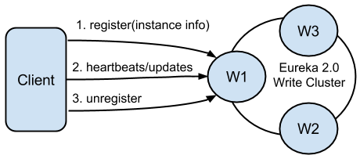
Client Registration
asd

Slide 12
Client Registration
Eureka clients
register themselves to be discoverable.
Registrations include
discoverable identifiers
service status,
optional freeform metadata.
A single client
can register multiple service instances/times.
Each registration is handled over a separate connection to the write server
As the connection status itself denotes the service liveness.
Software heartbeats at the Eureka level is used to determine connection liveness
as network stacks in virtualized environments are not 100% trustworthy.

Slide 13
Client Registration
If a connection is lost
the registration entry in the write cluster registry is put into the eviction queue
and ultimately remove from the registry.
Well behaving clients should always send unregister request prior to disconnecting.
This will result in immediate removal of the service from the registry.
After the registration,
the client can send any number of update requests,
changing its instance data.
For e.g. scale out/in update requests.

Slide 14
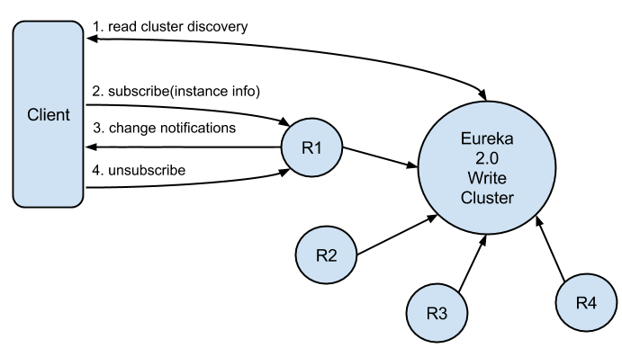
Service Discovery

Slide 15
Testing Microservices
Many applications are designed for eventual consistency.
QE Vs QA
Build Simulators.
Testing microservices is even more challenging.
Pay special attention to loosely coupled tests.
Isolate services for loosely coupled tests
Include tests that resemble production
Make security testing a first-class citizen

Slide 16
Testing Challenges
Cannot share a single environment
Environment is going to very dynamic.
Some testing in Java, Scala, Python, .Net ect.
Full ecosystem unsuitable for local testing
Lack of control over third party dependencies.
Functional change impact needs to be analyzed in detail.
Many calls could be asynchronous.
Asynchronous exception handling.

Slide 17
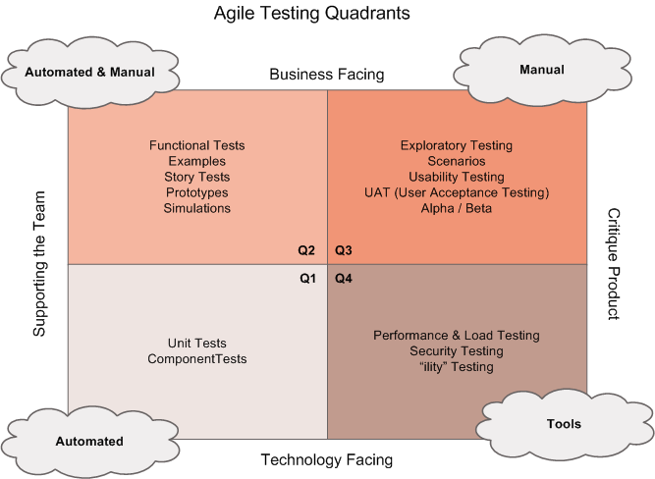
Agile Testing Quadrants

Slide 18
Testing Strategy
Isolate parts and ensure the contracts are not broken.
Lot of automated testing should ensure the contracts are good.
No isolations
Customer sees no isolations.
Ensure what customer want works the way they want.
Unowned components.
Isolate I own Vs. I don't own Vs Nobody owns.

Slide 19
Test Doubles
Dummy objects
passed around but never actually used.
Fake objects
working implementation not suitable for production
Stubs
provide canned answers to calls made during tests
Spies
Stubs that also record information based on how they were called.
Mocks
Objects pre-programmed with exceptions

Slide 20
Testing Strategy
Isolate parts and ensure the contracts are not broken.
Lot of automated testing should ensure the contracts are good.
No isolations
Customer sees no isolations.
Ensure what customer want works the way they want.
Unowned components.
Isolate I own Vs. I don't own Vs Nobody owns.

Slide 21
Testing Strategy
Isolate parts and ensure the contracts are not broken.
Lot of automated testing should ensure the contracts are good.
No isolations
Customer sees no isolations.
Ensure what customer want works the way they want.
Unowned components.
Isolate I own Vs. I don't own Vs Nobody owns.

Slide 22
Junit 5
Junit 5
Junit 4 was there for a long time.
Not up-to date with the latest in testing.
Mindset how people approach has not evolved
Java has evolved
Monolithic architecture
Bugs and features requests piled up.
Open source
Crowd funding.
Junit 5 came up.
Not an update to Junit 4
Cannot easily upgrade from Junit 4 to Junit 5

Slide 23
Junit 5
Broken down
Platform
library of Junit
Running tests
Providing a way to run TestRunner
Dev./We don't directly interact with.
Junit API - Jupiter
@Test, Assert ect are all part of Jupiter
We interact with Jupiter
Wintage
using when you run older Junit code.
Way to make it backword compatible with Junit4
Old tests should use this.
Extension
Third party library plugin should be done through Extension.
A test case that we write can
work with Jupiter or Wintage or Extension.

Slide 24
Maven Setup
maven
two dependencies atleast
Platform + what you want.
e.g. Platform + Jupiter
or
+ Wintage
or
+ Extension
IDE based
add dependency
junit-jupiter-engine
junit-jupiter-api
junit-vintage-engin # if you have old version test cases...

Slide 25
Junit 5 methods
@BeforeEach
run before each @Test, @RepeatedTest, @ParameterizedTest, or @TestFactory
Similar to @Before in junit4
@AfterEach
run after each @Test, @RepeatedTest, @ParameterizedTest, or @TestFactory
Similar to @After in junit4
@Test
This is a test method
@TestMethodOrder
Define test method order

Slide 26
Junit 5 methods cntd.
@BeforeAll
method should be executed before all @Test, @RepeatedTest, @ParameterizedTest, and @TestFactory methods
Similar to @BeforeClass in junit4
@AfterAll
method should be executed after all @Test, @RepeatedTest, @ParameterizedTest, and @TestFactory methods
Similar to @AfterClass in junit4
@Tag
Define key value pair tags.
Can be used to filter and run specific set of test cases.
Documentation: https://junit.org/junit5/docs/current/user-guide/

Slide 27
Implement an Integration Test
training\day3\Testing\InstrcutionsForTesting.txt

Slide 28
API Gateway
asd

Slide 29
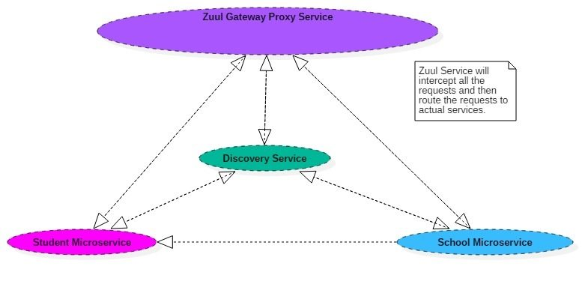
API Gateway

Slide 30
Junit 5

Slide 31
Junit 5

