Slide 1




Corporate Housing Multi-Supplier Program
July 1, 2012
Kelly Cockrell, Global Account Executive
Oakwood Worldwide Relocation Team
Oakwood | ExecuStay

Slide 2
Effective July 1st, 2012, ExecuStay Client Services (“ECS”) will take on the responsibility for the sourcing administration for Altair’s Corporate Housing requests through a web-based bidding program from Ariba Sourcing.
Benefits to Altair:
  Corporate housing is core competency which brings a broader base of knowledge and experience to our program
  Risk and liability through improved contract management
  Compliance strengthened and exceptions reduced while productivity and efficiency increased
  Decision making facilitated by access to comprehensive and consolidated data
  ECS has scalable resources to support peaks and valleys of housing demand
  Support team is exposed to other best practices and business cultures
  Technology enhancements through ECS applications
  Combination of Altair and ECS housing volume may result in greater leverage and savings/lower rates
  Exclusivity with ECS as their housing administrator: no other relocation company has this program

Slide 3
Benefits to Oakwood Worldwide and ExecuStay Franchised Markets:
  Corporate housing is OUR business and we will bring a broad base of knowledge, experience, coverage, and service to the program
  An increased exposure to Altair’s global housing needs: Oakwood and ExecuStay brands will be selected to participate and compete for each housing opportunity
  A increased focus on service quality, geographical distribution, ability to execute, and competitive pricing structure in the markets
  An enhanced partnership with a growing relocation management company that has, in the past, limited their volume to two primary partners (ExecuStay, BridgeStreet)
  An effective tool to showcase our newly joined corporate housing brands
  Higher volume of opportunities = higher opportunity to increase market share, days stayed, and revenue

Slide 4
June 19th and 21st, 2012
  Suppliers to attend Ariba training
June 25th , 2012
  Suppliers to review, sign and return:
    Altair Program Supplier Agreement
    ExecuStay Multi-Supplier Participation Agreement
    Ariba Bidding Agreement
July 1st , 2012
  Housing bids begin being sent through Ariba
August 10th , 2012
  Reconcile all reservations/invoices from July 1st through July 31st and submit Month End Reservations Report
August 15th , 2012
  ECS will submit consolidated ME Reservations Report to Altair

Slide 5
ExecuStay’s Multi-Supplier Bidding Program (ECS / Ariba) rolled out on Monday, July 2, 2012 for all of Altair’s discretionary opportunities (non client-directed)
ECS’ Accommodations Managers are Cherie Sharp and Hieu Van Tapp
ExecuStay and Oakwood will be sourced on all discretionary opportunities (as will other global and regional providers)
  ExecuStay’s service team will be led by Lisa Stevens via the ExecuStay GAMC
  GAMC Manager: Stacy Weindl
  Oakwood’s service team will be led by Gretchen Sandling and April Aron via the Oakwood WSSC
  WSSC NAC Team Manager: Michele Kern
  Leads for franchise markets will be sent to Ariba who notifies each brand representative, who will push out to local markets
  Markets should respond quickly so the ExecuStay brand team can offer our best location, value, and service package within the allotted time (if we miss the deadline, we are out of the bidding process)

Slide 6
Altair should see both an ExecuStay and an Oakwood brand option for each opportunity
Response time is key to winning these bids! Reponses are due within 4 hours for major markets and sub-markets, 8 hours for remote areas
ECS Accommodations Managers will compile the Ariba information into email format and send back to the Altair Relocation Consultant (RC) within 1 hour of bid closing
ECS will ask RC to select first and second choices and emphasize the importance of a speedy selection process
After the RC selects their preferred apartment, ECS will award the business to the supplier via Ariba, and then the supplier will contact Altair directly to continue their standard booking process
Our goal is to book 100% of Altair’s business between the ExecuStay and the Oakwood brands!

Slide 7
Offer your best rate the first time with a competitive service model
Offer discounted, commissionable rate that will cover both relo and ECS admin fees ($5.00 and $3.00 per day)
Check for all special requests or notes, and price accordingly
Add housekeeping service separately as an option
Offer 14-day NTV if possible, highlight in your response
Offer apartments in close proximity to the work site address (if given)
Offer reduced pet fees/deposits whenever possible
Highlight any value-added features and amenities that will not affect the rate
Keep your 3rd party offers to a minimum whenever possible
Know your competition by region: Lisa Stevens can tell you who you are competing against in each opportunity
Respond to Lisa Stevens/Ryan Campbell quickly, so they can enter your bid into Ariba, which is sent to the ECS Accommodations Manager, who submits all appropriate offers to the Altair consultant

Slide 8
Once the guest arrives, the local market will take ownership of that guest
All service issues and needs will still be handled by the local market, with an email to the GAMC service team so they are aware
GAMC service team will assist with communication with Altair, escalation issues, needs for clarifying information
NTV process is handled by the market, with most Altair guests being on MTM lease terms
  Market will need to contact the guest to remind them of an upcoming need to submit a 30-day notice, with an email copy to the GAMC service team
  If there are any potential concerns, GAMC service team will work with Altair for a resolution
  Any extension requests or changes must be approved by GAMC service team prior to allowing guest to change their departure date

Slide 9
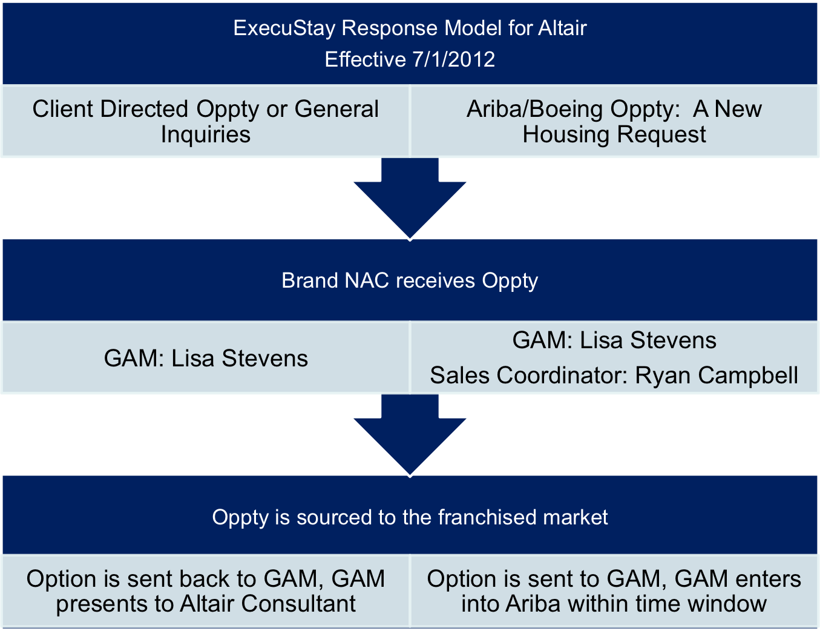

Slide 10
Oakwood Worldwide: Oakwood || ExecuStay
Stacy Weindl
sweindl@oakwood.com
(o) 602-687-3369
Kelly Cockrell, Global Account Executive for Altair Global Relocation
kcockrell@oakwood.com
(o) 925-513-9008
Lisa Stevens, Global Account Manager and Ryan Campbell, Sales Coordinator
lstevens@oakwood.com and rcampbell@oakwood.com
(o) 888-220-7655
Suzanne Guerra, Director of Owner and Franchise Services
sguerra@oakwood.com

Slide 11
Thank you for your commitment to Altair!

