Slide 1
Hot City Deals “Dine”
Live Like a Local®
Lisa Reich
Oakwood Worldwide Marketing
December 28, 2012

Slide 2
Hot City Deals
Agenda
Creative/Text
Terms and Conditions
Participating Cities
Offer Fulfillment
Success Measurement
Marketing & Communications
Resources
Q & A

Slide 3
Hot City Deals “Dine”
Live Like a Local®
January 1, 2013 – March 31, 2013
There is a little bit of a ‘foodie’ in all of us and who doesn’t want to enjoy some good eats from the local eatery? If an out-of-towner asked you “what’s good to eat around here” what would you recommend?

Slide 4
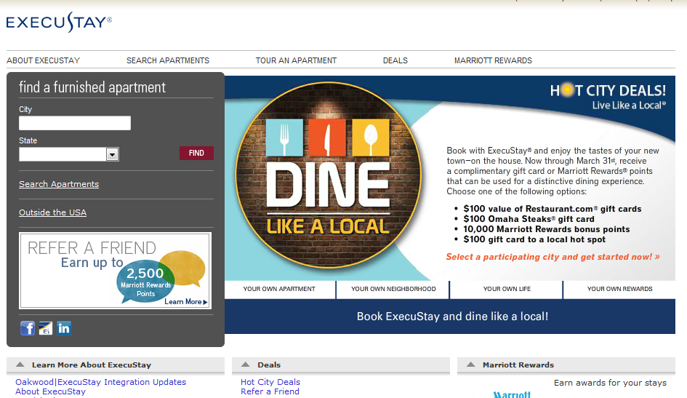
Creative: ExecuStay.com Home Page

Slide 5
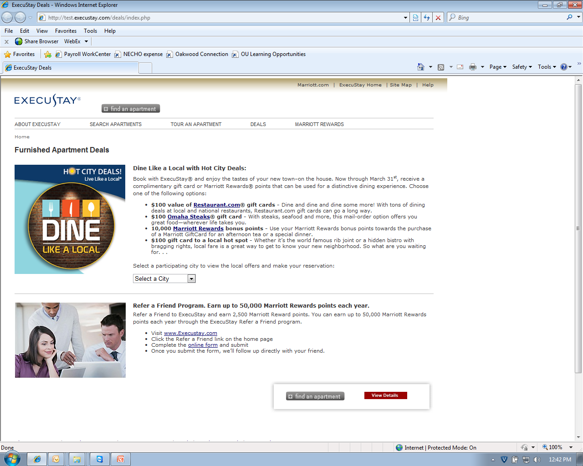
ExecuStay.com Deals Page

Slide 6
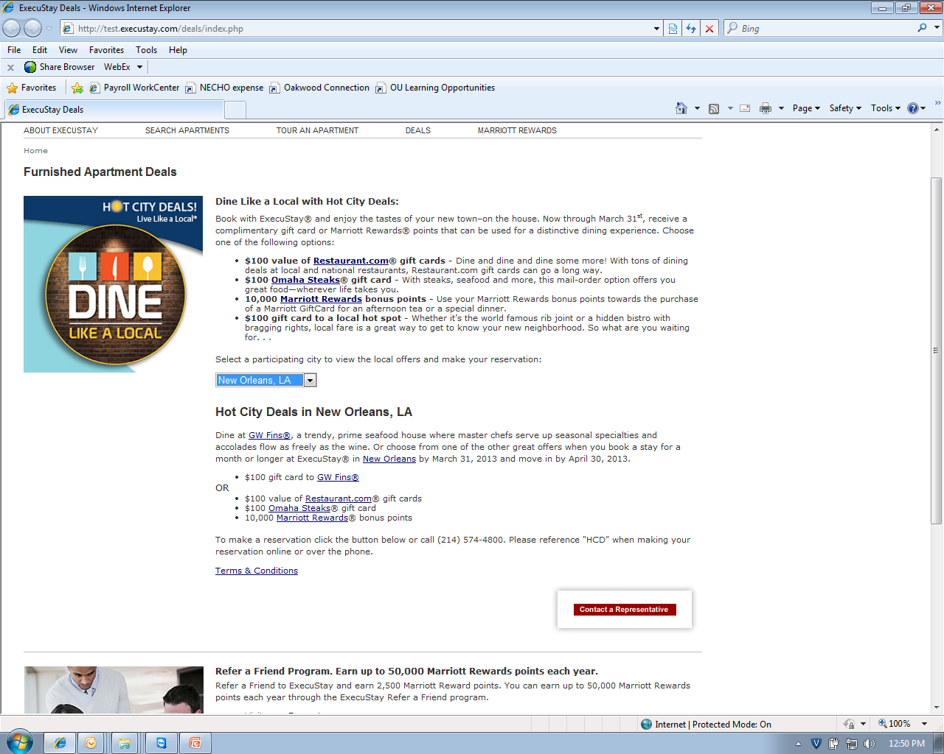
ExecuStay.com City Offer Page - Example

Slide 7
ExecuStay.com City Offer Page Terms and Conditions
Guests who make a month or longer ExecuStay® reservation at a participating property located in the United States between the dates of January 1, 2013 and March 31, 2013, based upon availability, and move in by April 30, 2013, can choose ONE of the following bonus gifts:
  $100 value of Restaurant.com gift cards
  $100 Omaha Steaks gift card
  10,000 Marriott Rewards® bonus points
  Local “Dine" offer valued at up to $100 (Offer may change if option is no longer available when guest moves in.)
Guest must reference code HCD (Hot City Deals) when booking their reservation in order to receive their bonus gift. When making reservations online via the Check Rates & Availability button, HCD should be referenced in the Special Requests field. When requesting reservation information using the Contact a Representative button/link, HCD should be referenced in the Promotion Code field. When making a reservation by calling the local phone number listed or 888.220.0301, HCD must be mentioned before finalizing the reservation.
  Guests will receive their gift card within 10 business days of moving into their ExecuStay apartment. If Marriott Rewards bonus points are chosen, the points will be posted 30-45 days following move in date.
  Back-to-back 30-day stays at the same property are considered one (1) stay and are eligible for only one bonus gift. Stays for less than 30 days are not eligible for this promotion.
  This offer is not valid with any other ExecuStay or Oakwood promotion.
  This promotion is not valid for guests who made a reservation or have moved in before January 1, 2013.
  This promotion is available on non-discounted, standard rates only.
  This promotion is not valid on commissionable rates or in conjunction with referral fee accounts.
  This offer is not transferable and has no cash value. Void where prohibited.
  This promotion is not valid with insurance claims, policyholder housing.
ExecuStay guests can also earn the standard 2.5 Marriott Rewards points per dollar spent on qualifying charges*. Guest must be a Marriott Rewards member to receive points.
*Qualifying charges include rental expenses and fees. Non-qualifying charges for points include taxes, long-distance charges, refundable deposits, or damage/move-out charges.

Slide 8
35 Hot City Deal “Dine” Participating Cities
Albany, NY
Atlanta, GA
Austin, TX
Baton Rouge, LA
Charleston, SC
Charlotte, NC
Charlottesville, VA
Cincinnati, OH
Columbus, OH
Dallas, TX
Des Moines, IA
Houston, TX
Indianapolis, IN
Jacksonville, FL
Kansas City, MO
Little Rock, AR
Lynchburg, VA
Miami, FL
New Orleans, LA
New York, NY
Oklahoma, OK
Omaha, NE
Orlando, FL
Pentagon City, VA
Philadelphia, PA
Raleigh, NC
Richmond, VA
Roanoke, VA
San Antonio, TX
Tampa, FL
Tulsa, OK
Virginia Beach, VA
Washington, DC
Wichita, KS
Williamsburg, VA

Slide 9
ExecuStay.com Home Page Promo Schedule
There will be a total of 12 city offers featured on the home page
Three different city offers will be featured every 3 – 4 weeks and will change as follows:
    January 1 – January 27
    January 28 – February 17
    February 18 – March 10
    March 11 – March 31

Slide 10
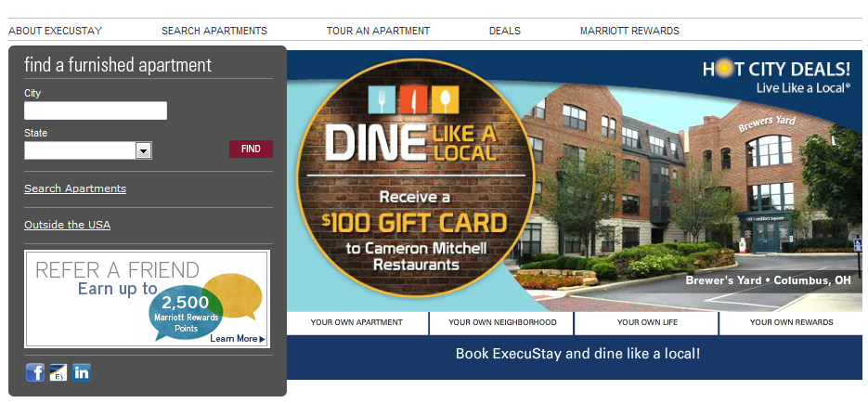
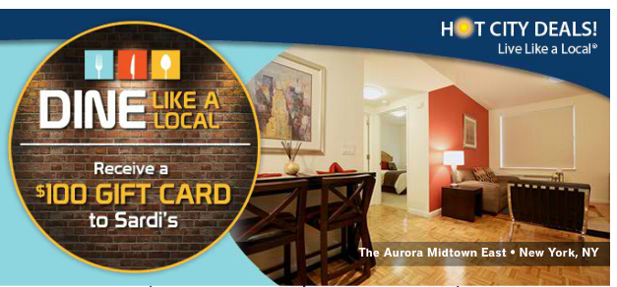
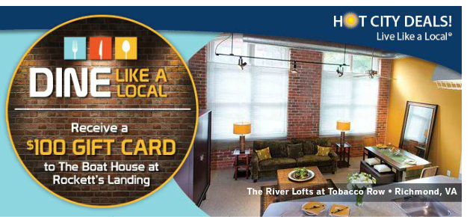
ExecuStay.com Home Page: Featured Offers

Slide 11
Fulfillment
Step #1: When a lead comes to you determine if it is eligible for Hot City Deals “Dine” (All leads should be going directly to our Franchise markets. There is a chance one could go to the Oakwood WSSC if the guest calls the general reservation number, but this would be a one-off):
  Reservation is being made between January 1, 2013 and March 31, 2013 and arrival is by April 30, 2013.
  Stay is for 30+ days.
  HCD was put in the Promotion Code field on the Contact a Representative form or mentioned when calling prior to finalizing the reservation. HCD is referenced in the Special Requests field when making online reservations using the Check Rates & Availability button (This is not a publicized booking method, but we’ll take it if done this way).
Step #2: All bookings eligible for this Hot City Deals promotion will need to be coded in Oscar/property management system in order to ensure fulfillment once the guest’s arrival date occurs.
  During your normal contact with the guest, determine which offer the guest prefers and put this in your Oscar/property management system. Here are the codes you need to use so you will know what to give the guest upon move in and so you can track the success of the promotion options:
      HCDR (Hot City Deals Restaurants.com)
      HCDO (Hot City Deals Omaha Steaks)
      HCDM (Hot City Deals Marriott Rewards)
      HCDD (Hot City Deals Local Dine)
  Also, please take note of when the reservation was made, since offers will change every few months, we want to make every attempt to honor the offer the guest chose at the time of booking.
Step #3:
  All promotion offers will be fulfilled in the market. Gift Cards (National and Local) must be given to the guest within 10 business days of move-in (see next slide for fulfillment of National offer gift cards).
  Marriott Rewards points must be posted by the 15th of the month following guest move-in. Use the regular form and code HCDD (this ensures that the description for the 10,000 points shows up on guest’s statement). Submit form to Connie.johansen@marriott.com
Step #4: At the end of each Hot City Deals segment (this segment is “Dine”), we will ask participating markets for tracking information including: Guests name, booking date, move-in/out dates, average daily rate, HCD gift guest chose, etc. Please share this information with us so we will be able to determine the success of the promotion.

Slide 12
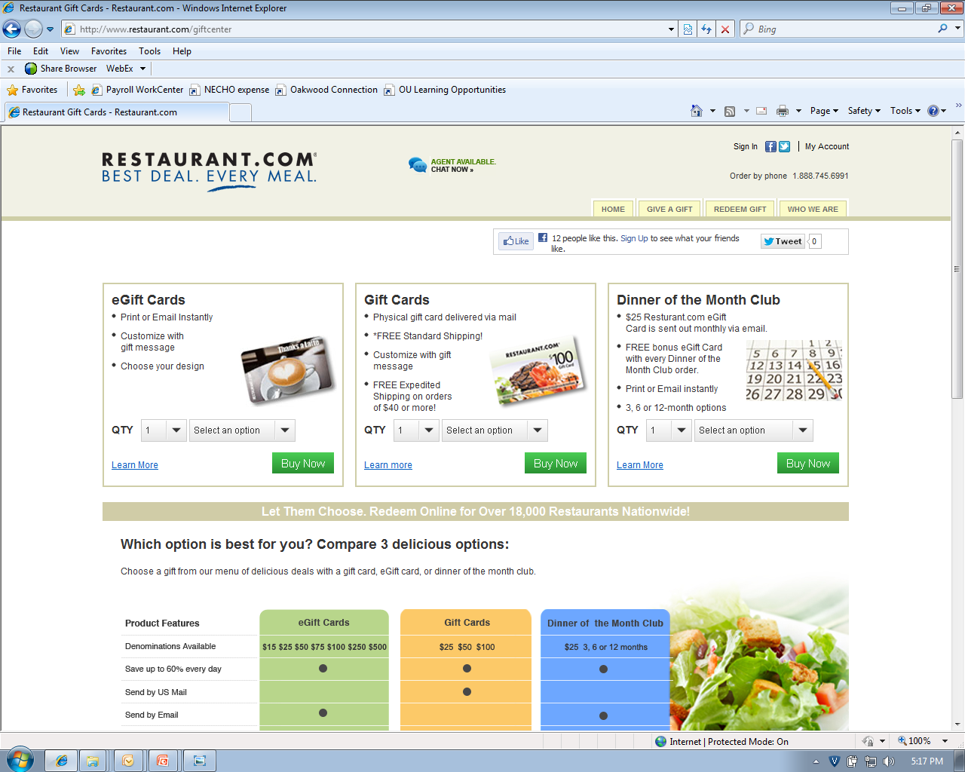
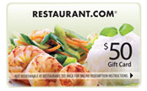
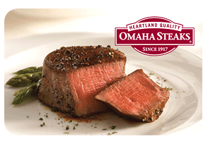
Offer Fulfillment
Physical or electronic gift cards are acceptable to give the guest for this promotions.
Markets will be responsible for fulfilling
National offers:
  $100 value of Restaurants.com Gift Cards
    Order online – purchase as much value as you can for $100
    (Currently, you can get $250 worth of value for spending $100.)
    Cost to you is $100 (Cost to process/ship = $0)
  $100 Omaha Steaks Gift Card
    Order online – purchase $100 gift card.
    Cost to you is $100 (Cost to process/ship = $0)
  Marriott Rewards® Bonus Points
    Order using form and submit to Connie Johanson
    Cost to you is $8.50 per 1,000 = $85
Markets will be responsible for fulfilling Local offers
= $100!

Slide 13
Marketing & Communications
Online
E.com Home page flash
E.com Deals landing page
Email
Marriott Rewards eNewsletter
Oakwood Worldwide eNewsletter
Email Signature
Social
Facebook, LinkedIn, Discover ExecuStay blog, market Facebook pages

Slide 14
Key Dates
12/28/12: Hot City Deals “Dine” Webinar
12/31/12: Current Hot City Deals “Give” ends
1/1/13: Hot City Deals “Dine” begins
2/15/13 Hot City Deals “Live” Participating Cities Due
Start thinking about your “Live” offers now - Here you can offer up some spending money that will help alleviate our guests’ expenses with food, gas, and other house ware needs. Gift cards to the local grocery store, gas station or specialty shop (keep it local!) would be of great value to help our guest get acclimated to their new place of residence.
3/31/13 Hot City Deals “Dine” ends
4/1/13: Hot City Deals “Live” begins

Slide 15
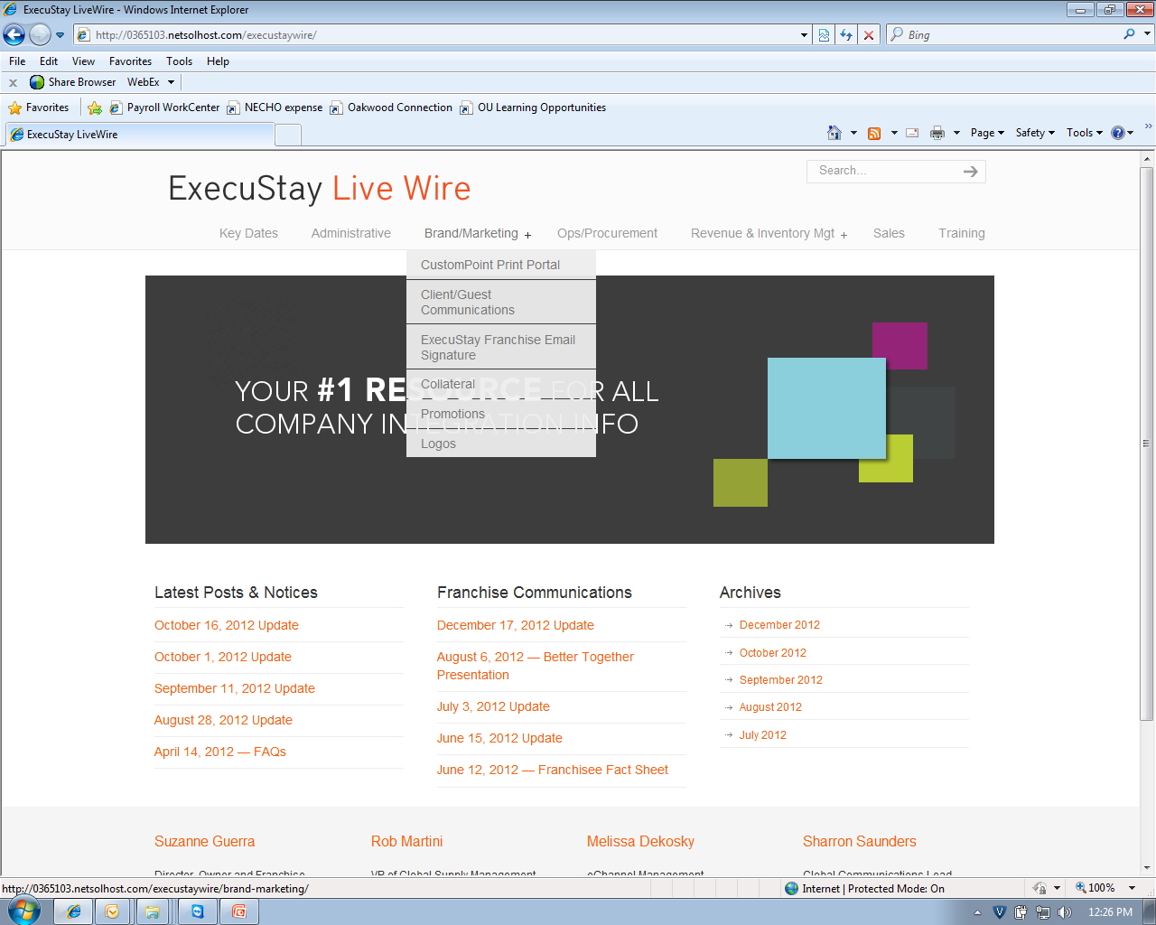
Hot City Deals Resources
For public information about the Hot City Deals promotion and all other promotions, go to the Deals page on ExecuStay.com.
For all internal documents, go the ExecuStay Live Wire: http://www.execustaylivewire.com
  Username: ExecuStay1
  Password: Franchisee
Questions:
Lisa Reich – lreich@oakwood.com or 240.720.3022

Slide 16
Questions & Answers

