Slide 1
Hot City Deals “Play”
Live Like a Local®
Lisa Reich
Oakwood Worldwide Marketing
June 20, 2013

Slide 2
Hot City Deals “Play”
Live Like a Local®
July 1, 2013 – September 30, 2013
Hot City Deals “Play” – No matter where one stays during the summer, the weather is sure to be nice for some quality play time. From tickets to an amusement park or museum, to a relaxing day at the golf course or spa, our guest are sure to value an opportunity for a little summer play.

Slide 3
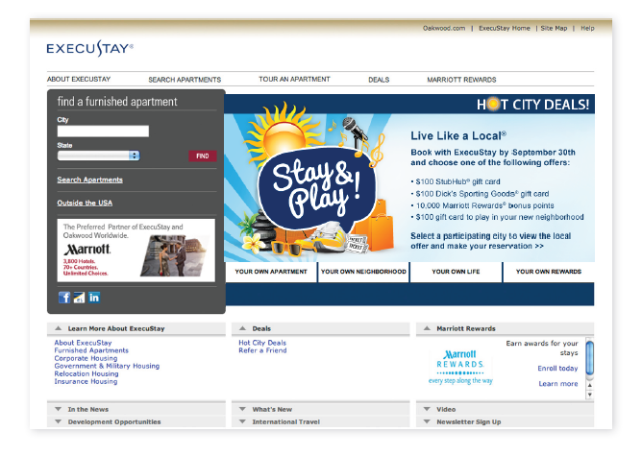
Creative: ExecuStay.com Home Page

Slide 4
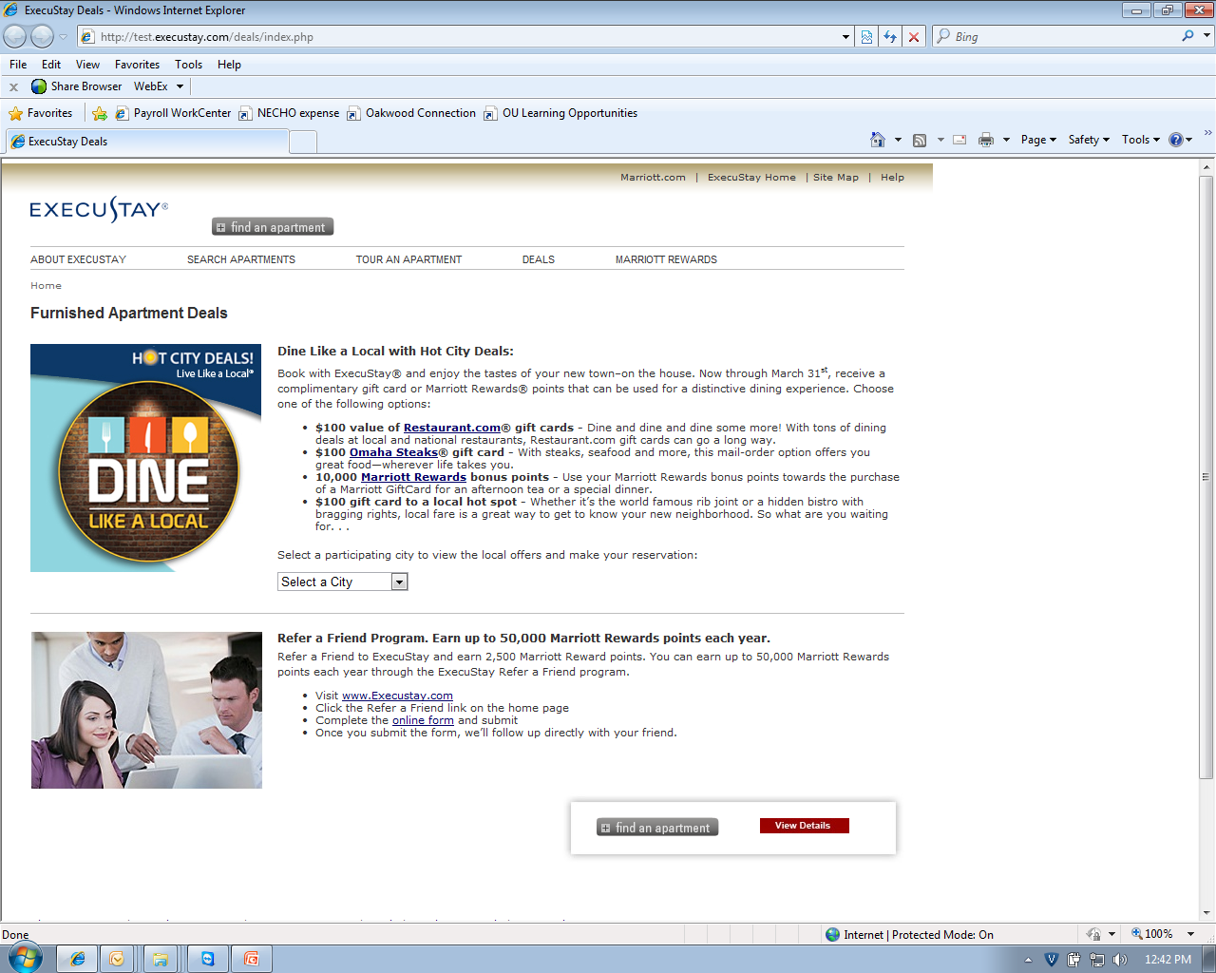

ExecuStay.com Deals Page
Live Like a Local®
Book with ExecuStay® and get out and play. Now through September 30th, receive a complimentary gift card or Marriott Rewards® points that will make this summer one to remember.
Choose one of the following options:
$100 StubHub® gift card—Root for the home team or catch the latest world tour with a gift card to the ultimate fun hub.
$100 Dick’s Sporting Goods® gift card—From running shoes to canoes, Dick’s offers you the chance to mix business with adventure.
10,000 Marriott Rewards® bonus points—Save up your points for a well-deserved spa day or a round of golf at any of Marriott’s award-winning golf courses.
$100 gift card to play in your new neighborhood—Let loose like the locals when you take advantage of an offer that’s been tailored to your town.
Select a participating city to view the local offer and make your reservation:

Slide 5
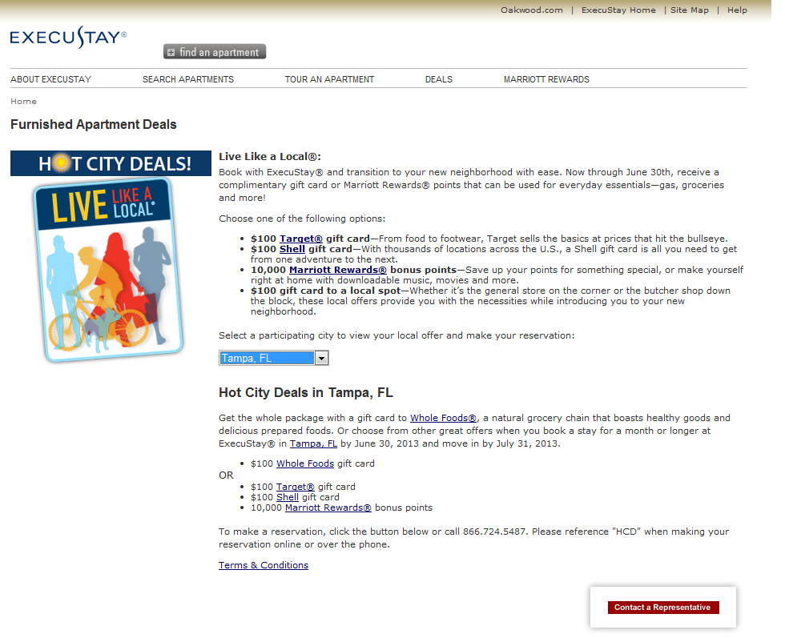
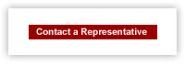
ExecuStay.com City Offer Page - Example
Live Like a Local®
Book with ExecuStay® and get out and play. Now through September 30th, receive a complimentary gift card or Marriott Rewards® points that will make this summer one to remember.
Choose one of the following options:
$100 StubHub® gift card—Root for the home team or catch the latest world tour with a gift card to the ultimate fun hub.
$100 Dick’s Sporting Goods® gift card—From running shoes to canoes, Dick’s offers you the chance to mix business with adventure.
10,000 Marriott Rewards® bonus points—Save up your points for a well-deserved spa day or a round of golf at any of Marriott’s award-winning golf courses.
$100 gift card to play in your new neighborhood—Let loose like the locals when you take advantage of an offer that’s been tailored to your town.
Select a participating city to view the local offer and make your reservation:
Experience the movies with taste at CinéBistro®, a luxurious in-theater dining experience. Or choose from other great offers when you book a stay for a month or longer at ExecuStay® in Tampa, FL by September 30, 2013 and arrive by October 31, 2013.
- $100 CinéBistro® gift card
OR
- $100 StubHub® gift card
- $100 Dick’s Sporting Goods® gift card
- 10,000 Marriott Rewards® bonus points
To make a reservation, click the button below or call 1-866-724-5487. Please reference "HCD" when making your reservation online or over the phone.
Terms & Conditions

Slide 6
ExecuStay.com City Offer Page Terms and Conditions
Guests who make a month or longer ExecuStay® reservation at a participating property located in the United States between the dates of July 1, 2013 and September 30, 2013, based upon availability, and arrive by October 31, 2013, can choose ONE of the following bonus gifts:
  $100 StubHub® gift card
  $100 Dick’s Sporting Goods® gift card
  10,000 Marriott Rewards® bonus points
  Local "PLAY" offer valued at up to $100 (Offer may change if option is no longer available when guest arrives.)
Guest must reference code HCD (Hot City Deals) when booking their reservation in order to receive their bonus gift. When making reservations online via the Check Rates & Availability button, HCD should be referenced in the Special Requests field. When requesting reservation information using the Contact a Representative button/link, HCD should be referenced in the Promotion Code field. When making a reservation by calling the local phone number listed or 888.220.0301, HCD must be mentioned before finalizing the reservation.
  Guests will receive their gift card within 10 business days of arrival at their ExecuStay apartment. If Marriott Rewards bonus points are chosen, the points will be posted 30-45 days following arrival date.
  Back-to-back 30-day stays at the same property are considered one (1) stay and are eligible for only one bonus gift.
  Stays for less than 30 days are not eligible for this promotion.
  This offer is not valid with any other ExecuStay or Oakwood promotion.
  This promotion is not valid for guests who made a reservation or have arrived before July 1, 2013.
  This promotion is available on non-discounted, standard rates only.
  This promotion is not valid on commissionable rates or in conjunction with referral fee accounts.
  This offer is not transferable and has no cash value. Void where prohibited.
  This promotion is not valid with insurance claims, policyholder housing.
ExecuStay guests can also earn the standard 2.5 Marriott Rewards points per dollar spent on qualifying charges*. Guest must be a Marriott Rewards member to receive points.
*Qualifying charges include rental expenses and fees. Non-qualifying charges for points include taxes, long-distance charges, refundable deposits, or damage/departure charges.

Slide 7
29 Hot City Deal “Play” Participating Cities
Albany, NY
Arlington, VA
Atlanta, GA
Austin, TX
Baltimore, MD
Baton Rouge, LA
Charleston, SC
Charlotte, NC
Charlottesville, VA
Chesapeake, VA
Dallas, TX
Des Moines, IA
Hampton, VA
Houston, TX
Jacksonville, FL
Kansas City, MO
Little Rock, AR
Miami, FL
New Orleans, LA
New York, NY
Oklahoma City, OK
Omaha, NE
Raleigh, NC
Richmond, VA
San Antonio, TX
Tampa, FL
Tulsa, OK
Washington, DC
Wichita, KS

Slide 8
ExecuStay.com Home Page Promo Schedule
There will be a total of 12 city offers featured on the home page
Three different city offers will be featured approximately every 3 weeks and will change as follows:
    July 1 – July 24
    July 25 – August 14
    August 15 – September 4
    September 5 – September 30

Slide 9
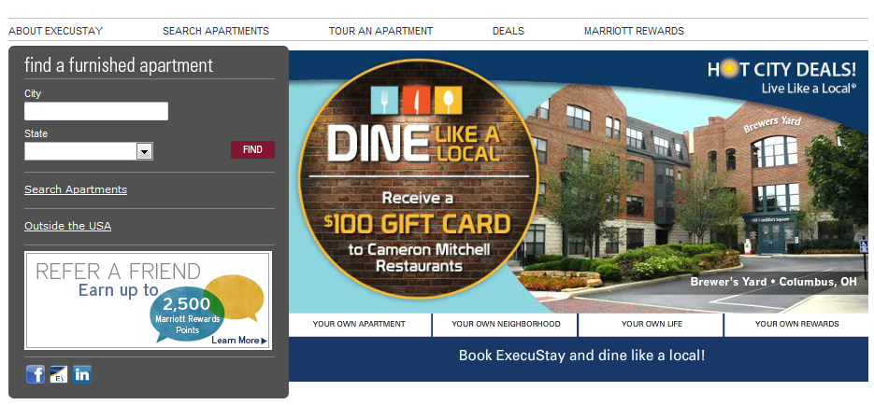
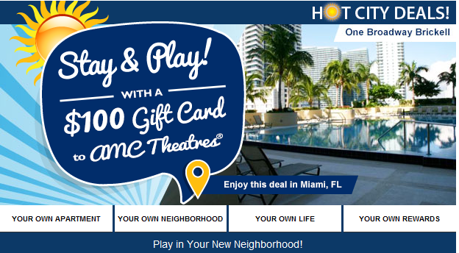
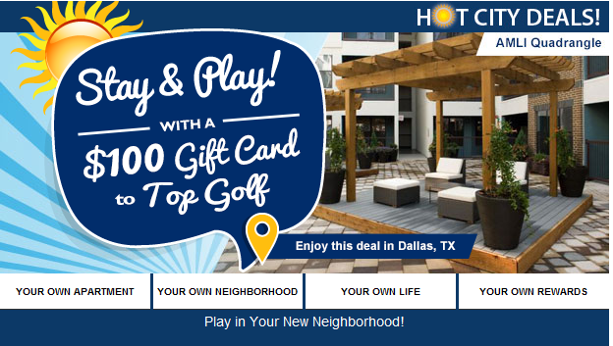
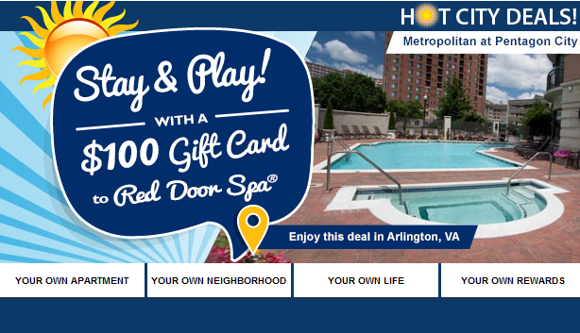
ExecuStay.com Home Page: Featured Offers

Slide 10
Fulfillment – Franchise Markets
Step #1: When a lead comes to you determine if it is eligible for Hot City Deals “Play” (All leads should be going directly to Franchise markets. There is a chance one could go to the Oakwood WSSC if the guest calls the general reservation number, but this would be a one-off):
  Reservation is being made between July 1, 2013 and September 30, 2013 and arrival is by October 31, 2013.
  Stay is for 30+ days.
  HCD was put in the Promotion Code field on the Contact a Representative form or mentioned when calling prior to finalizing the reservation. HCD is referenced in the Special Requests field when making online reservations using the Check Rates & Availability button (This is not a publicized booking method, but we’ll take it if done this way).
Step #2: All bookings eligible for this Hot City Deals promotion will need to be coded in Oscar in order to ensure fulfillment once the guest’s arrival date occurs.
  During your normal contact with the guest, determine which offer the guest prefers and put this in Oscar. Here are the codes you need to use so you will know what to give the guest upon move in and so you can track the success of the promotion options:
      HCDS (Hot City Deals StubHub®)
      HCDD (Hot City Deals Dick’s Sporting Goods®)
      HCDM (Hot City Deals Marriott Rewards®)
      HCDL (Hot City Deals Local)
  Also, please take note of when the reservation was made, since offers will change every few months, we want to make every attempt to honor the offer the guest chose at the time of booking.
Step #3:
  All promotion offers will be fulfilled in the market. Gift Cards (National and Local) must be given to the guest within 10 business days of arrival (see slide 12 for fulfillment of National offer gift cards).
  Marriott Rewards points must be posted by the 15th of the month following guest arrival. Use the form and code EHCD (this ensures that the description for the 10,000 points shows up on guest’s statement). Submit form to Connie.johansen@marriott.com
Step #4: At the end of each Hot City Deals segment (this segment is “Play”), we will ask participating markets for tracking information including: Guests name, booking date, arrival/departure dates, average daily rate, HCD gift guest chose, etc.
Please share this information with us so we will be able to determine the success of the promotion.

Slide 11

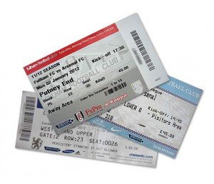

Offer Fulfillment
Physical or electronic gift cards are acceptable to give the guest for this promotion.
Markets will be responsible for fulfilling
National offers:
  $100 StubHub® gift card
    Order gift certificate online - cost to you is $100 and can either email certificate to guest or print for arrival. No additional fees.
    Pick up StubHub gift card at participating stores (Safeway, Giant, Shaw’s, Albertson’s, Lowes, etc.) Cost to you is $100.
    Additional processing fees may apply.
  $100 Dick’s Sporting Goods® gift card
    Order online - cost to you is $100 plus shipping ~ $1.
    Pick up at local Dick’s Sporting Goods location – cost to you
    is $100 .
  Marriott Rewards® Bonus Points
    Order using form and submit to Connie Johansen at connie.johansen@marriott.com
    Cost to you is $8.50 per 1,000 = $85
Markets will be responsible for fulfilling local offers

Slide 12
Marketing & Communications
Online
ExecuStay.com Home page
ExecuStay.com Deals landing page
Email
Marriott Rewards eNewsletter (scheduled for August)
Oakwood Worldwide eNewsletter
ExecuStay eNews (possible distribution during peak season)
Social
Facebook
Twitter

Slide 13
Key Dates
6/30/13: Current Hot City Deals “Live” ends
7/1/13: Hot City Deals “Play” begins
8/30/13 Hot City Deals “Give” Participating Cities Due
During the holiday season, let’s give the gift that keeps on giving. Our guests can have the option to make a monetary donation to a charity or receive a gift card that they can use themselves or pass along to someone else.
9/30/13: Hot City Deals “Play” ends
10/1/13: Hot City Deals “Give” begins

Slide 14
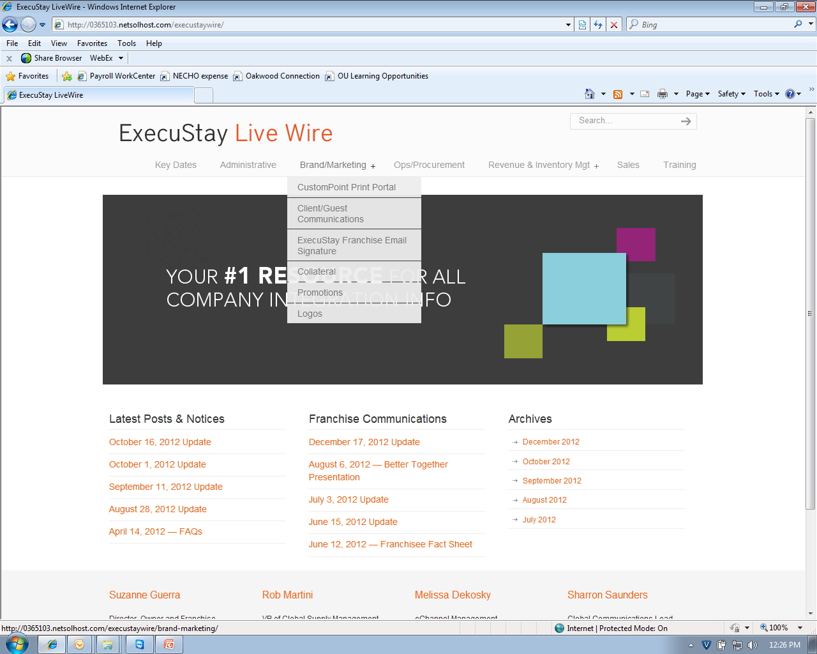
Hot City Deals Resources – Franchise Markets
For public information about the Hot City Deals promotion and all other promotions, go to the Deals page on ExecuStay.com.
For all internal documents, go the ExecuStay Live Wire: http://www.execustaylivewire.com
  Username: ExecuStay1
  Password: Franchisee
Questions:
Lisa Reich – lreich@oakwood.com or 240.720.3022
Amy Leeds – aleeds@oakwood.com or 240.720.3014

