Slide 1
Minix3 Project 2013-2014 Adding a transparent file encryption support to the Minix File System
Introductory project
INGI 1113
Groupe 43 : Lena Peschke & Mélanie Sedda

Slide 2
The system call getpidinfo
/usr/src/include/minix/callnr.h
/usr/src/servers/pm/table.c
/usr/src/server/pm/misc.c
/usr/src/servers/pm/proto.h
/usr/src/include/minix/type.h

Slide 3
Inclusion in the libraries
/usr/src/lib/libc/other/_getpidinfo.c
/usr/src/lib/libc/other/Makefile.inc
/usr/src/include/unistd.h
/usr/src/lib/libc/syscall/getpidinfo.S
/src/lib/libc/syscall/Makefile.inc

Slide 4
Steps to the system call
Find an unused slot : 32
Write the code of do_getpidinfo()
Add the prototype declaration to proto.h
Define a new structure pid_s

Slide 5
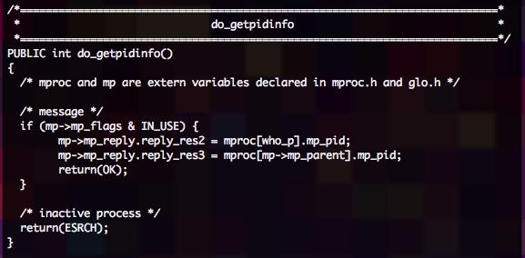
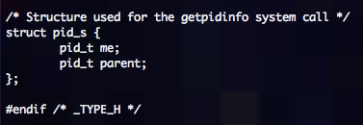
New code
misc.c
type.h

Slide 6
Modifying the libraries
Create a user library routine
Add ASM code
Add the prototype declaration to unistd.h

Slide 7
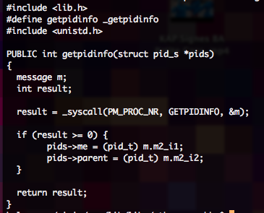

And more new code
_getpidinfo.c
getpidinfo.S

Slide 8
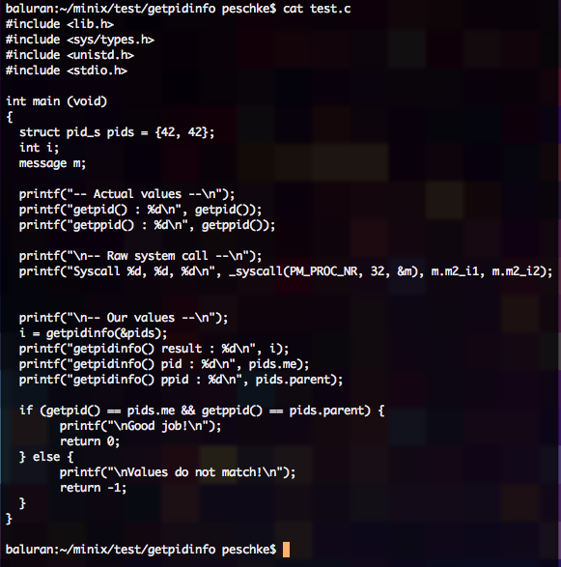
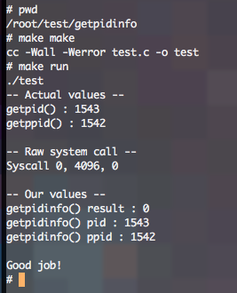
Testing

