Slide 1

Rockbuster Stealth Data Dictionary
Melanie Hicks

Slide 2
Table of Contents
Data Dictionary……………………………………………………………………………………………………………………………………………………………………1
Entity Relationship Diagram………………………………………………………………………………………………………………………………………………..3
Fact Table………………………………………...…………...……...................................................................................................................4
Rental.....................................................................................................................................................................................4
Dimension Tables.......................................................................................................................................................................5
Payment..................................................................................................................................................................................5
Inventory.................................................................................................................................................................................6
Film_actor...............................................................................................................................................................................7
Film_category.........................................................................................................................................................................8
Customer...........................................................................................................................................................................9, 10
Staff.................................................................................................................................................................................11, 12
Store.....................................................................................................................................................................................13
Address.................................................................................................................................................................................14
City........................................................................................................................................................................................15
Country.................................................................................................................................................................................16
Actor.....................................................................................................................................................................................17
Language..............................................................................................................................................................................18
Film.................................................................................................................................................................................19, 20
Category...............................................................................................................................................................................21

Slide 3
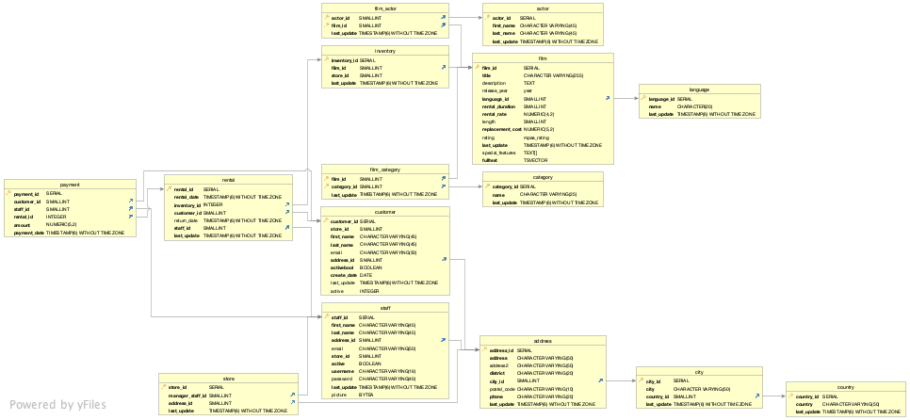
Entity Relationship Diagram

Slide 4
Fact Tables: Rental
Column | Data Type | Description | Key | Links to | Links From
rental_id | SERIAL | Number assigned to rental | Primary |  | Payment
rental_date | TIMESTAMP (6) WITHOUT TIME ZONE | Date rented
inventory_id | INTEGER | Number assigned to inventory | Foreign | Inventory
customer_id | SMALLINT | Number assigned to customer | Foreign | Customer
return_date | TIMESTAMP (6) WITHOUT TIME ZONE | Date rental returned
staff_id | SMALLINT | Number assigned to employee | Foreign | Staff
last_update | TIMESTAMP (6) WITHOUT TIME ZONE | Time last updated

Slide 5
Dimension Tables: Payment
Column | Data Type | Description | Key | Links to | Links From
payment_id | SERIAL | Number assigned to payment | Primary
customer_id | SMALLINT | Number assigned to customer | Foreign | Customer
staff_id | SMALLINT | Number assigned to employee | Foreign | Staff
rental_id | INTEGER | Number assigned to rental | Foreign | Rental
amount | NUMBER (5,2) | Payment amount
payment_date | TIMESTAMP (6) WITHOUT TIME ZONE | Date of payment

Slide 6
Dimension Tables: Inventory
Column | Data Type | Description | Key | Links to | Links From
inventory_id | SERIAL | Number assigned to inventory | Primary |  | Rental
film_id | SMALLINT | Number assigned to film | Foreign | Film
store_id | SMALLINT | Number assigned to store
last_update | TIMESTAMP (6) WITHOUT TIME ZONE | Time last updated

Slide 7
Dimension Tables: Film_actor
Column | Data Type | Description | Key | Links to | Links From
actor_id | SMALLINT | Number assigned to actor | Primary
film_id | SMALLINT | Number assigned to film | Foreign | Film
last_update | TIMESTAMP (6) WITHOUT TIME ZONE | Time last updated

Slide 8
Dimension Tables: Film_category
Column | Data Type | Description | Key | Links to | Links From
film_id | SMALLINT | Number assigned to film | Primary
category_id | SMALLINT | Number assigned to category | Foreign | Category
last_update | TIMESTAMP (6) WITHOUT TIME ZONE | Time last updated

Slide 9
Dimension Tables: Customer
Column | Data Type | Description | Key | Links to | Links From
customer_id | SERIAL | Number assigned to customer | Primary |  | Payment
store_id | SMALLINT | Number assigned to store | Foreign | Store
first_name | CHARACTER VARYING(45) | First name of customer
last_name | CHARACTER VARYING(45) | Last name of customer
email | CHARACTER VARYING(50) | Customer email
address_id | SMALLINT | Number assigned to customer address | Foreign | Address
activebool | BOOLEAN | Customer’s active status

Slide 10
Dimension Tables: Customer
Column | Data Type | Description | Key | Links to | Links From
Create_date | DATE | Date created
Last_update | TIMESTAMP (6) WITHOUT TIME ZONE | Time last updated
Active | INTEGER | Customer’s active status

Slide 11
Dimension Tables: Staff
Column | Data Type | Description | Key | Links to | Links From
Staff_id | SERIAL | Number assigned to employee | Primary |  | Payment, rental, store
First_name | CHARACTER VARYING(45) | First name of employee
Last_name | CHARACTER VARYING(45) | Last name of employee
Address_id | SMALLINT | Number assigned to employee address | Foreign | Address
Email | CHARACTER VARYING(5) | Employee email
Store_id | SMALLINT | Number assigned to store | Foreign | Store

Slide 12
Dimension Tables: Staff
Column | Data Type | Description | Key | Links to | Links From
active | BOOLEAN | Employee’s active statue
username | CHARACTER VARYING(16) | Employee’s username
password | CHARACTER VARYING(40) | Employee’s password
last_update | TIMESTAMP (6) WITHOUT TIME ZONE | Time last updated
picture | BYTEA | Picture of employee

Slide 13
Dimension Tables: Store
Column | Data Type | Description | Key | Links to | Links From
store_id | SERIAL | Number assigned to store | Primary
manager_staff_id | SMALLINT | Number assigned to manager | Primary | Staff
address_id | SMALLINT | Number assigned to manager’s address | Primary | Address
last_update | TIMESTAMP(6) WITHOUT TIME ZONE | Time last updated

Slide 14
Dimension Tables: Address
Column | Data Type | Description | Key | Links to | Links From
address_id | SERIAL | Number assigned to address | Primary |  | Store
address | CHARACTER VARYING(50) | Street address
address2 | CHARACTER VARYING(50) | Supplemental street address
district | CHARACTER VARYING(20) | District
city_id | SMALLINT | Number assigned to city | Foreign | City
postal_code | CHARACTER VARYING(10) | Postal code
phone | CHARACTER VARYING(20) | Phone number
last_update | TIMESTAMP(6) WITHOUT TIME STAMP | Time last updated

Slide 15
Dimension Tables: City
Column | Data Type | Description | Key | Links to | Links From
city_id | SERIAL | Number assigned to city | Primary |  | Address
city | CHARACTER VARYING(50) | City name
country_id | SMALLINT | Number assigned to country | Foreign | Country
last_update | TIMESTAMP(6) WIHTOUT TIME ZONE | Time last updated

Slide 16
Dimension Tables: Country
Column | Data Type | Description | Key | Links to | Links From
country_id | SERIAL | Number assigned to country | Primary |  | City
country | CHARACTER VARYING(50) | Country name
last_update | TIMESTAMP(6) WITHOUT TIME ZONE | Time last updated

Slide 17
Dimension Tables: Actor
Column | Data Type | Description | Key | Links to | Links From
Actor_id | SERIAL | Number assigned to actor | Primary |  | Film_actor
First_name | CHARACTER VARYING(45) | First name of actor
Last_name | CHARCTER VARYING(45) | Last name of actor
last_update | TIMESTAMP(6) WITHOUT TIME ZONE | Time last updated

Slide 18
Dimension Tables: Language
Column | Data Type | Description | Key | Links to | Links From
language_id | SERIAL | Number assigned to language | Primary |  | Film
name | CHARACTER(20)
last_update | TIMESTAMP(6) WITHOUT TIME ZONE | Time last updated

Slide 19
Dimension Tables: Film
Column | Data Type | Description | Key | Links to | Links From
film_id | SERIAL | Number assigned to film | Primary |  | Film_actor, inventory
title | CHARACTER VARYING(255) | Title of film
description | TEXT | Description of film
release_year | Year | Year film was released
language_id | SMALLINT | Number assigned to language | Foreign | Language
rental_duration | SMALLINT | Duration film was rented
rental_rate | NUMERIC(4,2) | Price of rental

Slide 20
Dimension Tables: Film
Column | Data Type | Description | Key | Links to | Links From
length | SMALLINT | Length of film
replacement_cost | NUMERIC(5,2) | Cost to replace film
rating | Mpaa_rating | Rating of film
last_update | TIMSTAMP(6) WITHOUT TIME ZONE | Time last updated
special_features | TEXT[] | Special features of film
filltext | TSVECTOR | Film keywords

Slide 21
Dimension Tables: Category
Column | Data Type | Description | Key | Links to | Links From
category_id | SERIAL | Primary |  |  | Film_category
name | CHARACTER VARYING(25)
last_update | TIMESTAMP(6) WITHOUT TIME STAMP

