Slide 1
Lanalytics package
Melanie Stefan
Salvador Garcia

Slide 2
Structure of the Focus Group (4 sections):
(5 minutes) Introduction of R, Rstudio and Shiny
(25 minutes) Introduction of the Learning Analytics Package and its Shiny Interface
There are some questions for each tab of the Interface
(20 minutes) User experience evaluation
Likert evaluation of the user experience in the dashboard.
(10 minutes) Open questions and suggestions

Slide 3


Introduction to R and Rstudio
Have an amazing number of packages related to Psychometrics
https://cran.r-project.org/web/views/Psychometrics.html
Well documented, flexible and easy to use
Free and open source!
https://cran.r-project.org/
-The most common (and really useful) IDE for R
https://www.rstudio.com/

Slide 4
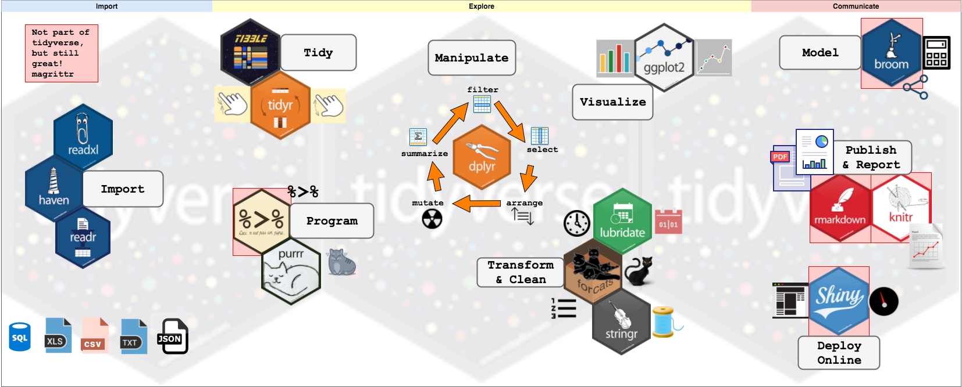
Data analysis in R (tidyverse)
https://www.tidyverse.org/

Slide 5

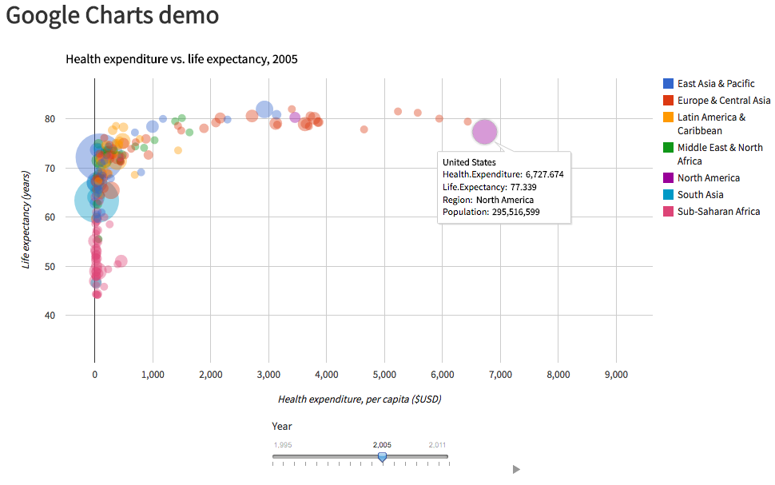
R Shiny
Basically 2 reasons to use R over other interactive visualization software:
Can work with any package of R!
Not directly code in HTML
https://shiny.rstudio.com/

Slide 6
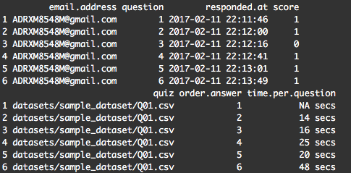
Lanalytics package
Objectives of Learning Analytics Package and Dashboard
Understand the items in low-stake online quizzes to improve the design of future quiz items. (Number of questions, time of quiz, easiness). Monitor the performance of the students in different levels: individual, per quiz and per group
Basic Structure of package: Quiz object (long format table with an entry per student-question) Course object (Grouped quiz objects in one object)

Slide 7
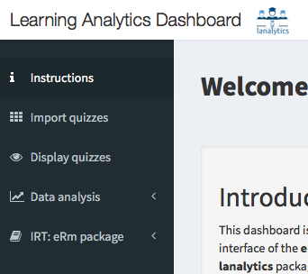
Lanalytics dashboard
5 Tabs to make analysis and display plots
Performs analysis at distinct levels: individual, group and quiz.
Uses rasch models (eRm package) to infer a person parameter and an item parameter.
The person parameter measure the ability of the person
The item parameter measure the difficulty of the item
Both are measured in the same scale (a latent variable). That means that we compare them!

Slide 8
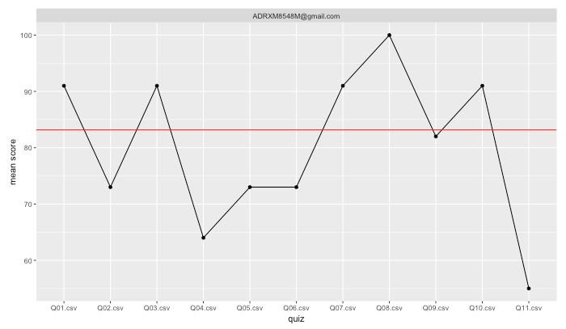
Individual analysis
Student
You can filter one student email and see its performance in all quizzes
You can monitor which students are not making progress or which are improving their scores.
Mean score
You can upload a file with the final grade of the exam and it can be shown like the red line in this example
quiz

Slide 9
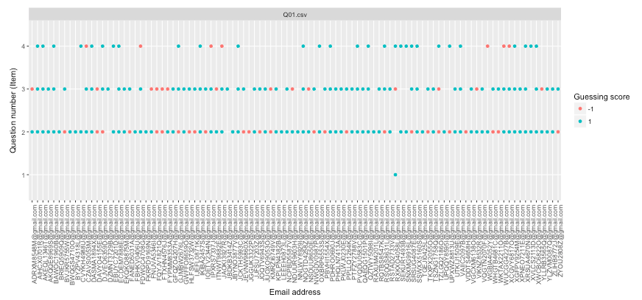
Group Analysis
Sometimes a student answers a question very fast is suspicious!
The probability that he gets this question wrong should be is high. But what happen in he gets many correct answers answering very fast the questions?
In this plot the questions that are answered in less than 20 seconds (or below an individual threshold set which is set by answering really questions) is shown.
1 means that he answer the question correctly and -1 means that he answer the question incorrectly.
Quiz
Question number
Email address

Slide 10
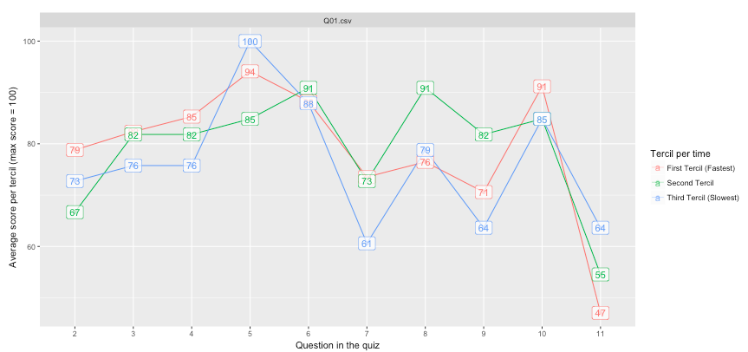
Group Analysis
The quizzes are designed for an specific time
Students are taking too long to answer each question?
This extra time really help them to answer correct the question?
Or they take more time because they don’t know the answer?
Analyzing the spent time vs the average score should give us an idea.
Quiz
Tercil divided per time
Average Score (Max = 100)
Fastest students
Middle-time students
Slowest students
Question in the quiz

Slide 11
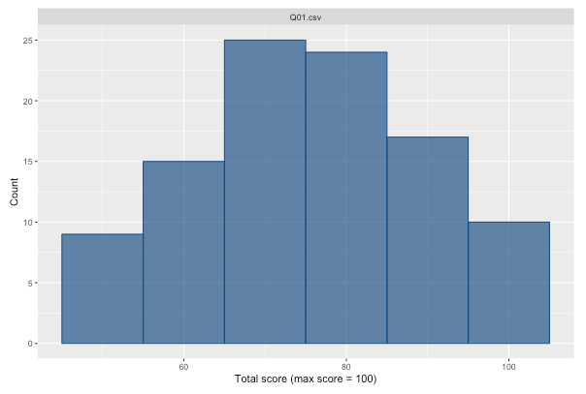
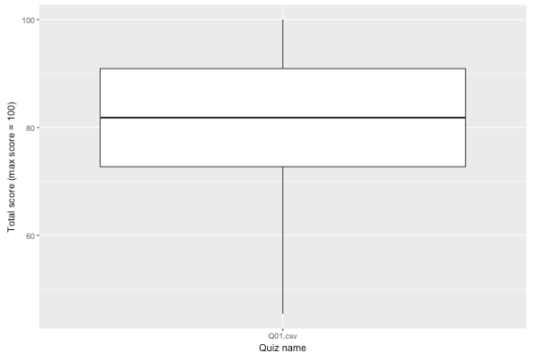
Quiz analysis
Show basic descriptive plots like histograms and boxplots.
Can study the dispersion, skewness and outliers.

Slide 12
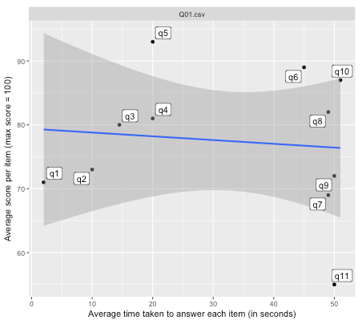
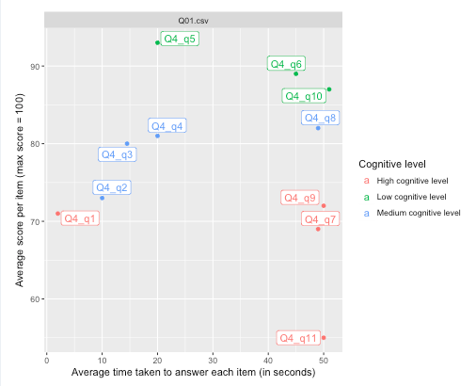
Quiz analysis
Easiness-Time plot shows relation between the spent time in each question versus the average score. (Easy questions are really answered faster?)
Easiness-Time-Level plot shows the relation between cognitive level (high cognitive items takes more time!
Average score per item (max = 100)
Average score per item (max = 100)
Average time taken to answer each item
Average time taken to answer each item

Slide 13
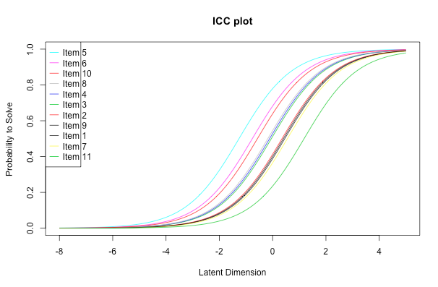
Rasch model – Item Characteristic Curve
A way to display the item parameter (difficulty) is to plot it as a sigmoid function. (slope is the parameter)
The latent dimension is sometimes called ability.
It shows the probability of getting correct the item
For example, item 5 is the easier in this set (for low levels of ability, it has high probability to be correct)

Slide 14
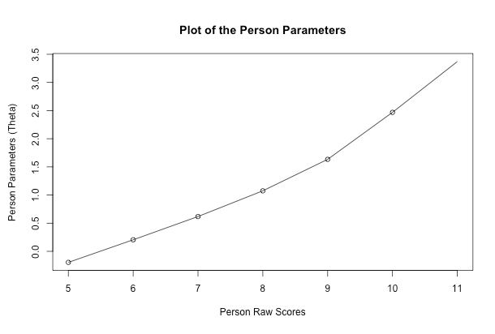
Rasch model – person parameter
The raw scores are the total number of correct answers per person.
The person parameter is in the same scale as the item parameter (latent dimension)
For example, this quiz is skewed to have more correct answers (there are people who have all questions correct, but there are no one who got 0 questions correct)

Slide 15
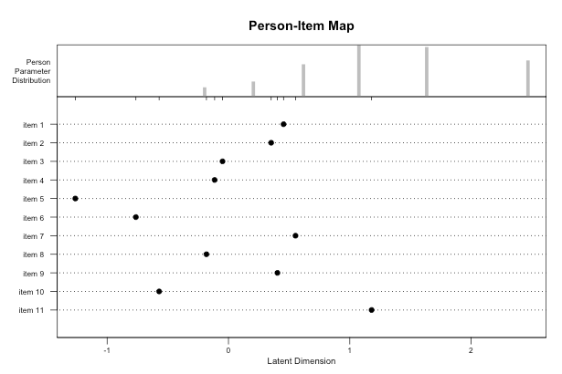
Rasch model – person item map
Distribution of person parameter
Person parameters are high compared with the difficulty of the items.
The dataset was designed so that minimum there is 50% probability to get correct the items.
Value of item parameter
Easy items compared with the abilities of the students
This example is of open book questions, so it’s normal to get this.
But, depending on the type of quiz, this might change

