Slide 1

Music & Mental Health
Trying to predict music effects

Slide 2
Music & Mental Health
Trying to predict music effects

Slide 3
Oxytocin

Slide 4
1
Identifying the problem

Slide 5
Oxytocin
is a type of hormone in your body that promotes positive feelings.
Music also seems to have the ability to increase oxytocin levels, especially when people sing in a group, which adds the element of bonding.
Harvard Medical School

Slide 6
Music & Mental Health:
Trying to discover trends -> predict music effects:
1) Connection mental health and music use
2) Connection mental health and music preference
3) Connection mental health and music genres
4) Connection mental health and greatest music effects
5) Connection mental health and age
6) Can I make helpful recommendations based on these findings?

Slide 7
2
Collecting relevant data

Slide 8
Dataset: Kaggle
Block 0: Background
Respondents answer generic questions focused on musical background and listening habits.
Block 1: Music genres
Respondents rank how often they listen to 16 music genres, where they can select:
Never
Rarely
Sometimes
Very frequently
Block 2: Mental health
Respondents rank Anxiety, Depression, Insomnia, and OCD on a scale of 0 to 10, where:
0 - I do not experience this.
10 - I experience this regularly, constantly/or to an extreme.
Notes:
Music therapy, or MT, is the use of music to improve an individual's stress, mood, and overall mental health.
MT is also recognized as an evidence-based practice, using music as a catalyst for "happy" hormones such as oxytocin.
However, MT employs a wide range of different genres, varying from one organization to the next.
The MxMH dataset aims to identify what, if any, correlations exist between an individual's music taste and their self-reported mental health. Ideally, these findings could contribute to a more informed application of MT or simply provide interesting sights about the mind.

Slide 9


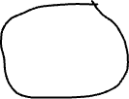

Dataset: Kaggle
Mental health:
Anxiety Depression Insomnia OCD
Notes:
Music therapy, or MT, is the use of music to improve an individual's stress, mood, and overall mental health.
MT is also recognized as an evidence-based practice, using music as a catalyst for "happy" hormones such as oxytocin.
However, MT employs a wide range of different genres, varying from one organization to the next.
The MxMH dataset aims to identify what, if any, correlations exist between an individual's music taste and their self-reported mental health. Ideally, these findings could contribute to a more informed application of MT or simply provide interesting sights about the mind.

Slide 10
3
Data cleaning

Slide 11


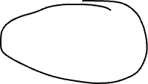
Dataset: Kaggle
Music effects:
Improve No effect Worsen
Notes:
Music therapy, or MT, is the use of music to improve an individual's stress, mood, and overall mental health.
MT is also recognized as an evidence-based practice, using music as a catalyst for "happy" hormones such as oxytocin.
However, MT employs a wide range of different genres, varying from one organization to the next.
The MxMH dataset aims to identify what, if any, correlations exist between an individual's music taste and their self-reported mental health. Ideally, these findings could contribute to a more informed application of MT or simply provide interesting sights about the mind.

Slide 12

Music effects
Timestamp
Age
Primary streaming service
Hours per day
While working
Instrumentalist
Composer
Favorite genres
Exploratory
Foreign languages
BPM
Frequency [Classical]
Frequency [Country]
Frequency [EDM]
Frequency [Folk]
Frequency [Gospel]
Frequency [Hip hop]
Frequency [Jazz]
Frequency [K pop]
Frequency [Latin]
Frequency [Lofi]
Frequency [Metal]
Frequency [Pop]
Frequency [R&B]
Frequency [Rap]
Frequency [Rock]
Frequency [Video game music]
Anxiety
Depression
Insomnia
OCD
Music effects
Permissions
Music use
Music preference
Music genres
Age
Mental health

Slide 13
Music effects
Timestamp
Age
Primary streaming service
Hours per day
While working
Instrumentalist
Composer
Favorite genres
Exploratory
Foreign languages
BPM
Frequency [Classical]
Frequency [Country]
Frequency [EDM]
Frequency [Folk]
Frequency [Gospel]
Frequency [Hip hop]
Frequency [Jazz]
Frequency [K pop]
Frequency [Latin]
Frequency [Lofi]
Frequency [Metal]
Frequency [Pop]
Frequency [R&B]
Frequency [Rap]
Frequency [Rock]
Frequency [Video game music]
Anxiety
Depression
Insomnia
OCD
Music effects
Permissions
Music use
Music preference
Music genres
Age
Mental health

Slide 14

Music effects
Timestamp
Age
Primary streaming service
Hours per day
While working
Instrumentalist
Composer
Favorite genres
Exploratory
Foreign languages
BPM
Frequency [Classical]
Frequency [Country]
Frequency [EDM]
Frequency [Folk]
Frequency [Gospel]
Frequency [Hip hop]
Frequency [Jazz]
Frequency [K pop]
Frequency [Latin]
Frequency [Lofi]
Frequency [Metal]
Frequency [Pop]
Frequency [R&B]
Frequency [Rap]
Frequency [Rock]
Frequency [Video game music]
Anxiety
Depression
Insomnia
OCD
Music effects
Permissions
Music use
Music preference
Music genres
Age
Mental health

Slide 15

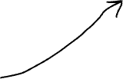

Music effects
Timestamp
Age
Primary streaming service
Hours per day
While working
Instrumentalist
Composer
Favorite genres
Exploratory
Foreign languages
BPM
Frequency [Classical]
Frequency [Country]
Frequency [EDM]
Frequency [Folk]
Frequency [Gospel]
Frequency [Hip hop]
Frequency [Jazz]
Frequency [K pop]
Frequency [Latin]
Frequency [Lofi]
Frequency [Metal]
Frequency [Pop]
Frequency [R&B]
Frequency [Rap]
Frequency [Rock]
Frequency [Video game music]
Anxiety
Depression
Insomnia
OCD
Music effects
Permissions
Music use
Music preference
Music genres
Age
Mental health

Slide 16


Music effects
Timestamp
Age
Primary streaming service
Hours per day
While working
Instrumentalist
Composer
Favorite genres
Exploratory
Foreign languages
BPM
Frequency [Classical]
Frequency [Country]
Frequency [EDM]
Frequency [Folk]
Frequency [Gospel]
Frequency [Hip hop]
Frequency [Jazz]
Frequency [K pop]
Frequency [Latin]
Frequency [Lofi]
Frequency [Metal]
Frequency [Pop]
Frequency [R&B]
Frequency [Rap]
Frequency [Rock]
Frequency [Video game music]
Anxiety
Depression
Insomnia
OCD
Music effects
Permissions
Music use
Music preference
Music genres
Age
Mental health

Slide 17
4
Data Analysis

Slide 18
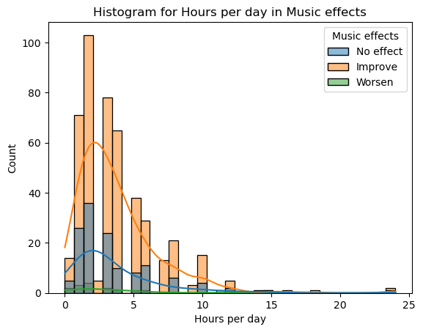
### 1) Connection mental health and music use:
* 'Music effects' and ‘Hours per day’
* 'Music effects' and 'While working'
* 'Music effects' and 'Exploratory'
### 2) Connection mental health and music preference:
### 3) Connection mental health and music genres:
### 4) Connection mental health and greatest music effects:
* 'Music effects’ and ‘Depression’
### 5) Connection mental health and age:
* ‘Age group’ and ‘Music effects’
### 6) Can I make helpful recommendations based on these findings?

Slide 19
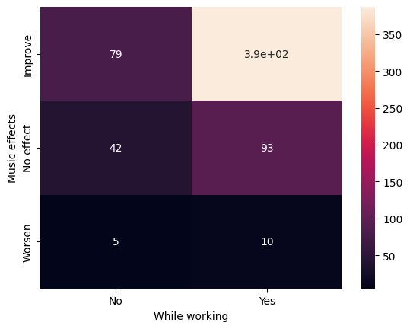
### 1) Connection mental health and music use:
* 'Music effects' and 'While working'
* 'Music effects' and 'Exploratory'
### 2) Connection mental health and music preference:
### 3) Connection mental health and music genres:
### 4) Connection mental health and greatest music effects:
* 'Music effects’ and ‘Depression’
### 5) Connection mental health and age:
* ‘Age group’ and ‘Music effects’
### 6) Can I make helpful recommendations based on these findings?

Slide 20
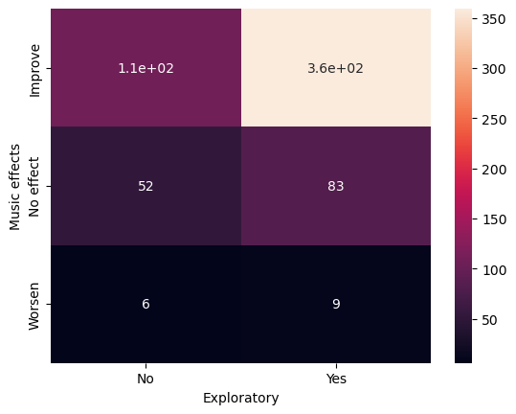
### 1) Connection mental health and music use:
* 'Music effects' and 'While working'
* 'Music effects' and 'Exploratory'
### 2) Connection mental health and music preference:
### 3) Connection mental health and music genres:
### 4) Connection mental health and greatest music effects:
* 'Music effects’ and ‘Depression’
### 5) Connection mental health and age:
* ‘Age group’ and ‘Music effects’
### 6) Can I make helpful recommendations based on these findings?

Slide 21
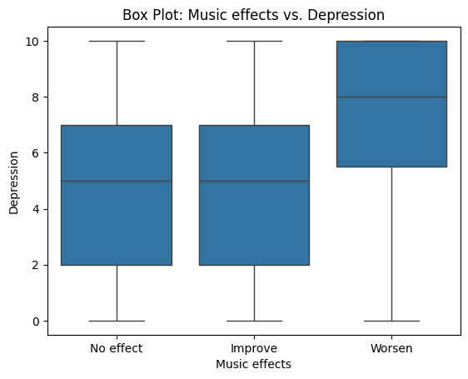
### 1) Connection mental health and music use:
* 'Music effects' and 'While working'
* 'Music effects' and 'Exploratory'
### 2) Connection mental health and music preference:
### 3) Connection mental health and music genres:
### 4) Connection mental health and greatest music effects:
* 'Music effects’ and ‘Depression’
### 5) Connection mental health and age:
* ‘Age group’ and ‘Music effects’
### 6) Can I make helpful recommendations based on these findings?

Slide 22
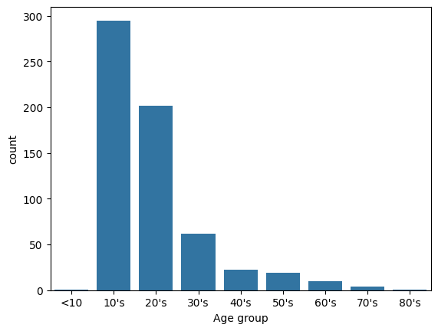
### 1) Connection mental health and music use:
* 'Music effects' and 'While working'
* 'Music effects' and 'Exploratory'
### 2) Connection mental health and music preference:
### 3) Connection mental health and music genres:
### 4) Connection mental health and greatest music effects:
* 'Music effects’ and ‘Depression’
### 5) Connection mental health and age:
* ‘Age group’ and ‘Music effects’
### 6) Can I make helpful recommendations based on these findings?

Slide 23
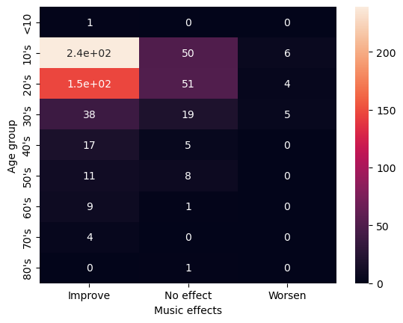
### 1) Connection mental health and music use:
* 'Music effects' and 'While working'
* 'Music effects' and 'Exploratory'
### 2) Connection mental health and music preference:
### 3) Connection mental health and music genres:
### 4) Connection mental health and greatest music effects:
* 'Music effects’ and ‘Depression’
### 5) Connection mental health and age:
* ‘Age group’ and ‘Music effects’
### 6) Can I make helpful recommendations based on these findings?

Slide 24

### 1) Connection mental health and music use:
* 'Music effects' and 'While working'
* 'Music effects' and 'Exploratory'
### 2) Connection mental health and music preference:
### 3) Connection mental health and music genres:
### 4) Connection mental health and greatest music effects:
* 'Music effects’ and ‘Depression’
### 5) Connection mental health and age:
* ‘Age group’ and ‘Music effects’
### 6) Can I make helpful recommendations based on these findings?

Slide 25
5
Reporting results

Slide 26
### 1) Connection mental health and music use:
* 'Music effects' and 'While working'
* 'Music effects' and 'Exploratory'
### 4) Connection mental health and greatest music effects:
* 'Music effects’ and ‘Depression’
### 5) Connection mental health and age:
* ‘Age group’ and ‘Music effects
Models:
Logistic Regression
Decision Trees
Random Forest
Linear Regression
ANOVA
Chi2

Slide 27
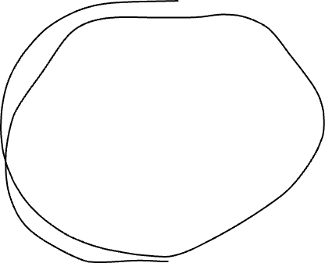

### 1) Connection mental health and music use:
* 'Music effects' and 'While working'
* 'Music effects' and 'Exploratory'
### 4) Connection mental health and greatest music effects:
* 'Music effects’ and ‘Depression’
### 5) Connection mental health and age:
* ‘Age group’ and ‘Music effects
Models:
Logistic Regression
Decision Trees
Random Forest
Linear Regression
ANOVA
Chi2

Slide 28
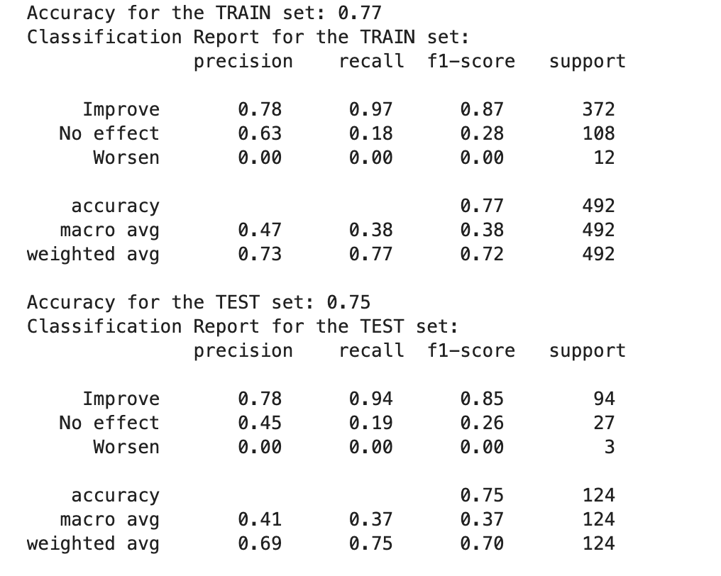
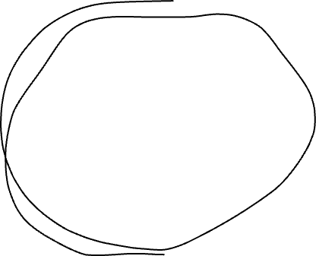

### 1) Connection mental health and music use:
* 'Music effects' and 'While working'
* 'Music effects' and 'Exploratory'
### 4) Connection mental health and greatest music effects:
* 'Music effects’ and ‘Depression’
### 5) Connection mental health and age:
* ‘Age group’ and ‘Music effects
Models:
Logistic Regression
Decision Trees
Random Forest
Linear Regression
ANOVA
Chi2
Decision Trees / Random Forest

Slide 29
6
Conclusion

Slide 30
There is a connection between music and mental health. We know from this data that listening to music while working and actively exploring new genres and artists has a positive effect on mental health especially for young people between 10 - 30.
### 6) Can I make helpful recommendations based on these findings?
* Train the best model
* Add to this research by doing a new survey and explore elements in music

Slide 31

There is a connection between music and mental health. We know from this data that listening to music while working and actively exploring new genres and artists has a positive effect on mental health especially for young people between 10 - 30.
### 6) Can I make helpful recommendations based on these findings?
* Train the best model
* Add to this research by doing a new survey and explore elements in music

Slide 32
Thank you!

Slide 33
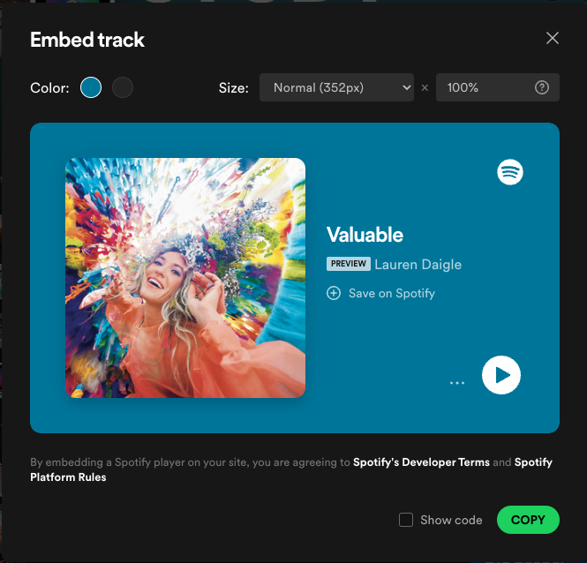
Thank you!

