Slide 1
Who is next? Cyber attacks analysis
Melanie Uhde

Slide 2
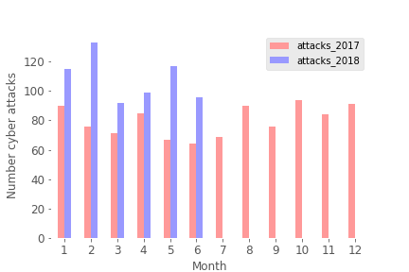

Slide 6
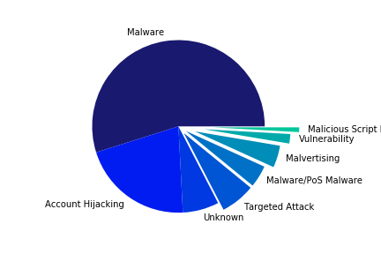

Slide 7
