Slide 1
Who is next? Analysis of cyber attacks reported between 2017-2018

Slide 2
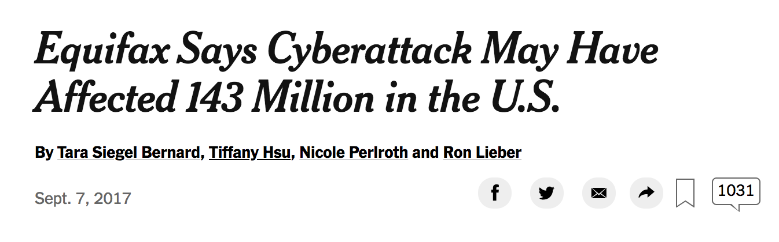
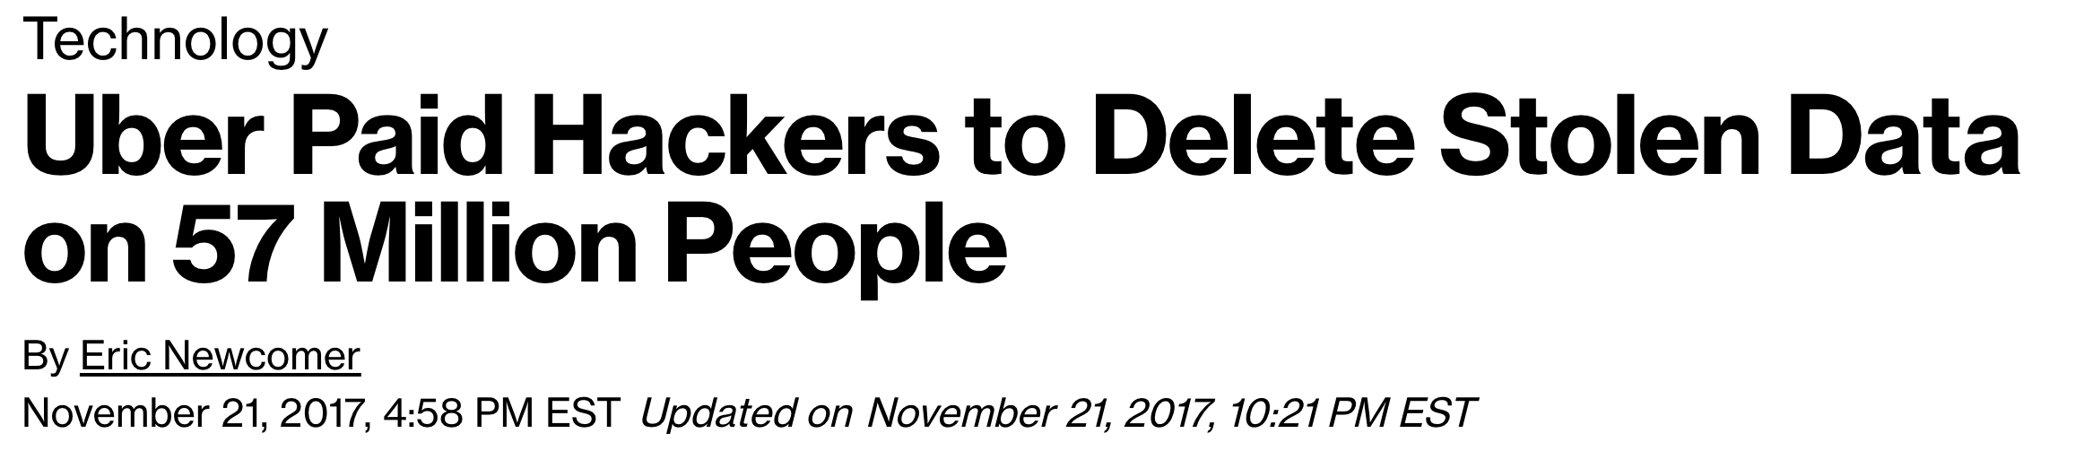

Slide 3
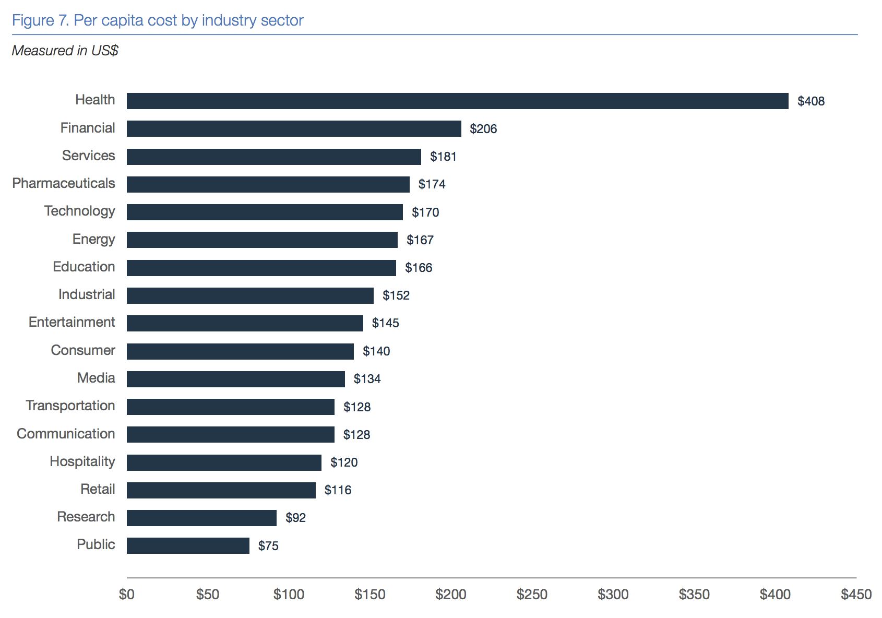
Data breach costs are highest for healthcare industry
The 2018 Cost of a Data Breach Study by the Ponemon Institute

Slide 4
Hackmageddon
scraped www.hackmageddon.com to collect information on:
Date of attack
Target
Target_class (industry category)
Type of attack
Country
Summary
Type of attack( crime, espionage, hacktivism, warfare)

Slide 5
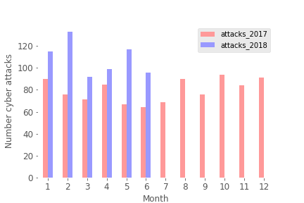
Trend of increasing cyber attacks for 2018

Slide 6
Top 5 categories affected: Individuals Healthcare Fintech Finances Multiple

Slide 7
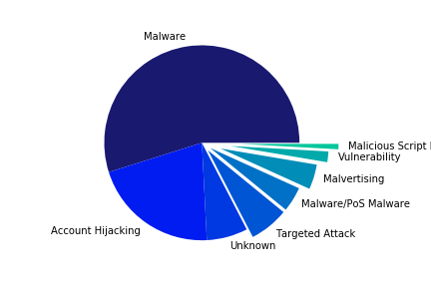
Target: Individuals

Slide 8
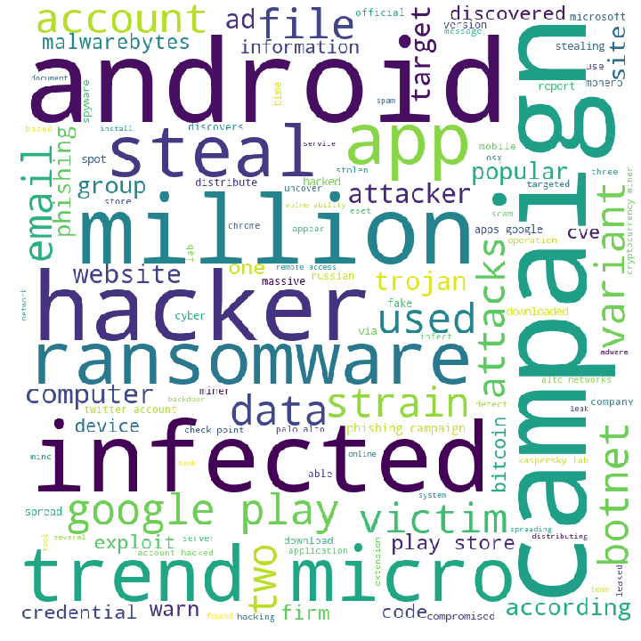
World Cloud of attack descriptions

Slide 9
Top 5 industries affected: Individuals Healthcare Fintech Finances Multiple

Slide 10
Glassdoor
identified companies/organizations from hackmageddon dataset
scraped www.glassdoor.com to collect information on:
Company name
Category
Revenue
Employees

Slide 11
Attacks by employees and revenue

Slide 12
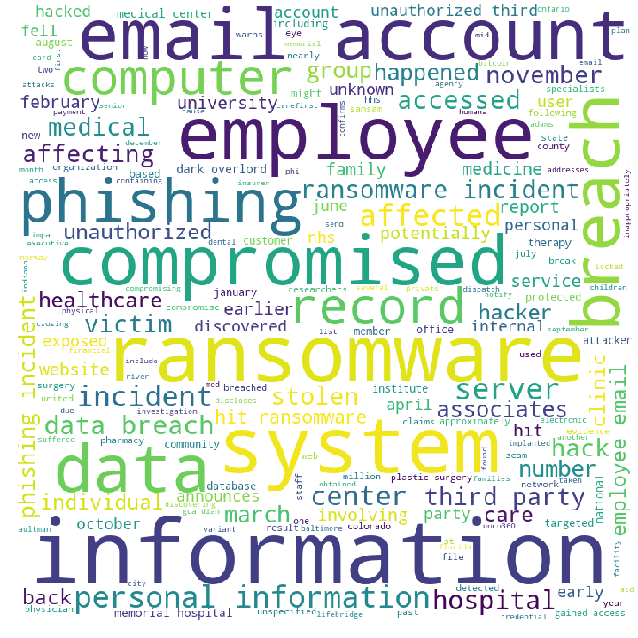
World Cloud of attack descriptions

Slide 13
Conclusions
Every individual using the internet is a potential target
App downloads, email accounts
Hospitals are ‘preferred’ target due to the sensitive information to be gained
Phishing emails to employees
Tip: scale up cyber security training for employees
Ransomware is becoming more popular
Tip: scale up cyber security investment!

