Slide 1
Who is next? Analysis of cyber attacks reported between 2017-2018
Melanie Uhde

Slide 2
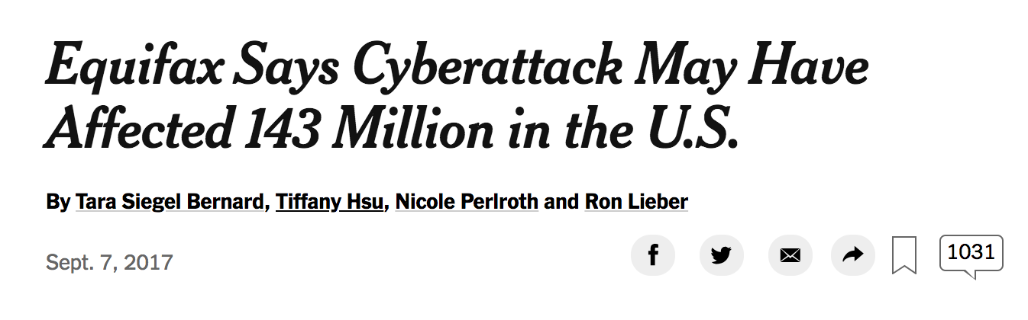
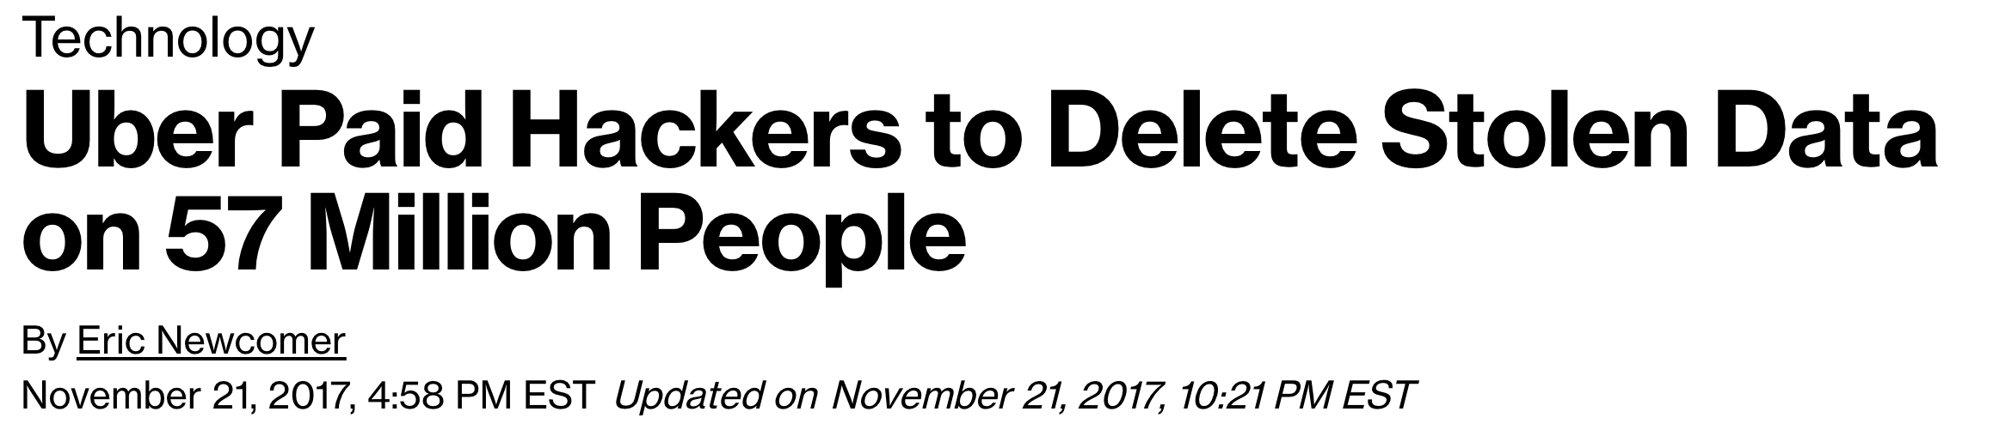

Slide 3
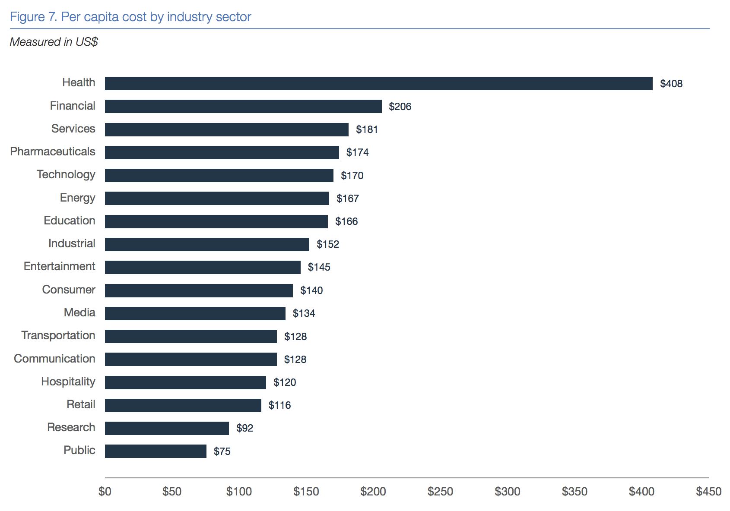
Data breach costs are highest for healthcare industry
The 2018 Cost of a Data Breach Study by the Ponemon Institute

Slide 4
Hackmageddon
scraped www.hackmageddon.com to collect information on:
Date of attack
Target
Target_class (industry category)
Type of attack
Country
Summary
Type of attack( crime, espionage, hacktivism, warfare)

Slide 5
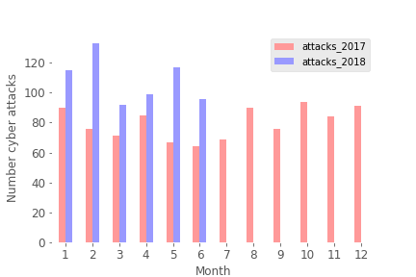
Trend of increasing cyber attacks for 2018

Slide 6
Top 5 industries affected: Individuals Healthcare Fintech Finances Multiple Industries

Slide 7
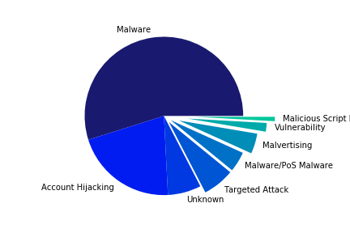
Target: Individuals

Slide 8
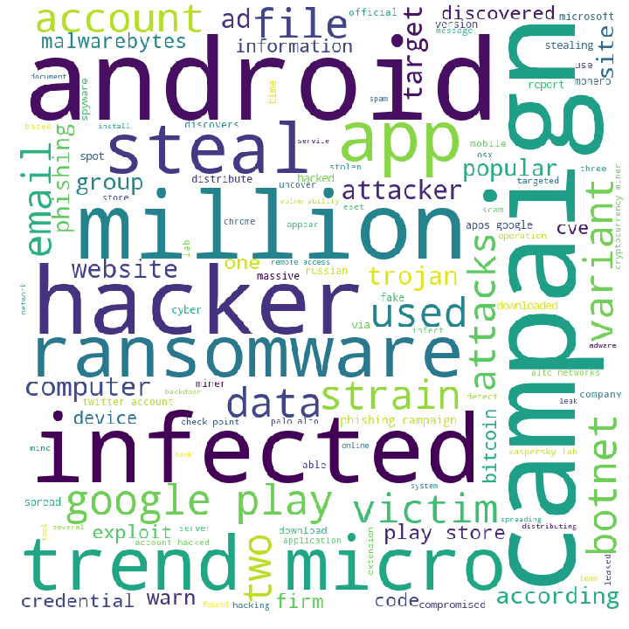
World Cloud of attack descriptions

Slide 9
Top 5 industries affected: Individuals Healthcare Fintech Finances Multiple Industries

Slide 10
Glassdoor
identified companies cyber attacked
scraped www.glassdoor.com to collect information on:
Company name
Category
Revenue
Employees

Slide 11
Attacks by employees

Slide 12
Attacks by revenue

Slide 13
Relationship between employees and revenue
Chi-square test (employees~revenue)
Chi-square statistic | 70.1219
P-value | 4.67 e-05
Degree of freedom | 30
Small companies as well as big companies are likely to be attacked
Non-profits, hospitals
Other factors?
Security inplace?

