Slide 1
Who is next? Analysis of cyber attacks reported between 2017-2018

Slide 2
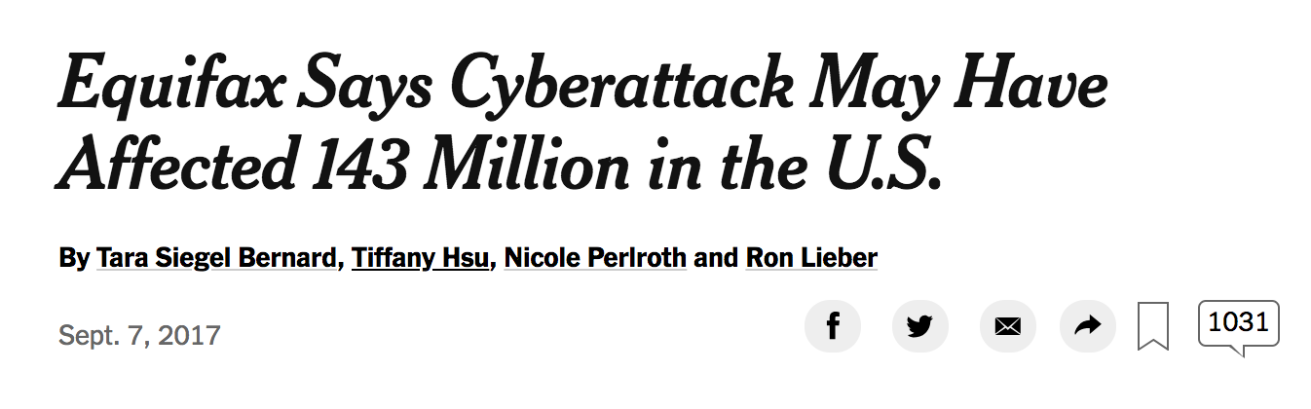
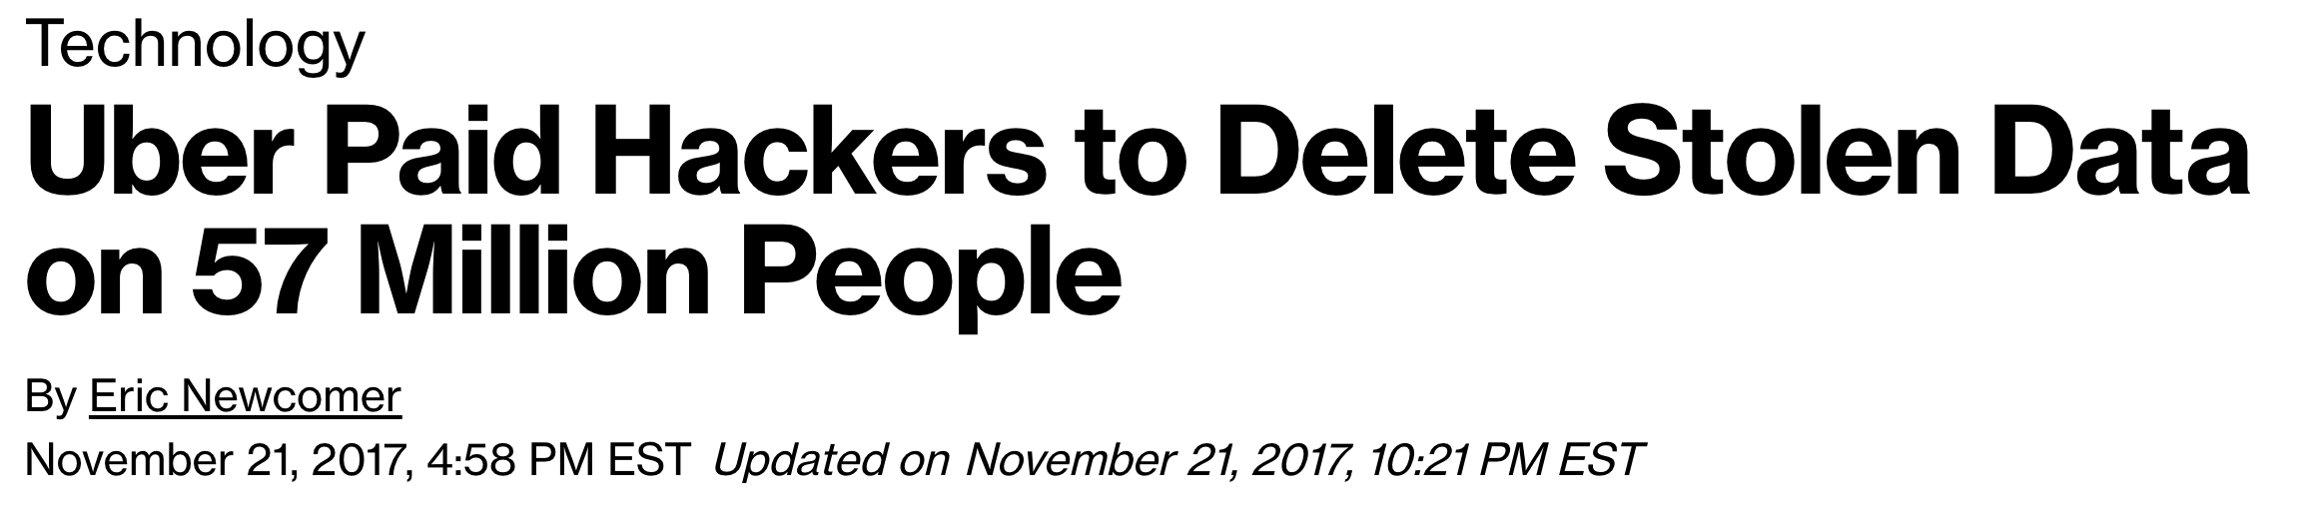

Slide 3
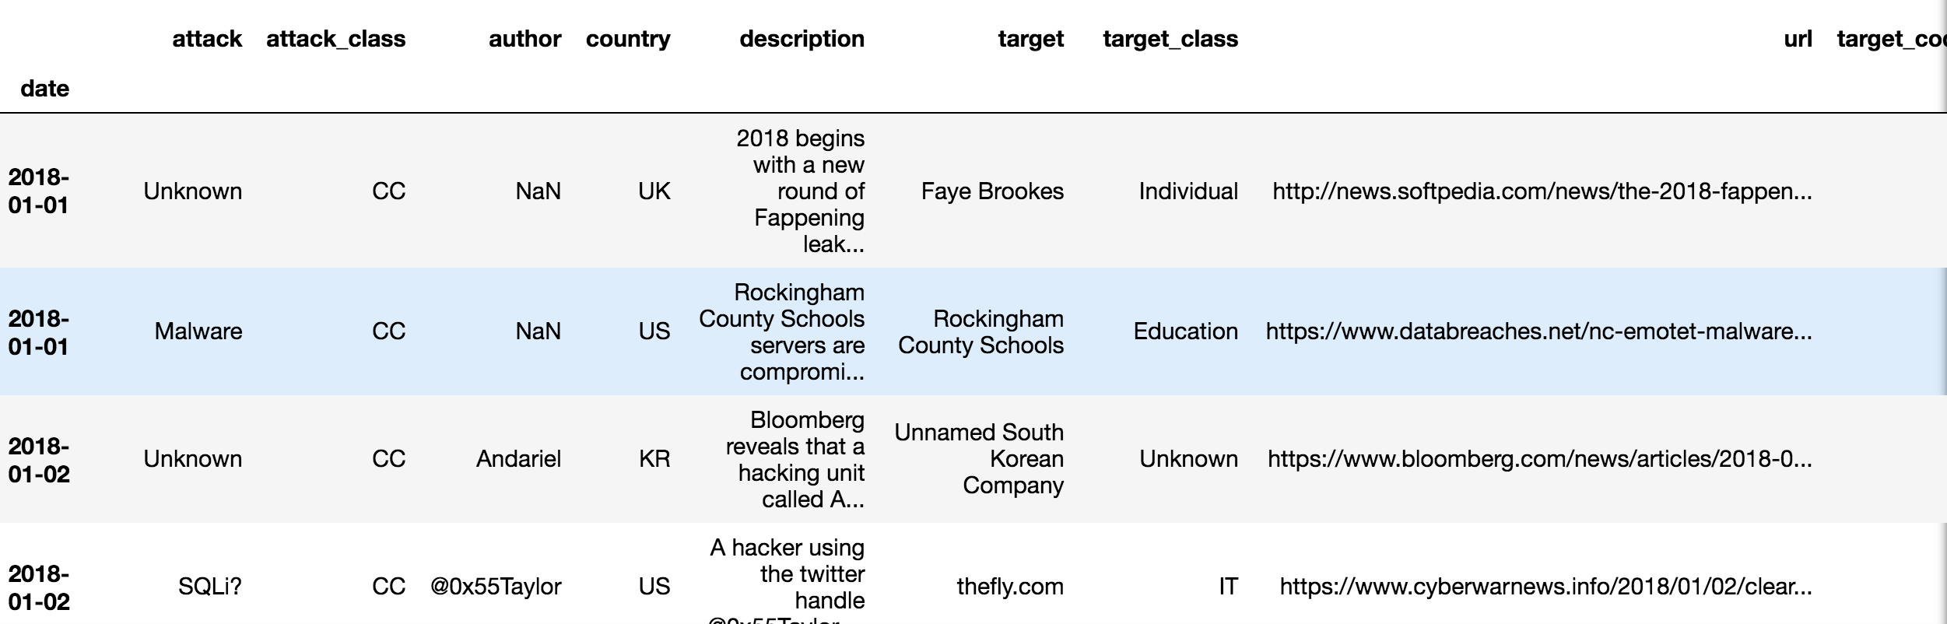
Hackmageddon
scraped www.hackmageddon.com to collect information on:
Date of attack
Target
Target_class (industry category)
Type of attack
Country
Summary
Type of attack( crime, espionage, hacktivism, warfare)

Slide 4
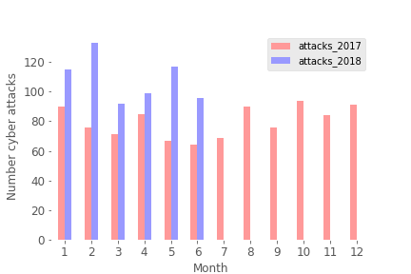
Trend of increasing cyber attacks for 2018

Slide 5
Top 5 categories affected: Individuals Healthcare Fintech Finances Multiple

Slide 6
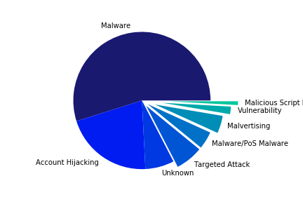
Main attack on individuals: MALWARE

Slide 7
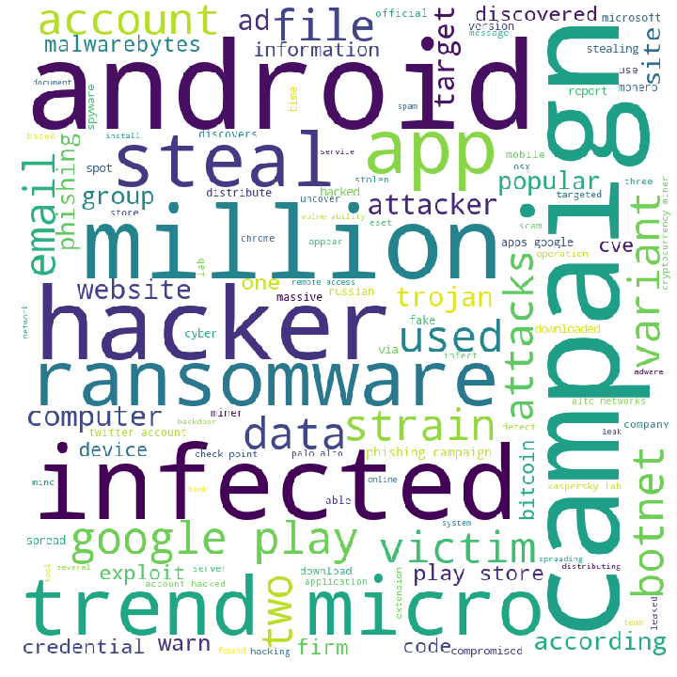
Individuals: WordCloud

Slide 8
Top 5 industries affected: Individuals Healthcare Fintech Finances Multiple

Slide 9
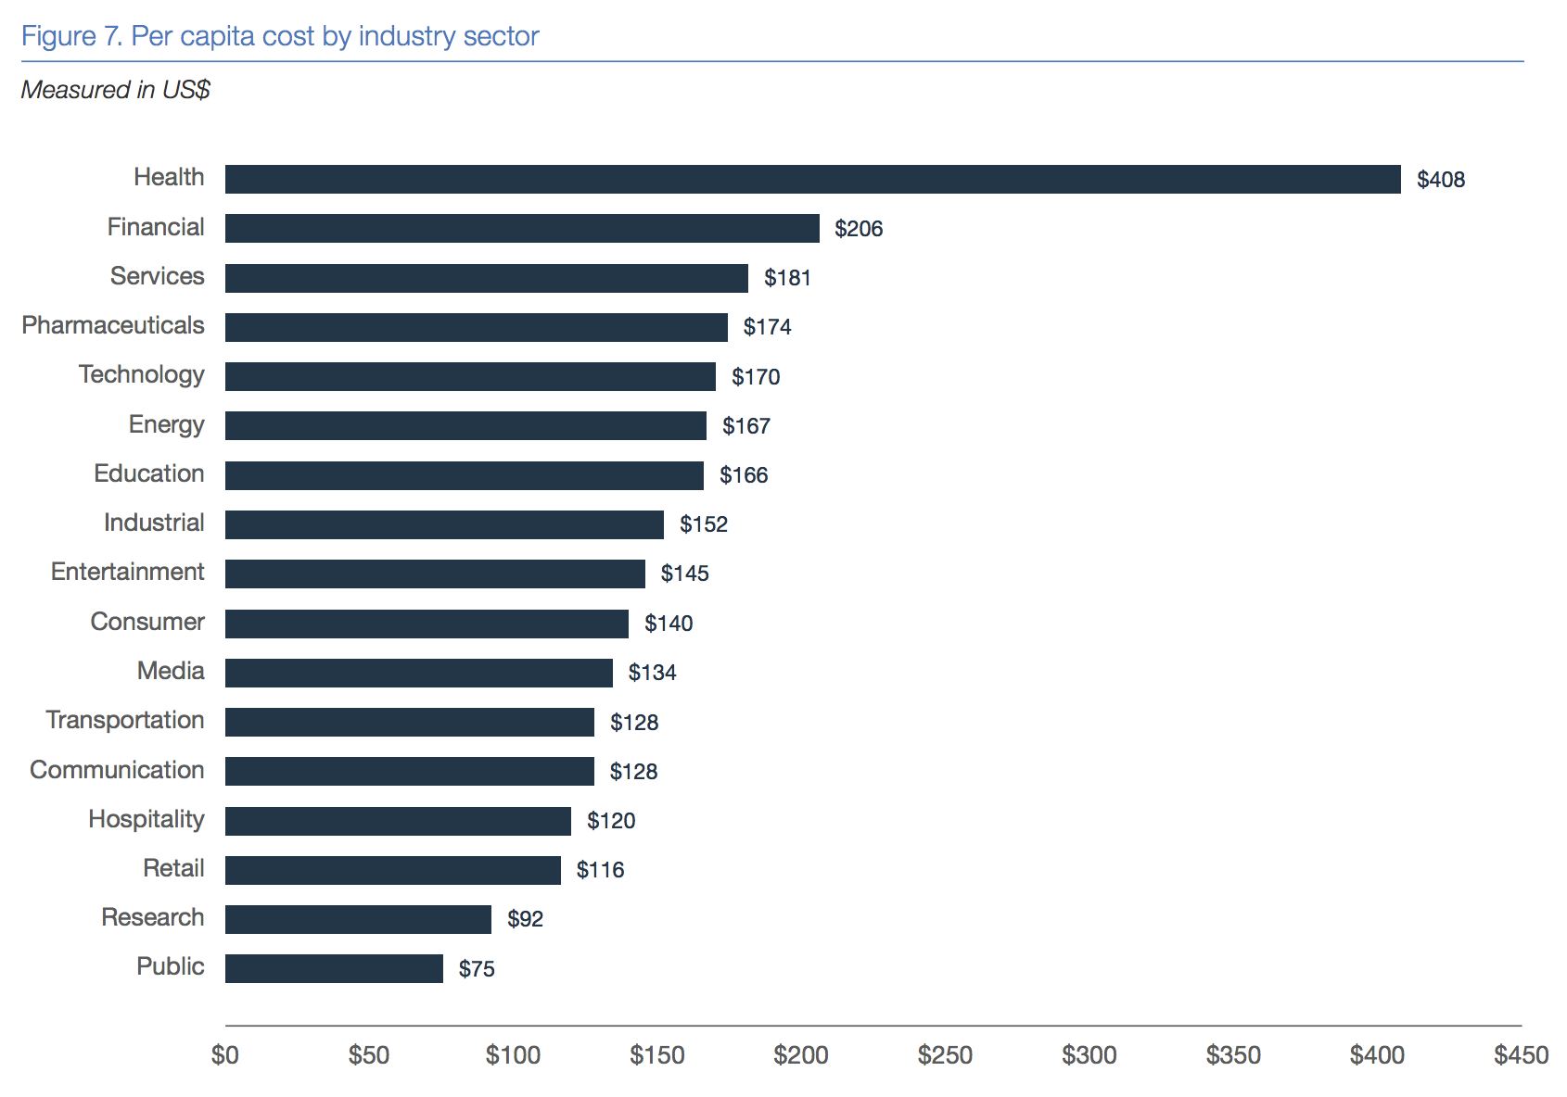
Data breach costs are highest for healthcare industry
The 2018 Cost of a Data Breach Study by the Ponemon Institute

Slide 10
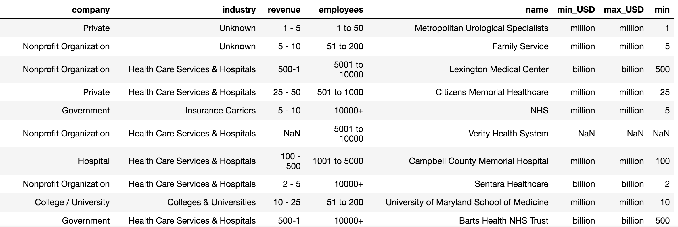
Glassdoor
identified companies/organizations from hackmageddon dataset
scraped www.glassdoor.com to collect information on:
Company name
Category
Revenue
Employees

Slide 11
Healthcare: Attacks by employees and revenues

Slide 12
Attacks by revenue

Slide 13
Attacks by employees

Slide 14
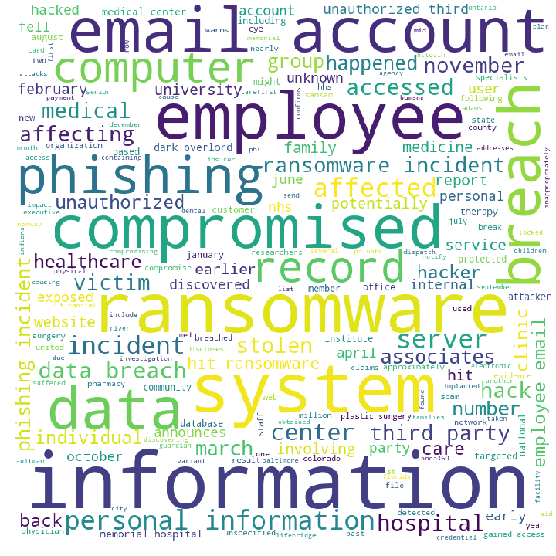
Healthcare: WordCloud

Slide 15
Conclusions
Individuals
Every individual using the internet is a potential target
App downloads, email accounts
Tip: avoid free wi-fi and useless apps
Healthcare
Hospitals, small private companies, and large non-profits are main targets
Phishing emails to employees
Tip: scale up cyber security training for employees
Ransomware is becoming more popular
Tip: scale up cyber security investment!

