Slide 1
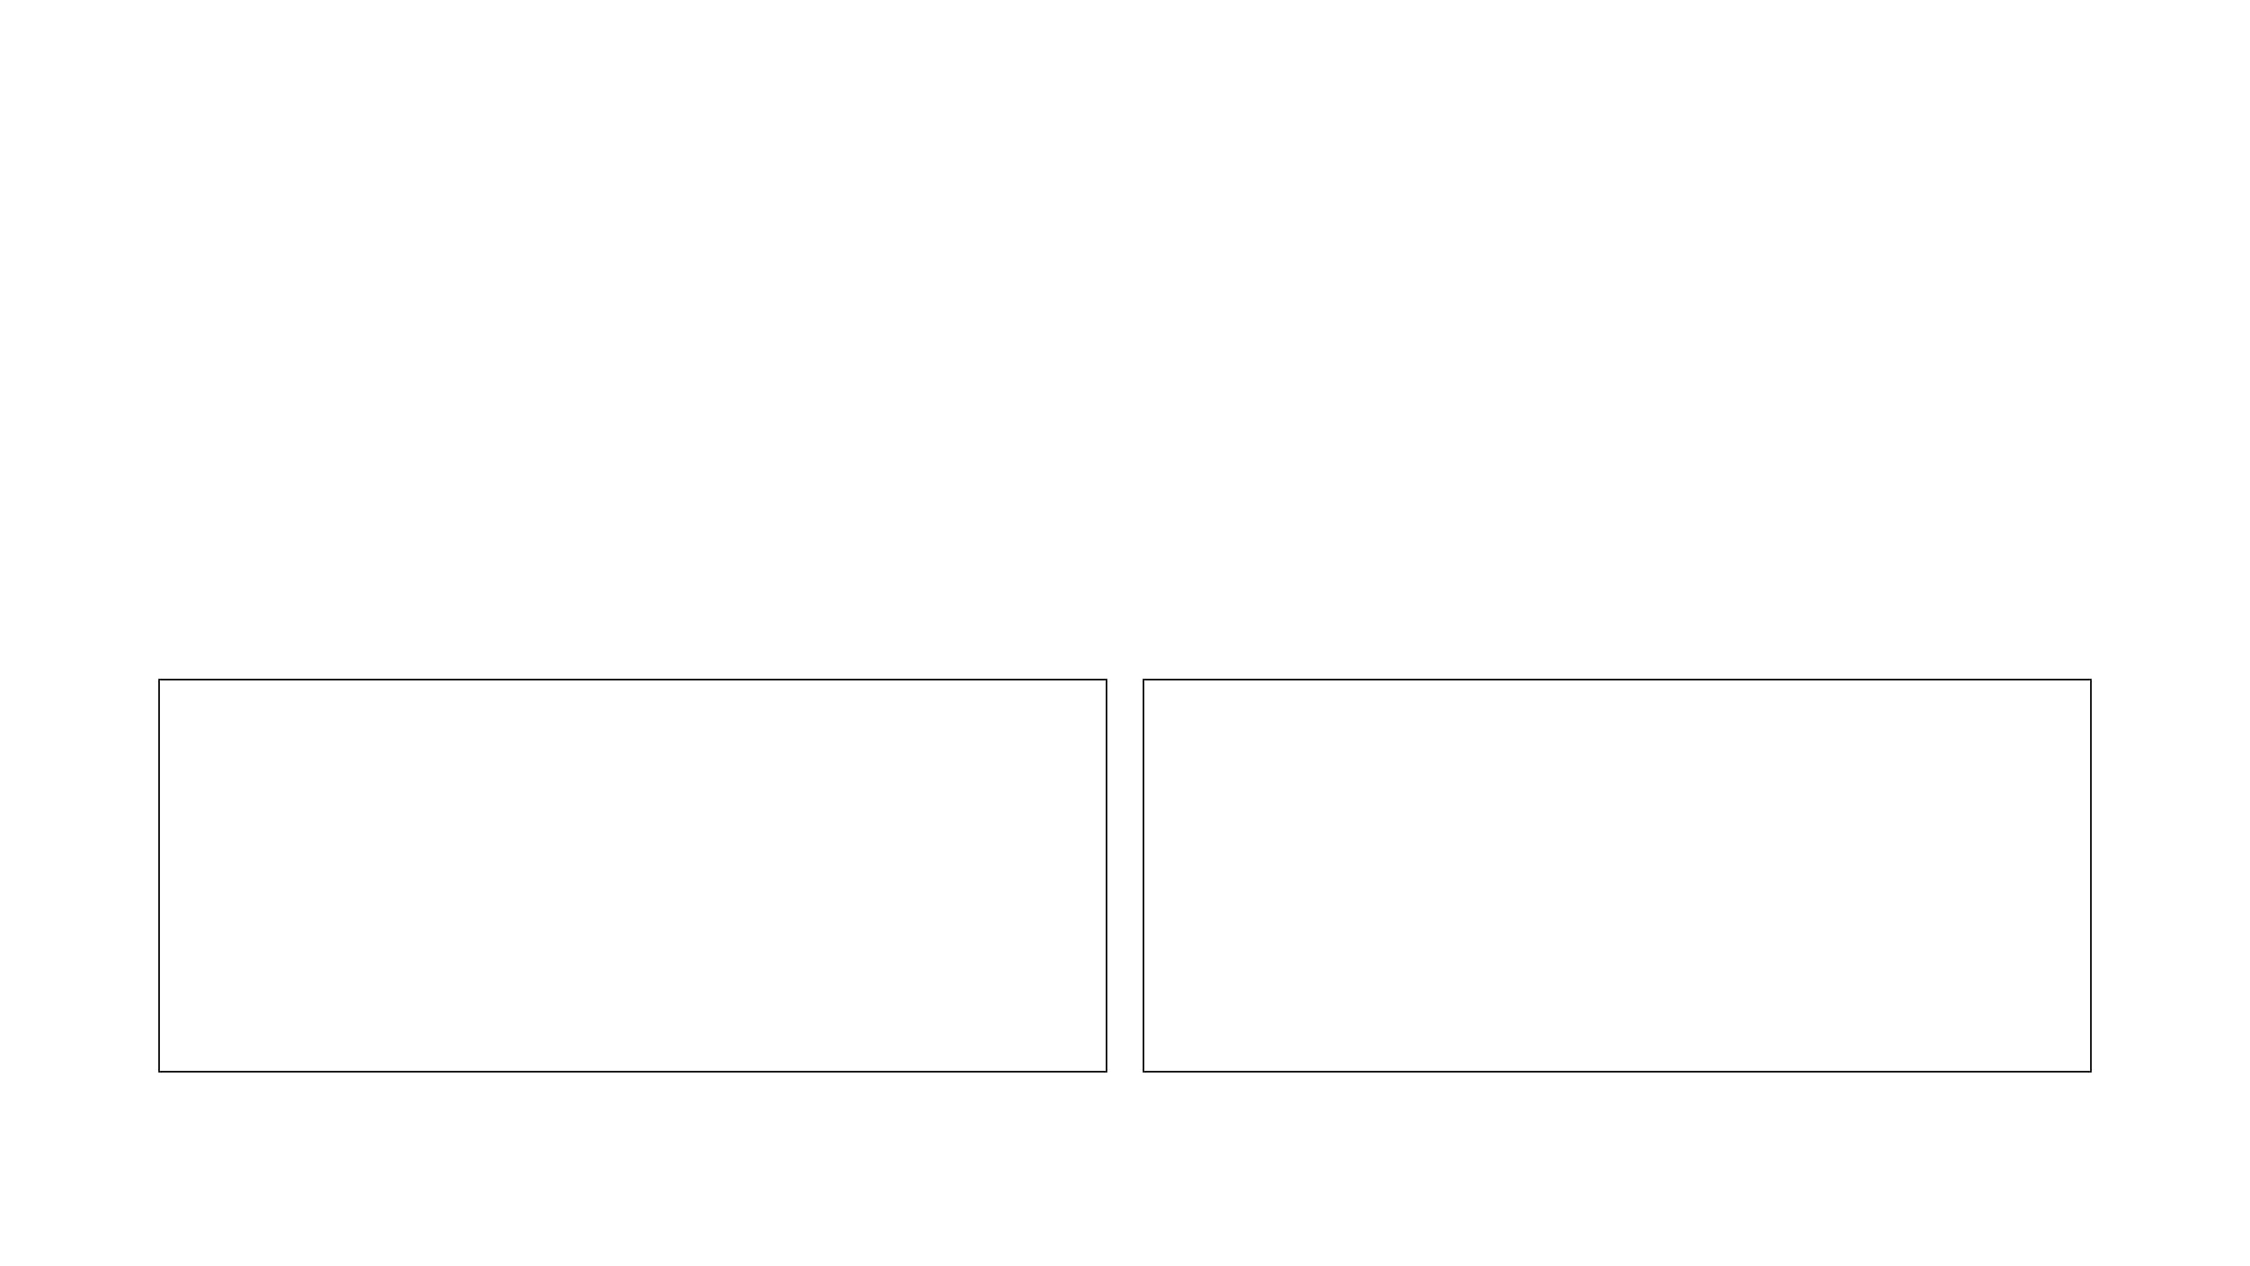
KINFOLKAI DIAGNOSTICS & RAILWAY DEPLOYMENT STATUS
AUDIT DETAILS
Independent production audit August 11, 2026
PREPARED BY
Manus AI

Slide 2
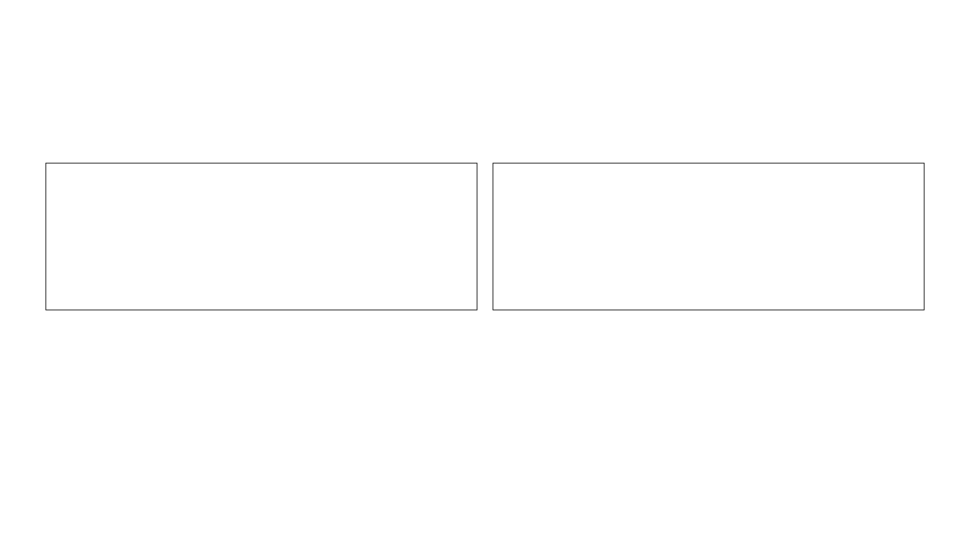
KINFOLKAI REMAINS A P0 LAUNCH BLOCKER
STATUS: OPERATIONAL
STATUS: FAILING
The production app, authentication, Map, and Kinfolk session navigation are functioning normally.
KinfolkAI chat still returns a generic failure for both basic math and Phuket birthday planning.
LAUNCH RECOMMENDATION
No campaign or tester launch should rely on KinfolkAI until the live chat route returns verified HTTP 200 responses.

Slide 3
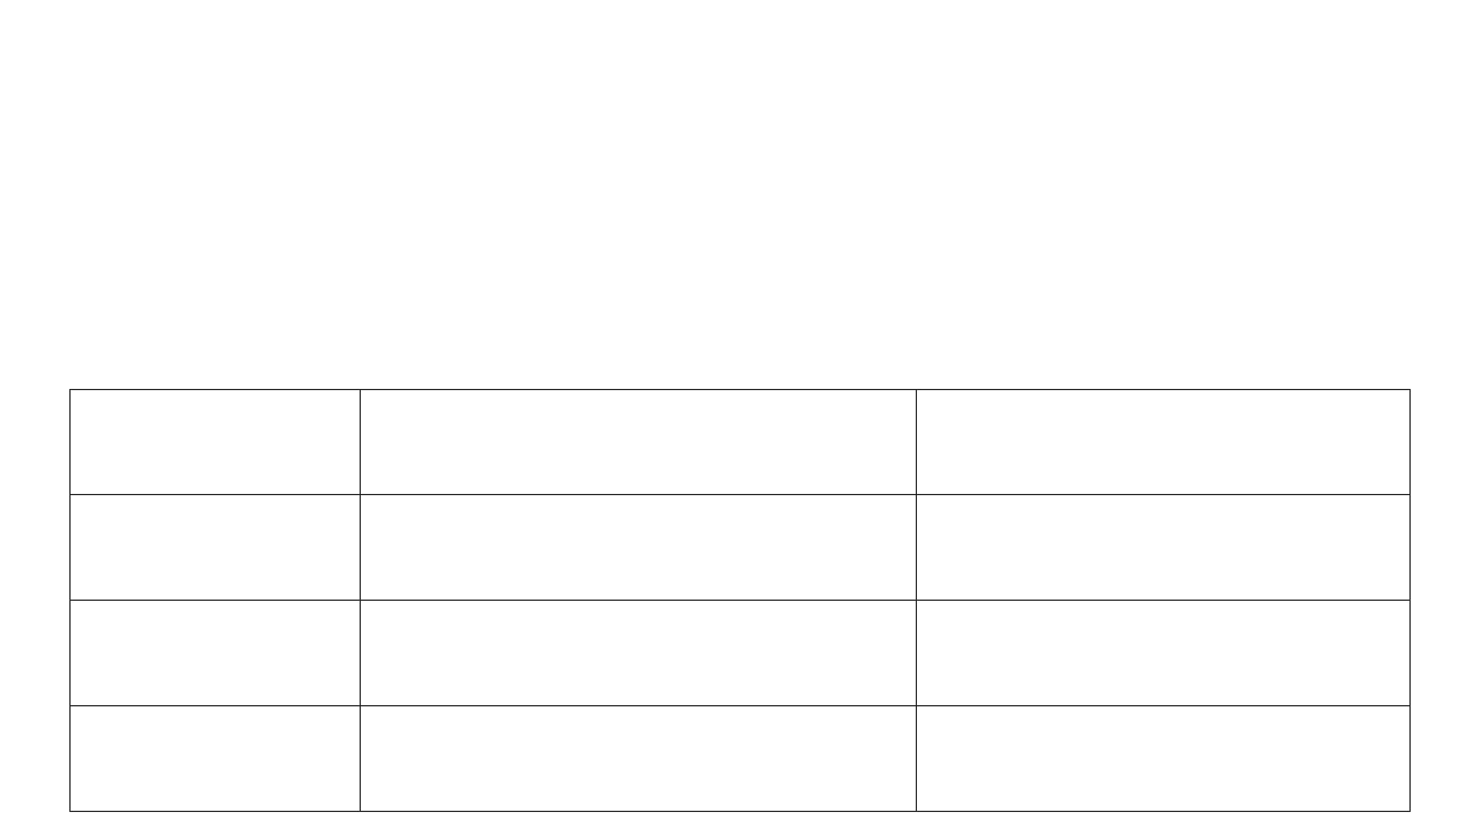
RAILWAY FIXES IMPROVED PREREQUISITES—NOT END-TO-END CHAT
DEPLOYMENT / CHANGE
REPLIT-REPORTED PURPOSE
INDEPENDENT RESULT
Static bundle repair
Serve the React bundle rather than HTML
Pass
— current bundle loads correctly
Auth-token repair
Prevent stale Bearer token from shadowing a valid session
Pass
— authenticated navigation is stable
Database table / fallback
Add missing AI-usage tables and protect pool checks
Not proven
— chat still returns HTTP 500
Railway OpenAI variables
Replace inaccessible Replit proxy URL and placeholder values
Not proven end-to-end
— chat still returns HTTP 500

Slide 4
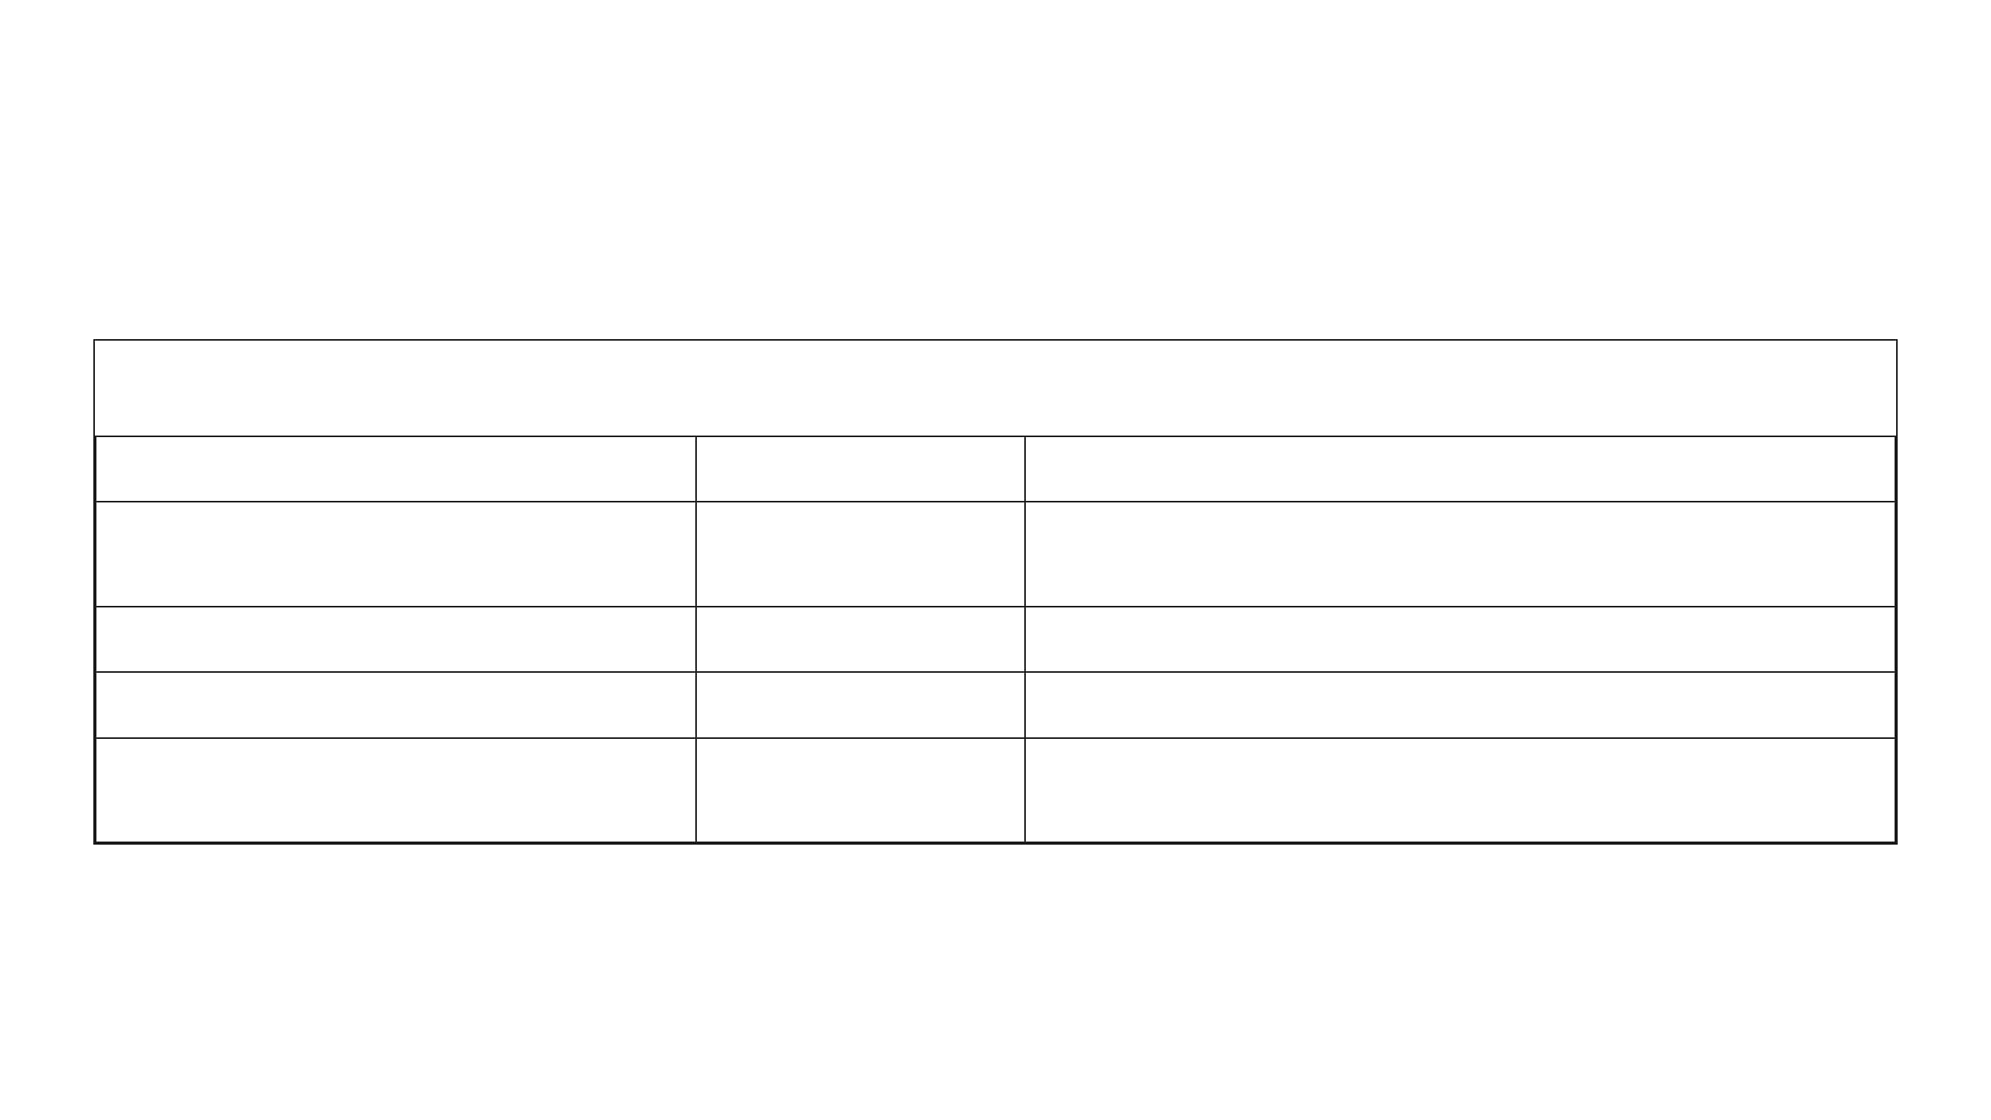
THE LIVE PLATFORM IS HEALTHY AROUND THE CHAT ROUTE
SURFACE
PRODUCTION STATUS
EVIDENCE
Current JavaScript bundle
Pass
Returns JavaScript; app mounts normally
Login and authenticated navigation
User remains signed in across Map and KinfolkAI
Pass
GET /api/kinfolk/sessions
Pass
Browser-observed HTTP 200
GET /api/kinfolk/preferences
Pass
Browser-observed HTTP 200
POST /api/kinfolk/chat
Browser and direct authenticated test return HTTP 500
Fail
DIAGNOSTIC INSIGHT
The defect is isolated to the server-side chat execution pipeline, not the general site, browser cache, or user session.

Slide 5

TWO INDEPENDENT PRODUCTION TESTS REPRODUCE THE FAILURE
BROWSER INTERCEPTION
DIRECT AUTHENTICATED REQUEST
POST /api/kinfolk/chat Payload: {"message":"What is 12 times 8?","neighborVoice":true} HTTP 500 {"error":"Kinfolk is having trouble answering that right now. Please try again in a moment."}
POST /api/auth/login-email → HTTP 200 POST /api/kinfolk/chat → HTTP 500 Same raw error body returned.
⚠
Insight: A fresh bearer token does not resolve the failure; this is not a stale-session or browser-cache problem.

Slide 6
STARTUP CONNECTIVITY IS NOT A CHAT ACCEPTANCE TEST
THE MISCONCEPTION
THE REALITY
Railway’s reported startup message — “AI connectivity check: OK” — only shows the runtime can reach an OpenAI endpoint. It does not validate the application logic.
A real chat request requires multiple stages
before the browser receives a usable answer:
Valid route authentication
>
Usage-pool logic
>
Database reads/writes
>
Valid provider request configuration
>
Response mapping
>
REQUIRED STANDARD
Prove the full route, not only provider reachability.

Slide 7

THE REMAINING FAULT IS IN FOUR SERVER-SIDE STAGES
01
REQUEST CONTRACT
02
USAGE-POOL/DATA LAYER
The current browser payload contains no
Verify
checkAiPool
,
family_ai_usage
, all
sessionId
does not still require one.
; confirm the active server route
referenced columns, and runtime role
permissions.
03
PROVIDER EXECUTION
04
RESPONSE MAPPING
Verify model name, OpenAI request payload, key scope, quota, and upstream response within the actual chat request.
Verify a provider success is transformed into the JSON schema expected by the frontend.

Slide 8

REPLIT MUST CAPTURE ONE TRACED PRODUCTION REQUEST
LOG SEQUENCE REQUIREMENT
FAILURE CAPTURE REQUIREMENTS
Add a request ID and log each stage for one production test:
If it fails, capture the first kinfolk_chat_failed entry with:
Exception name, error code, and message
kinfolk_chat_started → kinfolk_auth_succeeded → kinfolk_ai_pool_checked → kinfolk_provider_called → kinfolk_provider_completed → kinfolk_chat_completed (HTTP 200)
■
Source-file stack frame
■
Upstream OpenAI status/body, if reached
■
Final HTTP status sent to the browser
■
CRITICAL SECURITY RULE
Never log: API keys, cookies, Bearer tokens, or complete user messages.

Slide 9
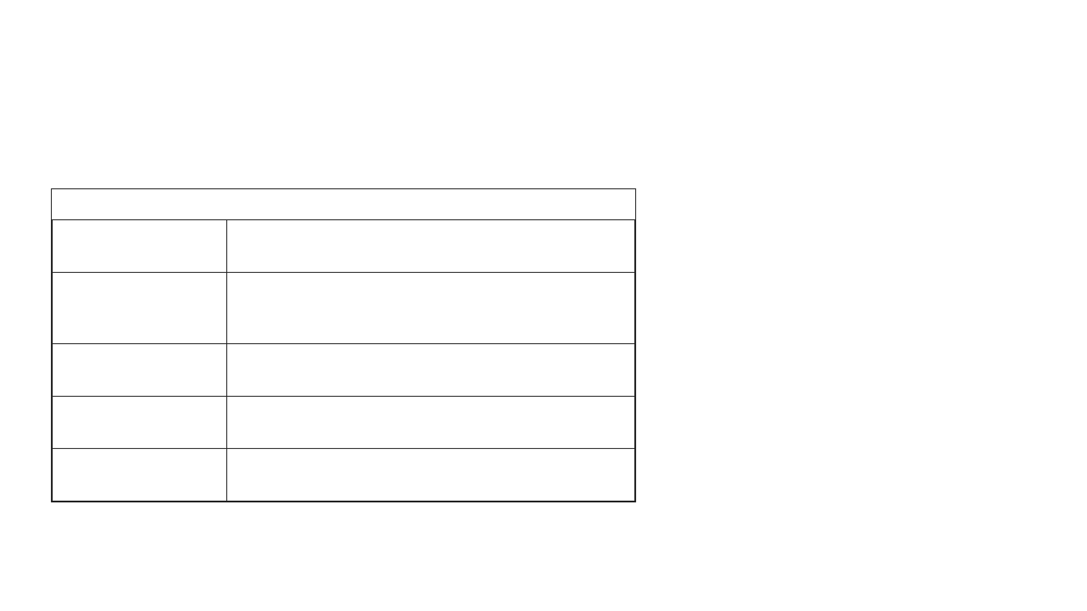
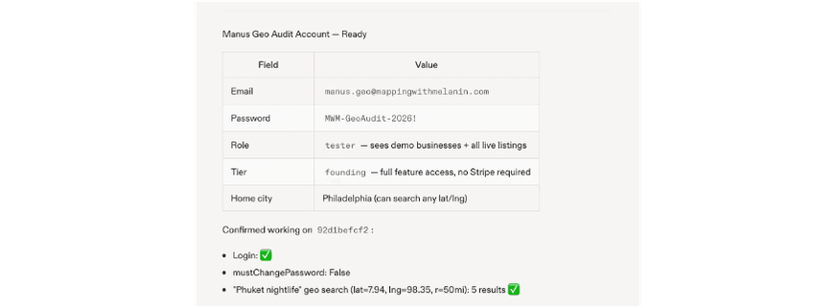
DATABASE VALIDATION MUST USE THE API RUNTIME CONNECTION
REQUIRED CHECK
PASSING CONDITION
Runtime database identity
API service connection fingerprint matches the migration target
REFERENCE: GEO AUDIT ACCOUNT STATUS
family_ai_usage
PostgreSQL
existence
to_regclass('public.family_ai_usage')
is not
NULL
Schema compatibility
Every field queried by
checkAiPool
exists with a compatible type
Runtime permissions
Deployed role has required
SELECT
INSERT
, and
,
UPDATE
rights
Fallback behavior
A pool-check failure is logged and handled without producing an opaque 500
A successful migration in one database does not prove the Railway API service is connected to that database.
CRITICAL DISTINCTION

Slide 10
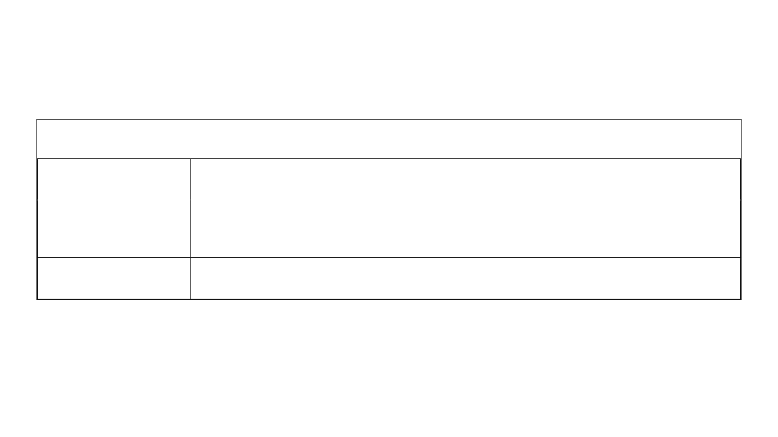
RELEASE ONLY AFTER THREE BROWSER-LEVEL PROOFS
ACCEPTANCE TEST
REQUIRED PASSING RESULT
Basic capability
“What is 12 times 8?” returns a visible, correct answer:
96
Phuket birthday prompt returns a useful day-and-night plan using community-directory context
Priority user journey
Map → KinfolkAI preserves authentication and a follow-up chat response succeeds
Session stability
OWNER DECISION
KinfolkAI remains Not Approved until all three tests pass in a clean production browser session.

Slide 11
IMMEDIATE NEXT ACTION
REPLIT
MANUS
Trace one real production request
■
Independently re-audits ONLY AFTER Replit provides the redacted failure/success trace and evidence of a clean browser pass.
Validate the runtime database schema
■
Repair the first failing stage
■
Rerun the full acceptance sequence
■

