Slide 1
FRC Software and Tools

Slide 2



Software Systems used in FRC
Field Management System
FRC Driver Station
RoboRIO Imaging tool
RoboRIO Operating System
WPILib – FRC software library
Robot simulation
Third party libraries
CTRE, REV etc.
Encoder, motor, joystick library etc.
OpenCV

Slide 3


Software Development Tools
Version control software
Git
Git client (sourcetree)
Git hosting (GitHub)
Integrated Development Environment (VSCode with WPI extension)
Editor
Compiler
Debugger
Gradle – build system (software to build software!)

Slide 4
What is a software library
Collection of pre-written software used in software development
Can be easily pulled into your own project
Well tested and documented
Mostly can be treated as a black box
Promotes re-use of code (don’t reinvent the wheel)
Examples:
C++ standard template library (STL)
C Math library
Networking libraries
WPILib

Slide 5
WPI Lib
Open source software library for the FRC
Has resources for interfacing with FRC robot hardware
Documentation
https://github.wpilib.org/allwpilib/docs/release/cpp/index.html
https://docs.wpilib.org/en/stable/docs/software/vision-processing/index.html
https://docs.wpilib.org/en/stable/docs/software/kinematics-and-odometry/swerve-drive-kinematics.html

Slide 6
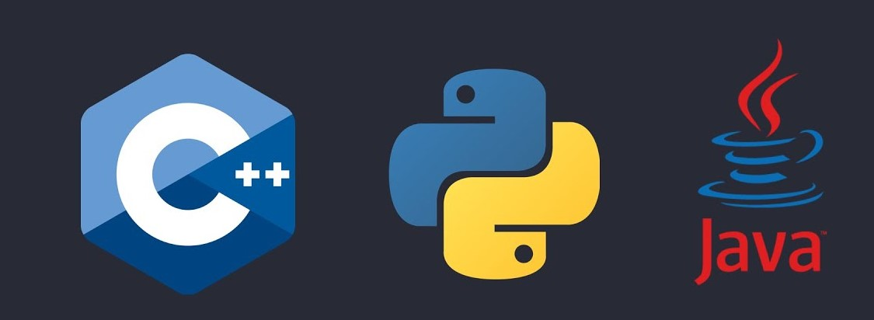
WPILib Supported Software Languages
C++
Both High and Low level
Strongly typed
Compiled language
No memory management
Java
High level
Strongly typed
Compiled
Has memory management
Python
High level
Weakly typed
Interpreted language

Slide 7
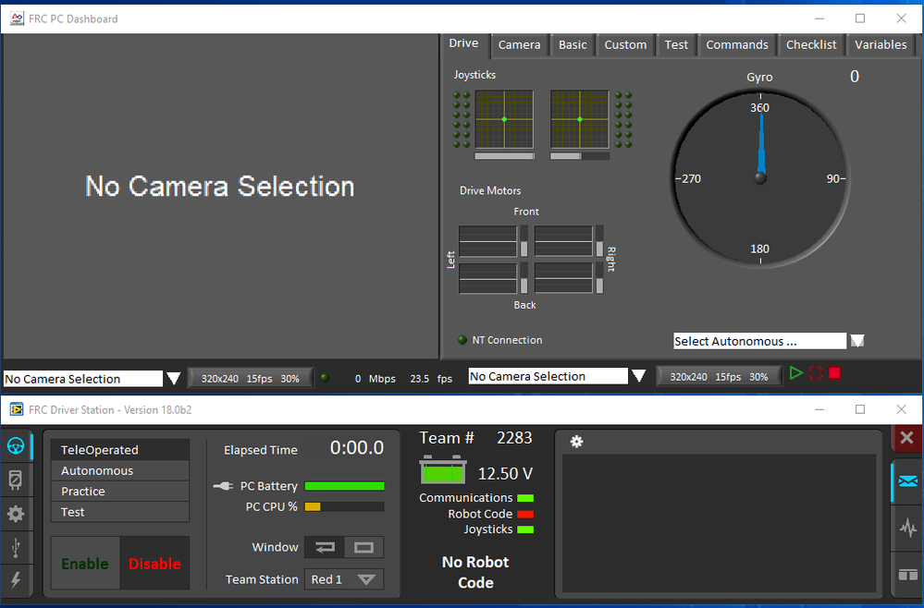
Install the Driver Station
https://docs.wpilib.org/en/stable/docs/zero-to-robot/step-2/frc-game-tools.html#installing-the-frc-game-tools
https://www.ni.com/en/support/downloads/drivers/download.frc-game-tools.html#500107

Slide 8
Exercise: Build and deploy code on Robot
Set up build environment
Clone 2024 Crescendo repo
https://docs.wpilib.org/en/stable/docs/software/vscode-overview/index.html

