Slide 1
Software Version Control
using Git

Slide 2
Purpose of Version Control
Helps teams manages software changes over time
Aids development by multiple users
Automatic backup of code
History of all code changes helps identify bugs
Software documentation
Auditing development history

Slide 3


Version control tools
Git
90% market share
Decentralised model
Fast
Allows large code bases and collaboration
Merges are easy
Subversion
Popular tool used used before git
Becomes slow as repository becomes larger
Merges were difficult

Slide 4
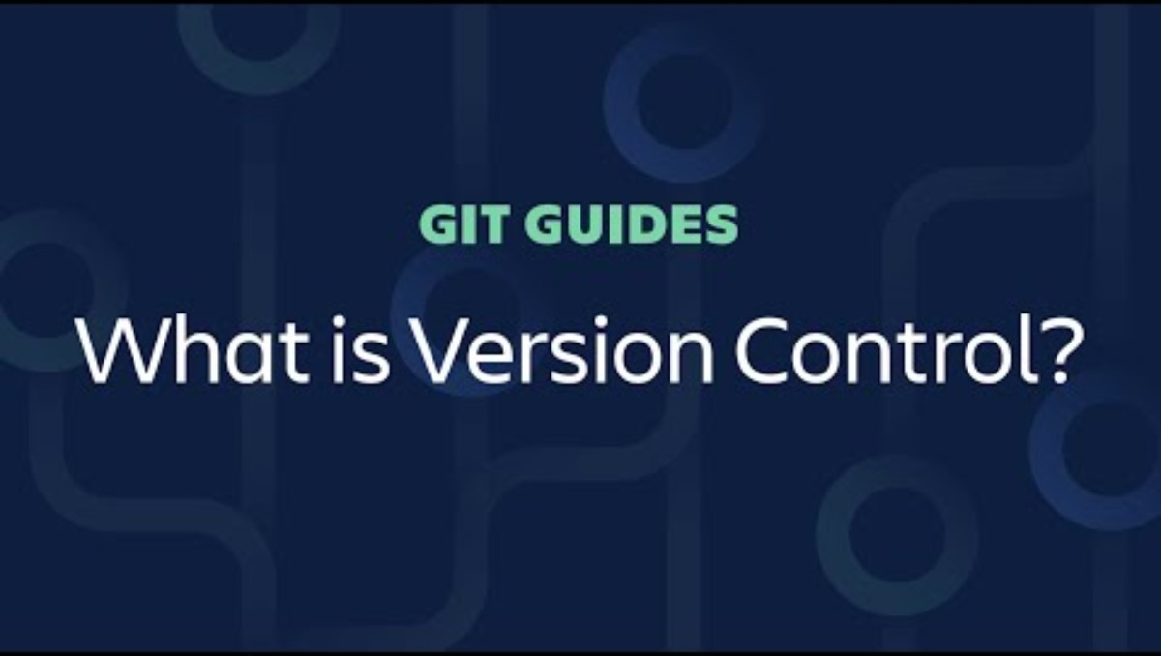
https://youtu.be/xQujH0ElTUg
https://www.atlassian.com/git

Slide 5



Exercise: Installing and setting up Git
Git local
Git bash
Command line tool
Git client
viewing and interacting with local git repository
Sourcetree
Github desktop
Git hosting service (remote)
GitHub
Bitbucket

Slide 6
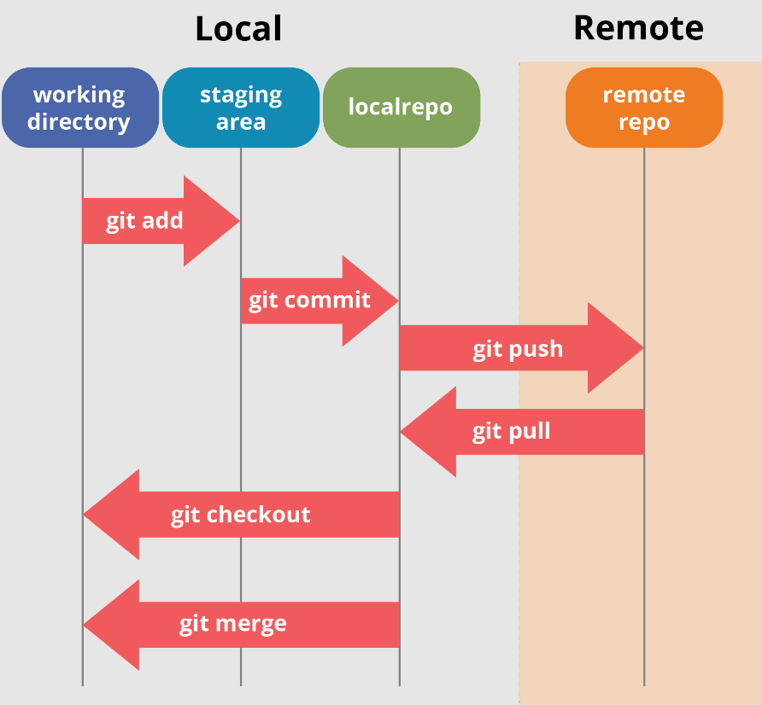
How Git works
Git keeps track of changes on
your local repo (on your computer), and
the remote repo (e.g. github)
Your local repo is a complete copy of the remote repo
Both these changes need to ‘synced’ periodically

Slide 7
Exercise: Cloning a repository
Go to: https://github.com/MelbourneRoboCats5648
Click on the Crescendo_2024 repository
Click the green ‘<> code’ icon
Copy the HTTPS link
Open sourcetree, create a new tab then click ‘clone’
Paste the link and choose a local folder to store the repository
Click clone
Use a file explorer to check if you have a local copy of the repo

Slide 8
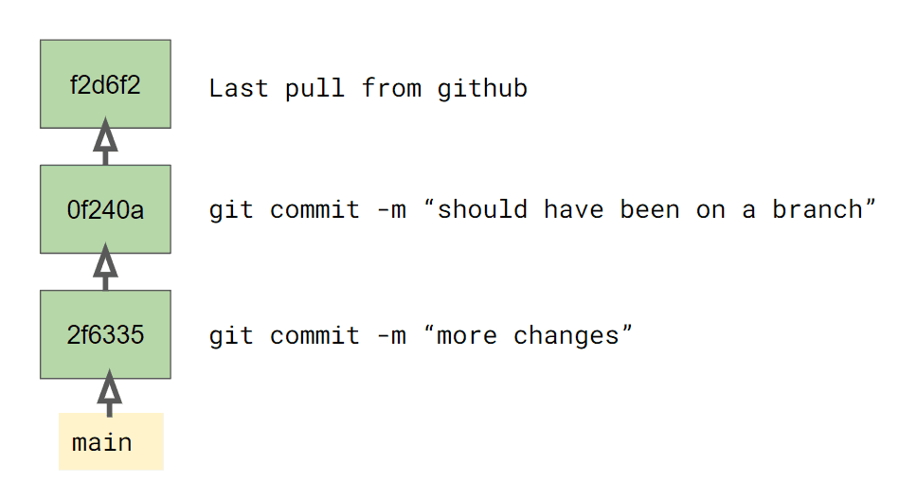
Git commit
One or more parent commits (except for the very first commit)
A commit message
Committer and commit date
Files
Pathname relative to repository root
Content
Commit hash
What are the commit details of the first commit on the Crescendo_2024 repo?

Slide 9
Git references
Git commits are difficult to remember
Instead use references:
Branches are moving references
Tags are immutable references
HEAD – reference that always points to current commit
Look at the sourcetree commit history. Can you find references?

Slide 10
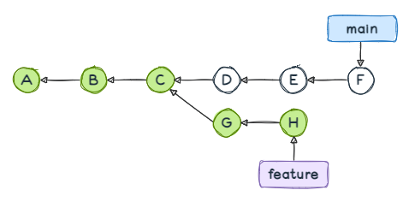
Git branching
Main is like the root of tree
‘Features’ are on branches
Branches are a copy of the repo at the point of branching
Every branch has an unbroken history all the way back to the very first commit

Slide 11
Exercise: git log
Open git-bash command line
Navigate to the repository
‘cd /c/Data/repos/Crescendo_2024’
Enter the command ‘git log’
What is the output?
Enter the commend ‘git log --oneline --graph --decorate –all’
What is the output?
Compare this to what you see on sourcetree

Slide 12
Exercise: Git branches
Open git-bash command line
Navigate to the repository
‘cd /c/Data/repos/Crescendo_2024’
Enter the command ‘git branch’
What is the output? Which branch are you on?
Enter the command ‘git branch –r’
What is the output? Why is this different to the previous command?
Use sourcetree to switch to the ‘origin/Auto-Testing’ branch
One the command line enter the command ‘git branch’
How many branches are shown? Which branch are you on?

Slide 13
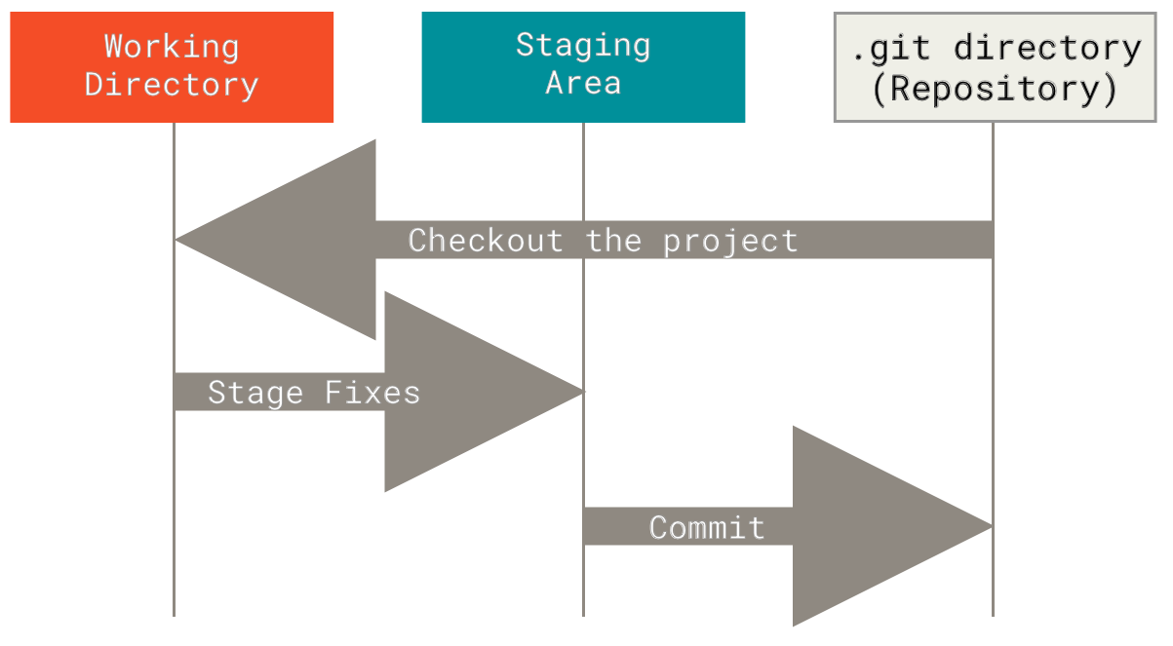
Your local Git repo has 3 states
Working – all your local changes
Staged – pre-commit changes
Committed – history written to repo

Slide 14
Exercise: Git status
Open git-bash command line
Navigate to the repository
‘cd /c/Data/repos/Crescendo_2024’
Enter the command ‘git status’
What is the output?
Use a Notepad++ to open the file ‘Robot.cpp’ and write your name as a comment on the first line. Save the file.
Enter the command ‘git status’ again
What is the output?

Slide 15
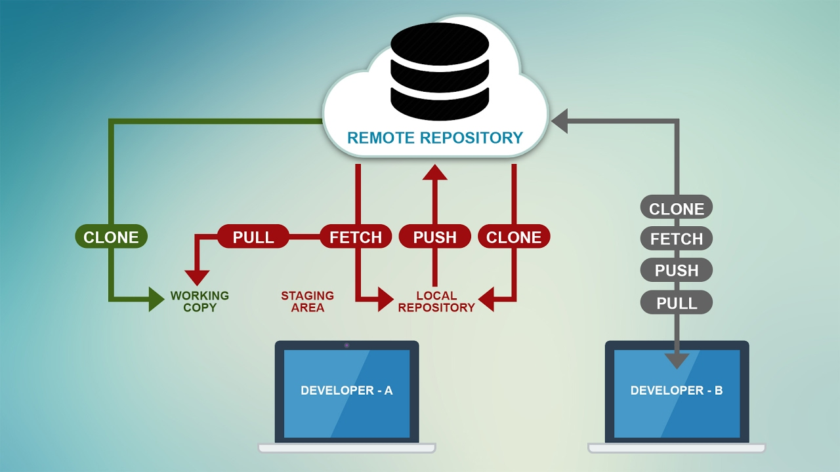
Interacting with the ‘Remote repository’

Slide 16
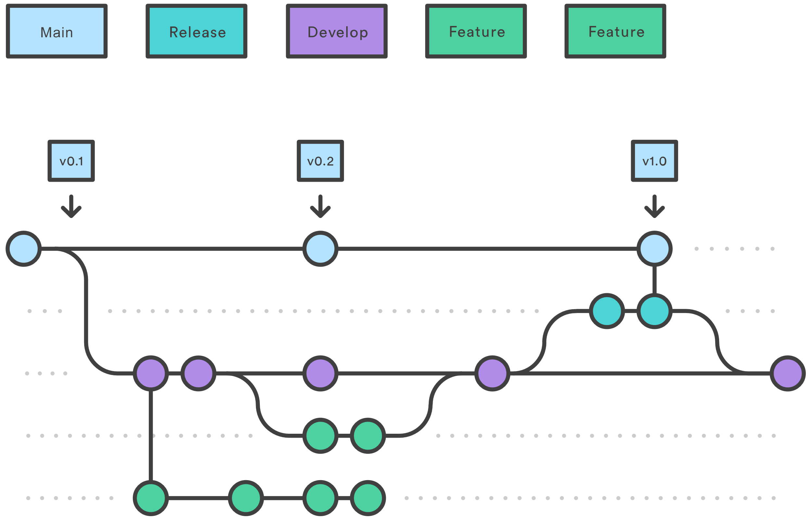
Git workflow
No direct commits to main or develop
ALL development happens on feature branches
Every feature is implemented on its own branch
Every branch has a GitHub issue (aka ticket, jira)
The GitHub issue describes the feature to be implemented

Slide 17

Git merge workflow
All merges to main require a Pull Request (PR) approval
PR can only be approved after a code review by an independent developer
Code review comments must be addressed
All merge conflicts must be resolved
Branch should be deleted after merge

Slide 18
Exercise: Practice git workflow
Clone the ‘Sandpit’ repository on sourcetree
Create an issue on the repository. Use your name for the issue title
Create a branch from the issue
Go to sourcetree and see if you can see your branch?
Click ‘Fetch’ on sourcetree
Can you see the new branch you just created?
Switch to the branch you just created

Slide 19
Exercise: Practice git workflow
Add a line to the ‘README.md’ file
Commit this change
Create a new text file with your name as the filename
Commit this change
On GitHub create a pull request
Add a reviewer to the pull request
Review each others pull request – add comments to the text file
Merge the pull request
Can you merge the change?
Do you have conflicts?

