Slide 1
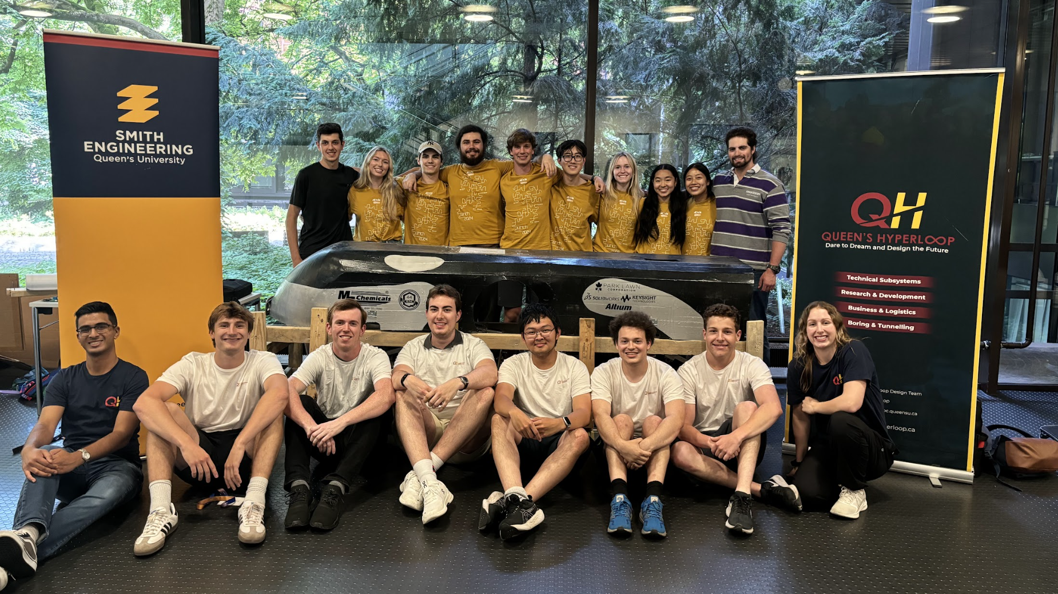


Slide 2

Transpod Challenge
Magnetic Levitation Control
Melissa Choloniuk and David Drobner
May 31st, 2025

Slide 3






Introduction
Team Members
Presenters
Melissa Choloniuk
Engineering Physics ‘26
David Drobner
Mathphys ‘25
Project Advisor
Contributors
Dr. Moein Mehrtash
Associate Professor
School of Engineering Technology, McMaster University
Noah Segal
Computer Science ‘28
Benjamin Cox
Mechatronics Engineering ‘27
2

Slide 4
Section 1
The Problem

Slide 5
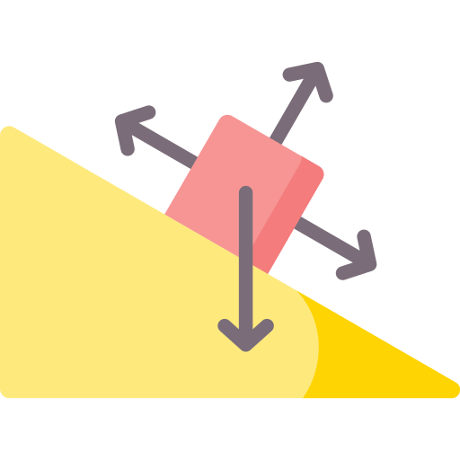
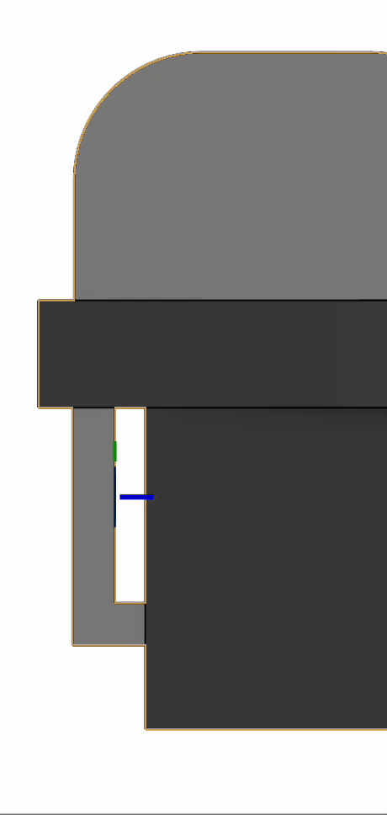



Introduction
Motivations
Monitor and control the 4 vertical forces of attraction
Air gap oscillating between 5 to 10 mm.
Account for the instability of magnetic attraction, vibrations and deformation from the guideway.
Monitor the air gap by means of a control system to adjust the force and system accordingly
Approximately 5-10mm air gap
3
Notes:
Explored 3 approaches to produce a hardware and mechanical design in addition to an algorithm solution.
MVP consists of a machine vision camera that allows for object detection and identification.
Solution will allow for increased passenger and pod safety once implemented

Slide 6
Introduction
Motivations
Air gap oscillating between 5 to 10 mm.
Control the 4 vertical forces
The Objective:
Create a magnetic levitation system to control the air gap distance by means of the forces generated by the electromagnets.
Account for the instability of magnetic attraction, vibrations and deformation from the guideway.
Monitor the air gap by means of a control system to adjust the force and system accordingly
Approximately 5-10mm air gap
3
Notes:
Explored 3 approaches to produce a hardware and mechanical design in addition to an algorithm solution.
MVP consists of a machine vision camera that allows for object detection and identification.
Solution will allow for increased passenger and pod safety once implemented

Slide 7
Section 2
Solution Breakdown

Slide 8
Solution Breakdown
1
2
3
Mechanical System
Control System
Simulation
3

Slide 9
Section 3
Mechanical System

Slide 10
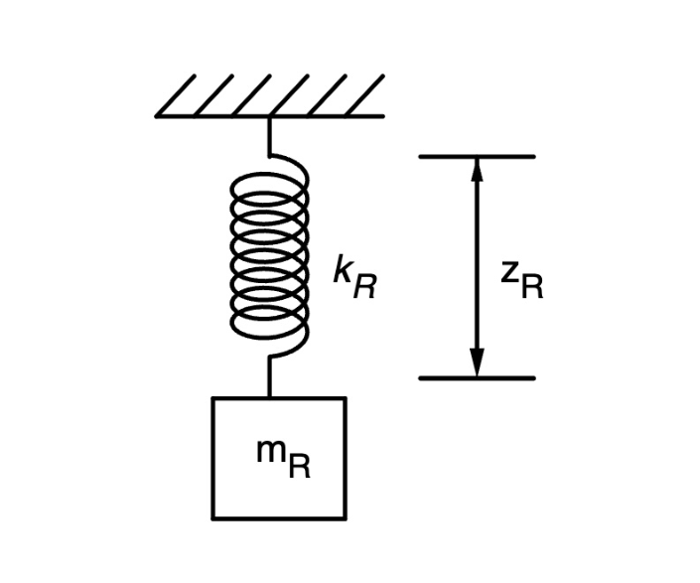
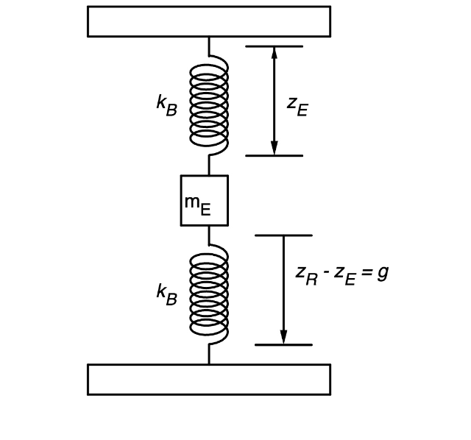

Mass Spring Models
Mechanical System
Geographical
Mass-Spring system of the rail vibration.
Mass-Spring system of the electromagnet vibration.
5
Notes:
3 subsystems
Sensor Infrastructure, Embedded System, & UI
Pic per subsystem

Slide 11
Mass Spring Models
Mechanical System
Geographical
K_{R}
Spring Constant of the rail [N/m]
z_{R}
Distance between the rail and electromagnet [m]
m_{R}
Mass of the electromagnet [kg]
Figure 1: Mass-Spring system of the rail vibration.
Figure 2: Mass-Spring system of the electromagnet vibration.
5
Notes:
3 subsystems
Sensor Infrastructure, Embedded System, & UI
Pic per subsystem

Slide 12
Mass Spring Models
Mechanical System
Geographical
K_{R}
Spring Constant of the rail [N/m]
z_{R}
Distance between the rail and electromagnet [m]
m_{R}
Mass of the electromagnet [kg]
Figure 1: Mass-Spring system of the rail vibration.
Figure 2: Mass-Spring system of the electromagnet vibration.
5
Notes:
3 subsystems
Sensor Infrastructure, Embedded System, & UI
Pic per subsystem

Slide 13
Mass Spring Models
Mechanical System
Geographical
K_{R}
Spring Constant of the rail [N/m]
z_{R}
Distance between the rail and electromagnet [m]
m_{R}
Mass of the electromagnet [kg]
Figure 1: Mass-Spring system of the rail vibration.
Figure 2: Mass-Spring system of the electromagnet vibration.
5
Notes:
3 subsystems
Sensor Infrastructure, Embedded System, & UI
Pic per subsystem

Slide 14
Mass Spring Models
Mechanical System
K_{B}
Spring Constant of the suspension beam [N/m]
Geographical
z_{R}
Distance between the rail and electromagnet [m]
Z_{E}
Distance from the ground to electromagnet [m]
m_{E}
Mass of one electromagnet [kg]
Figure 1: Mass-Spring system of the rail vibration.
Figure 2: Mass-Spring system of the electromagnet vibration.
5
Notes:
3 subsystems
Sensor Infrastructure, Embedded System, & UI
Pic per subsystem

Slide 15
Mass Spring Models
Mechanical System
K_{B}
Spring Constant of the suspension beam [N/m]
Geographical
z_{R}
Distance between the rail and electromagnet [m]
Z_{E}
Distance from the ground to electromagnet [m]
m_{E}
Mass of one electromagnet [kg]
Figure 1: Mass-Spring system of the rail vibration.
Figure 2: Mass-Spring system of the electromagnet vibration.
5
Notes:
3 subsystems
Sensor Infrastructure, Embedded System, & UI
Pic per subsystem

Slide 16
Mass Spring Models
Mechanical System
K_{B}
Spring Constant of the suspension beam [N/m]
Geographical
z_{R}
Distance between the rail and electromagnet [m]
Z_{E}
Distance from the ground to electromagnet [m]
m_{E}
Mass of one electromagnet [kg]
Figure 1: Mass-Spring system of the rail vibration.
Figure 2: Mass-Spring system of the electromagnet vibration.
5
Notes:
3 subsystems
Sensor Infrastructure, Embedded System, & UI
Pic per subsystem

Slide 17
Mass Spring Models
Mechanical System
K_{B}
Spring Constant of the suspension beam [N/m]
Geographical
z_{R}
Distance between the rail and electromagnet [m]
Z_{E}
Distance from the ground to electromagnet [m]
m_{E}
Mass of one electromagnet [kg]
Figure 1: Mass-Spring system of the rail vibration.
Figure 2: Mass-Spring system of the electromagnet vibration.
5
Notes:
3 subsystems
Sensor Infrastructure, Embedded System, & UI
Pic per subsystem

Slide 18
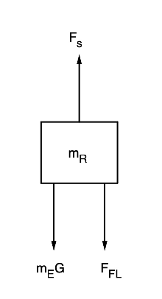
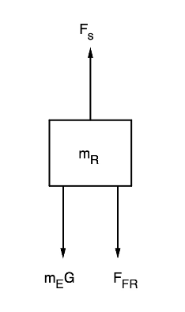
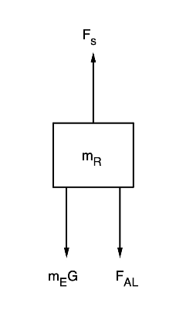
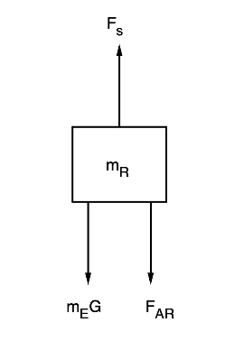
Free Body Diagrams
Rail Vibration
Forward-Left (F_{L})
Forward-Right (F_{FR})
Aft-Left (F_{AL})
Aft-Right (F_{AR})
6
Notes:
Hardware system:
Chassis adjusted to a protective case for the camera
Reduces 3D printing
Allows ease of access for camera repairability
Backend software:
Comprised of two algorithms:
Object detection algorithm (YOLO)
Lane detection algorithm (Canny Edge detection and probabilistic Hough Transformations)
Utilizes datasets from platforms like Open Images Dataset for training

Slide 19
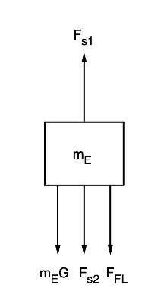
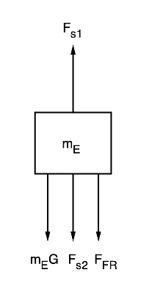
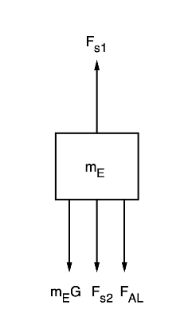
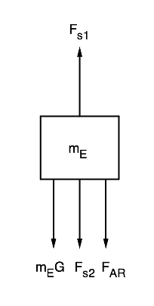
Free Body Diagrams
Electromagnet Vibration
Forward-Left (F_{L})
Forward-Right (F_{FR})
Aft-Left (F_{AL})
Aft-Right (F_{AR})
7
Notes:
Hardware system:
Chassis adjusted to a protective case for the camera
Reduces 3D printing
Allows ease of access for camera repairability
Backend software:
Comprised of two algorithms:
Object detection algorithm (YOLO)
Lane detection algorithm (Canny Edge detection and probabilistic Hough Transformations)
Utilizes datasets from platforms like Open Images Dataset for training

Slide 20



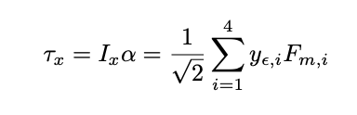
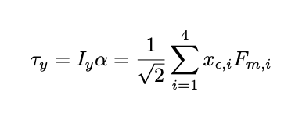
Equations of Motion
Rail Vibration
Electromagnet Vibration
Pitch and Roll
8
Construction and operational costs will depend on land prices, taxes, and subsidization practices which varies from region to region.
The primary usage of the Hyperloop path system will determine its proximity to metropolitan regions and surrounding transportation systems.
Notes:
Importance of endpoint location

Slide 21
Section 4
Control System

Slide 22


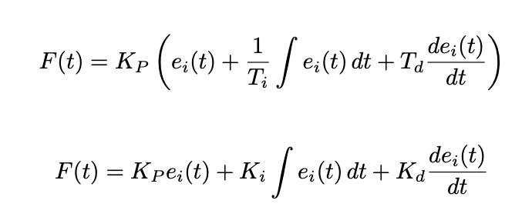
Equations
PID Controller
Gap Distance from Sensors
Calculates the gap distance from the sensors using the difference of the position of the rail and the electromagnet.
Error Signal
Calculated using the difference between the reference and actual gap distance.
Output of PID Controller
Calculates the force of attraction generated by the electromagnet using the three tuning parameters: K_{p}, K_{d}, and K_{i}.
Dijkstra's Algorithm is then applied to produce the optimal route path
9
Notes:
Protects embedded system components
Includes a 3D-printed case

Slide 23
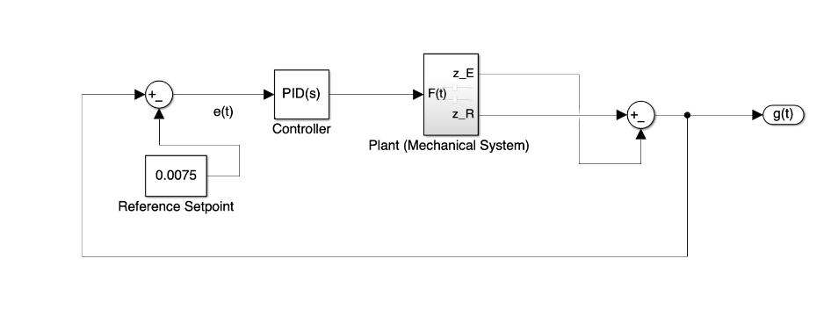
Signal Flow Path Diagram
Closed-Loop Feedback Control
Error Signal
PID Controller
Plant
Output Signal
Model of the control system using a closed-loop feedback controller
10
Notes:
Protects embedded system components
Includes a 3D-printed case

Slide 24
Section 5
Simulation

Slide 25
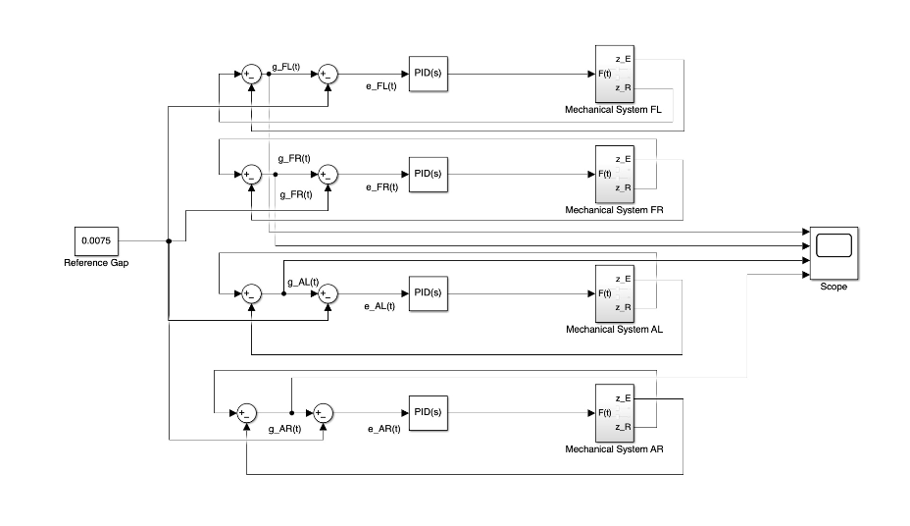
Simulation
Simulink with set variables
Full Simulink control system for all four electromagnets.
11
Notes:
Four groups of engineering students were tasked with the same objective of designing a prototype machine vision sensor model.
This was done over the course of 12 weeks as a part of their engineering design class.
The methodologies and results of these groups have been classified into 3 approaches which will be explored in this presentation
These approaches were then evaluated relative to the MVP to generate a final solution

Slide 26
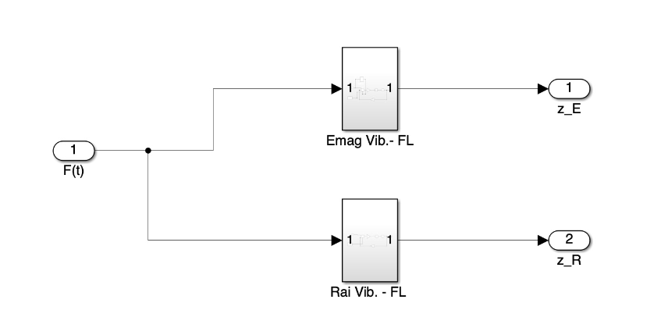
Control System
Plant
Electromagnet Vibration Model
PID Output Force
Electromagnet Position
Rail Position
Rail Vibration Model
12

Slide 27
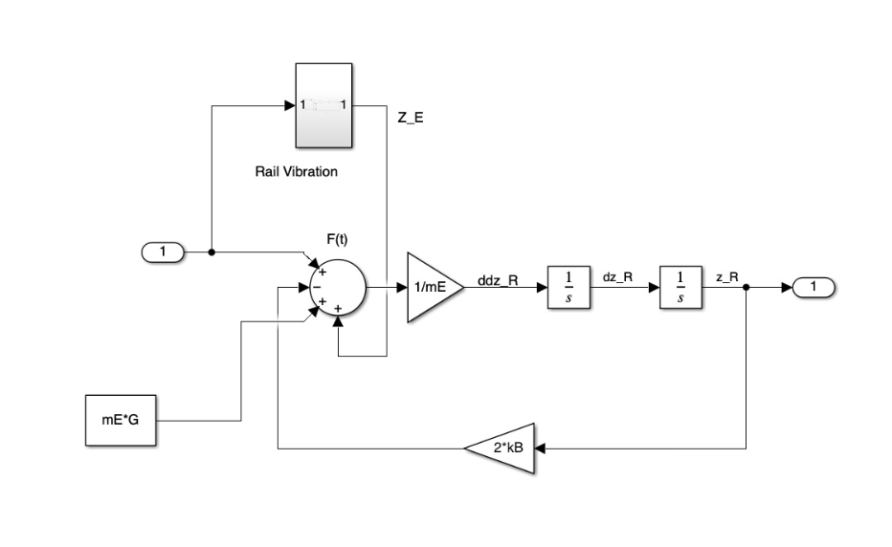
Control System
Electromagnet Vibration
Rail Vibration Model
PID Output Force
Electromagnet Position
13

Slide 28
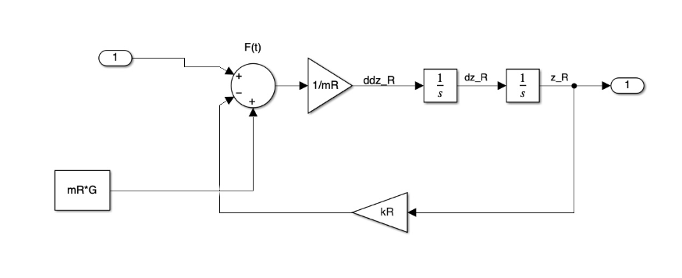
Control System
Rail Vibration
PID Output Force
Rail Position
14

Slide 29
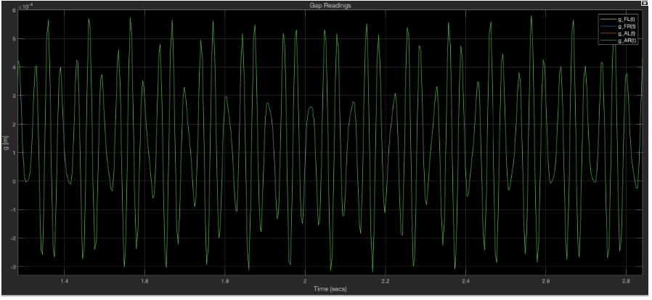
Control System
Output Plot
Desired Gap
Oscillating Gap Distance
15

Slide 30
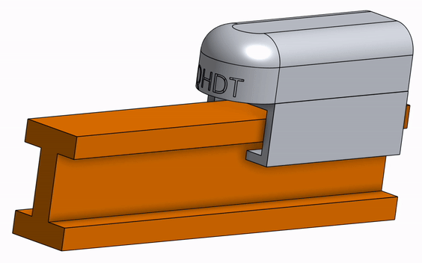


Next Steps
Future Plans and Scalability
Future Plans
Further development of this framework allows for the creation of a mag lev prototype
Additional future research will allow for the team to fully integrate mag lev alongside the LIM
Immediate Future
Finish prototype summer 2025
Full scale implementation 2025 to 2027
1:20 Scale of QHDT’s hyperloop pod
22
Notes:
Improve and refine all systems
Test with hyperloop related items to improve effectiveness
Reduce costs and improve manufacturability
Test on real hyperloop datasets to eliminate assumptions

Slide 31
Thank You!

Slide 32
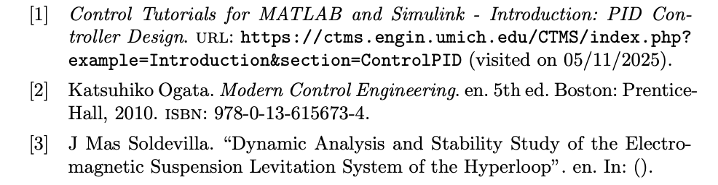
Bibliography
Citations & Sources

