Slide 1
The Show
Susan Alrifai, Varsha Garla, Melek Mizher, Tara Paranjpe, Tingqing Wu
MSDS 455, 2023 Spring, Section 55
Northwestern University, Data Visualization
June 4, 2023

Slide 2
The Carbon Footprint of Trade: Investigating the Environmental Impact of International Trade in OECD Countries

Slide 3
Global Climate Change Trends

Slide 4
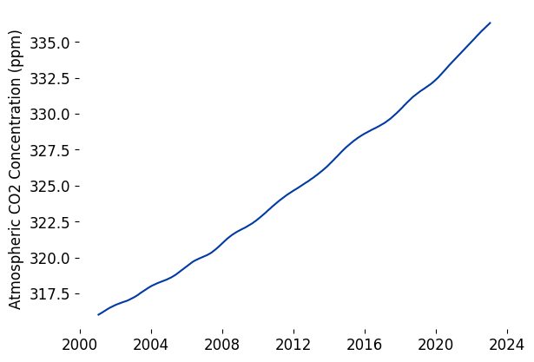
Atmospheric CO₂ Concentration
Source: National Oceanic and Atmospheric Administration (NOAA)
Concentrations of carbon dioxide in the Earth’s atmosphere have risen over the past two decades.
CO₂ is a greenhouse gas, which absorbs the sun's heat that radiates from the Earth's surface, trapping it in the atmosphere and preventing it from escaping into space

Slide 5
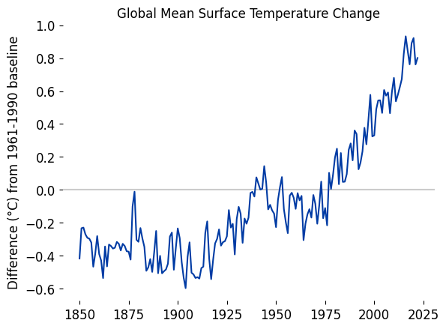
Temperature
Sources: Met Office Hadley Centre for Climate Science and Services, World Meteorological Organization
Yearly surface temperatures compared to the climatological baseline period (“normal” 30-year period defined by WMO) of 1961-1990 show that Earth’s temperature has risen at a steep rate.
The ten warmest years in the historical record have all occurred since 2010.

Slide 6
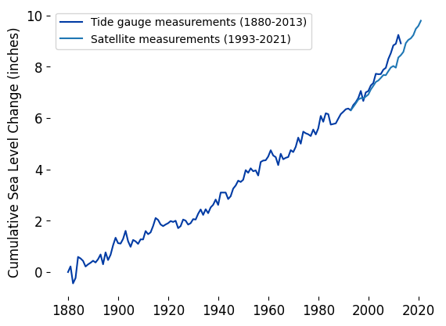
Sea Level
Sources: CSIRO 2017, NOAA 2022
The rate of global sea level rise has increased in recent decades.
Global average absolute sea level has risen by more than 8 inches since record keeping began in 1880.

Slide 7
What is the OECD?

Slide 8
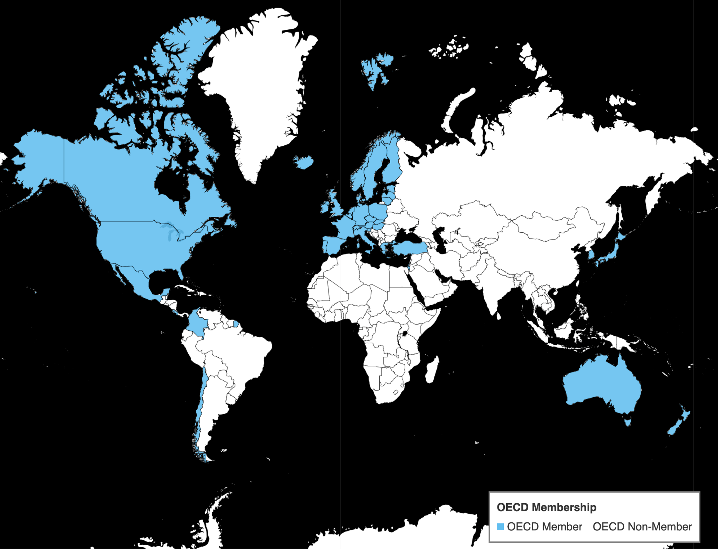
Source: OECD.org. Organisation for Economic Co-operation and Development
OECD Member Countries (2023)
OECD Members
The Organisation of Economic Cooperation and Development is composed of 38 member countries.
The OECD promotes policies with the objective of improving worldwide economic and social well-being by focusing on sustainable economic growth, development, and international trade.

Slide 9
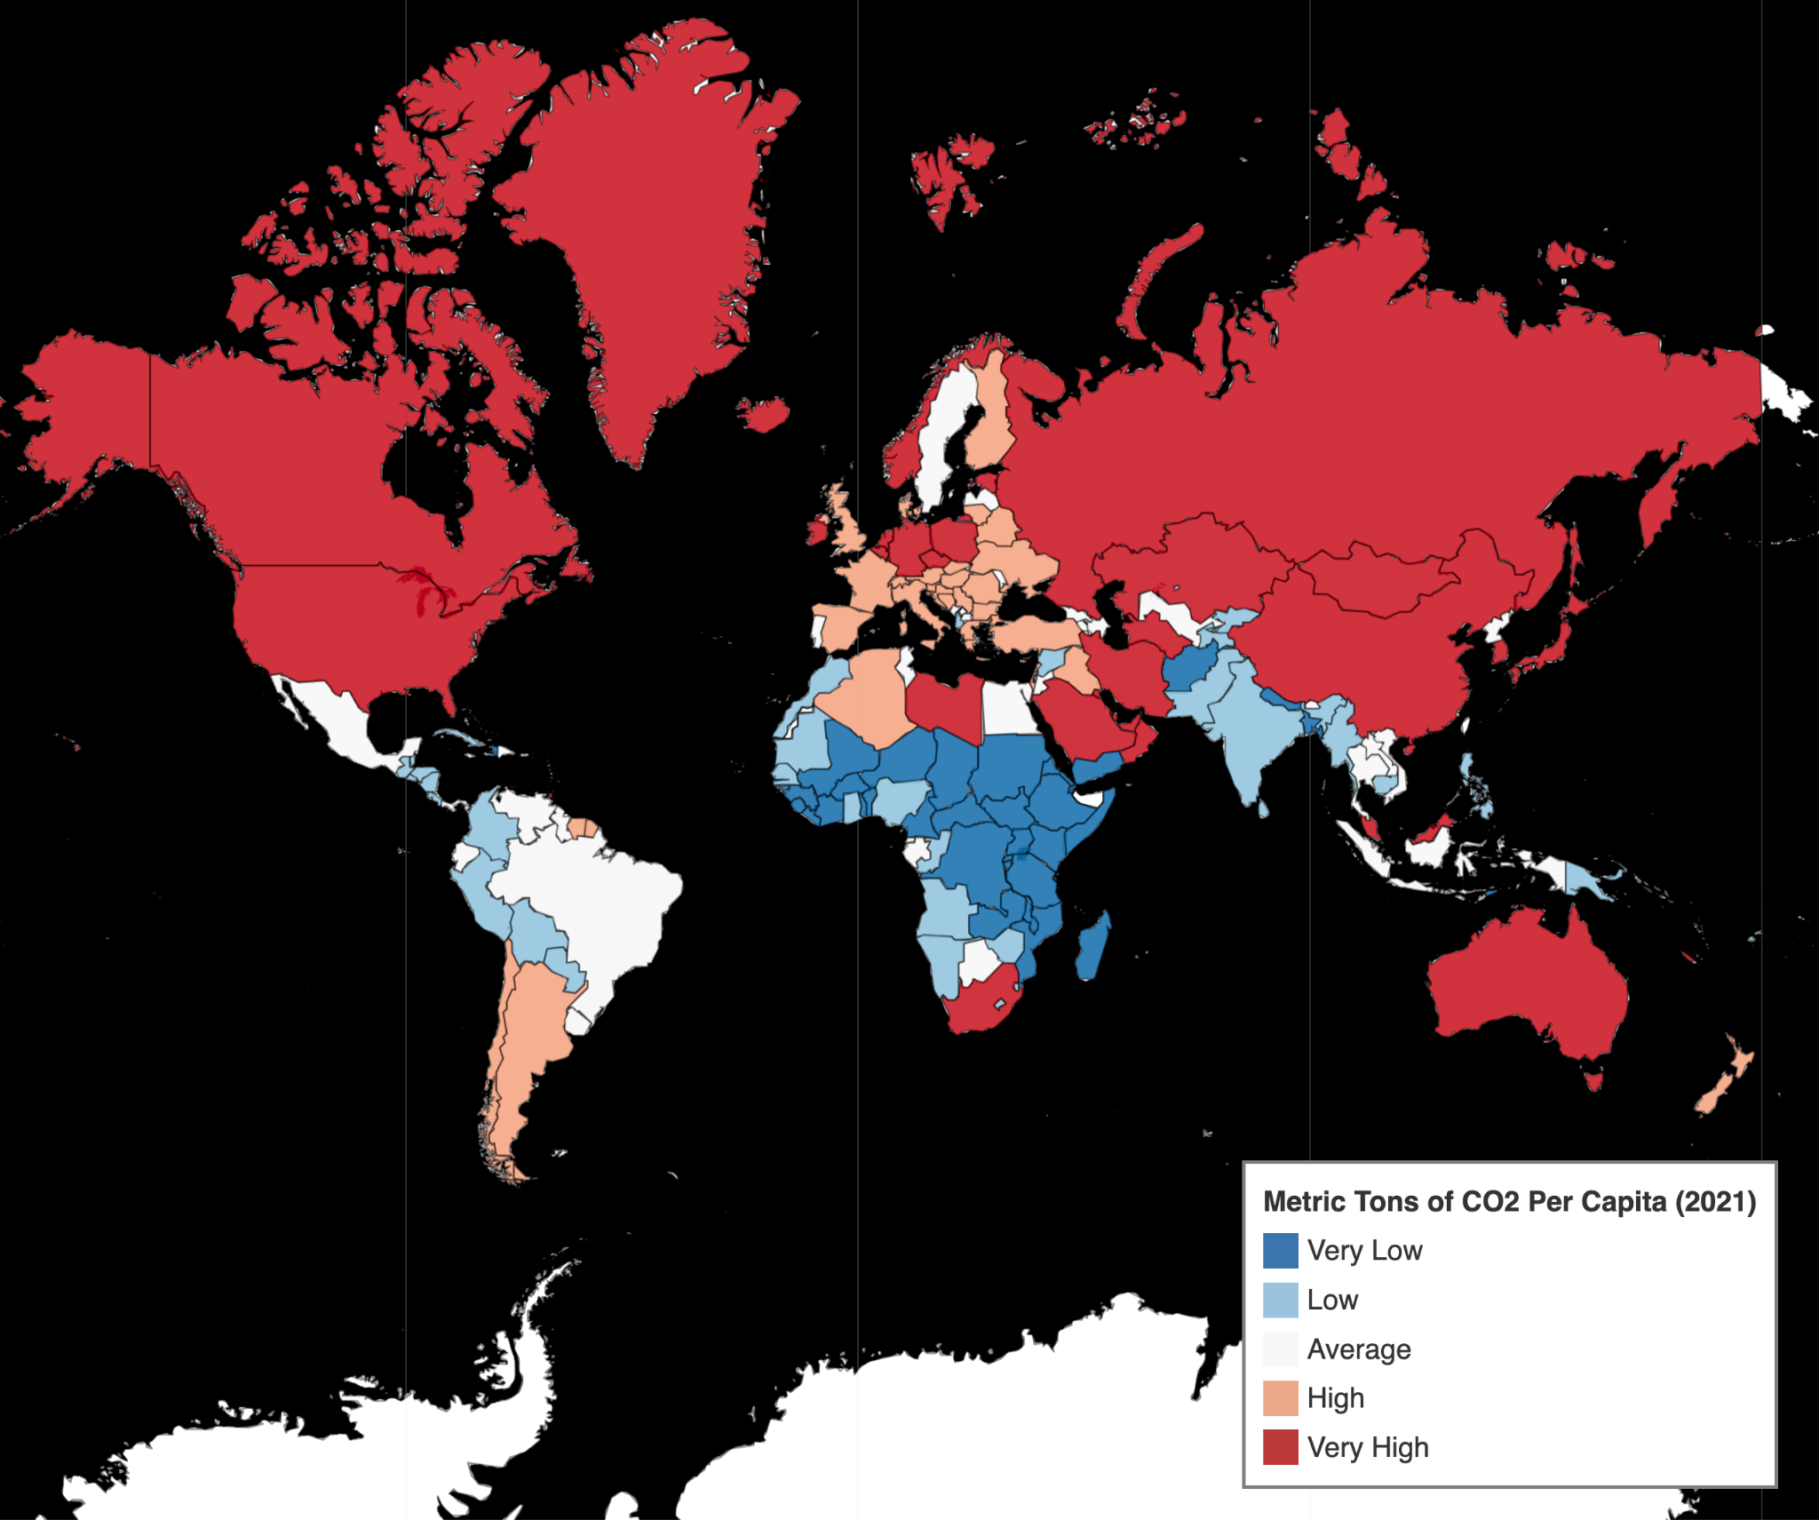
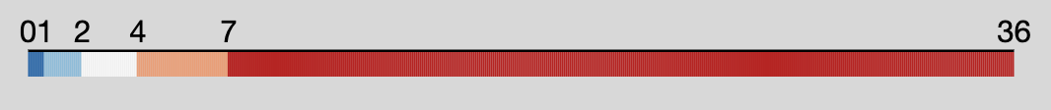
Source: World Bank and the Global Carbon Project
Metric Tons of CO₂ Per Capita (2021)
Worldwide CO₂ Emissions Per Capita
As of 2021, the global average for Territorial CO₂ emissions per person stands at 4.7 metric tons annually.
Majority of OECD member countries are developed nations that have emission levels above worldwide averages.
The map displays the distribution of nations across 5 quantiles.

Slide 10
CO₂ Emissions from Imports

Slide 11
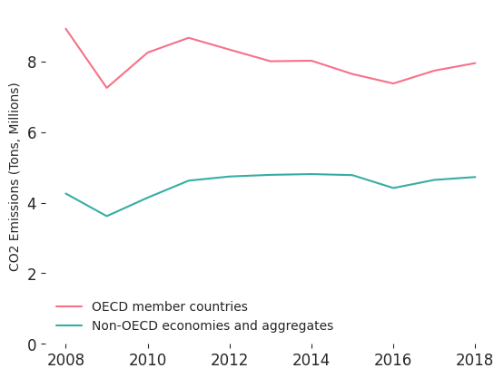
Total CO₂ emissions embodied in gross imports
Source: OECD.org. Organisation for Economic Co-operation and Development
OECD member countries had approximately double the volume of CO₂ emissions from import trade when compared to Non-OECD member countries between 2008 and 2018.

Slide 12
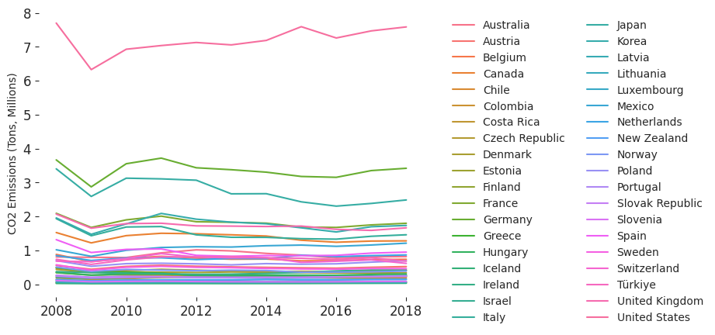
Total CO₂ Emissions Embodied in gross imports (OECD only)
Source: OECD.org. Organisation for Economic Co-operation and Development
The United States had the highest volume of CO₂ Emissions from OECD countries in gross imports from 2008-2018.

Slide 13
CO₂ Emissions from Exports

Slide 14
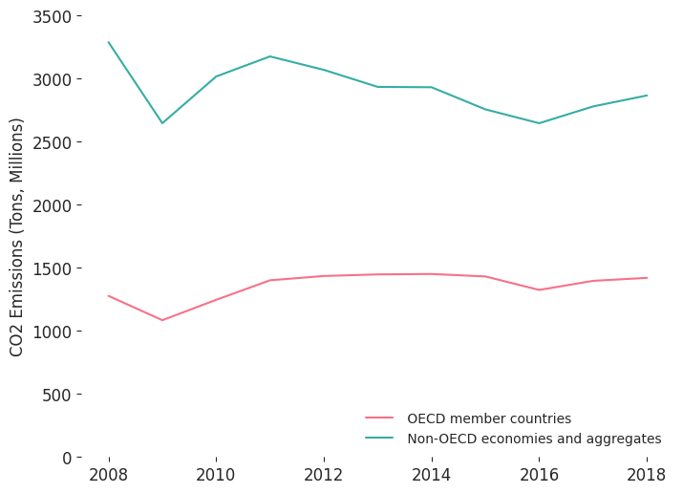
Total CO₂ Emissions Embodied in Gross Exports
Source: OECD.org. Organisation for Economic Co-operation and Development
Non-OECD member countries contributed twice as much to CO₂ emissions from export trade compared to OECD member countries between the years of 2008 and 2018.

Slide 15
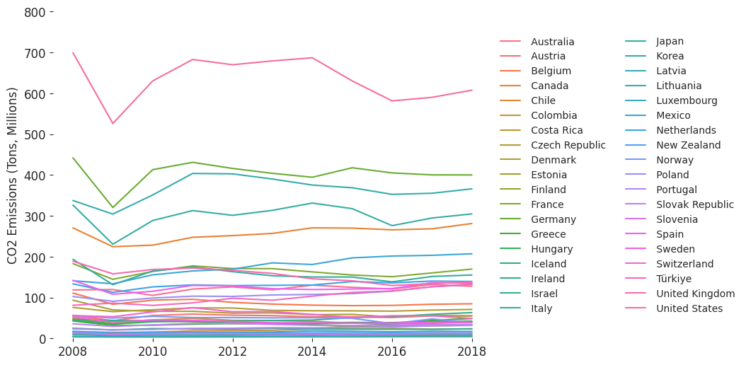
Total CO₂ Emissions Embodied in Gross Exports (OECD only)
Source: OECD.org. Organisation for Economic Co-operation and Development
The United States stood out as the OECD country with the highest volume of CO₂ emissions in gross exports between 2008 and 2018.

Slide 16
Top CO₂ Emissions Contributors

Slide 17
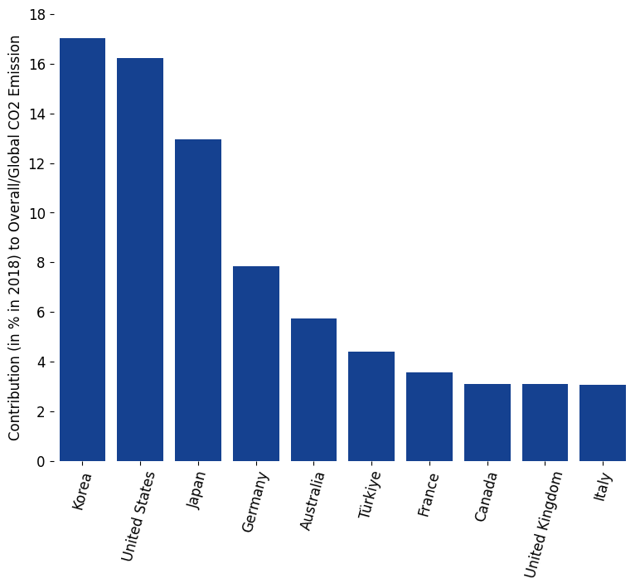
Source: OECD.org. Organisation for Economic Co-operation and Development
Top 10 OECD Country CO₂ Emissions Contributors
Korea and United States contribute to 33%, roughly one third, of overall emissions.
Japan follows behind Korea and the United States in a close third with 13% emissions, while the rest of OECD countries contribute <10% of total emissions.

Slide 18
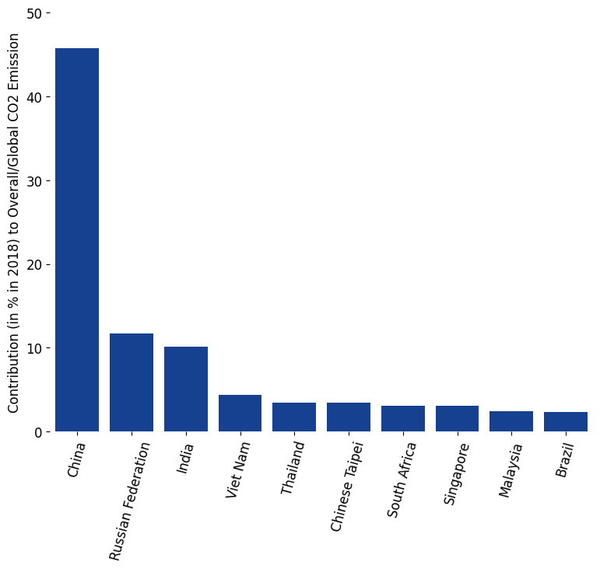
Source: OECD.org. Organisation for Economic Co-operation and Development
Top 10 Non-OECD Country CO₂ Emissions Contributors
China contributes 45% of overall emissions, while other Non-OECD country members have contributions closer to <10%.
Non-OECD countries within the Asian continent have a more significant contribution to CO₂ emission (≥10%) than anywhere else in the world.

Slide 19
Conclusions

Slide 20
Conclusions & Future Direction
Conclusions
Trends in rising global temperatures, sea levels, and atmospheric carbon dioxide concentration indicate global climate change and necessitate international cooperation to address environmental problems.
OECD member countries contribute less to CO₂ emissions from exports in international trade than countries outside the OECD.
However, a majority of OECD countries have higher per capita emissions than non-OECD countries for international trade imports, indicating a need to focus efforts on reducing these emissions.
It is essential for all countries, regardless of their OECD membership status, to focus on reducing emissions and transitioning to more sustainable and low-carbon development pathways.
Future Direction
Investigate root cause of why OECD countries have higher CO₂ emissions from international trade imports but lower emissions volume from international trade exports

Slide 21
References
Alam, Md Samsul, Nicholas Apergis, Sudharshan Reddy Paramati, and Jianchun Fang. 2021. "The Impacts of R&D Investment and Stock Markets on
Clean-Energy Consumption and CO2 Emissions in OECD Economies." International Journal of Finance & Economics 26, no. 4 (September): 4979-4992. https://doi.org/https://doi.org/10.1002/ijfe.2049. https://onlinelibrary.wiley.com/doi/abs/10.1002/ijfe.2049.
Cheng, Cheng, Xiaohang Ren, Kangyin Dong, Xiucheng Dong, and Zhen Wang. 2021. "How Does Technological Innovation Mitigate CO2
Emissions in OECD Countries? Heterogeneous Analysis Using Panel Quantile Regression." Journal of Environmental Management 280 (February): 111818. https://doi.org/https://doi.org/10.1016/j.jenvman.2020.111818. https://www.sciencedirect.com/science/article/pii/S0301479720317436.
Datopian. “Country Polygons as Geojson.” DataHub. Accessed June 4, 2023. https://datahub.io/core/geo-countries#data.
Global Carbon Project (GCP). “Global Carbon Budget 2022.” Carbon Budget. Accessed June 4, 2023. https://www.globalcarbonproject.org/carbonbudget/.
Huang, Shi-Wei, Yung-Fu Chung, and Tai-Hsi Wu. 2021. "Analyzing The Relationship Between Energy Security Performance and Decoupling of
Economic Growth From CO2 Emissions for OECD Countries." Renewable and Sustainable Energy Reviews 152 (March): 111633.
https://doi.org/https://doi.org/10.1016/j.rser.2021.111633. https://www.sciencedirect.com/science/article/abs/pii/S1364032121009084.
Lindsey, Rebecca, and LuAnn Dahlman. 2023. “Climate Change: Global Temperature | NOAA Climate.gov.” Climate.gov. https://www.climate.gov/news-features/understanding-climate/climate-change-global-temperature.
Oecd. “Greenhouse gas emissions.” Accessed June 4, 2023. https://stats.oecd.org/Index.aspx?DataSetCode=AIR_GHG.
Ritchie, Hannah, Max Roser, and Pablo Rosado. 2017. “CO₂ and Greenhouse Gas Emissions.” Our World in Data. https://ourworldindata.org/co2-and-greenhouse-gas-emissions.
Saidi, Kais, and Anis Omri. 2020. "Reducing CO2 Emissions in OECD Countries: Do Renewable and Nuclear Energy Matter?" Progress in
Nuclear Energy 126 (August): 103425. https://doi.org/https://doi.org/10.1016/j.pnucene.2020.103425.
https://www.sciencedirect.com/science/article/pii/S0149197020301773.

Slide 22
References (cont.)
Salahuddin, Mohammad, Khorshed Alam, and Ilhan Ozturk. 2016. "The Effects of Internet Usage and Economic Growth on CO2
Emissions in OECD Countries: A Panel Investigation." Renewable and Sustainable Energy Reviews 62 (September): 1226-1235. https://doi.org/https://doi.org/10.1016/j.rser.2016.04.018. https://www.sciencedirect.com/science/article/pii/S1364032116300351.
United States Environmental Protection Agency. 2022. “Climate Change Indicators: Sea Level | US EPA.” Environmental Protection Agency. https://www.epa.gov/climate-indicators/climate-change-indicators-sea-level.
U.S. Global Change Research Program. 2021. “USGCRP Indicator Details.” USGCRP Indicator Details | GlobalChange.gov. https://www.globalchange.gov/browse/indicators/global-sea-level-rise.
World Bank. “Data Catalog.” World Development Indicators. Accessed June 4, 2023.
https://datacatalog.worldbank.org/search/dataset/0037712.
Yamano, Norihiko. and Guilhoto, Joaquim. 2020. "CO2 Emissions Embodied in International Trade and Domestic Final Demand:
Methodology and Results Using the OECD Inter-Country Input-Output Database", OECD Science, Technology and Industry Working Papers, no. 2020 (November).
https://doi.org/10.1787/8f2963b8-en.

