Slide 1
Sprint # 4 - 5
GradeNest: A web platform that helps students compute and track their academic performance across multiple chances.
December 3, 2025

Slide 2
Sprint Goal
Sprint 4:
“Enable students to manage their profile, goals, and GWA with accurate computation and clear color-coded feedback”
Sprint 5:
“Deliver a release-ready GradeNest by completing full-system regression testing, polishing UI, cleaning the codebase, and finalizing all the user and technical documentation for project handover.”

Slide 3
Planned vs. Completed
A simple table or list showing:
User stories planned for this sprint
Which were completed ✅
Which were not completed ❌ (and why, briefly)

Slide 4
Sprint 4 User Stories
US-09.1 – Personal Information Management | Remarks
4.1.1 Given I click Settings in the sidebar. When I open Profile. Then my Name, Email, and other editable fields are pre-filled. | ✅
4.1. 2 Given I view my profile. When I check Academic Details. Then I see School Level (Grade 7–10 / Grade 11–12) and Strand (SHS only) based on the active school year. | ✅
4.1.3 Given I edit a field (Name/Email). When I click Save Changes. Then it validates, saves, and updates the dashboard greeting name right away. | ✅
4.1.4 Given the active school year is marked as Done. When a new school year starts. Then the system disables further editing or adding of information for the completed year. | ✅
4.1. 5 Given I change my email. When the format is invalid and I save. Then I see an error (e.g., “Invalid email format”) and it won’t save. | ✅
4.1.6 Given I clear a required field (e.g., Name) When I click Save Changes Then I see “This field is required” and it won’t save. | ✅

Slide 5
Sprint 4 User Stories
US-09.2 Account Security and Credential Management | Remarks
4.2.1 Given I open Settings > Security. When the page loads. Then I see Current Password, New Password, Confirm New Password. | ✅
4.2.2 Given all fields are correct. When I click Change Password. Then the password updates and I see a success message (next login uses the new password). | ✅
4.2.3 Given my new passwords match. When my current password is wrong. Then I see an error (“Incorrect current password”) and nothing changes. | ✅
4.2.4 Given my new password is weak. When I click Change Password. Then I see the requirements and the password is not changed. | ✅
US-10 Grade Computation and Data Validation | ✅
4.3.1 Given grading weights are set. When the system checks the components. Then the total must be 100%. | ✅
4.3.2 Given I add/update a component score. When it saves. Then the subject total updates immediately. | ✅

Slide 6
Sprint 4 User Stories
US-10 Grade Computation and Data Validation | Remarks
4.3.3 Given a subject final grade changes. When it updates. Then Term GWA and Overall GWA update automatically. | ✅
4.3.4 Given the system computes GWA. When it calculates. Then it uses a fixed, verified formula (e.g., units/credits based) for consistent results. | ✅
US-7.1 Goal Creation and Definition | ✅
4.4.1 Given I’m on Goals. When I click Add New Goal. Then a form/modal opens with Title, Description, Target Date, Category. | ✅
4.4.2 Given the form is valid. When I click Save/Create. Then the goal is added and I see a success message. | ✅
4.4.3 Given Title is blank. When I try to save. Then I see an error and the goal is not created. | ✅
4.4.4 Given I pick a past date. When I submit. Then the system blocks it or marks it Overdue (based on rule). | ✅

Slide 7
Sprint 4 User Stories
US-7.2 Goal Management and Tracking | Remarks
4.5.1 Given I’m on Goals list. When I view it. Then active goals show Title, Target Date, Status/Progress. | ✅
4.5.2 Given I open a goal. When I edit Description/Target Date and save. Then it updates in the database and reflects on the list. | ✅
4.5.3 Given I finish a goal. When I click Mark as Complete. Then it moves to Completed/Archived. | ✅
4.5.4 Given I click Delete. When the confirmation modal appears. Then it only deletes after I confirm. | ✅
4.5.5 Given I use filter/sort. When I select options (Category, Target Date, etc.). Then the list updates correctly and shows the correct count. | ✅
US-11 Grade Highlight and Color-Coding Indicators | ✅
4.6.1 Given passing grade is set (e.g., 75). When grades show (subject or GWA). Then colors follow tiers (e.g., Green/Yellow/Red). | ✅
4.6.2 Given I’m on Dashboard. When Term cards or Overall GWA show grades. Then the grade/progress indicator is color-coded by tier. | ✅

Slide 8
Sprint 4 User Stories
US-11 Grade Highlight and Color-Coding Indicators | Remarks
4.6.3 Given a subject has a final grade. When it’s displayed in the subject list. Then the card/grade uses the correct color (e.g., 70 = Red). | ✅
4.6.4 Given data is incomplete. When a subject/term is shown. Then it displays Pending/In Progress with a neutral color (Gray/Light Blue). | ✅
4.6.5 Given I finish a goal. When I click Mark as Complete. Then it moves to Completed/Archived. | ✅
4.6.6 Given I click Delete. When the confirmation modal appears. Then it only deletes after I confirm. | ✅
4.6.7 Given I use filter/sort. When I select options (Category, Target Date, etc.). Then the list updates correctly and shows the correct count. | ✅
US-11 Grade Highlight and Color-Coding Indicators | ✅
4.7.1 Given passing grade is set (e.g., 75). When grades show (subject or GWA). Then colors follow tiers (e.g., Green/Yellow/Red). | ✅
4.7.2Given I’m on Dashboard. When Term cards or Overall GWA show grades. Then the grade/progress indicator is color-coded by tier. | ✅

Slide 9
Sprint 5 User Stories
US-12 Full System Regression Testing | Remarks
5.1.1 Given a subject has weights (WW 40%, PT 60%). When I enter scores 85 and 90. Then final grade shows 88.00,and the dashboard GWA updates right away. | ✅
5.1.2 Given my target grade is 1.5 When my computed grade becomes 1.4 (better) Then the progress bar turns Green and status becomes Achieved. | ✅
5.1.3 Given I’m on Change Password. When I enter the wrong current password Then the request is blocked and it shows “Incorrect current password.” | ✅
US-13 Final Project Documentation | ✅
5.2.1 Given Goals and Settings are done When I export the User Guide PDF. Then it has updated screenshots (Goal creation, Profile settings) and step-by-step guides for Reset Password and Add New School Year. | ✅
5.2.2 Given the DB schema changed. When I review the ERD. Then Student–Subject–Goals relationships are correct and the architecture diagram matches the current deployment. | ✅

Slide 10
Sprint 5 User Stories
US-14 Code Cleanup & Peer Review | Remarks
5.3.1 Given I use the app normally When I check the browser console. Then there are no debug logs and no warnings like unique key props. | ✅
5.3.2 Given I review source files When I check imports and old blocks. Then no unused imports remain, and commented-out old code is deleted. | ✅
US-15 UI/UX Final Polish | ✅
5.4.1 Given errors appear on Login and Goals When they show. Then they use the same red color, and same font size + placement. | ✅
5.4.2 Given I have no subjects and no goals When I open Dashboard or Goals Then I see a friendly empty message (with a call-to-action) And the UI doesn’t look broken/blank. | ✅

Slide 11
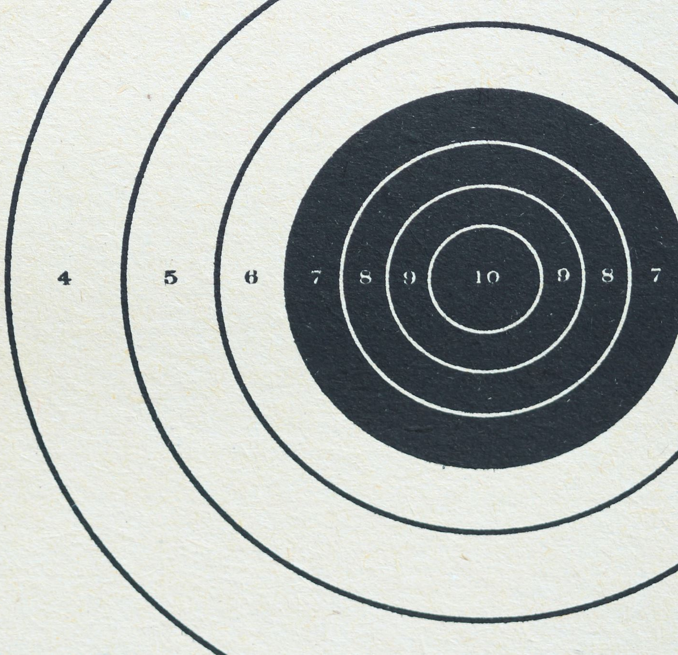
Demo

Slide 12
Progress
Sprint 4 completed 28 out of 28, while Sprint 5 completed 20 out of 20 Story points Committed
Bugs found and resolved?

Slide 13
Challenges / Blockers
Dev team blockers
Priorities were shifted

Slide 14

Appreciation (Optional)
Thank you to our Dev Team for your hard work, ownership, and relentless problem-solving throughout this sprint.
Your commitment is what keeps this project moving forward.

