Slide 1

Doubly_linked_list
Bello Melido
11/29/2023
CSC 210

Slide 2
Table of contents
01
02
03
Introduction
Doubly Linked List Representation
MIPS Mars code
04
05
06
Results
Explanation of Results
Conclusion

Slide 3
Introduction
Hello!
The provided MIPS assembly code is designed to create a user-friendly interactive program for
managing a list of text entries, similar to a to-do list. Users can perform actions like adding new
entries, deleting existing ones, moving between entries, and more. The program communicates
with users through text menus, making it easy to understand and use

Slide 4
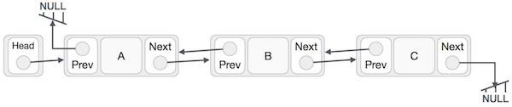
Doubly Linked List Representation
Element: Each part of a linked list holds some data.
Next: Every part of a linked list knows where the next part is.
Prev: Each part also knows where the previous part is.
Linked List: It's a chain of parts where the first and last parts have special connections to find the beginning and end of the list.

Slide 5
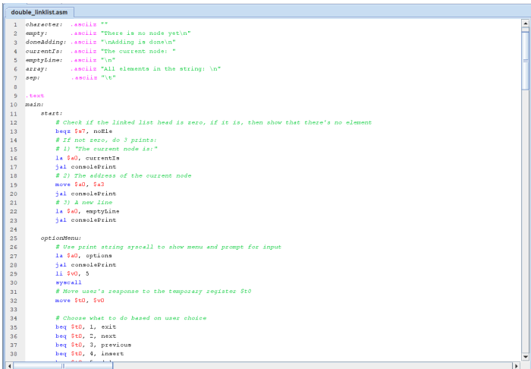
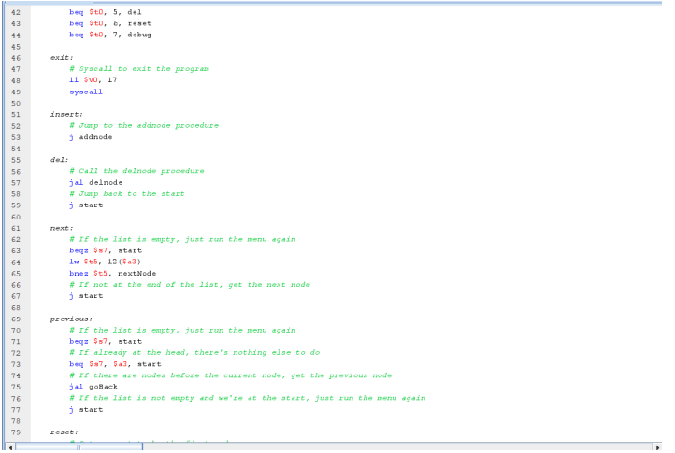
Mips mars code

Slide 6
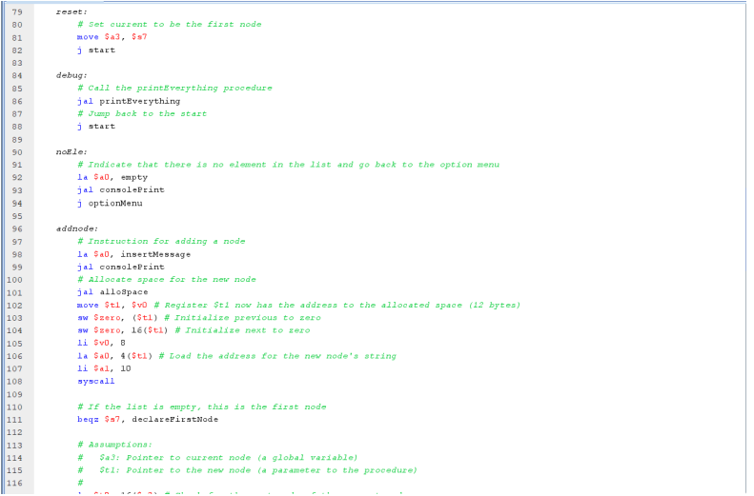
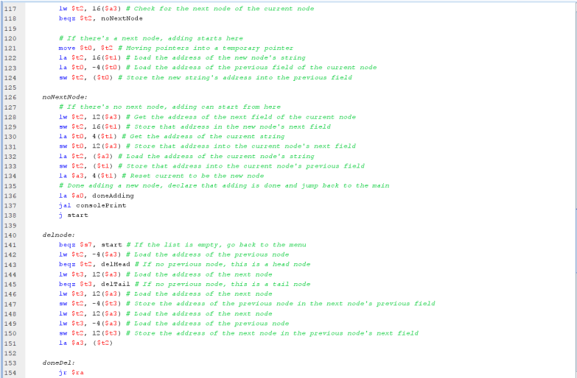

Slide 7
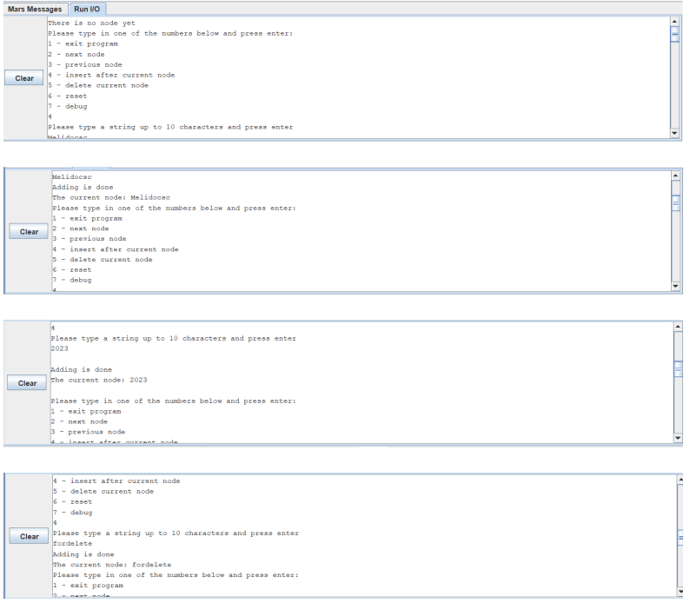
Results

Slide 8
Explanation of Results
The program initially starts with an empty list and presents a menu with various options, including adding, deleting, and navigating nodes.
The user inserts three nodes, with data "Melidocsc," "2023," and "fordelete," respectively, confirming each addition.
One node ("2023") is deleted from the list upon user request.
The program displays the current list with "Melidocsc" and "fordelete," indicating the current node as "2023," allowing further actions or program exit.

Slide 9
Conclusion
In conclusion, the provided code represents a simple interactive program that manages a linked list of nodes, each containing a string of up to 10 characters. The program offers a user-friendly menu with options to insert new nodes, delete the current node, navigate through the list, reset the current position, view the entire list, and exit the program. Users can input strings, which are added as nodes to the list. The program provides clear feedback for each operation, such as
confirming the addition of a new node and displaying the current node's data. It also handles scenarios where there are no nodes in the list or when deleting a node.

Slide 10
Thank you!

