Slide 1

Quicksort
Bello Melido
11/29/2023
CSC 210

Slide 2
Table of contents
01
02
03
Introduction
Quicksort Representation
MIPS Mars code
04
05
06
Results
Explanation of Results
Conclusion

Slide 3
Introduction
Hello!
In the provided MIPS assembly code, we embark on a digital journey through a user-friendly interactive program that acts as a digital assistant for managing and sorting an array of numbers. Imagine it as your trusted companion in the world of numbers, helping you bring order to chaos. This program takes an initially disordered list of numbers and, with a touch of algorithmic magic, neatly arranged them from the smallest to the largest. It communicates with users through text messages, guiding them through the sorting process step by step. Join us as we delve into the inner workings of this program, exploring how it transforms randomness into order, making numbers more manageable and organized.

Slide 4
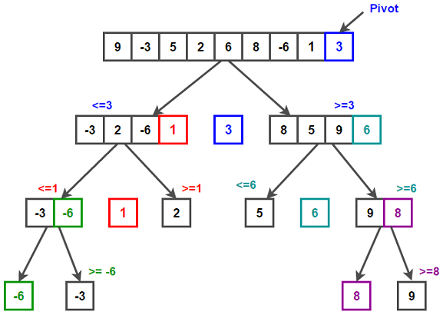
Doubly Linked List Representation

Slide 5
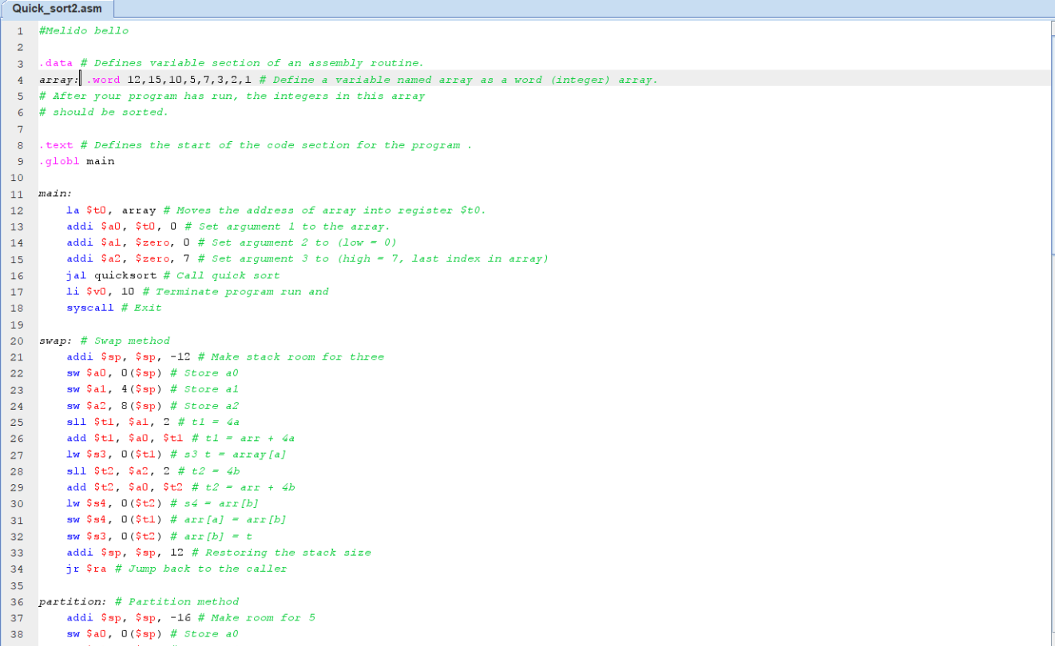
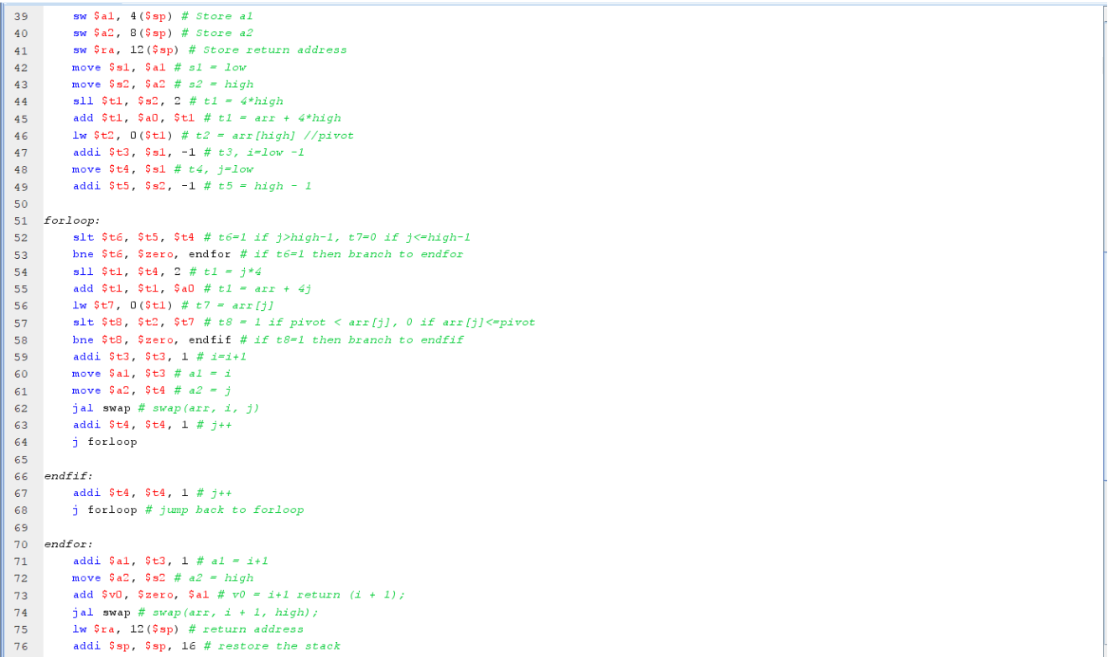
Mips mars code

Slide 6
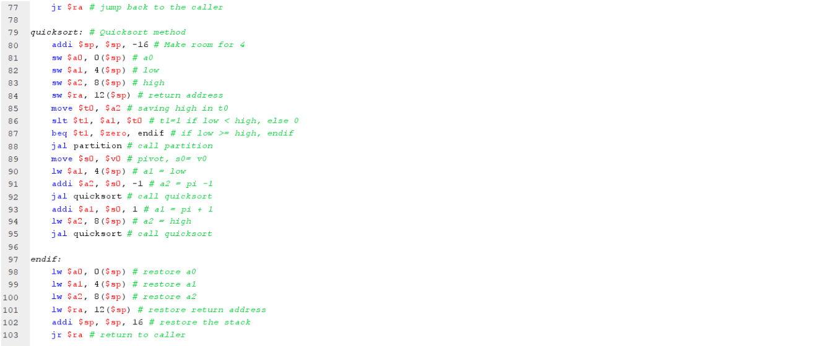

Slide 7
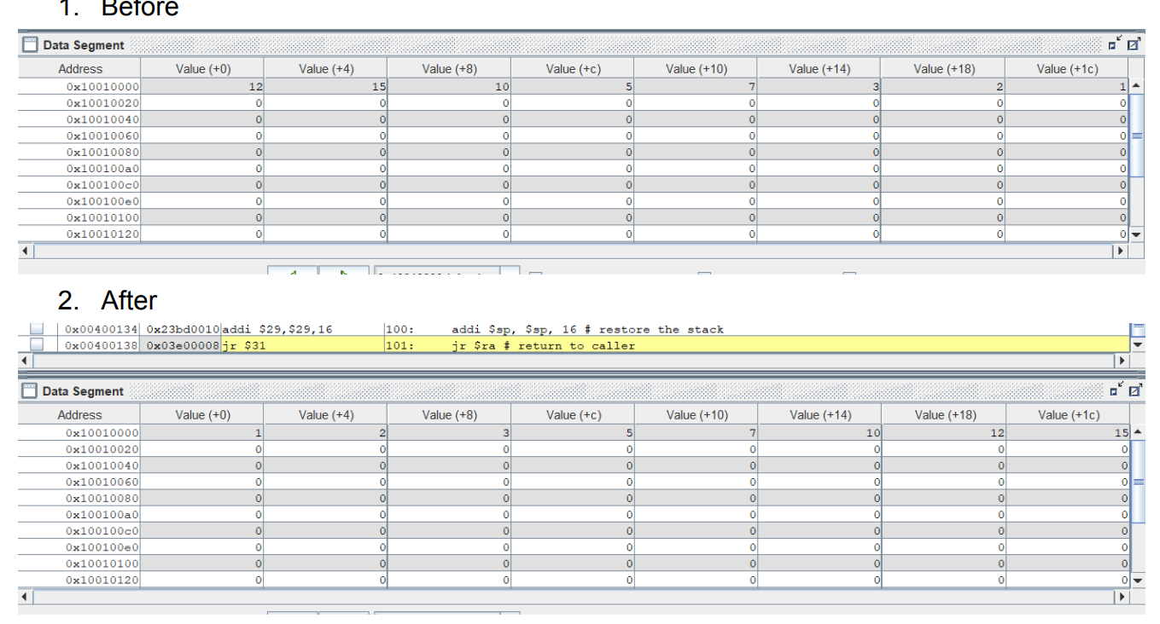
Results

Slide 8
Explanation of Results
Before Sorting:
array[0] is 12
array[1] is 15
array[2] is 10
array[3] is 5
array[4] is 7
array[5] is 3
array[6] is 2
array[7] is 1
After Sorting (Ascending Order):
array[0] is 1
array[1] is 2
array[2] is 3
array[3] is 5
array[4] is 7
array[5] is 10
array[6] is 12
array[7] is 15

Slide 9
Conclusion
The MIPS assembly code we've explored presents a practical and efficient solution for sorting arrays of integers. It showcases the process of organizing a jumbled collection of numbers into a neatly arranged sequence from the smallest to the largest values. The program's user-friendliness is evident through its menu-driven interface, which assists users in initiating
sorting operations and provides transparent feedback on the ongoing process. Moreover, the code handles diverse scenarios effectively, including cases with empty arrays and actions on the first or last elements. Through this code, we've witnessed the implementation of a fundamental sorting algorithm, all the while prioritizing user comprehension and optimizing memory usage. It serves as a valuable example of how sorting can be achieved elegantly in a low-level
programming environment.

Slide 10
Thank you!

