Slide 1

@Razor
Mohamed Meligy
(@@Meligy)
Senior Developer, Readify
http://gurustop.net

Slide 2














We would like to thank our sponsors and supporters for helping us bring you this event

Slide 3
@model RazorSession @using(Html.BeginSession()) { @Html.DisplayModel() }
<footer>
By Mohamed Meligy (@Twitter.Avatar(“@Meligy”))
</footer>

Slide 4
Agenda
View Engines
Razor Syntax
Basic Syntax Elements
Helpers
Functions
Tips & Tricks
Razor JavaScript
Themes
Compiled Views

Slide 5
Who’s This?
Developing .NET Since 2004
Developing Web Since 2002
Loveing International Customerbase
Egypt, KSA, USA, Azerbaijan, UAE, Australia
Frequent Speaker In Egypt
SilverKey DemoDay, DotNetWork UG, ITWorx TechClub, CairoCodeCamp Conference, …
Scrum, Design Patterns, Coding Practices, MVC, DDD, …
Bloggeing Since 2004
GeeksWithBlogs, ASP.NET Weblogs,
Currently GuruStop.NET (Thanks, @Shanselman Blog-Suck-Less)

Slide 6
What You May Need
VS 2010 SP1
http://bit.ly/vs2010-sp1
ASP.NET MVC 3 + April 2011 Tools Update
http://asp.net/mvc/mvc3
NuGet
http://nuget.org
WebMatrix
http://microsoft.com/web

Slide 7
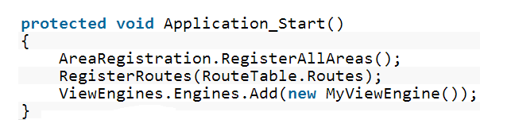
ASP.NET MVC View Engines

Slide 8
View Engines
Webforms
Spark
NHAML
Razor
...

Slide 9
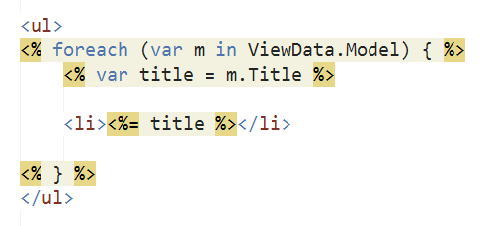

Webforms
We know it already

Slide 10
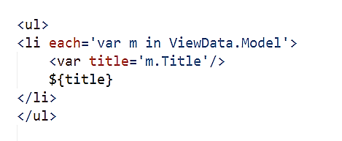
Spark
Markup Oriented

Slide 11
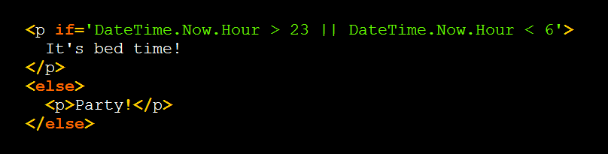

Slide 12
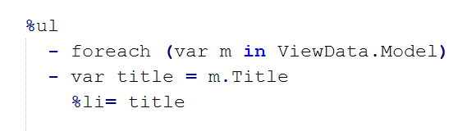
NHAML
Comes from Rails
Not HTML

Slide 13
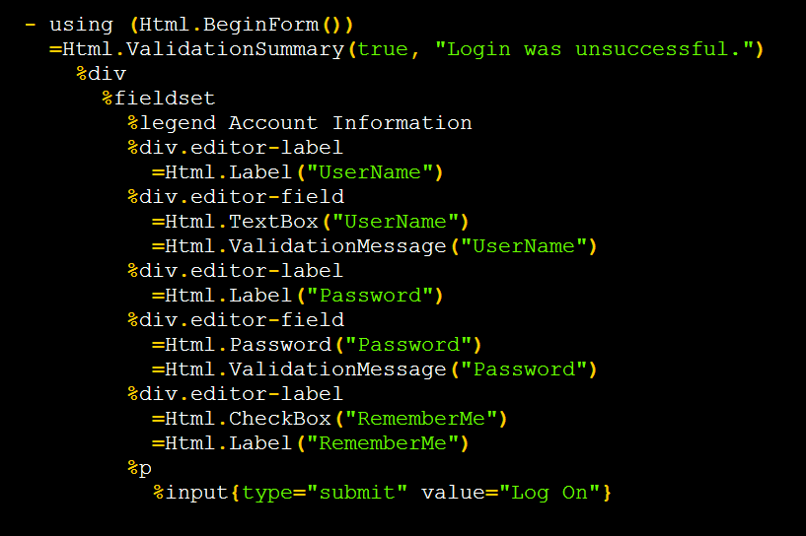

Slide 14
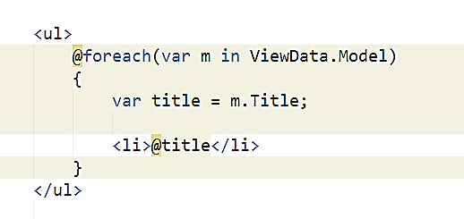
Razor
Code Oriented
Automatic Encoding

Slide 15
They’re all just template languages!

Slide 16
When To Use Which…
It’s up to you

Slide 17
When To Use Which…
It’s up to you
NHAML
If you do Ruby a lot, or really hate XMLness of HTML
Webforms
Legacy Code
Custom Controls (Not Recommended)
Spark
Client & Server Templates
If non-developers will write the markup
Razor
Use By Default

Slide 18
@Razor

Slide 19



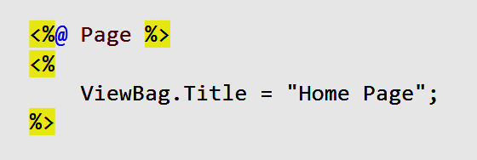

Basic Syntax

Slide 20
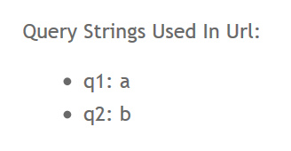
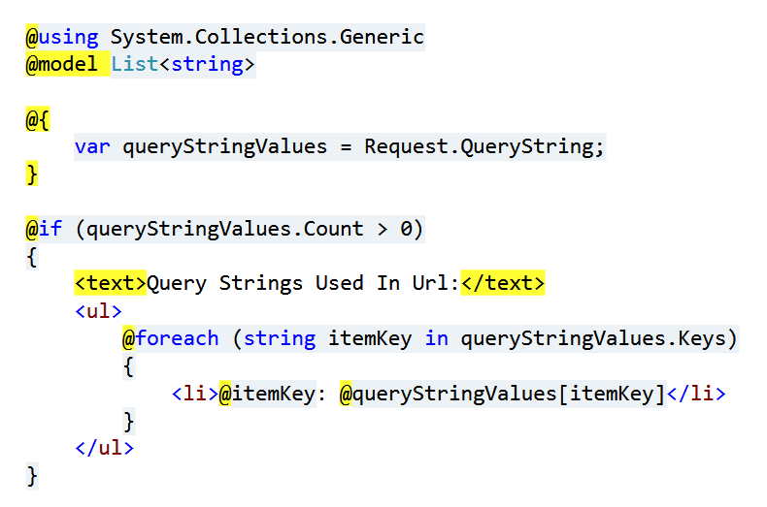
Basic Syntax

Slide 21
Basic Syntax
Demo

Slide 22
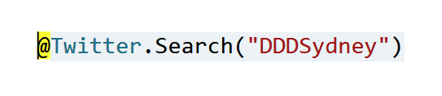
Helpers & Functions
ASP.NET Helpers
http://bit.ly/asp-helpers-api

Slide 23
Helpers & Functions
Demo

Slide 24
Using Non HTML Templates
Also check http://bit.ly/razor-js
Didn’t seem to build for me, but is nice idea
Demo

Slide 25
Next Demo
Kazi Rashid Theming PoC http://bit.ly/razor-theming
Pre-compiled Views

Slide 26
Final Words
Razor syntax is nice, but that’s not all
The opportunities in having templates and packing them easily for project or for masses is the big bit
It is one option that Microsoft is pushing, which doesn’t suck enough to look elsewhere…

Slide 27
Please complete the feedback form in your delegate pack for a chance to win some great prizes.
Please remember to return the form before you enter the lock note, or leave the event.

Slide 28
Compile Razor To Separate DLL http://bit.ly/razor-dll
Some Tips http://bit.ly/slaks-razor
Sample App http://nerddinner.codeplex.com/
Compile Razor Views As Part of Build http://bit.ly/mvc-build-views
Andrew Nurse http://vibrantcode.com/ (Who wrote Razor syntax parser)
Ch9 video: deep-dive into Razor http://bit.ly/ch9-razor
“use Razor outside ASP.NET” sample http://bit.ly/razor-outside-asp
Phil Haack (ASP.NET MVC PM) http://haacked.com
David Ebbo http://bit.ly/david-razor (Maintains NuGet, has VERY useful ASP.NET packages)
Razor Generator http://bit.ly/razor-generator - http://bit.ly/razor-engine
Compile Razor In Design Time http://bit.ly/precompile-razor
Convert ASPX Views To Razor http://github.com/telerik/razor-converter
Me! http://gurustop.net - http://twitter.com/meligy

