Slide 1

Books
Website
Think Before You Speak
Read Before You Think

Slide 2





Our Team
And our work distribution
Anush
Senik
Anahit
Meline
Database Structure
Database Structure
Database Structure
Database Structure
Web Application
(Front-End)
Web Application
(Front-End)
Web Application
(Front-End)
Web Application
(Back-End)
Web Application
(Back-End)
Web Scraping
Web Application
(Back-End)
Web Scraping

Slide 3


Database
Library:

Slide 4
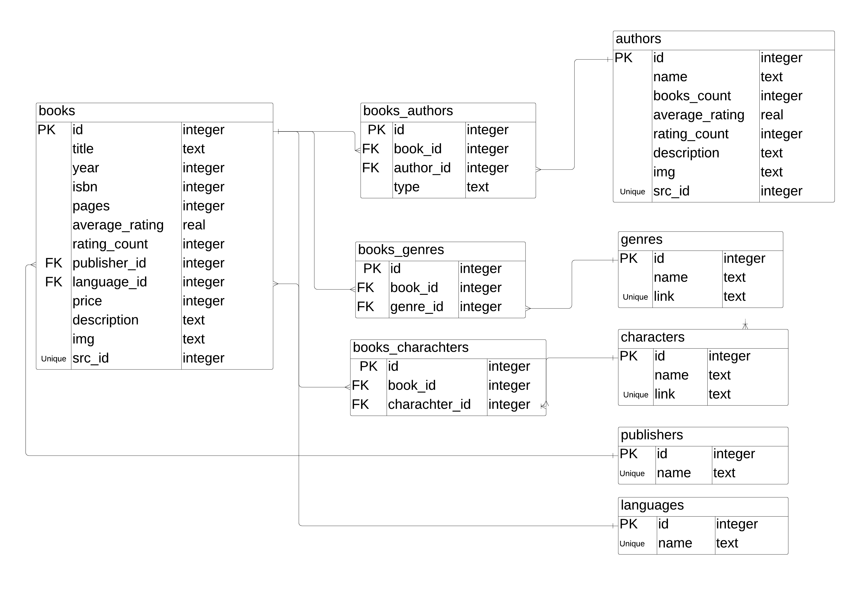


Slide 5
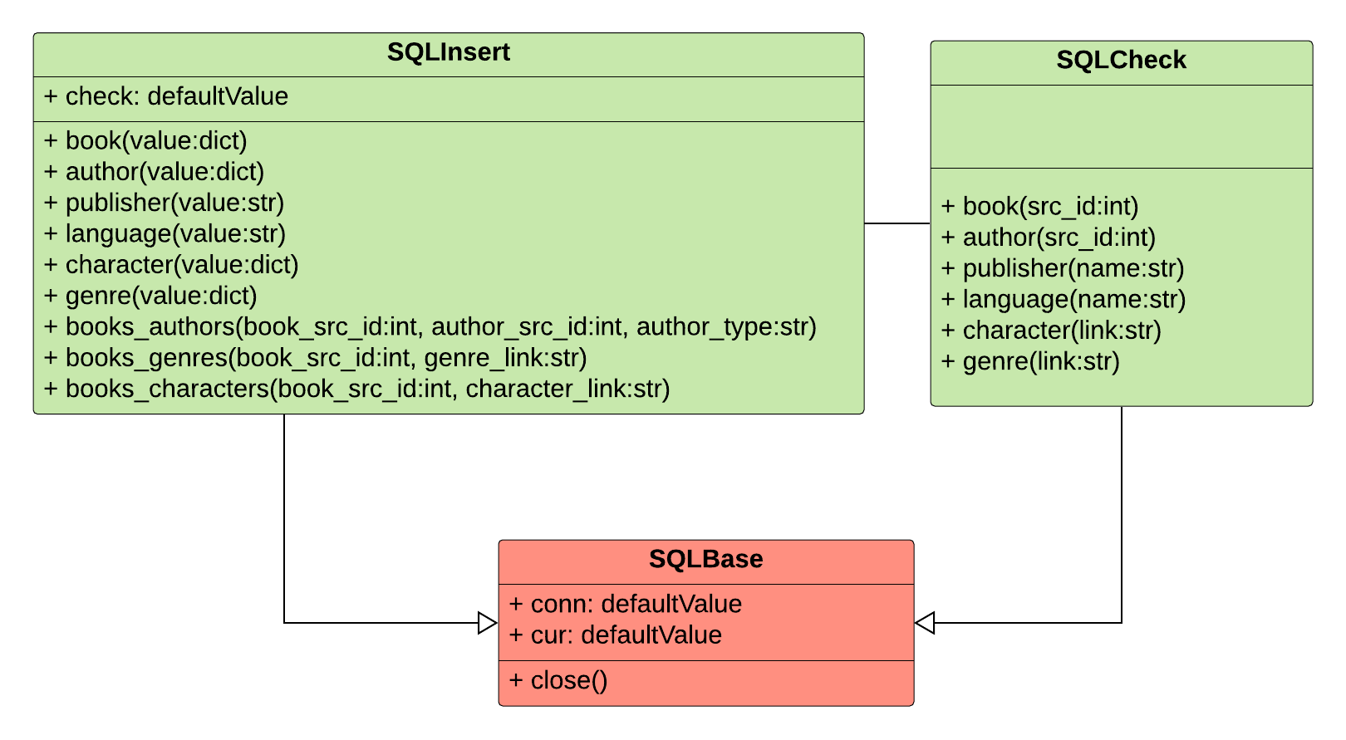
Database Class Diagram

Slide 6
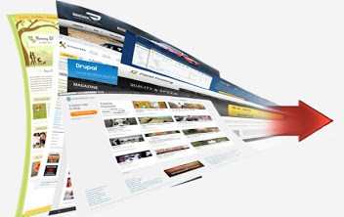


Web Scraping
Libraries: Beautiful Soup
Modules: urllib.request, urllib.error

Slide 7
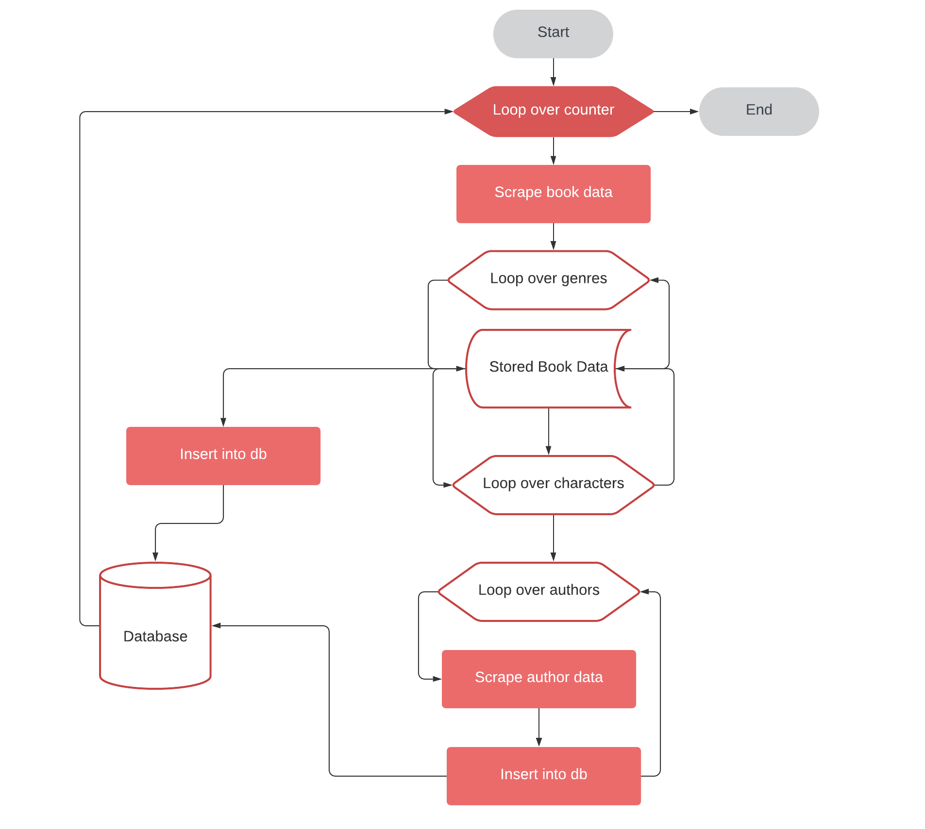

Slide 8
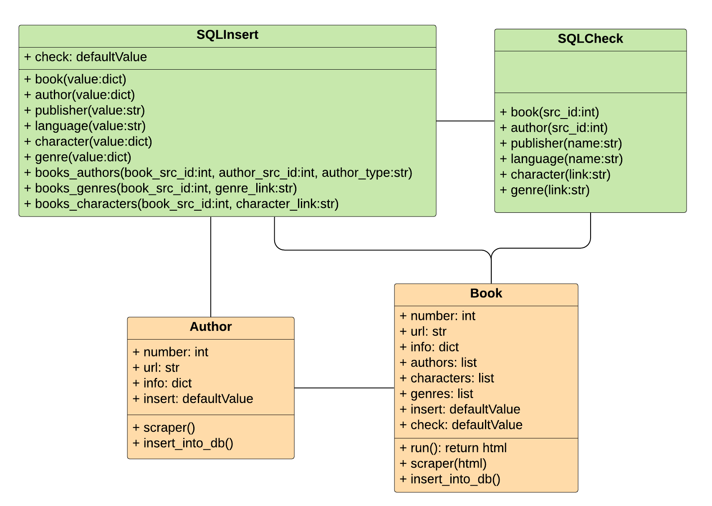
Scraping Class Diagram

Slide 9


Web Application
Framework:
Templating language:
+

Slide 10
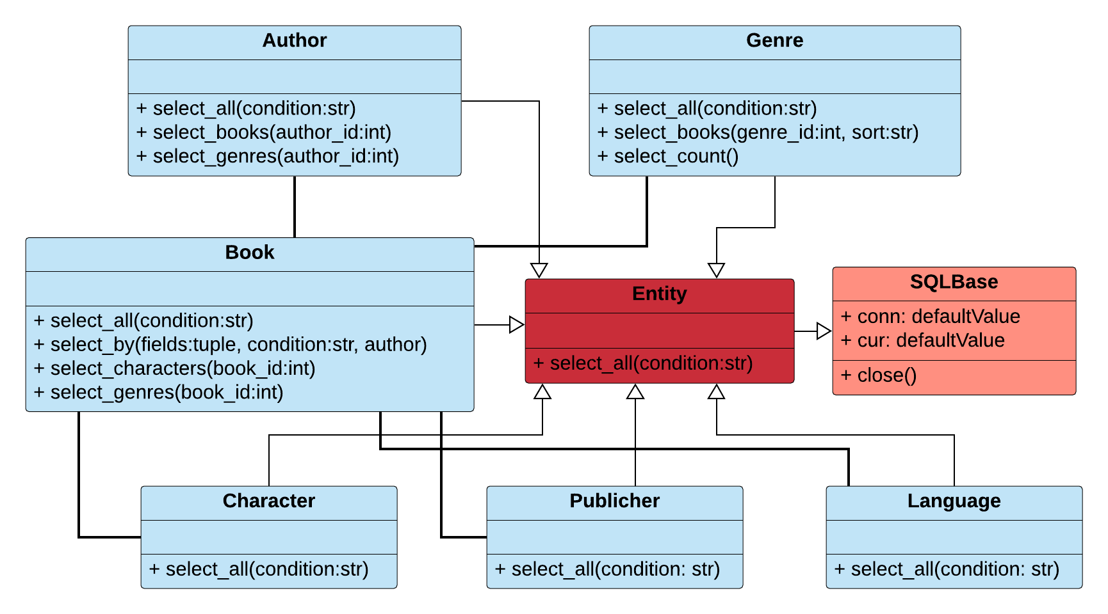
Application Class Diagram

Slide 11

THANK YOU

