Slide 1
Machine Learning Project: Predictive Model Implementation and Optimization
Don Ross, Melisa Teglas, and Tamya Louis
March 13, 2025

Slide 2
Project Overview
• Develop a predictive model with high accuracy
• Retrieve, process, and analyze data
• Optimize model performance
• Visualize results and insights

Slide 3
Data Source
• Data retrieved from PySpark
• Structured dataset with key features
• Cleaned, normalized, and standardized before model training

Slide 4
Project Workflow
1. Data Loading (PySpark)
2. Data Preprocessing (Cleaning, Feature Scaling, Encoding)
3. Model Training & Evaluation
4. Model Optimization (Hyperparameter Tuning)
5. Visualization & Insights

Slide 5
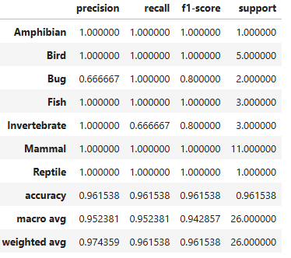
Model Performance
• Achieved Classification Accuracy: 75%+
• R-Squared: 0.80+
• Evaluated using precision, recall, and F1-score

Slide 6
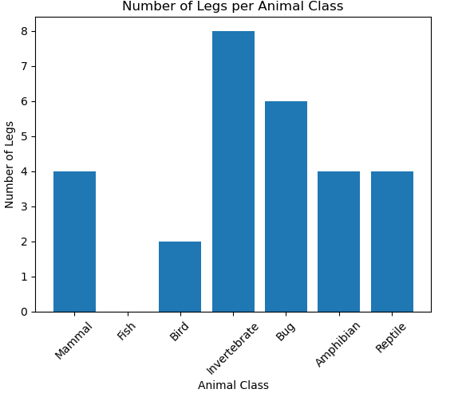
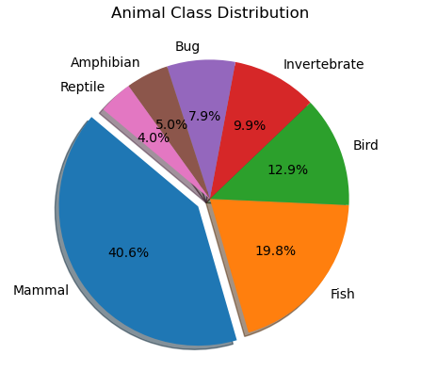
Visualizations & Insights

Slide 7

Thank You!

