Slide 1
İntroduction to programming
Dr. Cemil OZ
Lecture 1: Course Introduction

Slide 2
outline
Syllabus
Course textbooks and materials
Grading
Special needs
Topics to be covered

Slide 3
Syllabus
Week | Topics
1 | Introduction
2 | Variables, Constant, and Operators
3 | loops
4 | Functions
6 | structure
7 | class
8 | Arrays

Slide 4
Syllabus
Week | Topics
9 | strings
10 | Operator overloading
11 | Inheritance
12 | Pointers
13 | Input, Output and disk files
14 | Students project

Slide 5
History of C and C++
History of C
  Evolved from two other programming languages
    BCPL and B
      “Typeless” languages
  Dennis Ritchie (Bell Laboratories) in the early 1970s
    Added data typing, other features
  Development language of UNIX
  Hardware independent
    Portable programs
  1989: ANSI standard
  1990: ANSI and ISO standard published
    ANSI/ISO 9899: 1990

Slide 6
History of C and C++
History of C++
  Extension of C
  Early 1980s: Bjarne Stroustrup (Bell Laboratories)
  “Spruces up” C
  Provides capabilities for object-oriented programming
    Objects: reusable software components
      Model items in real world
    Object-oriented programs
      Easy to understand, correct and modify
  Hybrid language
    C-like style
    Object-oriented style
    Both

Slide 7
C++ Standard Library
C++ programs
  Built from pieces called classes and functions
C++ standard library
  Rich collections of existing classes and functions
“Building block approach” to creating programs
  “Software reuse”

Slide 8
Java
Java
  1991: Sun Microsystems
    Green project
  1995: Sun Microsystems
    Formally announced Java at trade show
  Web pages with dynamic and interactive content
  Develop large-scale enterprise applications
  Enhance functionality of web servers
  Provide applications for consumer devices
    Cell phones, pagers, personal digital assistants, …

Slide 9
Visual Basic, Visual C++ and C#
BASIC
  Beginner’s All-Purpose Symbolic Instruction Code
  Mid-1960s: Prof. John Kemeny and Thomas Kurtz (Dartmouth College)
Visual Basic
  1991
    Result of Microsoft Windows graphical user interface (GUI)
      Developed late 1980s, early 1990s
  Powerful features
    GUI, event handling, access to Win32 API, object-oriented programming, error handling
  Visual Basic .NET

Slide 10
Visual Basic, Visual C++ and C#
Visual C++
  Microsoft’s implementation of C++
    Includes extensions
    Microsoft Foundation Classes (MFC)
    Common library
      GUI, graphics, networking, multithreading, …
      Shared among Visual Basic, Visual C++, C#
.NET platform
  Web-based applications
    Distributed to great variety of devices
      Cell phones, desktop computers
  Applications in disparate languages can communicate

Slide 11
Visual Basic, Visual C++ and C#
C#
  Anders Hejlsberg and Scott Wiltamuth (Microsoft)
  Designed specifically for .NET platform
  Roots in C, C++ and Java
    Easy migration to .NET
  Event-driven, fully object-oriented, visual programming language
  Integrated Development Environment (IDE)
    Create, run, test and debug C# programs
    Rapid Application Development (RAD)
  Language interoperability

Slide 12
Other High-level Languages
FORTRAN
  FORmula TRANslator
  1954-1957: IBM
  Complex mathematical computations
    Scientific and engineering applications
COBOL
  COmmon Business Oriented Language
  1959: computer manufacturers, government and industrial computer users
  Precise and efficient manipulation of large amounts of data
    Commercial applications

Slide 13
A computer is an electronic device that manipulates information, or data. It has the ability to store, retrieve, and process data. You may already know that you can use a computer to type documents, send email, play games, and browse the Web. You can also use it to edit or create spreadsheets, presentations, and even videos.

Slide 14
A computer program is a collection of instructions that performs a specific task when executed by a computer.
A computer requires programs to function, and typically executes the program's instructions in a central processing unit.
A computer program is usually written by a computer programmer in a programming language. From the program in its human-readable form of source code, a compiler can derive machine code—a form consisting of instructions that the computer can directly execute. Alternatively, a computer program may be executed with the aid of an interpreter.
A part of a computer program that performs a well-defined task is known as an algorithm. A collection of computer programs,libraries and related data are referred to as software. Computer programs may be categorized along functional lines, such asapplication software or system software.

Slide 15
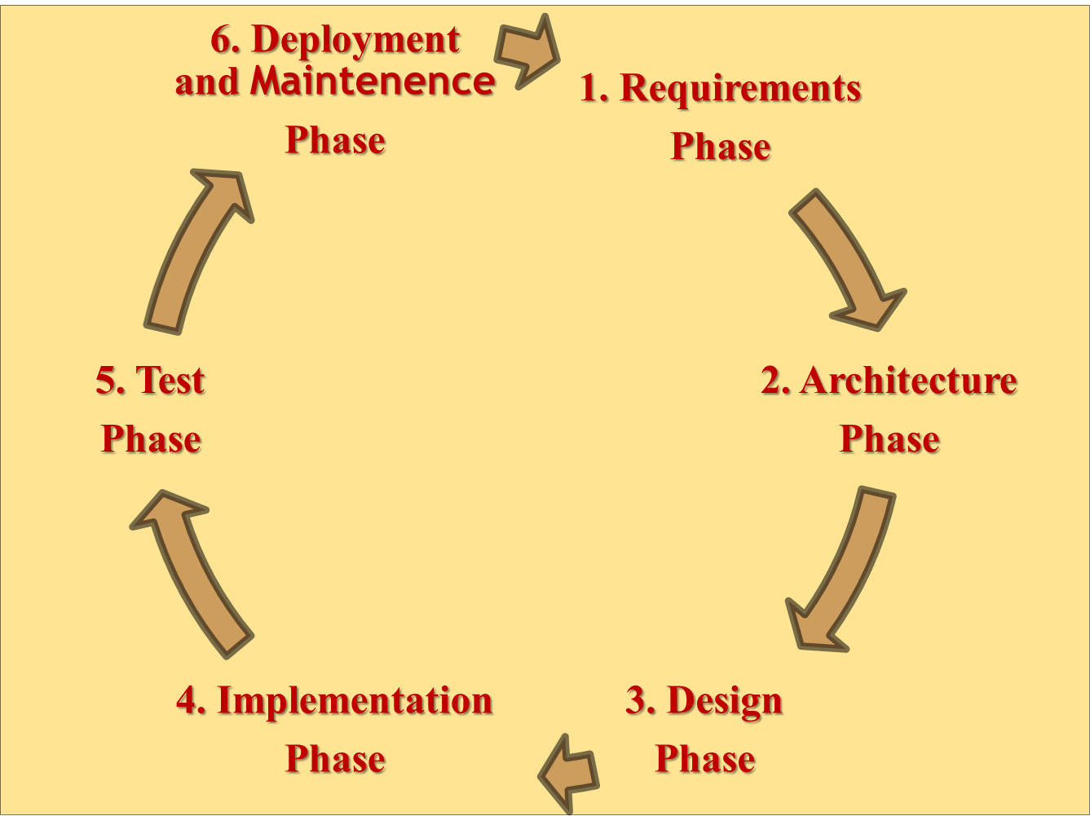
Yazılım Geliştirme Yaşam Döngüsü
Sakarya Üniversitesi
BSM 103 Programlamaya Giriş

Slide 16
Other High-level Languages
Pascal
  Prof. Niklaus Wirth
  Academic use

Slide 17
Basics of a Typical C++ Environment
Phases of C++ Programs:
  Edit
  Preprocess
  Compile
  Link
  Load
  Execute
Editor
Program is created in
the editor and stored
on disk.
Disk
Preprocessor
Disk
Preprocessor program
processes the code.
Compiler creates
object code and stores
it on disk.
Compiler
Disk
Linker links the object
code with the libraries,
creates a.out and
stores it on disk
Linker
Disk
Primary
Memory
Loader
Loader puts program
in memory.
Disk
.
.
.
.
.
.
Primary
Memory
CPU
CPU takes each
instruction and
executes it, possibly
storing new data
values as the program
executes.
.
.
.
.
.
.

Slide 18
Analyzing C programs
C is a structured program: The most distinguish features of a structured language is that it uses blocks. A block is a set of statements that are logically connected.

Slide 19
First Program in c
#include < stdio.h>
void main()
{
printf("\nHello World\n");
}
Hello World

Slide 20
  A c program, whatever its size, consists of functions and variables.
  A function contains statements that specify the computing operation to be done, and variables store values used during the computation.
  C functions are like the subroutines and functions in Fortran or the procedures and Functions of Pascal.
  Our example is a function named main. Normally you can give functions any name whatever you like.
  Main is special that c program begins executing at the beginning of main.
  Every c program must have a main function.
  Main will usually call other functions to help perform its job. Some that you wrote , and others from libraries that are provided for you. The first line of the program.

Slide 21
  The first line of the program
#include < stdio.h>
  Tells the compiler to include information about the standard input/output library: the line appears at the beginning of many C sources files. ( Libraries will be described later)
  One method of communicating data between functions is for the calling function to provide a list of values, called arguments, to the function it calls. The parentheses after the function name surround the argument list. Main( argument list)
  The statements of a function are enclosed in braces { }. Here in this example function main contains only one statement,
printf("\nHello World\n");
  Printf a function and “hello, world\n” is its argument.
A sequence of characters in double quotes, like “hello, world\n”, is called a character string or string constant. .
\n is newline character
Printf function never supply a newline character automatically.

Slide 22
#include < stdio.h>
void main()
{
printf("Hello");
printf(" World");
printf("\n");
}
  /* ….*/
  Comments can be written anywhere in the code: any characters between /* and */ are ignored by the compiler and can be used to make the code easier to understand.
  ; is using after statements.

Slide 23
#include < stdio.h>
void main(){printf("\nHello World\n");}
#include < stdio.h>
void main()
{
printf("\n");
printf("Hello World");
printf("\n");
}

Slide 24
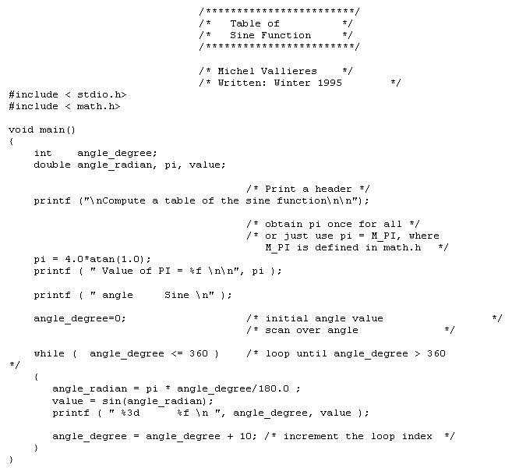
The following program, sine.c, computes a table of the sine function for angles between 0 and 360 degrees.

Slide 25
Why Do We Need Object-Oriented Programming?
Object-Oriented Programming was developed because limitations were discovered in earlier approaches to programming.
what these limitations are and how they arose from traditional programming languages.
Procedural Languages
C, Pascal, FORTRAN, and similar languages are procedural languages.
That is, each statement in the language tells the computer to do something: Get some input, add these numbers, divide by 6, display that output.
A program in a procedural language is a list of instructions.
For very small programs, no other organizing principle (often called a paradigm) is needed.
The programmer creates the list of instructions, and the computer carries them out.

Slide 26
Division into Functions
When programs become larger, a single list of instructions becomes unwieldy.
Few programmers can comprehend a program of more than a few hundred statements unless it is broken down into smaller units.
For this reason the function was adopted as a way to make programs more comprehensible to their human creators. (The term function is used in C++ and C. In other languages the same concept may be referred to as a subroutine, a subprogram, or a procedure.) A procedural program is divided into functions, and (ideally, at least) each function has a clearly defined purpose and a clearly defined interface to the other functions in the program.
The idea of breaking a program into functions can be further extended by grouping a number of functions together into a larger entity called a module (which is often a file), but the principle is similar: a grouping of components that carries out specific tasks.
Dividing a program into functions and modules is one of the cornerstones of structured programming, the somewhat loosely defined discipline that influenced programming organization for several decades before the advent of Object-Oriented Programming.

Slide 27
Problems with Structured Programming
As programs grow ever larger and more complex, even the structured programming approach begins to show signs of strain.
Analyzing the reasons for these failures reveals that there are weaknesses in the procedural paradigm itself. No matter how well the structured programming approach is implemented, large programs become excessively complex.
What are the reasons for these problems with procedural languages? There are two related problems. First, functions have unrestricted access to global data. Second, unrelated functions and data, the basis of the procedural paradigm, provide a poor model of the real world.
Let’s examine these problems in the context of an inventory program. One important global data item in such a program is the collection of items in the inventory. Various functions access this data to input a new item, display an item, modify an item, and so on.

Slide 28
Problems with Structured Programming
As programs grow ever larger and more complex, even the structured programming approach begins to show signs of strain.
Analyzing the reasons for these failures reveals that there are weaknesses in the procedural paradigm itself. No matter how well the structured programming approach is implemented, large programs become excessively complex.
What are the reasons for these problems with procedural languages? There are two related problems. First, functions have unrestricted access to global data. Second, unrelated functions and data, the basis of the procedural paradigm, provide a poor model of the real world.
Let’s examine these problems in the context of an inventory program. One important global data item in such a program is the collection of items in the inventory. Various functions access this data to input a new item, display an item, modify an item, and so on.

Slide 29
Characteristics of Object-Oriented Languages
İn general and C++ in particular
Objects
When you approach a programming problem in an object-oriented language, you no longer ask how the problem will be divided into functions, but how it will be divided into objects.
Thinking in terms of objects, rather than functions, has a surprisingly helpful effect on how easily programs can be designed.
This results from the close match between objects in the programming sense and objects in the real world.

Slide 30
What kinds of things become objects in object-oriented programs?
The answer to this is limited only by your imagination, but here are some typical categories to start you thinking:
Physical objects Automobiles in a traffic-flow simulation Electrical components in a circuit-design program Countries in an economics model Aircraft in an air-traffic-control system
• Elements of the computer-user environment Windows Menus Graphics objects (lines, rectangles, circles) The mouse, keyboard, disk drives, printer • Data-storage constructs Customized arrays Stacks Linked lists Binary trees
• Human entities Employees Students Customers Salespeople • Collections of data An inventory A personnel file A dictionary A table of the latitudes and longitudes of world cities
• User-defined data types Time Angles Complex numbers Points on the plane
• Components in computer games Cars in an auto race Positions in a board game (chess, checkers) Animals in an ecological simulation Opponents and friends in adventure games

Slide 31
Classes
In OOP ,objects are members of classes.
What does this mean?
Almost all computer languages have built-in data types. For instance, a data type int, meaning integer, is predefined in C++
You can declare as many variables of type int as you need in your program:
int day;
int count;
int divisor;
int answer;
In a similar way, you can define many objects of the same class, as shown in Figure.
A class serves as a plan, or template. It specifies what data and what functions will be included in objects of that class. Defining the class doesn’t create any objects, just as the mere existence of data type int doesn’t create any variables.

Slide 32
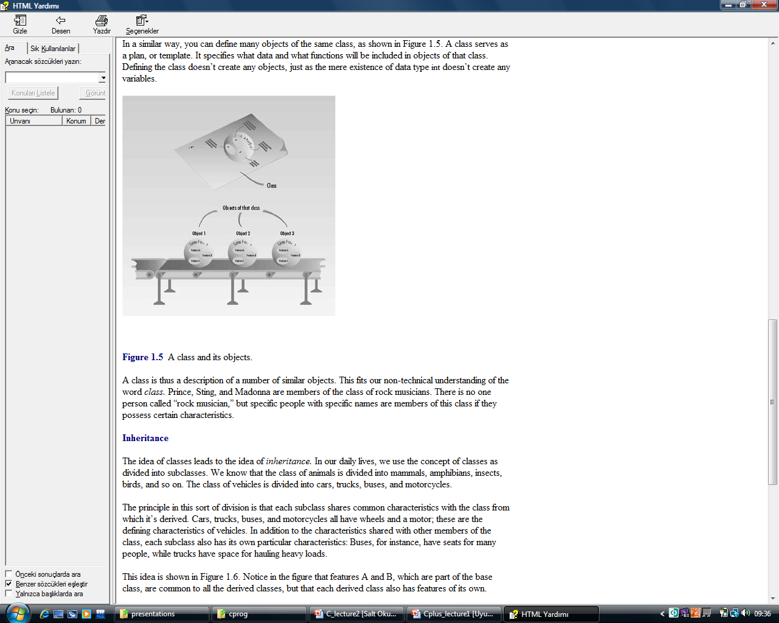
A class is thus a description of a number of similar objects.

Slide 33
Inheritance
The idea of classes leads to the idea of inheritance.
In our daily lives, we use the concept of classes as divided into subclasses.
We know that the class of animals is divided into mammals, amphibians, insects, birds, and so on. The class of vehicles is divided into cars, trucks, buses, and motorcycles.
The principle in this sort of division is that each subclass shares common characteristics with the class from which it’s derived. Cars, trucks, buses, and motorcycles all have wheels and a motor; these are the defining characteristics of vehicles. In addition to the characteristics shared with other members of the class, each subclass also has its own particular characteristics: Buses, for instance, have seats for many people, while trucks have space for hauling heavy loads.

Slide 34
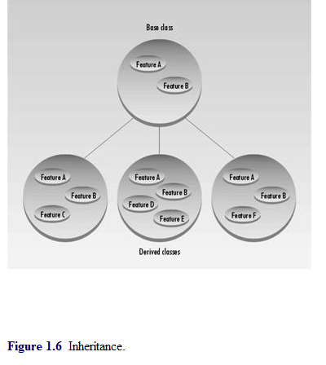
This idea is shown in Figure.
In the figure that features A and B, which are part of the base class, are common to all the derived classes, but that each derived class also has features of its own.
In a similar way, an OOP class can be divided into subclasses. In C++ the original class is called the base class; other classes can be defined that share its characteristics, but add their own as well. These are called derived classes.

