Slide 1
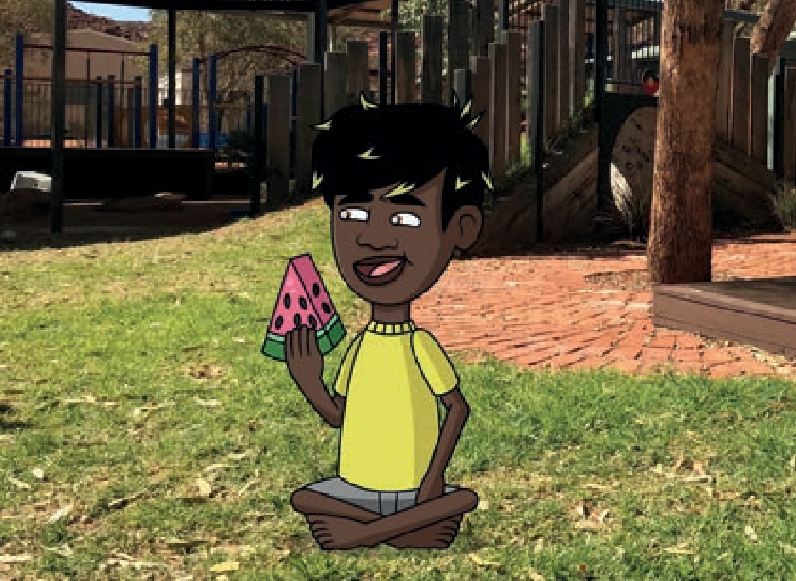


Sounds-Write Initial Code
Uniľ
1
Ĩim saľ
Written by SPELD SA. Illustrated by Trent Lambert.
Phonic Book Series

Slide 2

Learning to read
SPELD SA Phonic Books support the teaching of reading by using a structured synthetic phonics approach. The books support the learning of letter-sounds and blending in a sequential phonic order, helping readers to develop their independent decoding skills.
Reading tips:
Have the reader point to each letter, saying the sound it represents. Swipe left to right under the letters, saying the sounds quickly and smoothly together to read the word. e.g. p-a-t is ‘pat’; s-a-n-d is ‘sand’; n-e-s-t is ‘nest’.
If the reader is having difficulty hearing the word when blending, try to model stretching the sounds together without pauses, e.g. nnnniiiiiip, is ‘nip’. If you can’t stretch the sounds, e.g. ‘tap’, have the reader put the first two sounds together before adding the final sound. Alternately you can use letter tiles and push them together while saying the sounds.
Check that the reader understands the meaning of the words in the book.
Some words include sounds that will be taught in later units. Many of these words will be able to be sounded out as the reader learns more alternate spellings. For these words tell the reader the word and determine any ‘tricky’ parts by breaking it up into its sounds.
Readers may need help with these words:
is

Slide 3
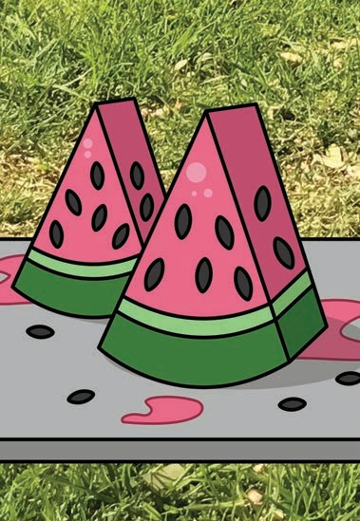
1

Slide 4
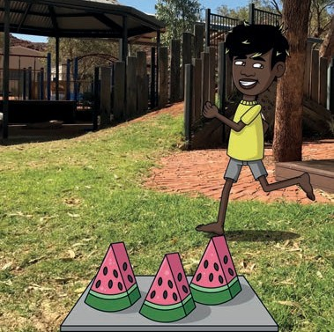
“Siľ, Ĩim.”
2

Slide 5
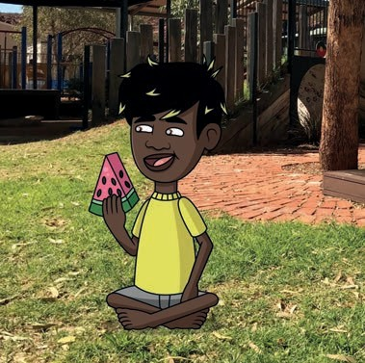
Ĩim saľ.
3

Slide 6
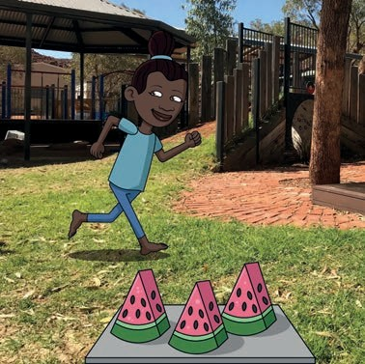
Iľ is Sam.
4

Slide 7
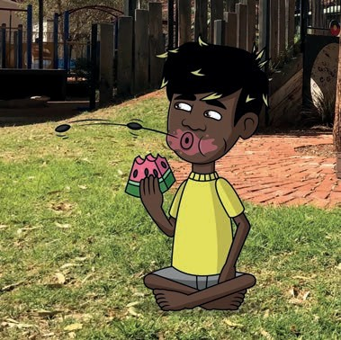
“Sam!”
5

Slide 8
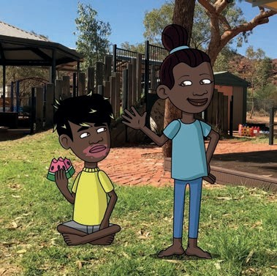
“Siľ, Sam.”
6

Slide 9
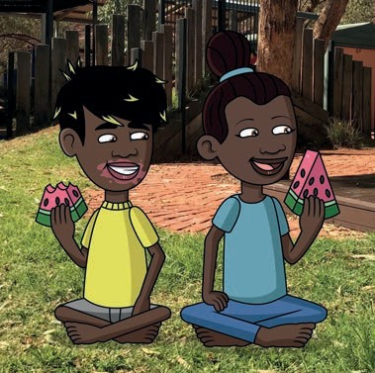
Sam saľ.
7

Slide 10
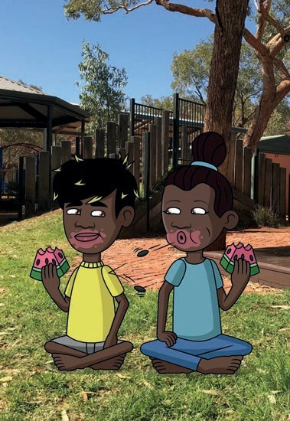
8

Slide 11

Cover artwork by Elizabeth Close
Elizabeth Close is an Anangu woman from the Pitjantjatjara and Yankunytjatjara language groups in the APY Lands in outback South Australia. She was born in Adelaide and spent much of her upbringing in remote communities, learning her language and receiving cultural education.
‘This artwork represents the literacy and numeracy learning journey, and the path towards independent learning. The circles represent the collaborative learning and supports around children with specific learning di culties, including children, schools, families, SPELD SA and others.’ Elizabeth Close, Artist.
About this series
The SPELD SA Phonic Book Series complements the teaching of reading and writing using a structured synthetic phonics approach. SPELD SA aims to help Aboriginal students engage with phonic books by having characters, content and settings that reflect Aboriginal communities. In developing this series, SPELD SA has consulted with people who live and work in the Anangu, Pitjantjatjara Yankunytjatjara (APY) Lands.
We understand that the content, settings and characters may not reflect all Aboriginal people and their experiences but hope that Aboriginal students learning to read can find some familiarity in and connection with these books in their literacy journey.
Acknowledgments
Produced by SPELD SA 2022.
Thanks to the Anangu Lands for their contribution, including cultural advice on Anangu communities and language.
SPELD SA is grateful for the contributions of staff and volunteers for: consultation and project development; writing texts; illustrating, photography and graphic design;
character development and cultural advice; speech and language advice. This is a wide community effort, with talents, expertise and knowledge being shared for a common purpose – to improve literacy. Thank you all.

Slide 12



This set of SPELD SA Phonic Books aligns with the learning objectives of the Sounds-Write linguistic phonics program. Sounds-write.co.uk
Initial Code:
Unit 1
Unit 2
Unit 3
Unit 4
Unit 5
Unit 6
Unit 7
Unit 8
Unit 9
Unit 10
a i m s t
n o p
b c g h d e f v k l r u
j w z
x y ff ll ss zz vcc cvcc
ccvc
ccvcc cvccc cccvc
Unit 11 sh
Unit 11 ch
Unit 11 th
Unit 11 ck
Unit 11 wh
Unit 11 ng
Unit 11 qu
Bridging Unit
Bridging Unit Bridging Unit
ch tch
c k ck
w wh
SPELD SA acknowledges the traditional custodians of the lands on which we deliver our services. We pay our respects to elders past, present and emerging, and recognise their cultural heritage, beliefs and relationship with the land.
Copyright SPELD SA, 2022

