Slide 1


Splunk Enterprise Evaluation Experimental Analysis of Threat Detection Capabilities
ICT Risk Assessement
Melissa Abdelkafi - 702815
Academic Year : 2025-2026

Slide 2
Introduction
The project started as an evaluation of Splunk Enterprise’s technical capabilities in detecting threats as a security analytics platform. While the main point of this study was to test features using synthetic data, a blind analysis was conducted that revealed additional malicious activity that weren’t in the provided alerts file. What started as a straightforward ”Can Splunk Enterprise detect threats?” turned into a much more intriguing question: ”Can Splunk Enterprise effectively identify additional threats that were missed?” This report documents my attempts to answer this question.

Slide 3

Primary Objectives
Ingest log datasets
Real-time analytics via Search Processing Language (SPL)
Test AI toolkit
Leverage Splunk’s BI-style dashboards
Threat detection and risk scoring
Evaluate performance
>

Slide 4


Methodology & Evaluation Metrics
Set up
Key Metrics
Analysis Approach
Alert Coverage
Threat Discovery Rate
Data Loss Amount
Attacker Servers
Malware Delivery
Attack Infrastructure
Behavioral Patterns
Dataset: WarmCookie malware traffic (pcap + alerts)
Time windows: 4 min (alerts) /
32 min (traffic)
Total packets: 18,189
Data converted to CSV for Splunk ingestion.
Analysis using SPL queries for threat discovery and validation

Slide 5
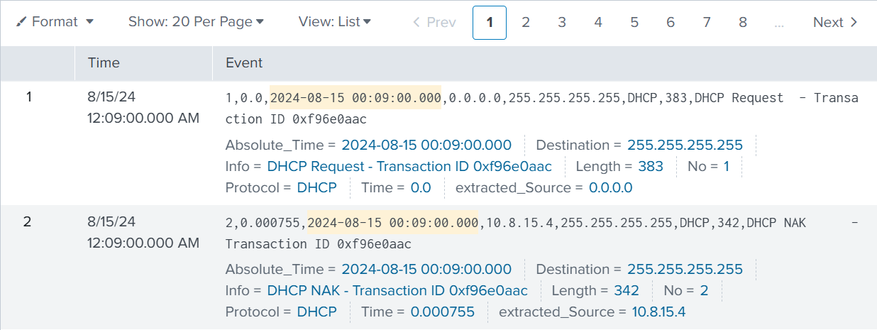
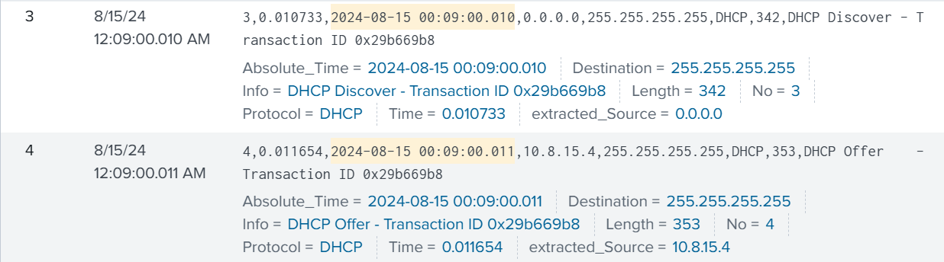
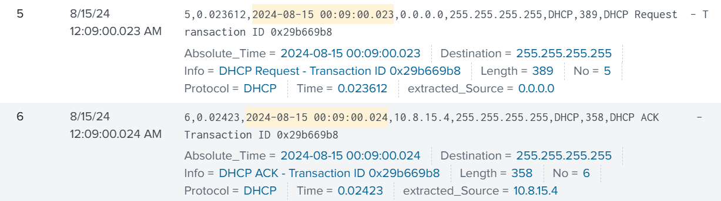
Log Ingestion The traffic data ingestion happened through a lookup creation which helped to parse the log effectively.

Slide 6
Experimental
Evaluation

Slide 7
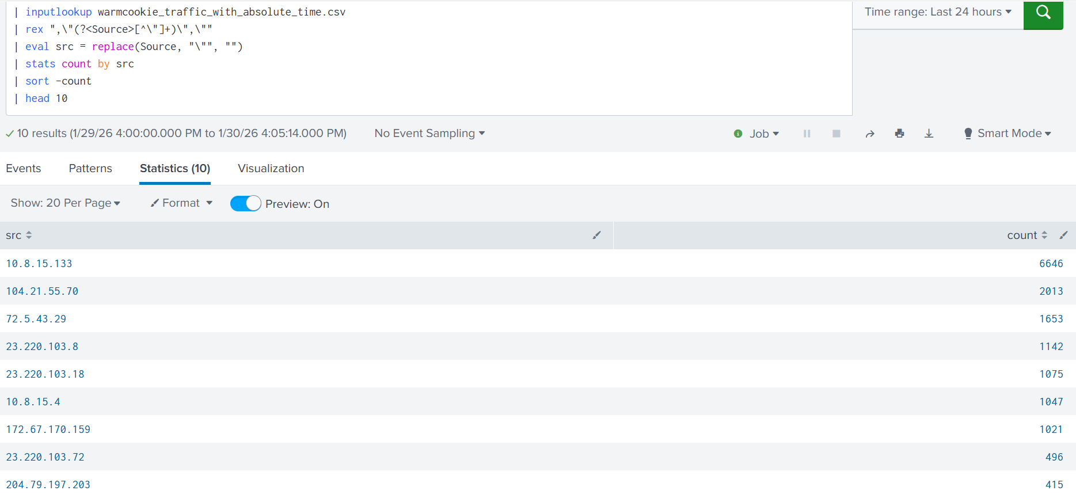
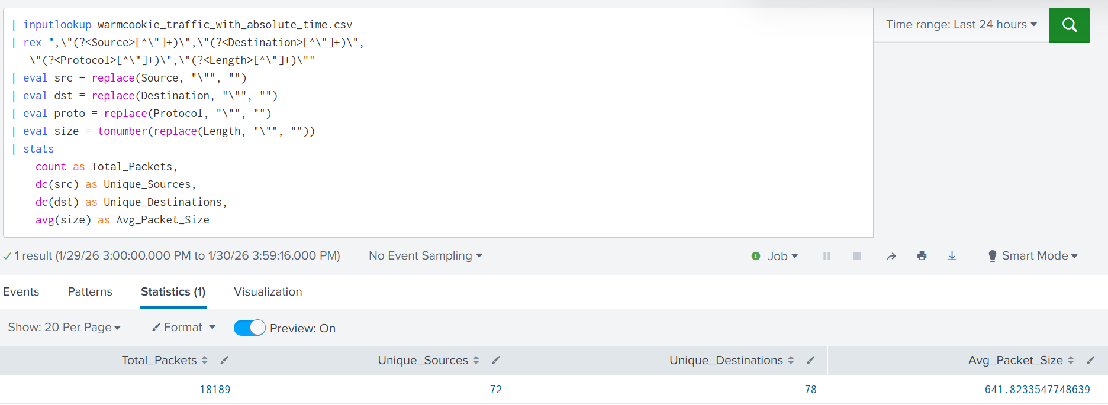
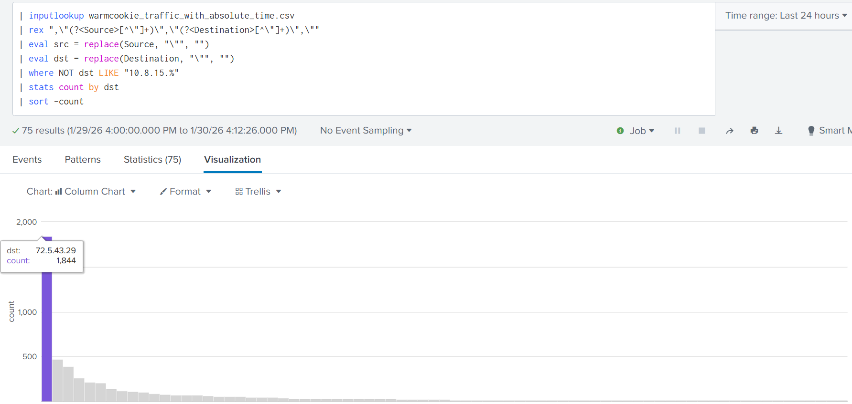
Network Discovery
Baseline Statistics:
Total Packets: 18,189
Unique Sources: 72
Unique Destinations: 78
Avg Packet Size: 642 bytes
The ‘Noisiest’ Device:
10.8.15.133
6,646 packets (36.5% of all traffic)
One internal device doing 1/3 of the traffic
External Communication:
Top destination: 72.5.43.29
1,844 packets to this single IP
Discovery Takeaway:
The network baseline gave us a suspect (10.8.15.133) and a destination to watch (72.5.43.29).

Slide 8
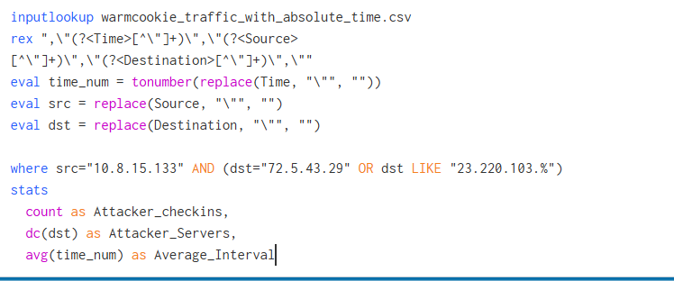
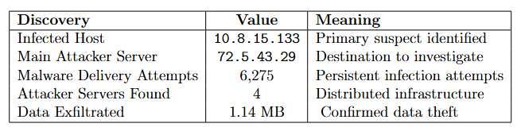
From Reconnaissance To Detection
The investigation flow
Step 1:
Found Noisy Host
10.8.15.133
:
Step 2:
Traced its traffic
to 72.5.43.29
Step 3:
Analyzed traffic
Malware, Attacker servers, and Exfiltration
Query identifies the communiation pattern between the infected host and known malicious servers
What the investigation revealed
Through correlation of our findings, the 4 Attacker servers are:
72.5.43.29,
104.21.55.70,
23.220.103.8,
23.220.103.18

Slide 9
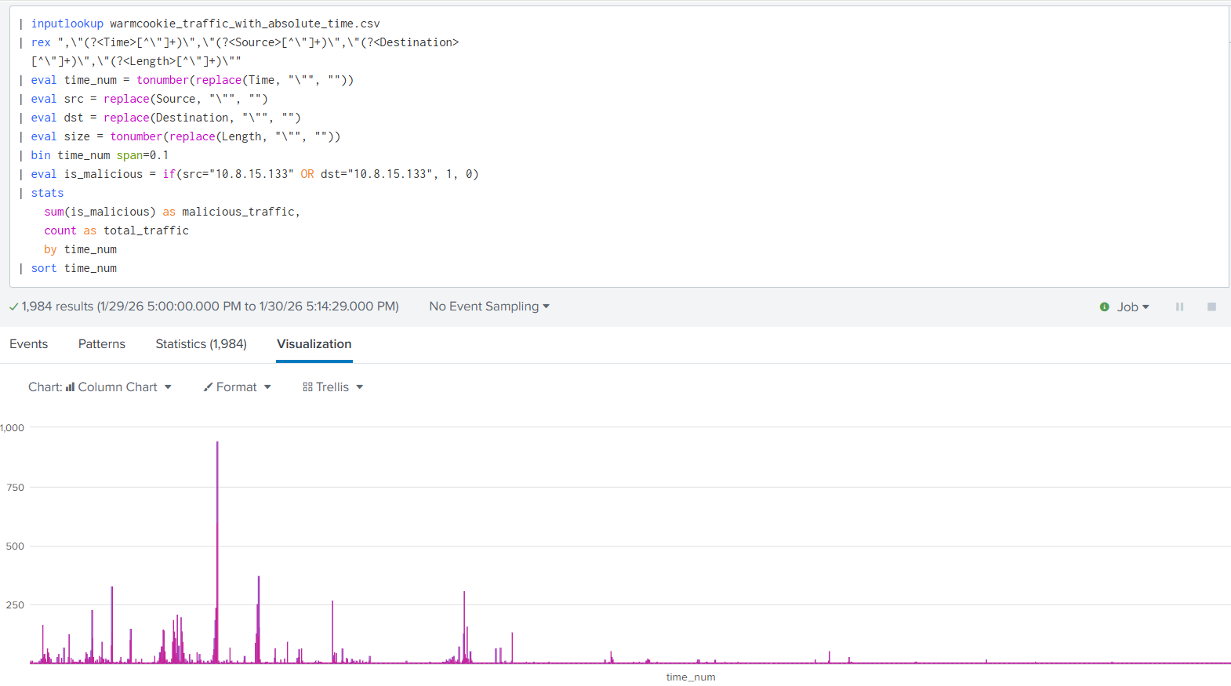
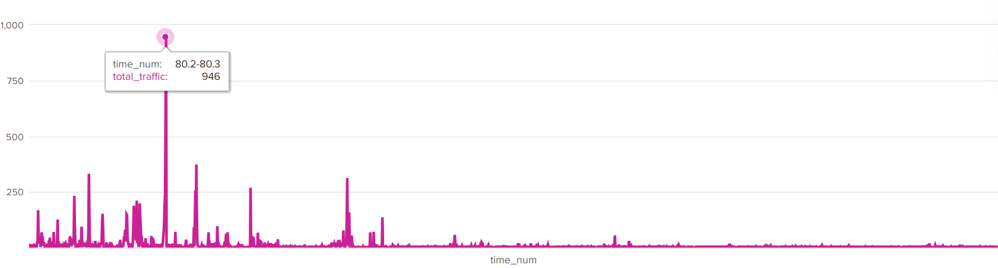
Attack Timeline Reconstruction
Query Creates a time-series visualization of malicious activity by grouping traffic into time buckets and marking communications involving the infected host.
Peak activity happened at time: 80.2 - 80.3 (between 00:10:20.200 and 00:10:20.300 UTC). The attack peaked at that specific moment with 946 packets representing the highest concentration of malicious activity.

Slide 10

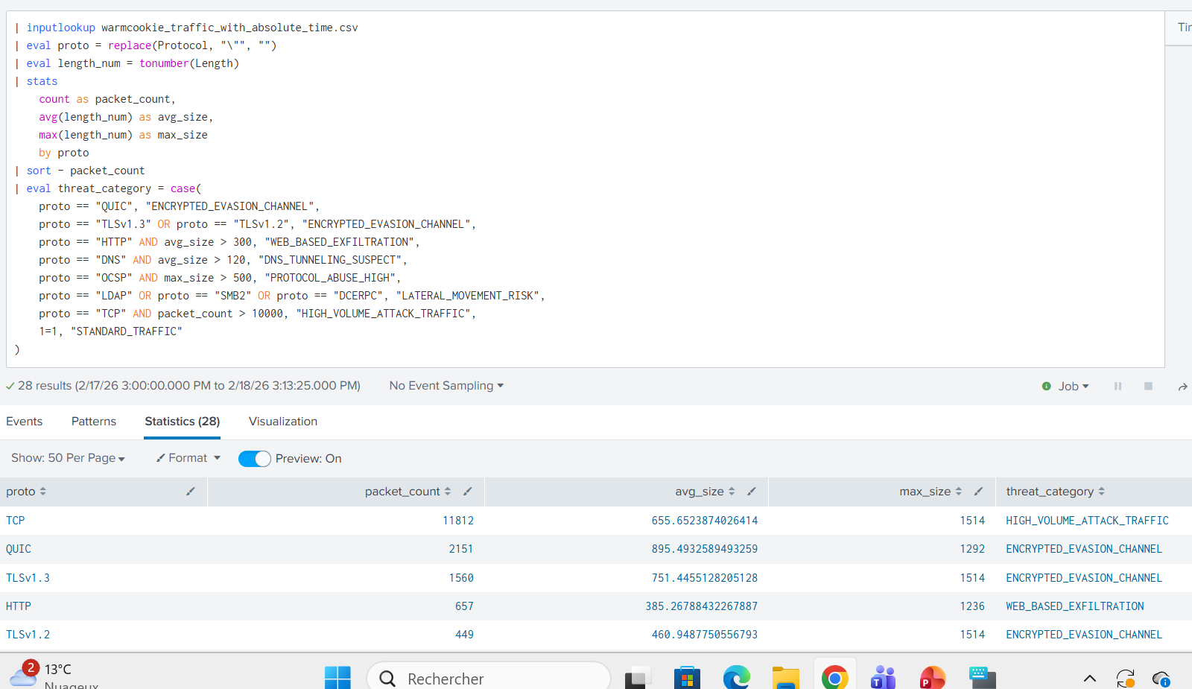
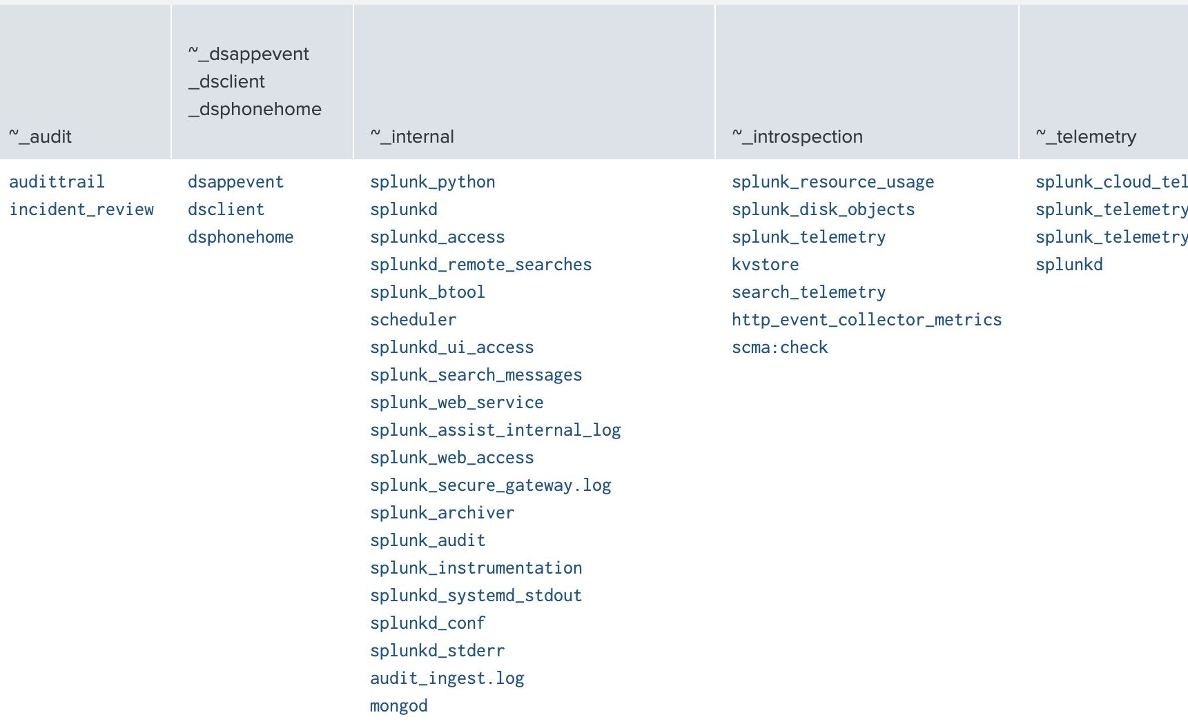


Protocol-based Threat Categorization
Query groups all network traffic by protocol, then calculates for each protocol how many packets, average size and maximum size.
Then classifies each protocol into a threat category based on some behavioral rules.

Slide 11
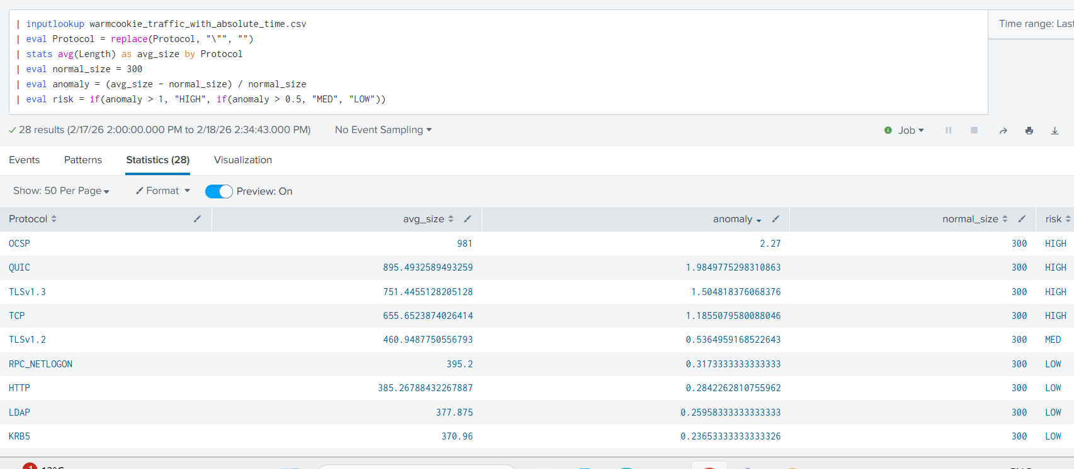
Protocol-based Anomaly Detection (Baseline Comparison)
Query sets a ”normal” packet size at 300 bytes, then computes avg packet size for each protocol to measure the deviation from the 300 bytes baseline using an anomaly score, then assigns risk levels (High/Medium/Low).

Slide 12
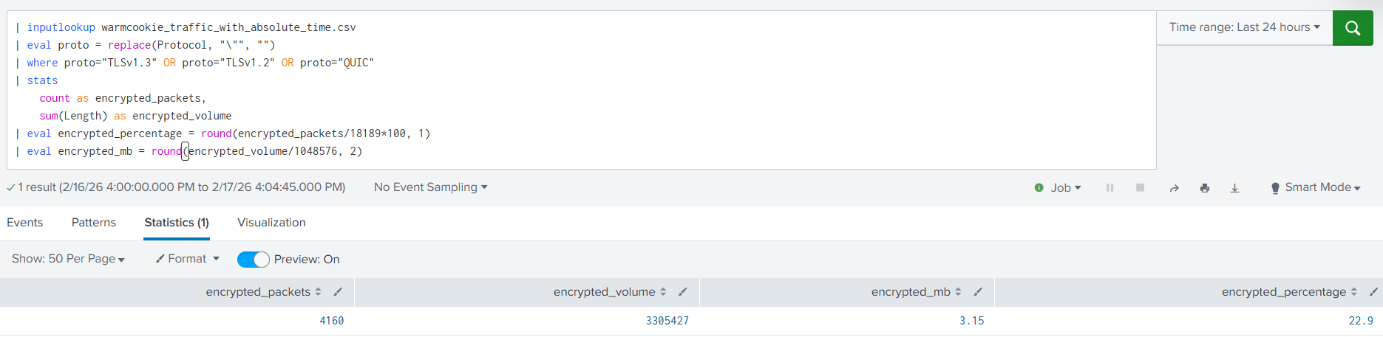
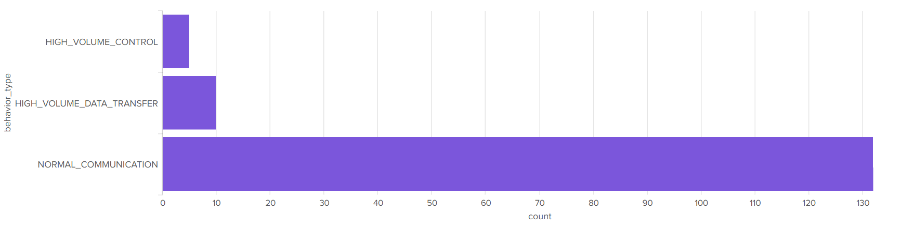
Encrypted Traffic Analysis
Query filters only encrypted protocols (TLSv1.2, TLSv1.3, QUIC), then counts total encrypted packets and sum their bytes, to then calculate what percentage of total traffic is encrypted.
22.9% of all network traffic was encrypted (QUIC + TLSv1.2 + TLSv1.3);
This represents 3.15 MB of data that cannot be inspected;
WarmCookie malware abused QUIC ;
The existing security alerts didn’t include most encrypted threats.
Clustering Analysis
Computes frequency of the communication, the average message size, the consistency size for each src-dst pair, then clusters the behavior-type in three categories

Slide 13
AI Toolkit

Slide 14
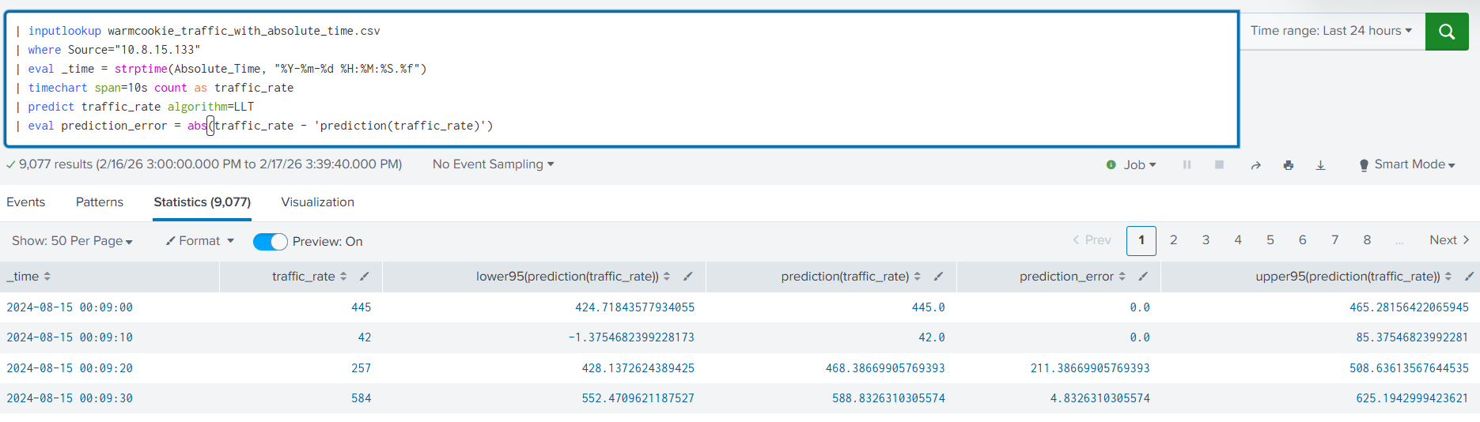
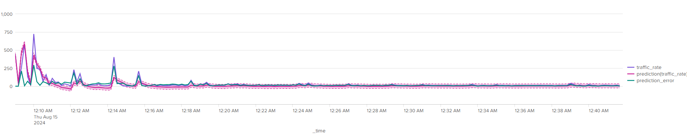
Time Series Forecasting
Query uses the LLT = Local Level Trend algorithm (exponential smoothing),which learns the normal traffic pattern and predicts what the next value should be, then it compares actual vs. predicted to measure accuracy.

Slide 15
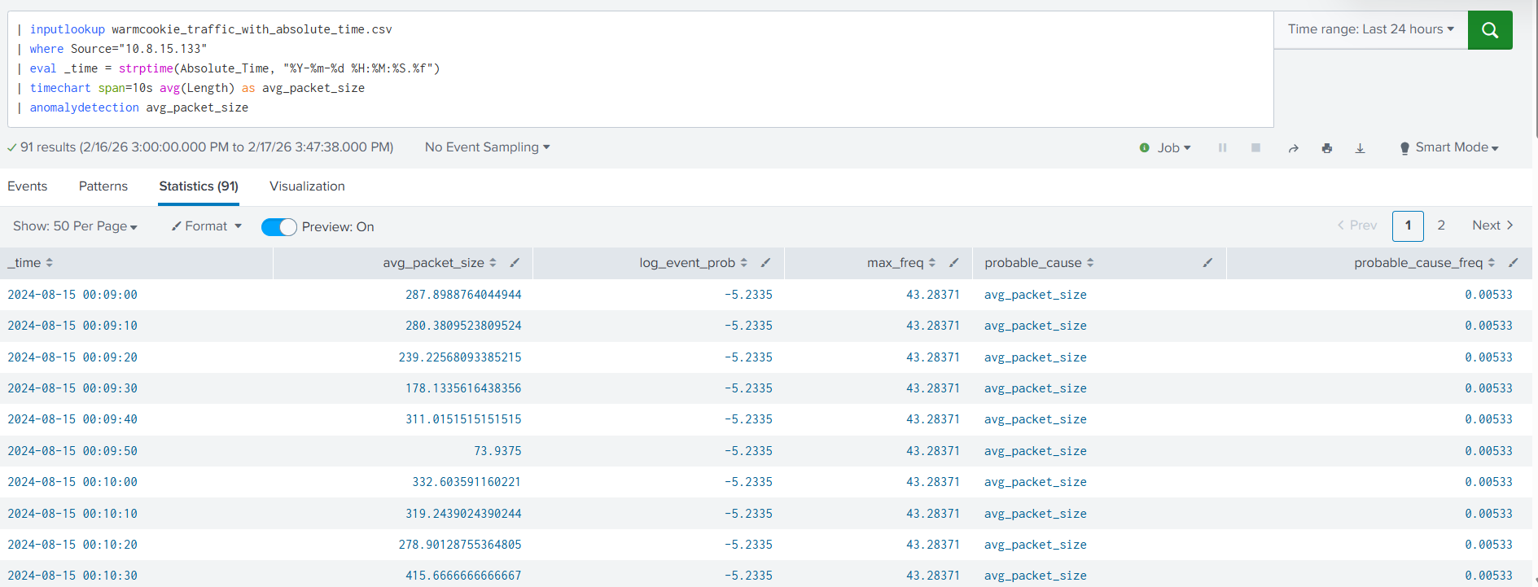
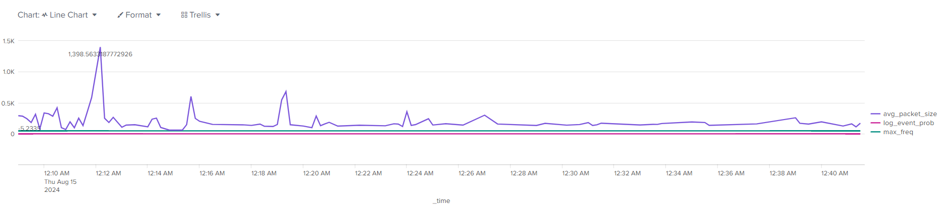
Anomaly Detection
Query uses anomalydetection (Probabilistic Autoregressive) algorithm to look for statistical outliers in packet sizes.

Slide 16
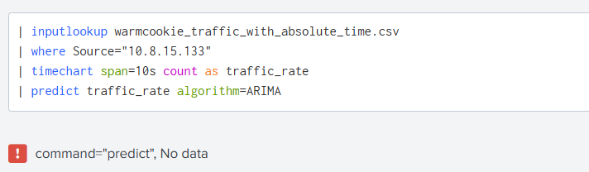
Splunk AI toolkit shows selective utility
With ARIMA (Autoregressive Integrated Moving Average) algorithm the query returns command=”predict” No data errors. And the main reason is that it requires historical data and our 32.7 minutes attack window isn’t enough for it to process.
This part shows that in the AI Toolkit we might encounter a tool-data mismatch.
AI Toolkit Assessment:
• LLT: Actually useful (predicted attack earlier)
• Anomalydetection: Silent failure (looked like it worked, but it didn’t)
• ARIMA: ”No data” errors (impossible to process)

Slide 17
Comparing against Alerts file
The alerts caught what they were designed to catch:
3 alerts about HTTP traffic to/from 72.5.43.29 (the main attacker server). These caught the malware download and some POST backs
2 alerts about HTTP traffic to 23.205.110.48 (another attacker server). These caught some early attack reconnaissance and connectivity tests
1 alert about TLSv1.0 (outdated encryption)
2 alerts about internal stuff (DNS errors and RPC kerberos traffic). These represented noise, not the main event
8 alerts in total that actually related to the attack
What wasn’t in the alerts file:
• 3,711 encrypted packets (TLSv1.3 + QUIC) - 0 alerts
• 593 lateral movement packets (LDAP, SMB2, DCERPC) - 0 alerts
• 419 DNS tunneling packets - 0 alerts
• OCSP protocol abuse (981-byte payload) - 0 alerts
• 28+ minutes of post-compromise activity - 0 alert

Slide 18
Results and Findings

Slide 19
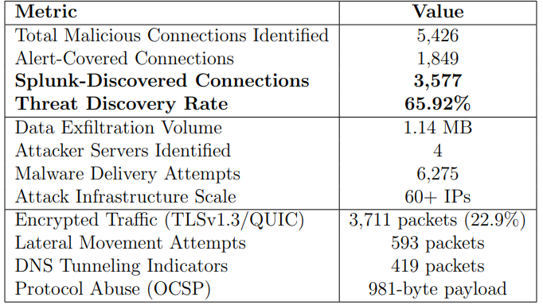
>
Results Summary
Our initial question got answered: yes, Splunk found a lot that the alerts file missed. About 65% more malicious. But it is even more interesting:
• The malware just prioritized encryption and abused trusted protocols.
• Distributed Infrastructure: The attack utilized 60+ external servers rather than focusing on centralized Attacker servers.
• Splunk’s Machine Learning Toolkit was really inconsistent, some algorithms worked, some failed silently, and some couldn’t even run on 32 minutes of data.
• The biggest wins came from manual SPL queries, not automation.

Slide 20
Splunk Evaluation

Slide 21
Strengths
Limitations
Detection Gap Coverage: +65.92% threat discovery
Comprehensive Visibility: Raw traffic analysis
Flexible SPL: Enables deep correlation
Real-time Analytics: Captured attack progression
Actionable Dashboards: BI-style visualizations
Data Preparation for parsing: Requires clean, structured logs
AI Toolkit-data incompatibility and reliablity issues
Skill Barrier: Advanced SPL knowledge needed

Slide 22
Security Recommendations
Isolate infected host (10.8.15.133) to prevent further compromise.
Block identified Attack infrastructure by implementing firewall rules for 72.5.43.29,23.205.110.48, 23.33.138.184, and 60+ additional malicious IPs.
Investigate domain controller (10.8.15.4) for movement evidence.
Encrypted Traffic Profiling for QUIC and TLSv1.3 to external destinations. Packet contents can’t be inspected but metadata can identify anomalous encrypted channels.
Query Depth Monitoring by tracking query sizes and responses.
Protocol Abuse Detection by monitoring non-web protocols (e.g OCSP) for anomalous payload sizes.
Lateral Movement Baseline by establishing communication baselines for LDAP,SMB, and DCERPC traffic and any deviation from normal patterns involving the infected host should trigger immediate containment.
>

Slide 23

Conclusion
Splunk found 65% more threats than existing alerts and not just more of the same, but entire new categories of threats which is essential in an environment where this level of visibility is no longer optional. Finally, we can conclude that the platform’s true value lies not in automated detection but in enabling human analytical reasoning through its flexible query language.

Slide 24
Thank You!

