Slide 1

SelenIum WebdrIver and TestNG project

Slide 2
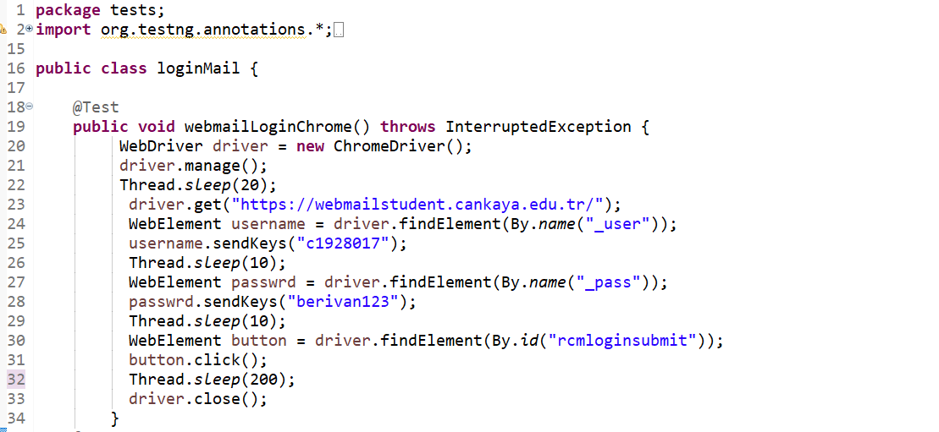
SELENIUM WEB DRIVER1

Slide 3
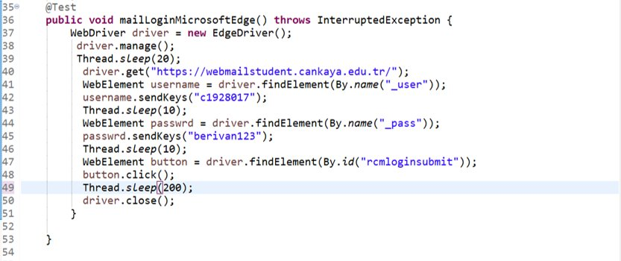

Slide 4
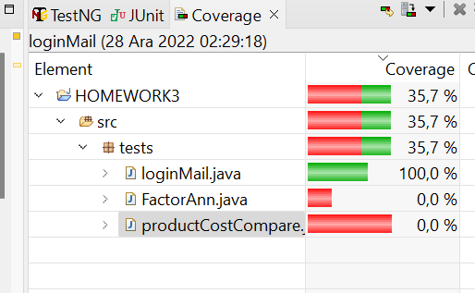
TEST COVERAGE

Slide 5
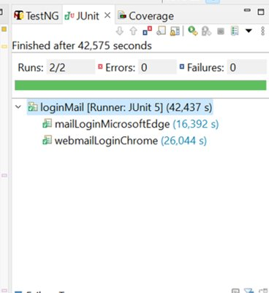

Slide 6
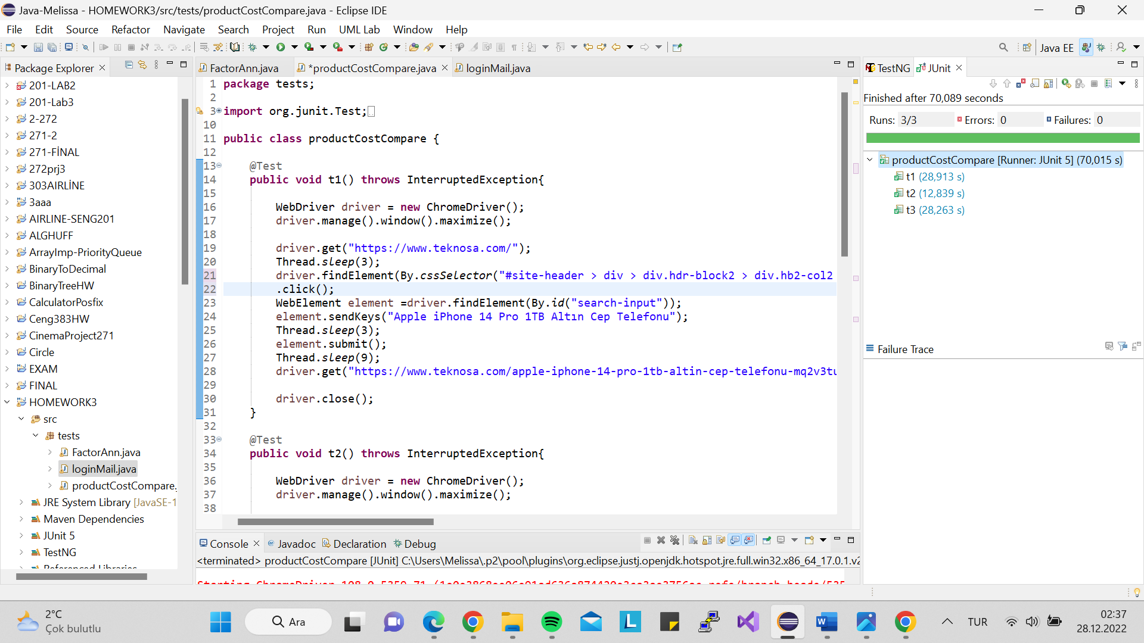
SELENIUM WEB DRIVER2

Slide 7
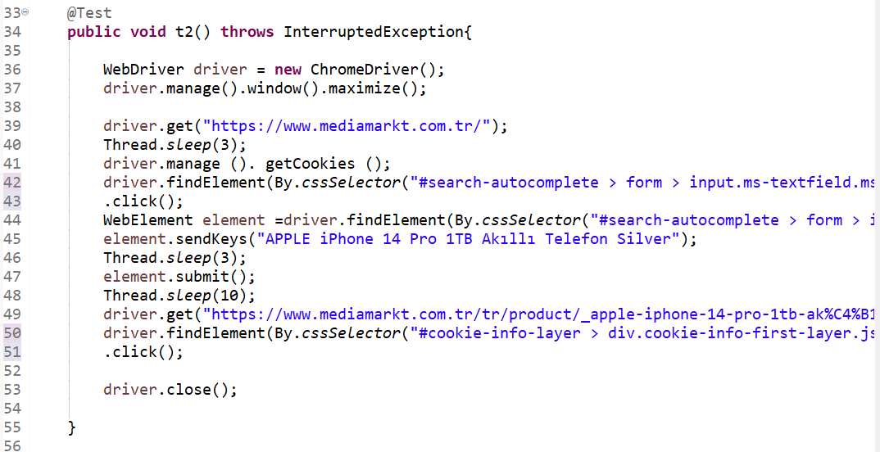

Slide 9
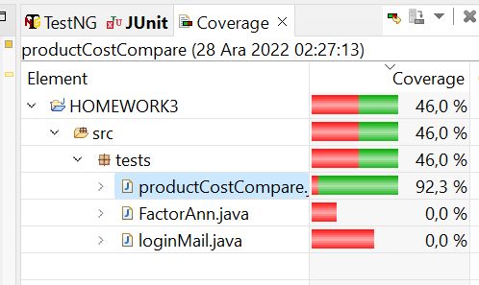
TEST COVERAGE

Slide 10
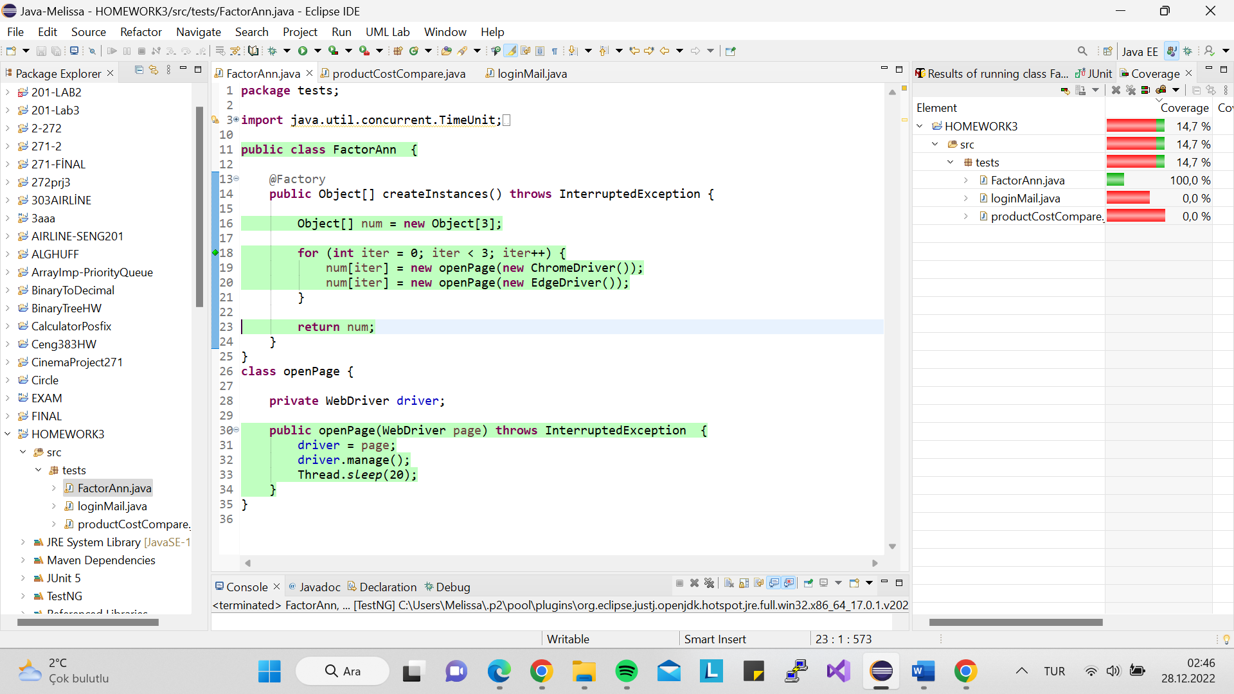
TESTNG

Slide 11
TEST COVERAGE

Slide 12
THANKS

