Slide 1
Women in Economics
Karen Pence
Federal Reserve Board
13 January 2020
Disclaimer. The views in this talk are mine and are not necessarily those of the Federal Reserve Board. Thanks to Amanda Bayer for inspiring many of the ideas and to Kathy Bi and Jackie Blair for being my test audience.

Slide 2
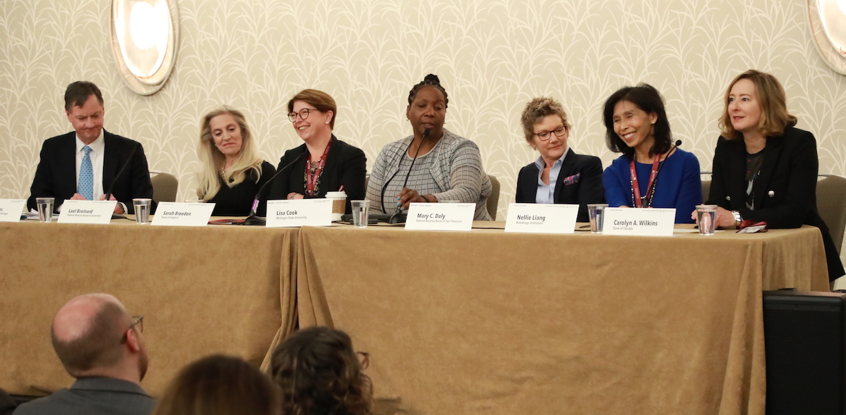
Women in Central Banking Panel, AEA 2020

Slide 3
Statistics

Slide 4
White men are a disproportionate share of economics majors at UVA (data: 2011-15)
Source. https://www.newyorkfed.org/data-and-statistics/data-visualization/diversity-in-economics#interactive/overview
Notes:
WM: 13.7% WW: 5.2% URM-W: 3.5% URM-M: 8.1% AM: 15.7% AW: 9.8%

Slide 5
Women are more under-represented as they advance in their careers
Source. Committee on the Status of Women in the Economics Profession Annual Report, 2018.

Slide 6
Progress for new PhDs has stalled since 2006
Source. Committee on the Status of Women in the Economics Profession Annual Report, 2018.

Slide 7
Black, Latinx, and American Indian numbers are abysmal
Recipients of PhDs in Economics from US Institutions, 2016-17 Academic Year | Number
All women | 380
U.S. Citizen or permanent resident | 148
American Indian or Native Alaskan | 0
Black or African-American | 7
Hispanic or Latina | 4
Source. Committee on the Status of Minority Groups in the Economics Profession Annual Report, 2018

Slide 8
US looks worse than Europe
Source. Auriol, Friebel, Weinberger, and Wilhelm (2019) on behalf of European Economic Association.

Slide 9
Women are especially under-represented in finance, macro, and international economics
Share of authors of papers presented at the NBER Summer Institute who are female
Source. Chari and Goldsmith-Pinkham (2018).

Slide 10
Female authors are under-represented at top journals
The share of papers in the AER, QJE, JPE, and ECA written only by women rose from 1% in 1987 to 6% in 2015
The QJE did not publish a single exclusively female-authored paper between 2015-17
In several recent years, ECA and the JPE did not either
Source. Erin Hengel, “Publishing while female: Are women held to higher standards? Evidence from peer review.”

Slide 11
Why does it matter?

Slide 12
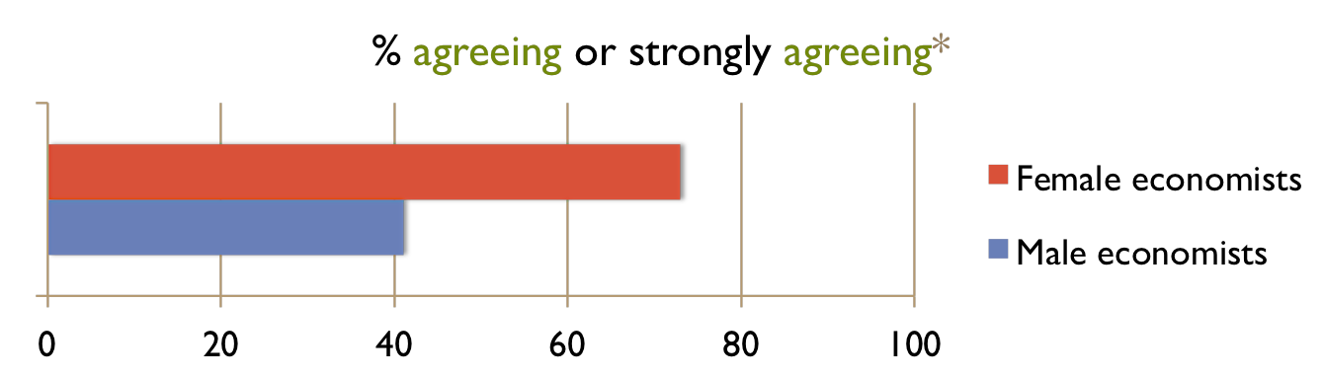
Men and women have different views on the economy
From a survey of economists:
“The distribution of income in the US should be made more equal.”
☐strongly disagree ☐disagree ☐neutral ☐agree ☐strongly agree
*regression-adjusted
Source. May, McGarvey, and Whaples (2013).

Slide 13
Economic policymaking is shaped by personal experiences

Slide 14
Diverse teams conduct more influential research
A study of 2.5 million scientific papers written by U.S. based researchers from 1985 to 2008 found:
Papers with author teams of different ethnicities and in different locations were published in higher-impact journals and cited more often.
Source. Freeman and Huang (2015). Journal of Labor Economics, 33(S1):S289-S318.

Slide 15
Diverse teams are more profitable
An undergraduate business school class in the Netherlands required its students to work in teams to start a venture.
Teams with an equal gender mix performed better in terms of sales and profits than male dominated teams.
Source. Hoogendoorn, Oosterbeek, and van Praag. Management Science (2013). 59(7):1514-1528.

Slide 16
Mechanisms

Slide 17
Preferences and ability
Economists often start with the presumption that markets are efficient and so any differences across groups must result from differences in preferences or ability.
Renee Adams, a professor at Oxford who researches gender in finance (among other issues), shared comments that she has gotten on her work (next slide). Her summary:
It’s always the woman’s fault!

Slide 18
Typical comments on papers on gender…
Paintings by women sell for less:
“For example, it is possible that female artists were less famous because they had to take "time off" to take care of kids (and this then affects price).” JPE referee report
“Maybe art made by males is simply better! I know this a tricky statement but we are scientists…”
“After your presentation, [name suppressed]’s network comment kept me thinking about what possibly could better explain the gender gap. Then I remembered a paper that shows fundamental differences in the way males and females network, what risks they are taking, and how they perform.”
Labor force participation explains board leadership patterns:
“Based on my observations of my wife and her friends, women seem to prefer to stay home.” JFQA referee report
Women hold fewer board seats in STEM firms:
“Women prefer less math-intensive jobs because they are more social.”
Women hold fewer board seats in Finance:
“Women are more risk-averse and shy away from competition.“
“Women do not like math.”
Female finance professors earn less money:
“they are not as productive as the male professors.”

Slide 19
Women’s careers are more affected by child birth
Source. Kleven, Landais, SØgaard (2019). Children and Gender Inequality: Evidence from Denmark. AEJ:Applied, 11(4):181-209.

Slide 20
Gender-neutral parental leave widens the gap
From Antecol, Bedard, and Stearns, “Equal but Inequitable: Who Benefits from Gender-Neutral Tenure Clock Stopping Policies?,” AER, 108(9):2420–2441.
Gender-neutral clock stopping policies decrease female tenure rates in top-50 economics departments by 19 percentage points while increasing male tenure rates by 17 percentage points.
Primary mechanism driving the results appears to be that men publish more in top-5 journals after the policies are implemented, but women do not.
Because women do not similarly increase their productivity, fewer are granted tenure in their first job.
We find no evidence that gender-neutral clock stopping policies reduce the fraction of women who eventually earn tenure in the profession.

Slide 21
The share of white women majoring in math has increased in the past 15 years
White women, math
URM women, econ
Source. Bayer and Wilcox (2017) from IPEDS data on graduates from all 4-year, public or private not-for-profit institutions.

Slide 22
Female-authored papers are cited more
A study of editorial decisions and referee recommendations at 4 major journals found that:
Accepted female-authored papers were cited 25% than observably similar male-authored papers
Suggests a higher bar for female papers than would be implied by citation maximization
Card, DellaVigna, Funk, and Iriberri (2020). “Are Referees and Editors in Economics Gender Neutral?” QJE

Slide 23
Female-authored papers are written better
From Hengel (2019), “Publishing while female.”
Using readability scores, I find that female-authored papers are 1-6% better written than equivalent papers by men
The gap widens during peer review
Tougher editorial standards are most obviously consistent with authors’ observed choices.

Slide 24
Women get less credit for co-authored work
From Sarsons, Gërxhani, Reuben, and Schram (2019), “Gender Differences in Recognition for Group Work,” conditionally accepted, JPE:
Men are tenured at roughly the same rate regardless of whether they co-author or solo-author.
Women are less likely to receive tenure the more they co-author, especially when they co-author with men.
Stereotypes surrounding a task and the evaluators’ gender are factors.

Slide 25
Women do more service work
From Babcock, Recalde, Vesterlund, and Weingart (2017). “Gender Differences in Accepting and Receiving Requests for Tasks with Low Promotability.” AER, 107(3):714-747.
Examines the allocation of a task that everyone prefers be completed by someone else
Finds evidence that women, more than men, volunteer, are asked to volunteer, and accept requests to volunteer for such tasks.
Beliefs that women, more than men, say yes to tasks with low promotability appear as an important driver of these differences.

Slide 26
Female and nonwhite instructors are evaluated more harshly by students
From Boring (2017), “Gender biases in student evaluations of teaching,” Journal of Public Economics, 145:27-41.
Male students express a bias in favor of male proessors.
Men are perceived by both male and female students as being more knowledgeable and having stronger class leadership skills (which are stereotypically associated with males), despite the fact that students appear to learn as much from women as from men.
(Unfairly) poor teaching evaluations mean that women have to spend more time on their teaching relative to men.
Many professional associations have endorsed a statement that these evaluations are problematic (www.asanet.org/studentevaluations)

Slide 27
Women face more hostile audiences in seminars
From Dupas, Modestino, Niederle, and Wolfers (2019)
Collected data on questions asked of speakers in 588 seminars at 32 institutions
Women are asked on average 3.5 more questions, particularly by male faculty
Women are more likely to be asked patronizing or hostile questions

Slide 28
Don’t be this person
“Despite warning the room that she was running out of time, the questions continued. Nearing the end, one male professor insisted on an answer to a previous question with which he was unsatisfied, continued to speak over her for a time when she tried to move on, and instigated an entire corner of the room to talk over her. There was no time left at the end for Q&A, and despite cheery responses and confidence throughout interruptions, this closing “question” (disruption) seemed especially demoralizing.”
Source. Dupas, Modestino, Niederle, and Wolfers (2019).

Slide 29
Toxic attitudes toward women persist
From Wu (2019), “Gender Bias in Rumors among Professionals,” REStat
Collected 100,000 posts on Econ Job Market Rumors that discuss women (female posts) and 300,000 that discussed men (male posts)
Female posts on average contained 42% less academic or professional terms but 196% more personal or physical terms than male posts
True for women at all levels of the profession
A female post has a significantly higher chance of triggering a deviation from professional topics than a male post
Recent publicity about EJMR has not substantively changed behavior on the site

Slide 30
AEA professional climate survey
In the winter of 2018-19, the AEA surveyed its members on their views on and experiences in the profession
10,406 economists responded, for an overall response rate of 23% (33% among current members)
The responses revealed that women, nonwhite men, LGBTQ individuals, individuals with disabilities, and Muslims have worse experiences in the profession and are subject to more harassment
Nonwhite women suffer pervasive sexism and racism
https://www.aeaweb.org/resources/member-docs/final-climate-survey-results-sept-2019

Slide 31
Selected climate survey responses by gender
 | Men | Women
Satisfied with overall climate in economics | 40% | 20%
Feel valued within the field of economics | 46% | 25%
Ever been discriminated against or treated unfairly on the basis of sex | 4% | 48%
Experienced discrimination or unfair treatment in service assignments | 9% | 43%
Experienced discrimination or unfair treatment in course evaluations | 8% | 47%
Witnessed discrimination or unfair treatment on the basis of sex | 33% | 44%
Not spoken at a conference or seminar to avoid harassment | 19% | 46%
Felt disrespected by economist colleagues | 38% | 62%
Another economist or economics student made inappropriate or sexual jokes, remarks, or gestures | 13% | 43%
Another economist or economics student made unwanted romantic or sexual overtures despite your effort to discourage it | 3% | 23%

Slide 32
Resources

Slide 33
Widespread agreement: economics has a problem

Slide 34

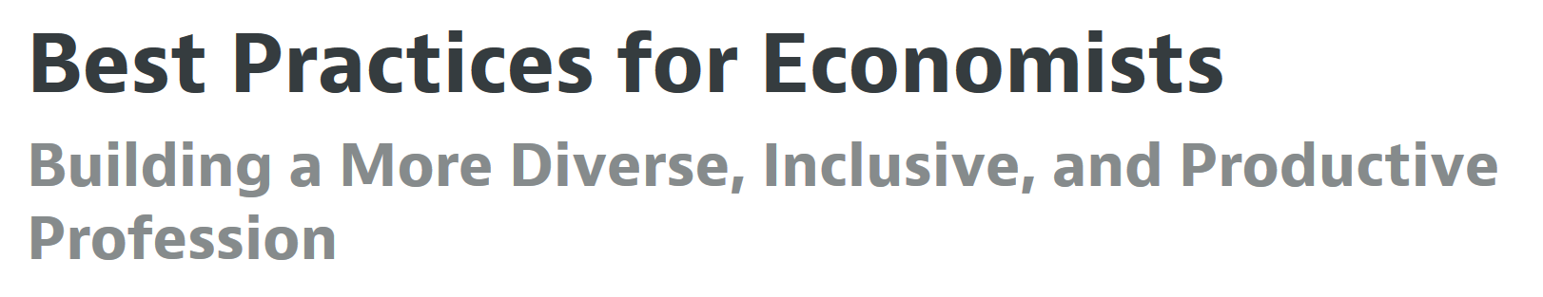
Best practices
Source: https://www.aeaweb.org/resources/best-practices

Slide 35
Some representative best practices
Conducting research
Organize conferences, seminars, and visitor programs that are inclusive.
Serving as colleagues
Be an effective bystander.
Working with students
Use outreach to counter stereotypes about economics and close other information gaps.
Leading departments and workplaces
Conduct promotion, tenure, and annual performance reviews in a transparent and equitable manner.

Slide 36
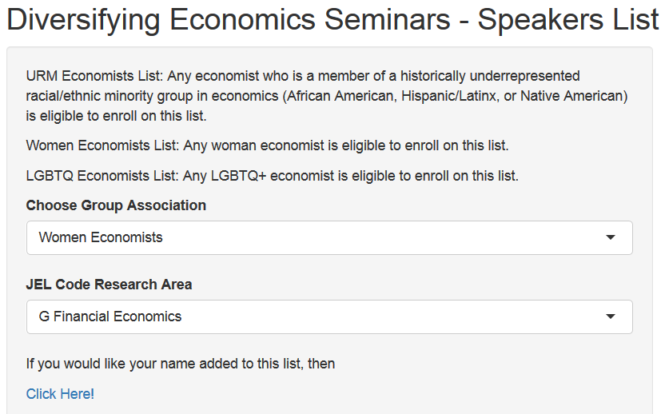
Diversifying seminar speakers in economics
https://econspeakerdiversity.shinyapps.io/EconSpeakerDiversity/

Slide 37
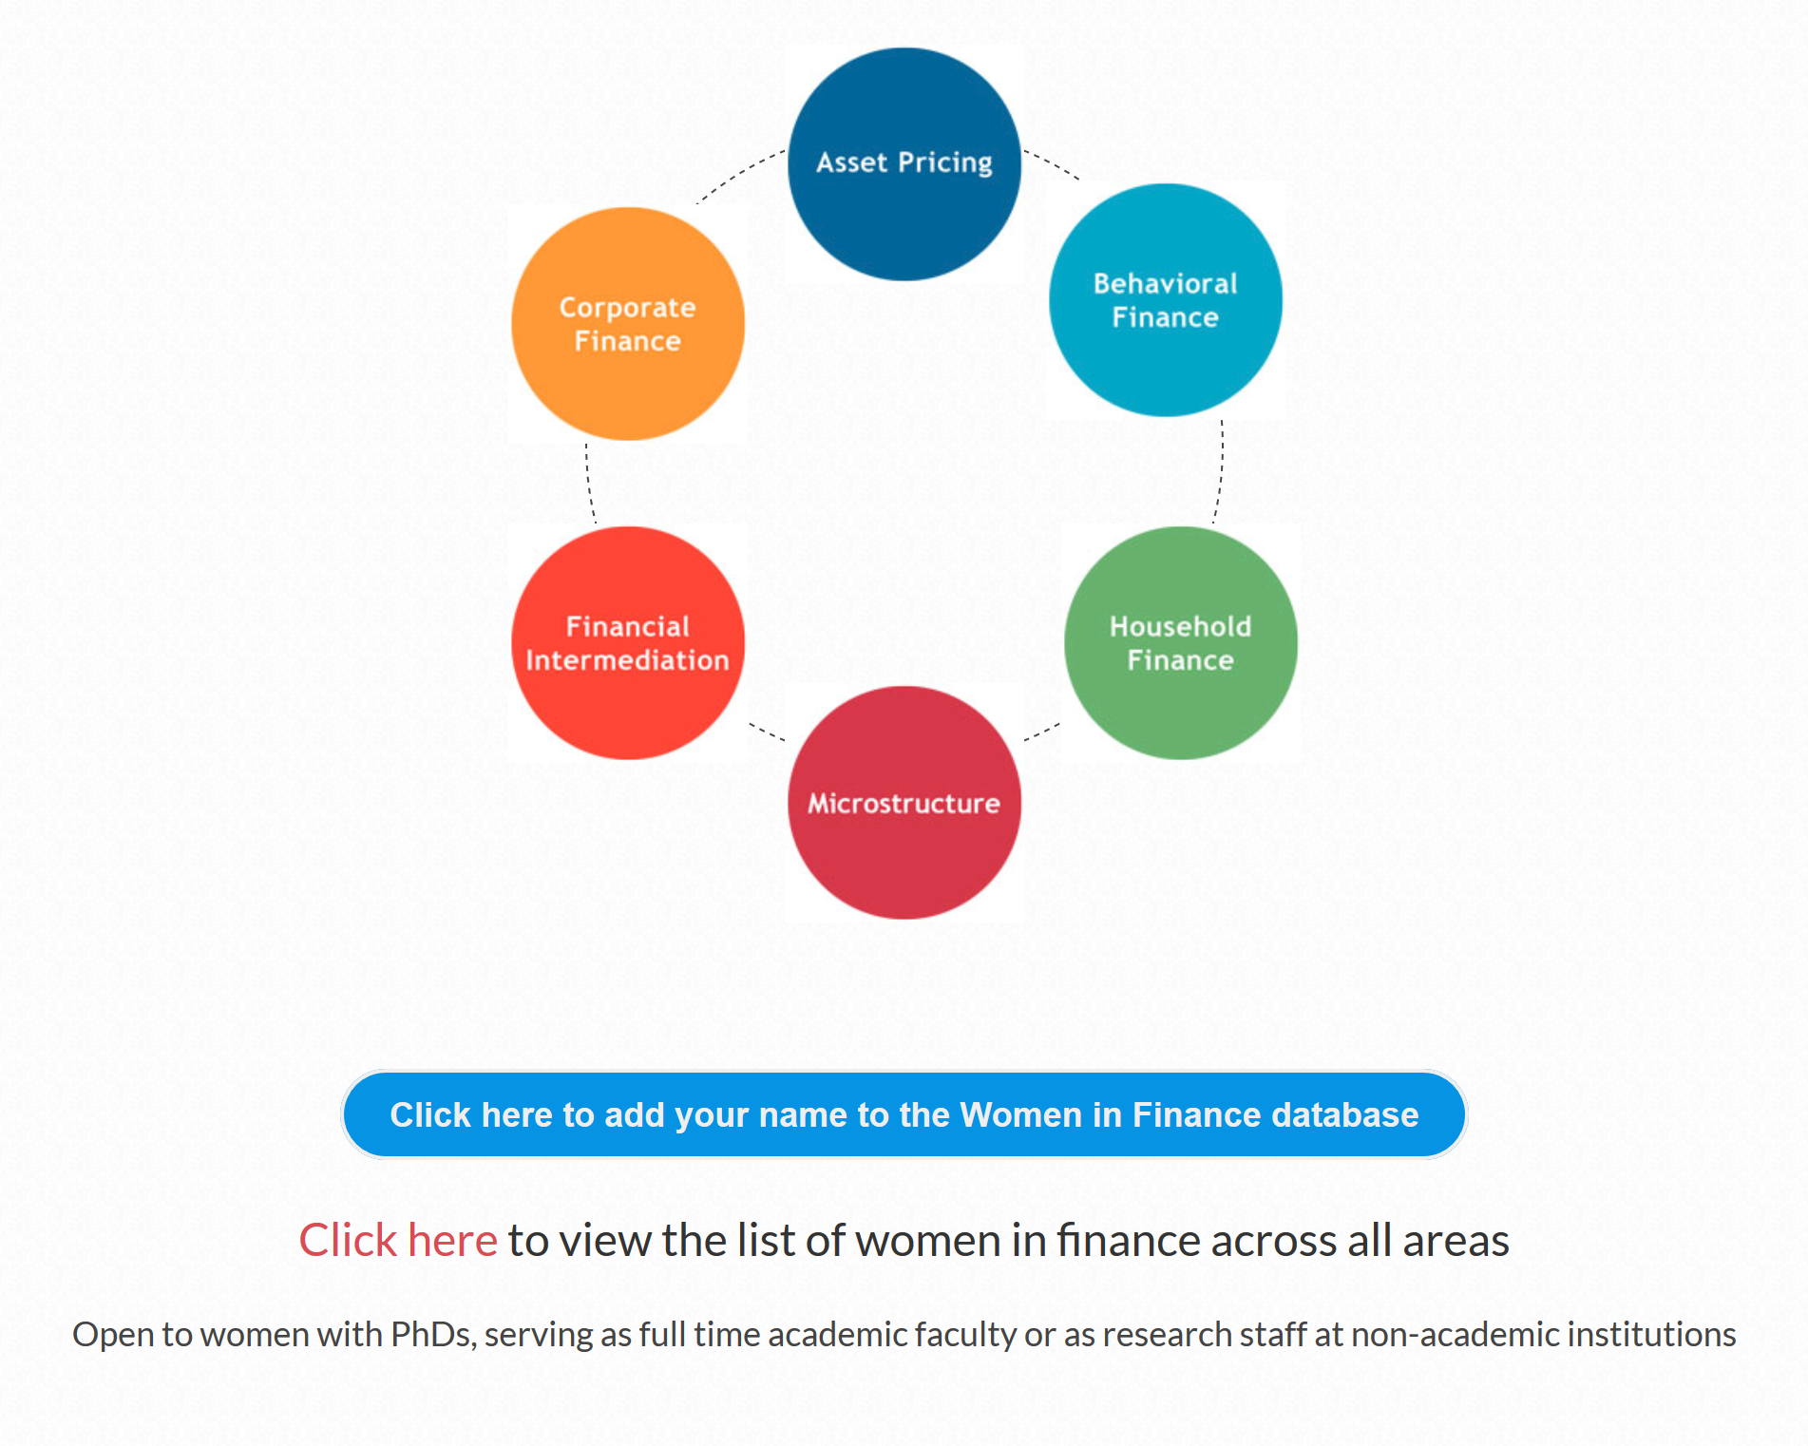

And in finance

Slide 38
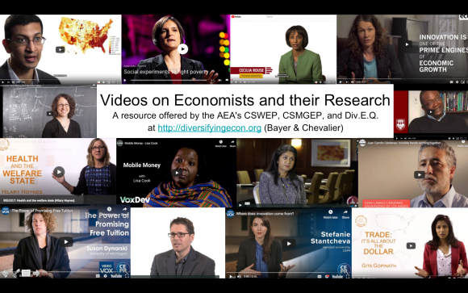
Engaging students

Slide 39

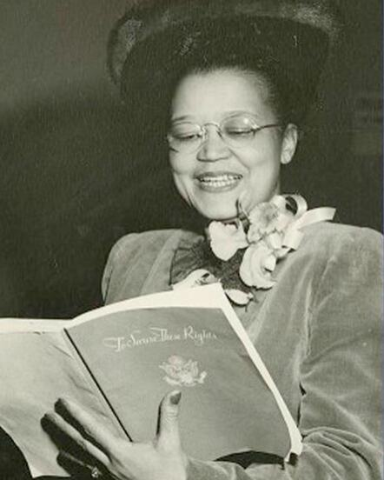
Sadie Collective for Black Female Undergrads
See Banks, Nina (2005). “Black Women and Racial Achievement: The Economics of Sadie Tanner Mossell Alexander.” Review of Black Political Economy, 33(1):89-124 for more information on Sadie Alexander.

Slide 40
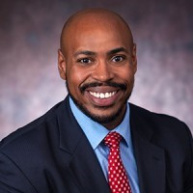
Opportunities at the Federal Reserve
Spring RA recruiting deadline for the Board is January 31
Visit fedeconjobs.org for info on RA positions across the Federal Reserve System
Contact Quentin Johnson (econoutreach@frb.gov) about Exploring Careers In Economics (save the date coming soon)

Slide 41
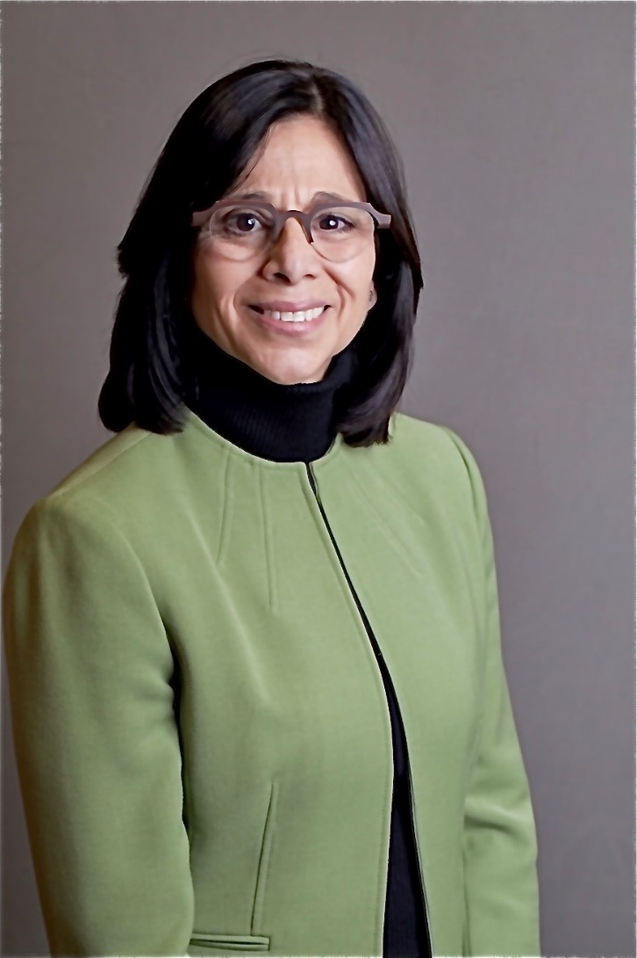

Ombudsperson
Provides informal, confidential assistance to individuals who need advice about work-related ethical issues, discrimination, or harassment.
Francine Montemurro
AFA Ombudsperson
ombuds@afajof.org
Leto Copeley, AEA Ombudsperson
Contact Form: https://www.cjglawfirm.com/aea-contact-form/ Email: aeaombuds@cjglawfirm.com Phone: 919-937-9382

Slide 42
Reflections

Slide 43
Discrimination has existed for thousands of years
You are not going to solve these problems overnight
But there are a lot of things you can do, individually and collectively, that will improve the situation

Slide 44
Discrimination flourishes in discretion
One of the most important things you can do as an organization is boring and tedious.
For important decisions:
Write down your process – your goal, criteria, and procedure.
Publicize your process to all stakeholders.
Follow your process.

Slide 45
Be curious
Explore the resources on the AEA website and the references in this presentation.
Listen to the experiences of people different from yourself.
Diversify your Twitter feed – CSWEP; CSMGEP; @LGBTQ_Econ; Div.E.Q.; Sadie Collective; NEAEcon; Lisa Cook; Jennifer Doleac; Claudia Sahm; Jacob Vigdor; Martha Olney; Sue Dynarski; Erin Hengel

Slide 46
Accept that you will make mistakes
You will say or do things that hurt or offend other people.
The goal is not to never do this.
The goal is to build relationships with other people where they will tell you, you can discuss it, and you can learn.

Slide 47
Be an ally
“In the end, we will remember not the words of our enemies, but the silence of our friends.” (Martin Luther King, Jr.)
There are many valid reasons why bystanders don’t intervene in disturbing situations: shyness, awkwardness, power imbalances
But there are many ways to be an ally while respecting the obstacles
You can tell someone else
You can check in with the person afterwards
You can change the topic or be a distraction

Slide 48
Take collective responsibility
Diversity and inclusion is the responsibility of everyone in an organization
Women are not responsible for solely solving sexism; minorities are not responsible for solely solving racism.
Living out the value that it is a collective responsibility
Relieves an enormous burden on under-represented groups.
Leads to better outcomes for the organization.
The problem is big: it needs the ideas and creativity of everyone

Slide 49
Thank you!

