Slide 1

Object detection models for a Formula Student Driverless Car
Paolo Melissari 0287567

Slide 2
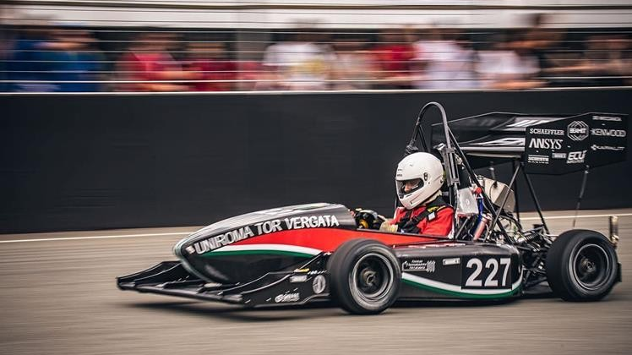
Introduction
Formula Student is a design competition organized by SAE International
Each student team designs, builds and tests a prototype based on a series of rules, whose purpose is both ensuring on-track safety and promoting clever problem solving

Slide 3
With the introduction of the Driverless category in 2017, all teams are getting ready for the construction of an autonomous vehicle
In this category, in addition to "static" tests in which judges will evaluate the design choices, costs and business plan, the prototype must be able to complete some "dynamic" tests

Slide 4
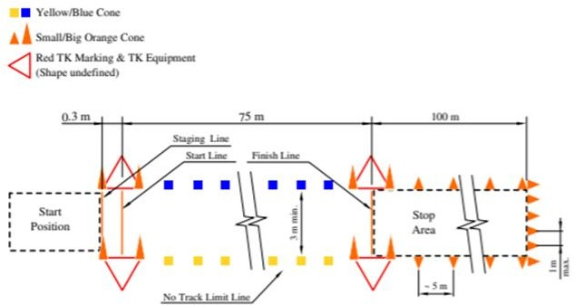
Acceleration

Slide 5
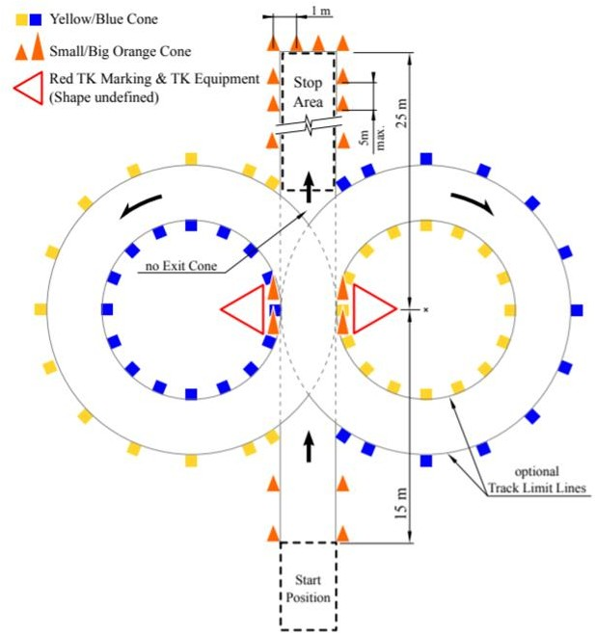
Skidpad

Slide 6
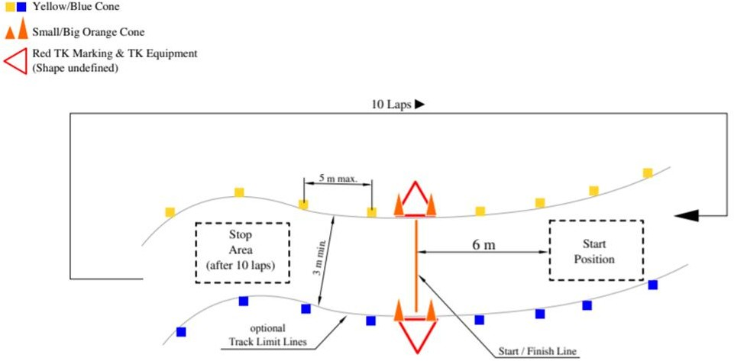
Trackdrive/Autocross

Slide 7
Goal
The goal of this study is therefore to analyze the different possible solutions for detecting the cones along the route, comparing them with each other and choosing the one that is most suitable for this task.
We have to choose the model that allows us to achieve good accuracy and that has a high speed.
Possibile solutions:
R-CNN
Fast-CNN
Faster-CNN
SSD
YOLO v3
YOLO v4

Slide 8
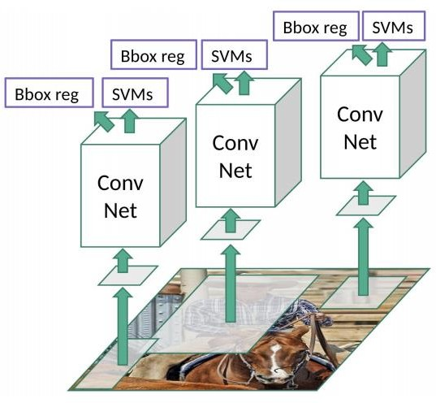
Region Proposal Convolutional Neural Network (R-CNN)
In this approach, we select what are the regions that are likely to contain the cones (Region Of Interest, ROI) and then apply a CNN classification only on this region, drastically reducing the time needed to detect all cones in the frame then applying CNN to each crop of the image (varying size and shape).

Slide 9
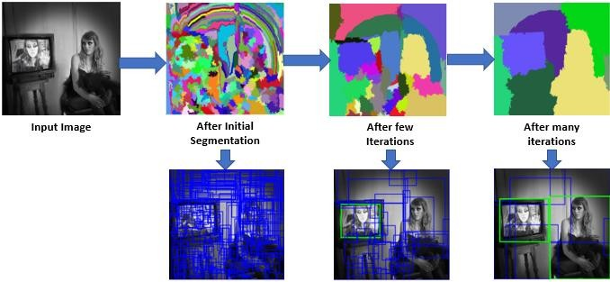
Selective search
In order to find ROI, we can use the “Selective Search” algorithm
It works by clustering image pixels into segments and then performing hierarchical clustering to combine segments from the same object into object proposals:
It starts generating an initial sub-segmentation for the input image, and then recursively merge the smaller “similar” regions into the larger ones.
Then, it use the segmented region proposals to generate the candidate object locations on which will be applied the CNN classification.

Slide 10
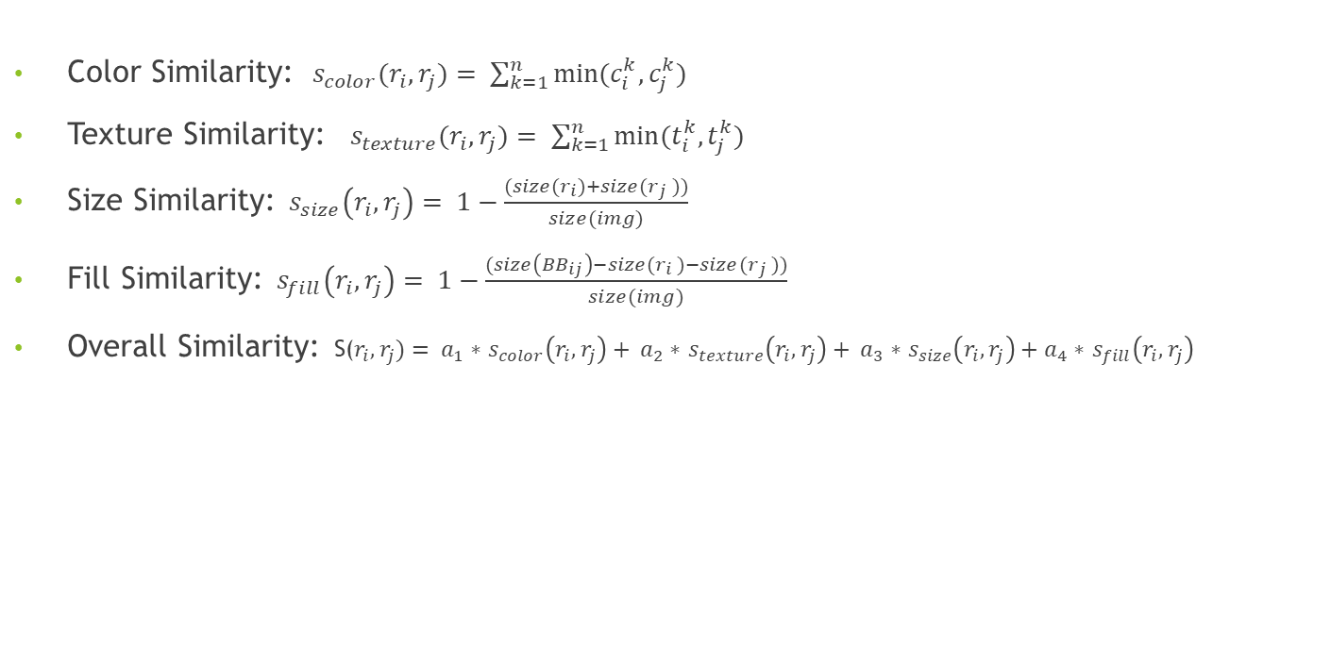
Similarity
Color Similarity:$s_{color}(r_{i},r_{j})= \sum_{k=1}^{n}{min(c_{i}^{k},}c_{j}^{k})$
Texture Similarity: $s_{texture}(r_{i},r_{j})= \sum_{k=1}^{n}{min(t_{i}^{k},}t_{j}^{k})$
Size Similarity: $s_{size}\left(r_{i},r_{j}\right)= 1−\frac{(size(r_{i})+size(r_{j} ))}{size(img)}$
Fill Similarity: $s_{fill}\left(r_{i},r_{j}\right)= 1−\frac{(size\left({BB}_{ij}\right)−size(r_{i} )−size(r_{j} ))}{size(img)}$
Overall Similarity: S($r_{i},r_{j})= a_{1}∗$ $s_{color}\left(r_{i},r_{j}\right)+ a_{2}∗$ $s_{texture}\left(r_{i},r_{j}\right)+ a_{3}∗$ $s_{size}\left(r_{i},r_{j}\right)+a_{4}∗$ $s_{fill}\left(r_{i},r_{j}\right)$

Slide 11
Results
Even though this approach is much faster than sliding window, the main problem is that it still has a very high detection time (about 47 s) , which makes it unsuitable for real-time applications.
Moreover, the selective search algorithm is a fixed algorithm so no learning is happening at that stage. This could lead to the generation of bad candidate region proposals

Slide 12
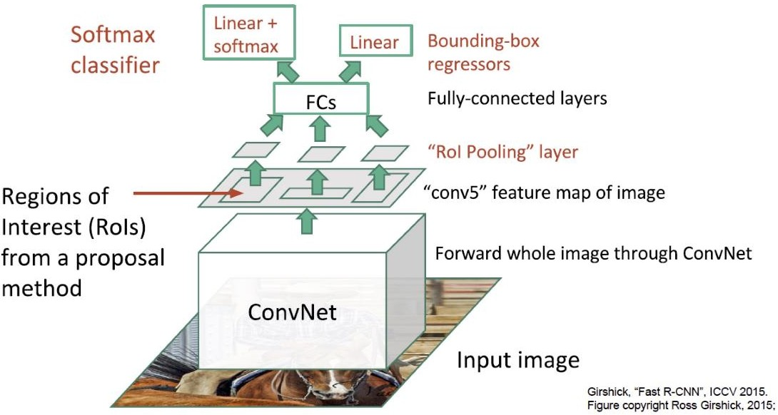
Fast R-CNN
This approach is an evolution of R-CNN approach. Instead of feeding the region proposals to the CNN, we feed the input image to the CNN to generate a feature map
From this feature map, we identify the region of proposals, warp them into squares and we reshape them into a fixed size by using a RoI pooling layer, so that it can be fed into a fully connected layer
From the RoI feature vector, we use a softmax layer to predict the class of the proposed region and also the offset values for the bounding box

Slide 13
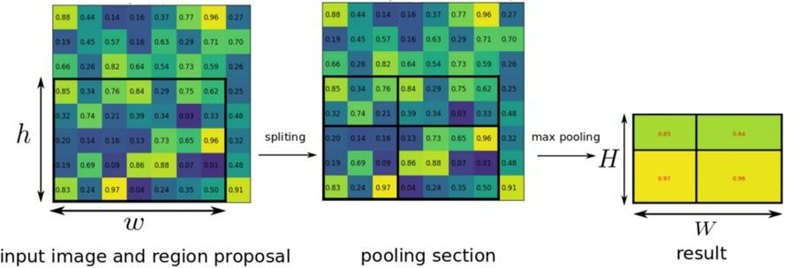
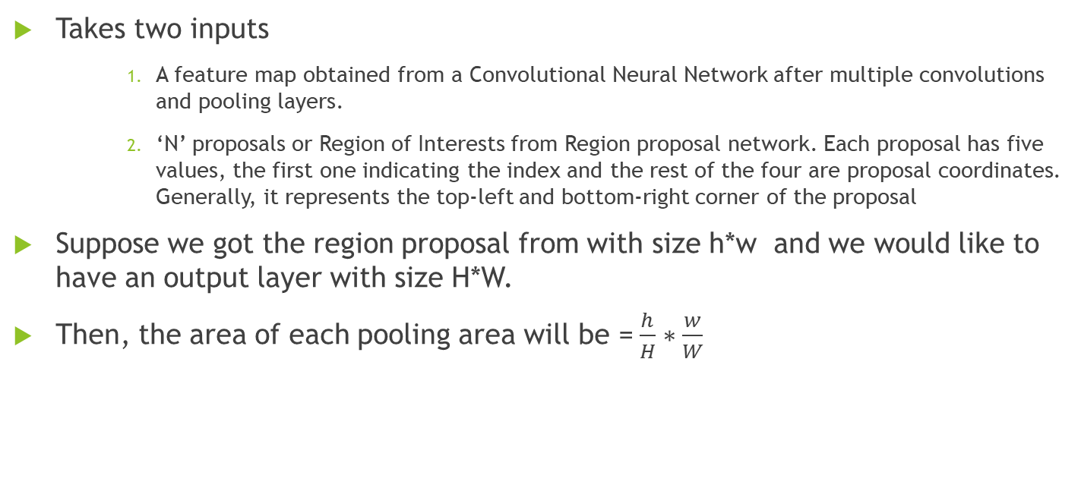
ROI Pooling Layer
Takes two inputs
A feature map obtained from a Convolutional Neural Network after multiple convolutions and pooling layers.
‘N’ proposals or Region of Interests from Region proposal network. Each proposal has five values, the first one indicating the index and the rest of the four are proposal coordinates. Generally, it represents the top-left and bottom-right corner of the proposal
Suppose we got the region proposal from with size h*w and we would like to have an output layer with size H*W.
Then, the area of each pooling area will be = $\frac{h}{H}∗\frac{w}{W}$

Slide 14
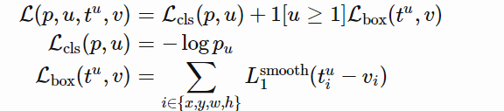
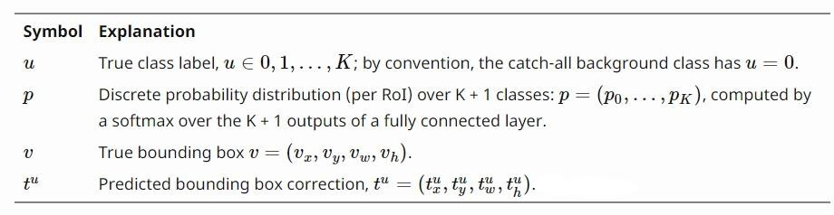
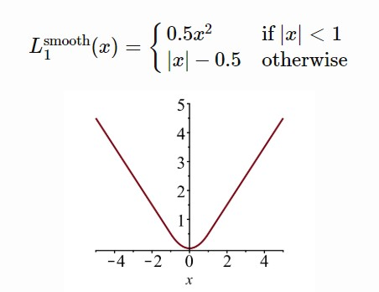
Loss Function
Multi-task loss function that combines Log Loss of classification as a classification function loss and Smooth L1 loss of bounding-box regression as a bounding-box function loss

Slide 15
Results
 | R-CNN | Fast R-CNN
Training time | 84 hours | 9.5 hours
(Speedup) | 1x | 8.8x
Test time per image | 47 seconds | 0.32 seconds
(Speedup) | 1x | 146x
Test time per image with Selective Search | 50 seconds | 2 seconds
(Speedup) | 1x | 25x
mAP(tested with VOC 2007 test set) | 66.0 | 66.9

Slide 16
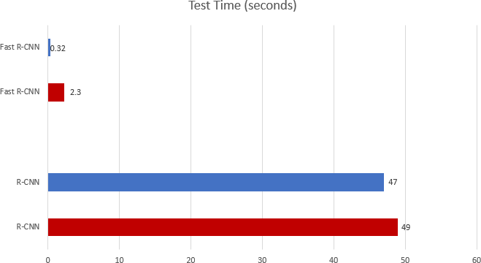


Bottleneck
Including region proposal
Excluding region proposals

Slide 17
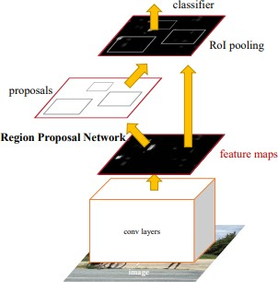
Faster R-CNN
The network itself predict its own region proposals, instead of compute them using a fixed algorithm
We apply the CNN in order to generate a feature map
Instead of using selective search algorithm on this feature map to identify the region proposals, a separate Region Proposal Network is used to predict them
The predicted region proposals are then reshaped using a RoI pooling layer which is then used to classify the image within the proposed region and predict the offset values for the bounding boxes.

Slide 18
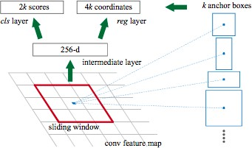
Region Proposals Network - RPN
The goal of RPN is to output a set of proposals, each of which has a score of its probability of being an object and also the class/label of the object
One of the most important concepts of RPN are the Anchor Boxes which are responsible for providing a predefined set of bounding boxes of different sizes and ratios that are used for reference when first predicting object locations for the RPN
The original implementation uses 3 scales (size) and 3 aspect ratios (width of image / height of image) , which means k=9 proposals are possible for each pixel
These proposals are given as input to 2 fully connected layers, one for bounding box regression and the other for box classification

Slide 19
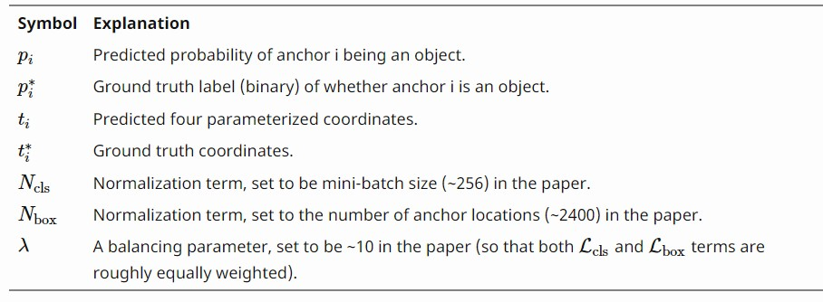

Training Losses
Slightly different Multi task loss function

Slide 20
Results
 | R-CNN | Fast R-CNN | Faster R-CNN
Test time per image (with proposals) | 50 seconds | 2 seconds | 0.2 seconds
(Speedup) | 1x | 25x | 250x
mAP (tested with VOC 2007 test set) | 66.0 | 66.9 | 66.9

Slide 21
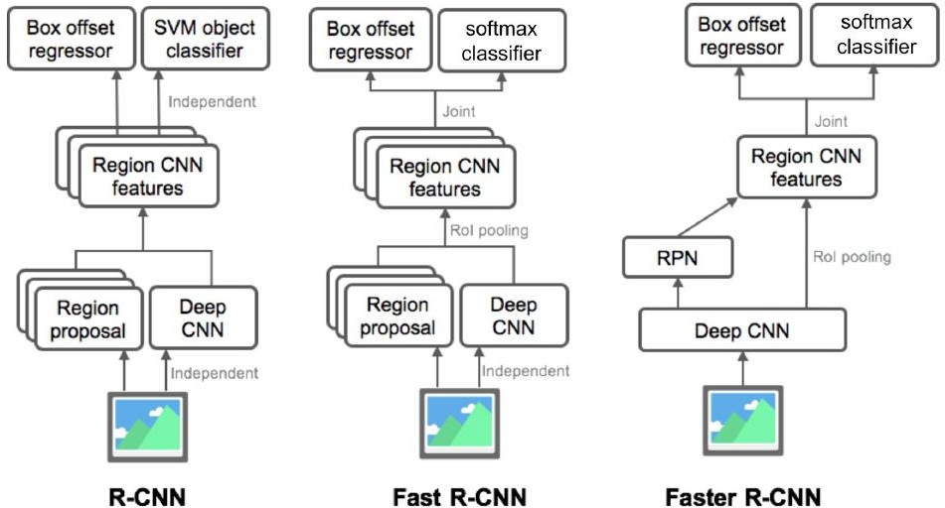
Summary of R-CNN Family

Slide 22
Single Shot Detector - SSD
New type of detector called ‘single-stage detector’ where the convolutional layers make both predictions directly in one shot
Single Shot Detector is one of this
The SSD approach is based on a feed-forward convolutional network that produces a fixed-size collection of bounding boxes and the relative scores for the presence of an object in those boxes
This approach speeds up the process by eliminating the region proposal network.

Slide 23
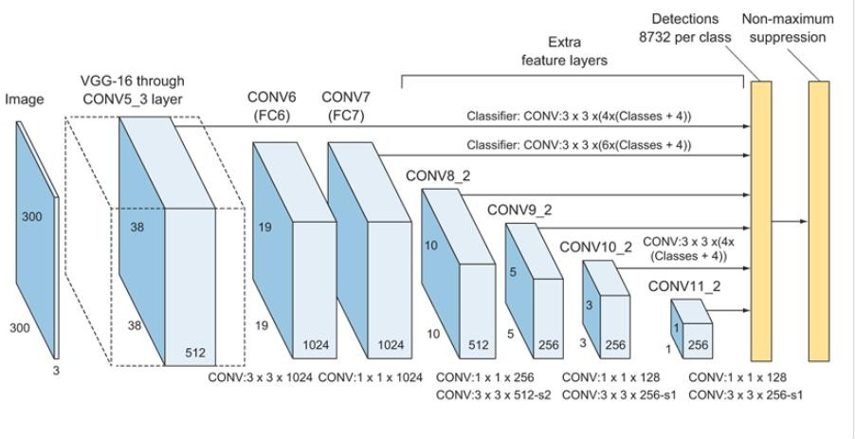
SSD Architecture
Base network to extract feature maps: a standard pretrained network used for high quality image classification and truncated before any classification layers (e.g. VGG16 network).
Multi-scale extra feature layers: a series of convolution filters added after the base network. These layers decrease in size progressively to allow predictions of detections at multiple scales.
Non-maximum suppression to eliminate overlapping boxes and keep only one box for each object detected

Slide 24
SSD Detection Process
Given an input image and the goal of finding all the cones with its color and height the detection process goes as follows:
Similar to the Anchors concept in Faster R-CNN, SSD overlays a grid of Anchors around the image and for each anchor, the network will create bounding boxes at its center
The base network looks at each bounding box as a separate image. Within each bounding box, the network will ask the question: is there a cone in this box? In other words, it will ask: did I extract any features of a cone in this box?
When the network finds a bounding box that contains cone features, it sends its coordinates prediction and object classification to the non-maximum suppression layer
Non-maximum suppression will then eliminate duplicate predictions pointing to the same object. First we sort the predictions by the confidence score and, starting from the top confidence prediction, evaluates whether any previously predicted boundary boxes have an IoU higher than 0.5 with the current prediction for the same class. If found, the current prediction will be ignored. In this way, we will eliminate different detection for the same object (the ones with IoU higher than 0.5) without removing the candidates for a different object (the ones with IoU less than 0.5)

Slide 25

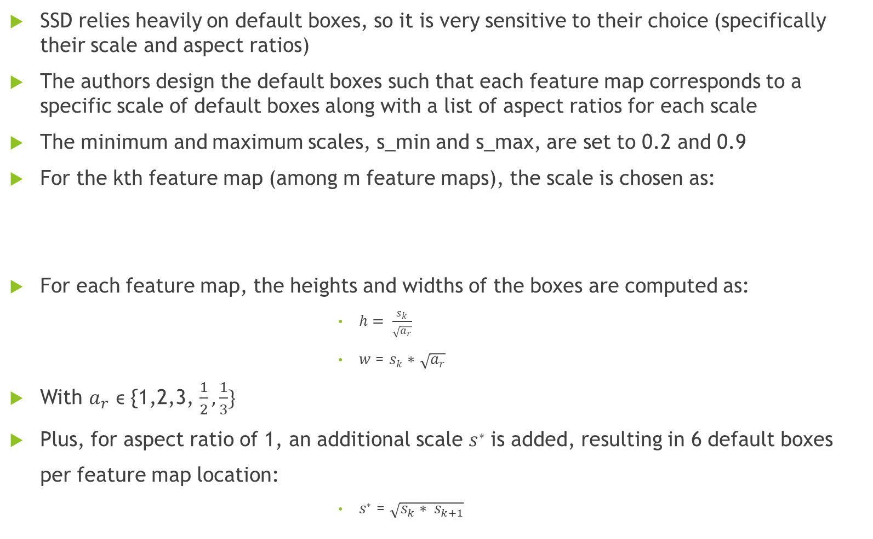
Default boxes choice
SSD relies heavily on default boxes, so it is very sensitive to their choice (specifically their scale and aspect ratios)
The authors design the default boxes such that each feature map corresponds to a specific scale of default boxes along with a list of aspect ratios for each scale
The minimum and maximum scales, s_min and s_max, are set to 0.2 and 0.9
For the kth feature map (among m feature maps), the scale is chosen as:
For each feature map, the heights and widths of the boxes are computed as:
$h= \frac{s_{k}}{\sqrt{a_{r}}}$
𝑤 = 𝑠_{𝑘} ∗ $\sqrt{a_{r}}$
With $a_{r}$ ϵ {1,2,3, $\frac{1}{2}, \frac{1}{3}\}$
Plus, for aspect ratio of 1, an additional scale 𝑠∗ is added, resulting in 6 default boxes
per feature map location:
𝑠∗ = $\sqrt{s_{k}∗ s_{k+1}}$

Slide 26

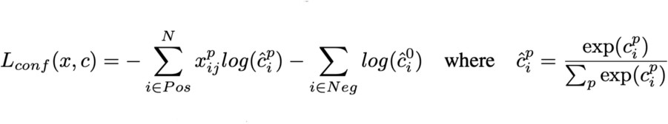
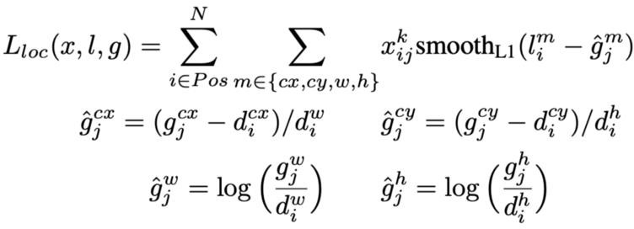

Loss Function
Combination of confidence loss and localization loss:
Where confidence loss is:
And localization loss is, given the predicted box l and the ground truth g:
With:
cx and cy = offset to the default bounding box d of width w and height h
${x^{p}}_{ij}$ = 1 if the IoU between default box i and ground true box j on class p is greater than 0.5, 0 otherwise

Slide 27
Results
Method | mAP | FPS
Faster R-CNN | 73.2 | 7
SSD | 74.3 | 46
This approach is definitely one of the candidates to solve the cone detection task, thanks to its good accuracy and high speed.
To improve the performance, we could study a better distribution of default boxes that fit a specific dataset.

Slide 28
You Only Look Once – YOLO (v3)
We only predicts over a limited number of bounding boxes by splitting the input into a grid of cells and each cell directly predicts a bounding box and object classification
The result is a large number of candidate bounding boxes that are consolidated into a final prediction using non-maximum suppression
This leads to a much faster model, with some losses on accuracy.

Slide 29
YOLO Overview
The YOLO network splits the input image into a grid of S×S cells and each grid cell predicts B number of bounding boxes and their objectness score along with their class predictions as follows
YOLO predicts 4 coordinates for each B bounding box (bx,by,bw,bh). Where x and y are set to be offset of a cell location.
It detects one objectness score through a sigmoid function in order be treated as a probability with a value range between 0 and 1.
If the bounding box contains an object, the network predicts the class probability of each of the K classes as P(𝑐𝑙𝑎𝑠𝑠_{𝑖}| 𝑜𝑏𝑗𝑒𝑐𝑡)
So for each bounding box, the prediction have:
4 values representing the bounding box coordinates
1 value representing the objectness score
K class probabilities
Resulting in 5B + K values predicted for all bounding boxes of a cell. Then, if we have a SxS grid, the total number predicted is S*S*(5B +K).

Slide 30
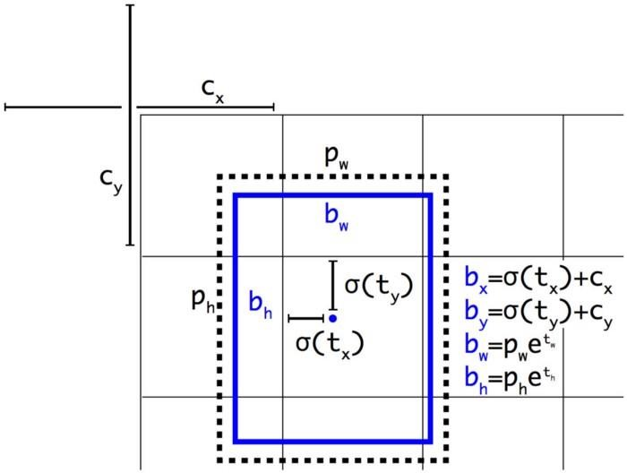
Anchor Boxes
We run k-means clustering (with k = 5) on the training set bounding boxes using the IoU as part of a distance metrics:
𝑑(𝑏𝑜𝑥, 𝑐𝑒𝑛𝑡𝑟𝑜𝑖𝑑) = 1 – 𝐼𝑜𝑈(𝑏𝑜𝑥, 𝑐𝑒𝑛𝑡𝑟𝑜𝑖𝑑)
For the boundary box prediction, rather than directly predicting the bounding box dimensions , we simply predict the offset from our anchor box dimensions such that we can fine- tune our predicted bounding box dimensions

Slide 31
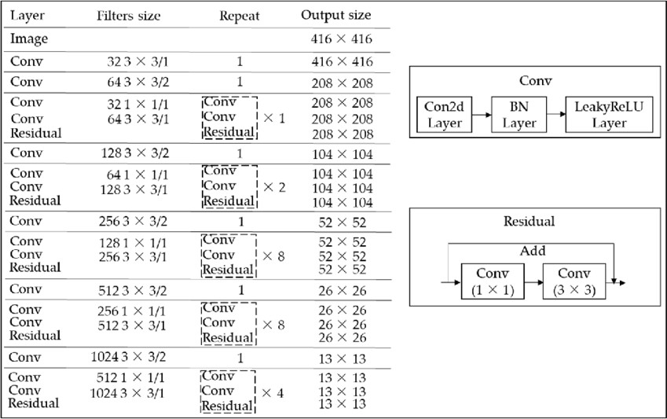
Darknet
YOLO uses a variant of “Darknet-53” as feature extractor, which is mainly compose of 3 × 3 and 1× 1 filters with skip connections like the residual network in ResNet

Slide 32
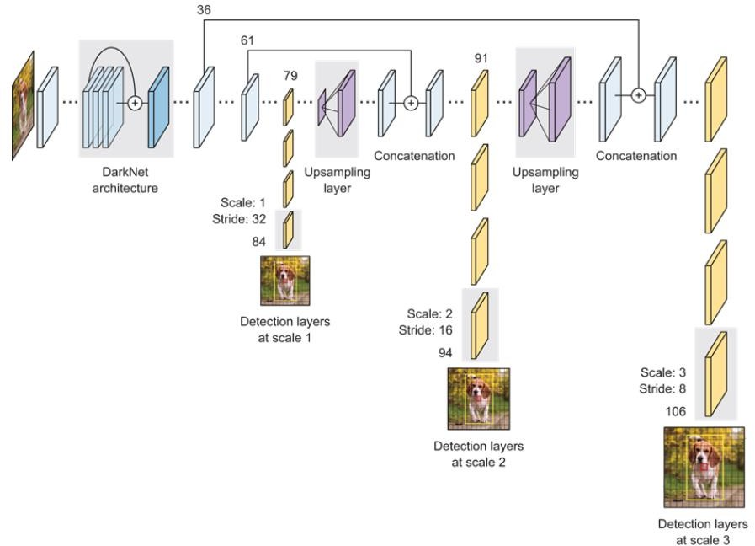
Multi Scale Detection
In order to handle different scales, YOLOv3 makes predictions in 3 different times:
The network downsamples the input image until the first detection layer, where a detection is made using feature maps of a layer with stride 32 (scale 13x13 for large object)
Further, layers are upsampled by a factor of 2 and concatenated with feature maps of a previous layers having identical feature map sizes and another detection is now made at layer with stride 16 (scale 26x26 for medium object)
The same upsampling procedure is repeated, and a final detection is made at the layer of stride 8 (scale 52x52 for small object)

Slide 33
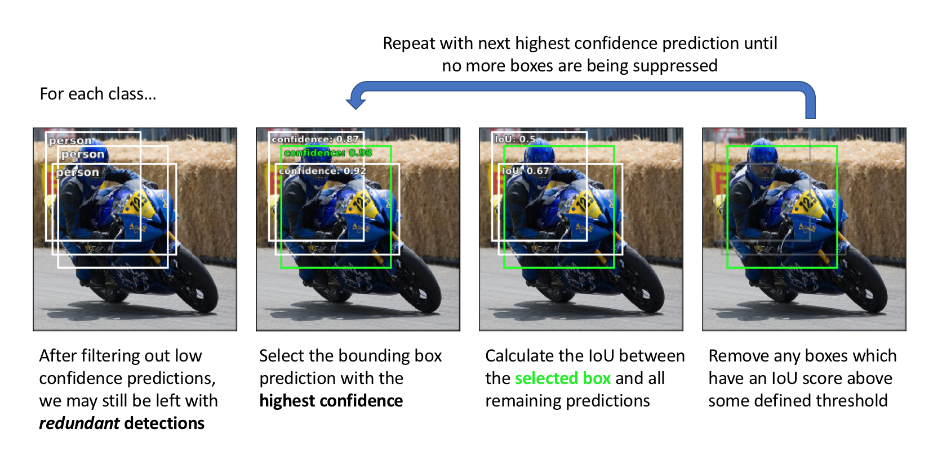
Non-Max Suppression
One of the most common problems with object detection algorithms is that rather than detecting an object just once, they might detect it multiple times
The Non-Max Suppression technique cleans up this up so that we get only a single detection per object
Discard all the boxes having probabilities (objectness score) less than or equal to a pre-defined threshold (say, 0.5)
For the remaining boxes:
Pick the box with the highest probability and take that as the output prediction
Discard any other box which has IoU greater than the threshold with the output box from the above step
Repeat step 2 until all the boxes are either taken as the output prediction or discarded
We repeat these steps until all the boxes have either been selected or compressed and we get the final bounding boxes

Slide 34
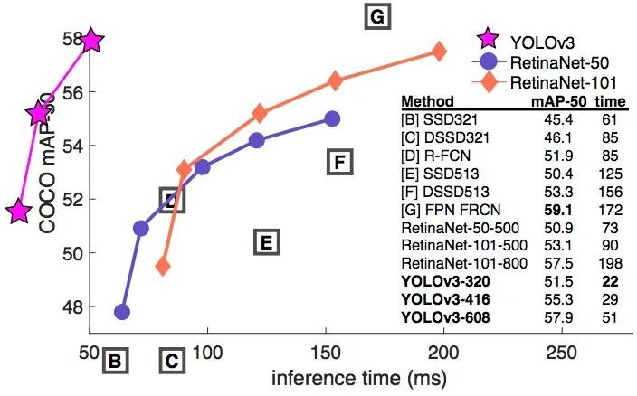
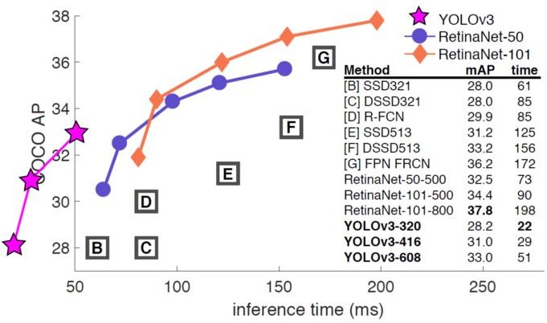
Results

Slide 35

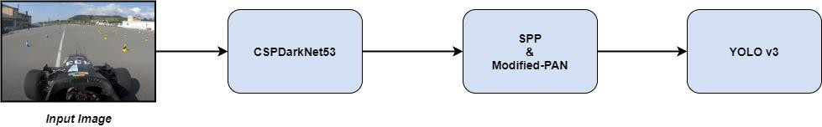
YOLOv4
This architecture introduces a series of optimization in order to archive better accuracy and speed.
For the backbone, CSPDarknet53 was chosen over CSPResNext50 and EfficientNet B3
CSPDarknet53 was chosen for its balance between Receptive field size, the number of parameters (𝑤𝑖𝑑𝑡ℎ 𝑜𝑓 𝑘𝑒𝑟𝑛𝑒𝑙² ∗ 𝑛𝑢𝑚𝑏𝑒𝑟 𝑜𝑓 𝑐ℎ𝑎𝑛𝑛𝑒𝑙 𝑜𝑓 𝑡ℎ𝑒 𝑖𝑛𝑝𝑢𝑡 𝑖𝑚𝑎𝑔𝑒 ∗ 𝑛𝑢𝑚𝑏𝑒𝑟 𝑜𝑓 𝑘𝑒𝑟𝑛𝑒𝑙𝑠) and the average size of layer output.

Slide 36
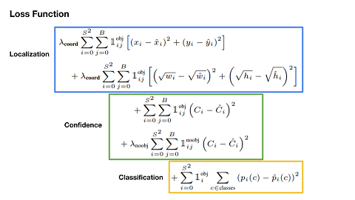
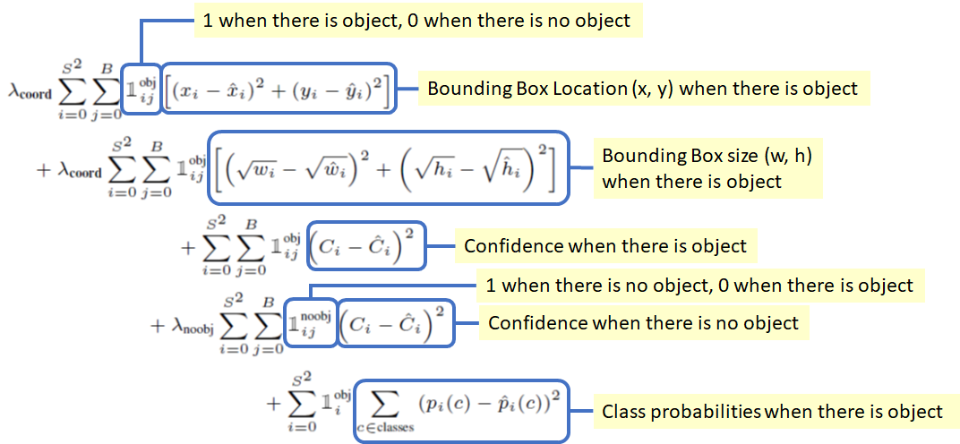
Loss Function
In YOLO v3, the first two term are replaced with the sum of squared error loss

Slide 37
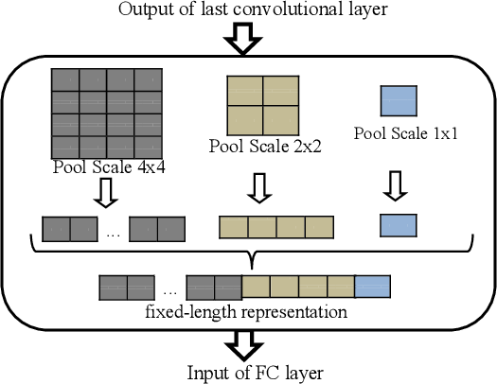
SPP and PAN
A Spatial Pyramid Pooling (SPP) and a Path Aggregation Network (PAN) was added on top of the backbone
SPP is a pooling technique designed to handle multi-scale images. The technique performs pooling (ex: Max pooling) on the last convolution layer (either convolution or sub sampling) and produces a N*B dimensional vector (where N=Number of filters in the convolution layer, B= Number of Bins). The vector is then fed to the FC layer

Slide 38
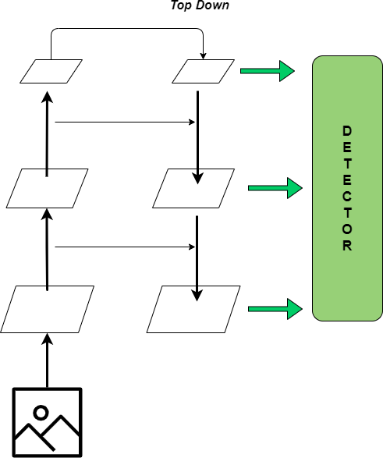
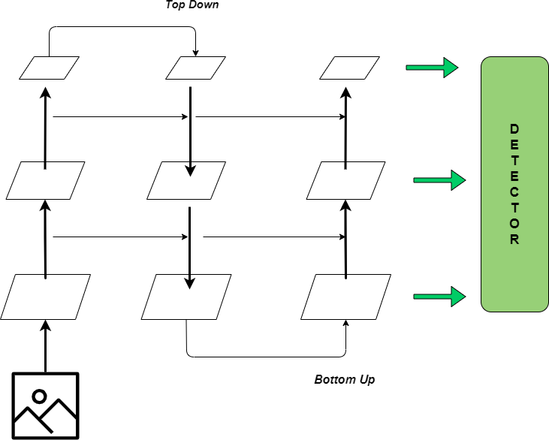
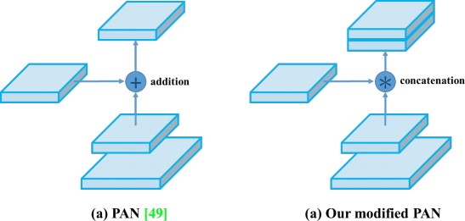
SPP and PAN
PAN is a method of parameter aggregation similar to Feature Pyramid Network (which is the top-down pathway to combine multi-scale features used in YOLO v3). PAN adds an extra bottom up path aggregation network on top of FPN
The authors modified PAN replacing the addition with concatenation

Slide 39
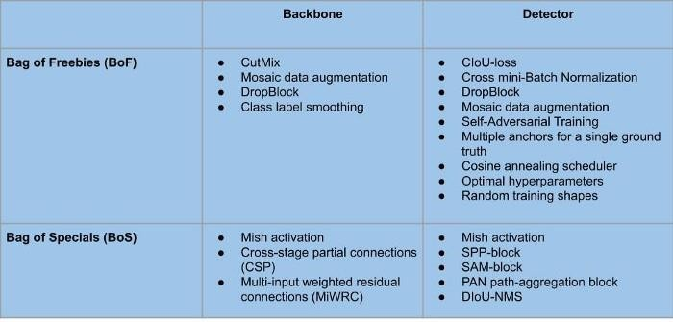
Improve detector accuracy
The authors of YOLO v4 paper distinguish between two categories of methods that are used to improve the object detector’s accuracy. These both categories are:
Bag of freebies (BoF): Methods that can make the object detector receive better accuracy without increasing the inference cost. These methods only change the training strategy or only increase the training cost.
Bag of specials (BoS): Those plugin modules and post-processing methods that only increase the inference cost by a small amount but can significantly improve the accuracy of object detection

Slide 40
Self-Adversarial Training
New data augmentation method introduced by authors in order to defend the model from adversarial attack
This technique operates in 2 forward backward stages
In the 1st stage the neural network alters the original image instead of the network weights.
In this way the neural network executes an adversarial attack on itself, altering the original image to create the deception that there is no desired object on the image
In the 2nd stage, the neural network is trained to detect an object on this modified image in the normal way
This makes the model partially more robust, but it can increase the training complexity, and in some cases it fails completely

Slide 41
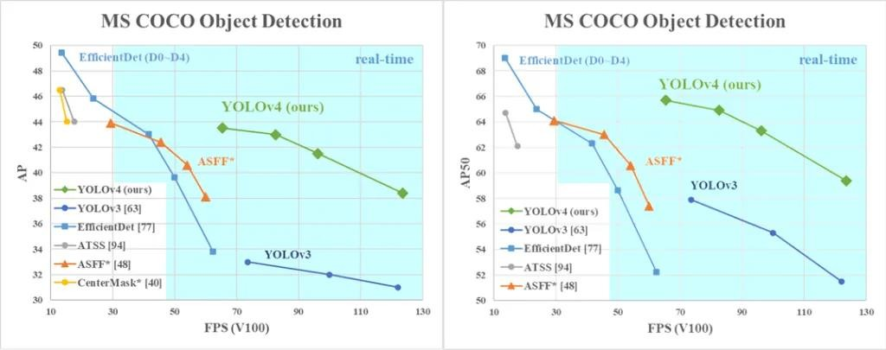
Results

Slide 42
Final Considerations
Based on the results analysis of all the models considered, the best choice would seem to be:
YOLOv4
Besides, we will use also Lidar Sensors to be able to detect the presence of cones and their distance from the machine
A possible strategy could be to collect data from Lidars and then focus the search for cones in the images only on the zones where the Lidars have detected object, in order to increase the detections speed (in this case, we might also consider using SSD since it has a better accuracy).

Slide 43
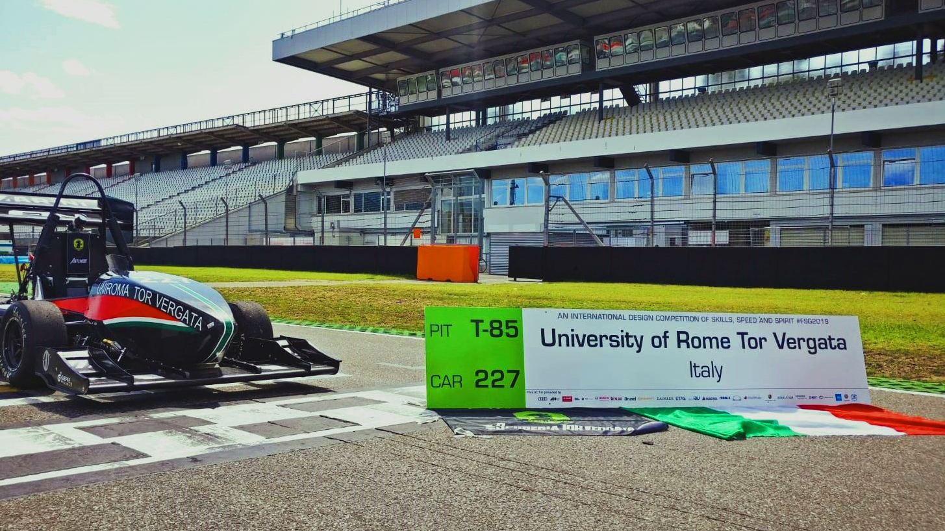
Thanks
For Attention

