Slide 1
Validare Comenzi
MQT
Silviu-Alexandru Hanc

Slide 2
Application architecture:
The application is divided into three microservices/projects:
`Frontend`:
uses ReactJS + MaterialUI to provide a minimal user interface for sending orders
`API`:
uses Java + SpringBoot + KafkaProducer
listens to all the commands send via the Frontend project and Produces a message for each, into `kstream-topic1`
`Kstream`:
uses Java + KafkaStreams
creates a stream between `kstream-topic1` and `kstream-topic2`
takes the messages from `kstream-topic1` to validate them then sends the valid messages to `kstream-topic2` so they can be picked up by `Analiza Comenzi Project`

Slide 3
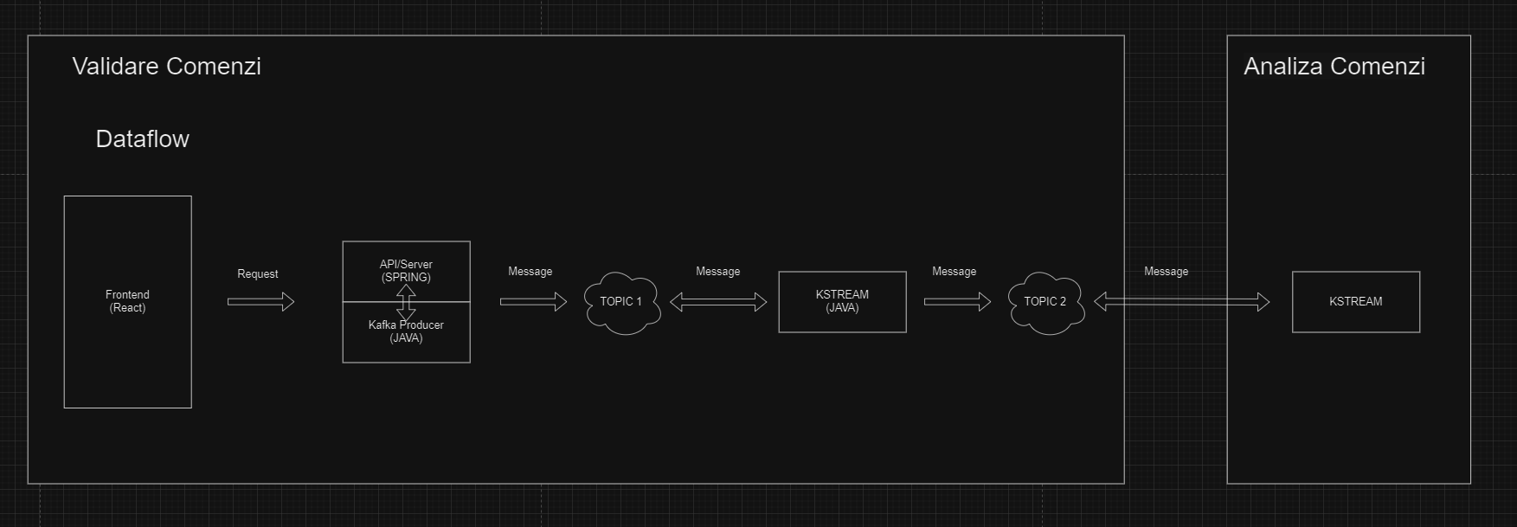
Dataflow:

Slide 4
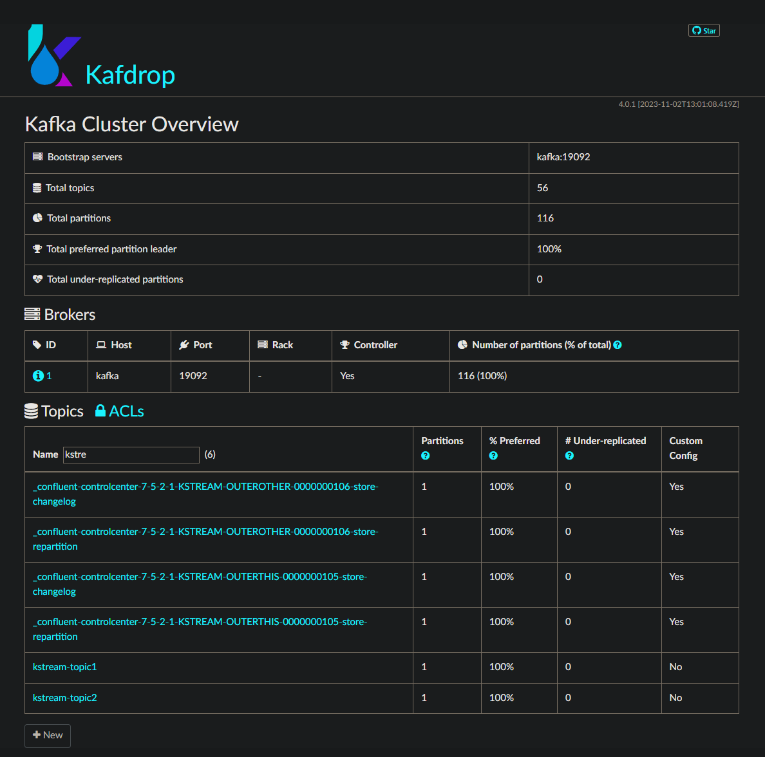
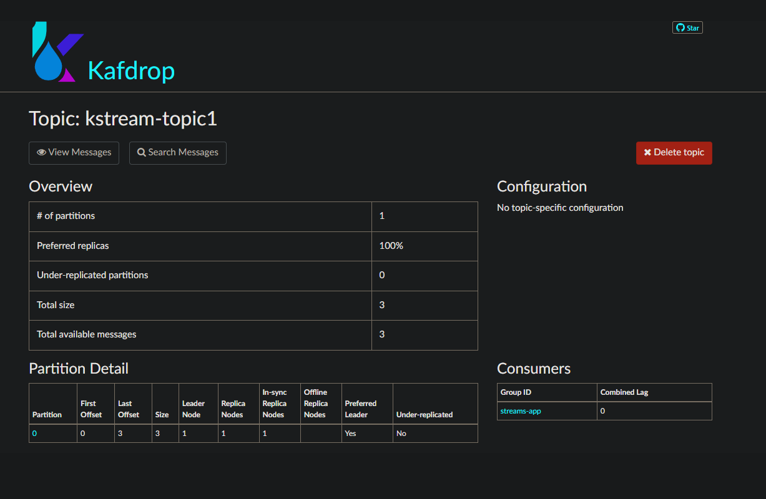
Tool used to view the topics and messages: Kafdrop

Slide 5
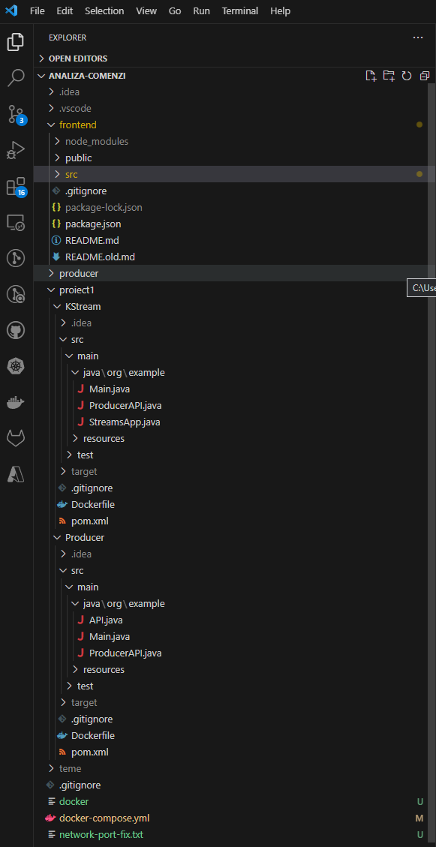
Running the project:
For running the project, go to GitHub and switch to `project1` branch, then follow the steps below:
Run `docker compose up` from the terminal to create the required containers as well as to run them
Go inside `frontend` project folder and run:
`npm intall` - to install all the necessary modules
`npm start` - to start the application itself
Go to `project1` folder and using Intellij/Eclipse, open and run:
`Producer` project (API.java)
`Kstream` project (StreamsApp.java)

Slide 6
Thank you!

