Slide 1

BRITISH AIRWAY
Predictive Modelling

Slide 2
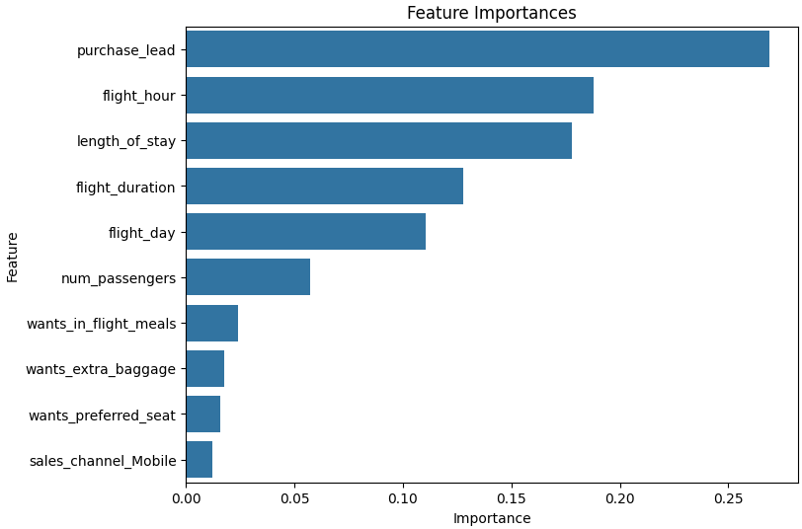
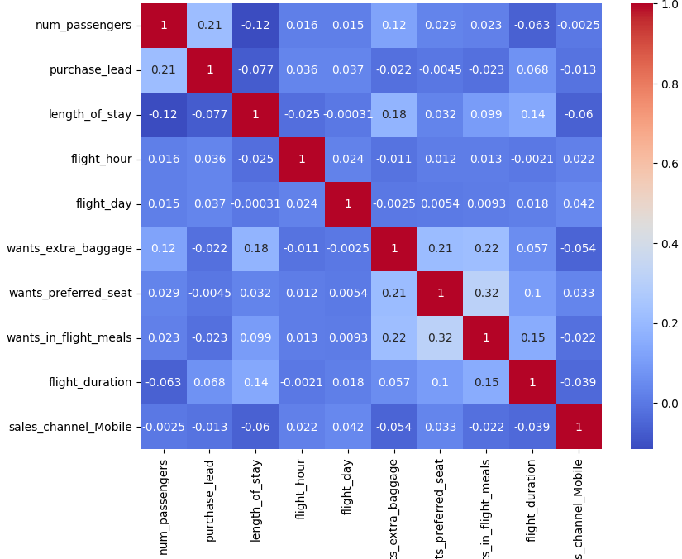
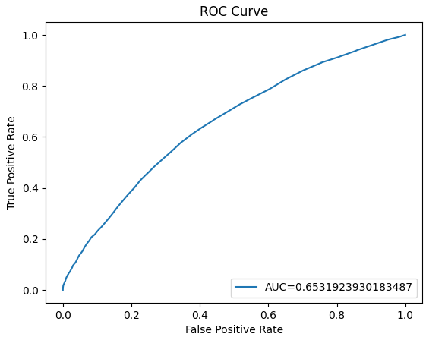
Predictive Modelling
84%
Accuracy of the model:
Out of all the flight booking predictions made by the model, 85% are correct.
43.5%
Precision Score:
When the model predicts that a flight will be booked, it is correct about 43.5% of the time. This indicates that there are a significant number of false positives
These features that may increase the probability of a booking, improving British Airway revenue.
It is important to go into more in-depth research and prioritize on the important features.
65.3%
AUC Score:
An AUC of 0.653 indicates that the model has a moderate ability to distinguish between flights that will be booked and those that will not.

