Slide 1
Pointour
Analysis and Design

Slide 2
Analysis
Prototyping and Testing

Slide 3
Solutions & Outcomes
The Google Maps API has proven to be very solid and powerful
A simple two column interface for desktops works effectively for this use case
Further research required for mobile layout design
A web app has proven to be the simplest way to implement this application
No compilation flow or restrictive IDE choice required, until the native port stages of development
Data storage can be achieved per device through both URL arguments and cookies

Slide 4
User Interface
And Style Guide

Slide 5
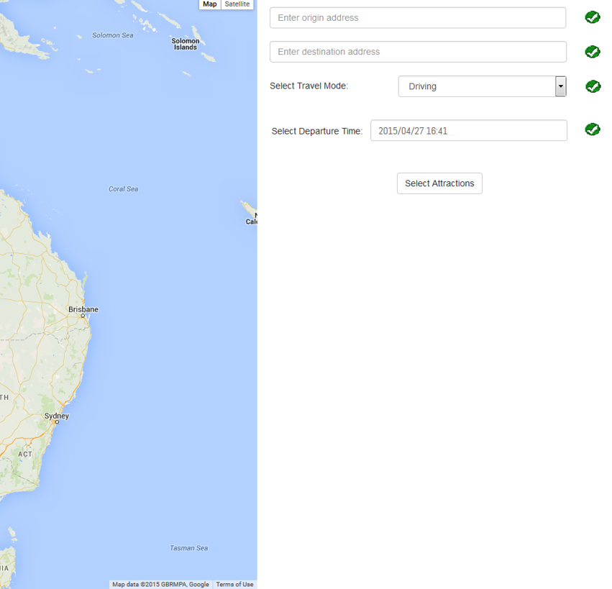
Prototype Design
Inputs
Origin Address
Destination Address
Modifiers
Travel Mode
Departure Time

Slide 6
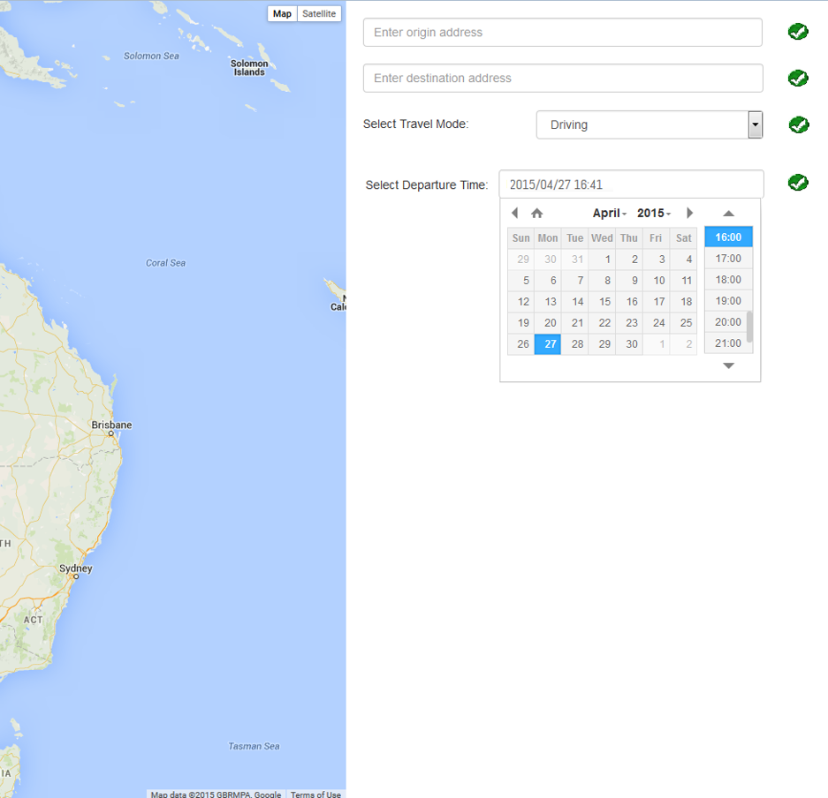
Context Sensitive Menus
Shows a date picker on the appropriate input fields
Automatically fills in potential points of interest
Auto-suggests origin and destination addresses

Slide 7
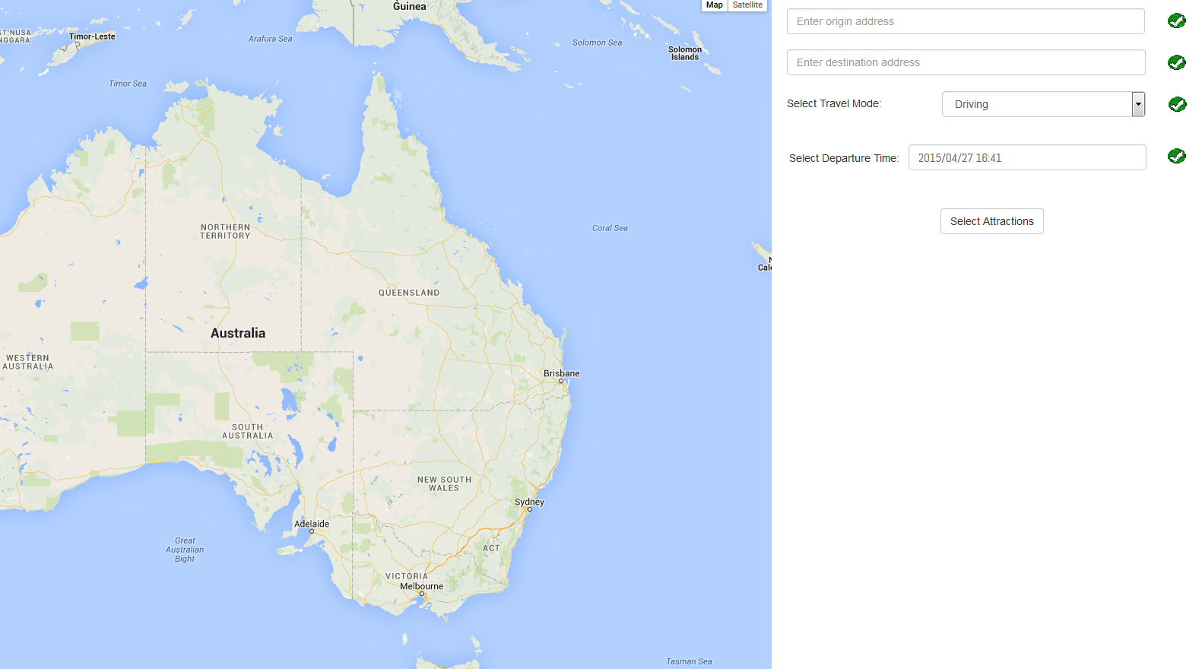
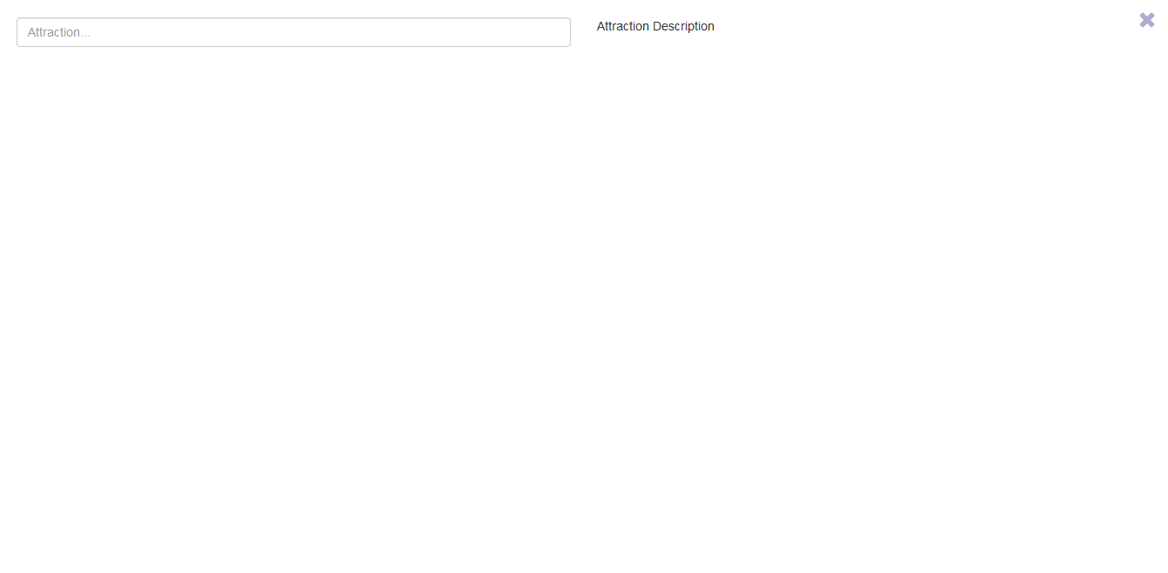





Tour Planning Dialog
Scales as attractions added.
Melbourne Cricket Ground (8 hours)
Next Venue (1 hour)
Min time (Start to destination): 6 days
Min time (All attractions): 9 days
Starts at value of start to end destination and does not go below that value.
Is highlighted as red when the trip duration exceeds the user set days.
Days : 10
Inline window displaying short info about the locations selected

Slide 8

Attraction Info Popup
When pressed , shows location on the route
Melbourne Cricket Ground (8 hours)
Next Venue (1 hour)
Min time (Start to destination): 6 days
Min time (All attractions): 9 days
Melbourne Cricket ground
Brunton Avenue, Richmond VIC 3002
Days : 10
Open: 08:00 - 8AM
Popup appears when information button is clicked
Shows in both standard and friendly format
Close: 21:00 - 9PM
Close

Slide 9

Style Guide
Application wide typeface
Roboto with Helvetica/Arial fallback
Colour selection
Pantone Emerald - #08CA74
Pantone Blue Iris - #2B167B
Pale Blue Iris - #EDE9FA
Pantone Tangerine - #F05329

Slide 10
Lifecycle Planning
Implementation, Testing, Deployment, Maintenance

Slide 11
Implementation
Group member tasks
George Paton – UI/UX Design, Shipping Leader
Matthew Sienkiewicz – API Programmer, Client Liason
Iana Bardash – Interface Programmer
Miley Zhang – Documentation and Records
Brian Ma – Documentation and Quality Assurance

Slide 12
Testing
Group member tasks
George Paton – UX debugging and consistency
Matthew Sienkiewicz – Application debugging
Iana Bardash – Application debugging
Miley Zhang, Brian Ma – Quality Assurance and Bug Testing
All Programmers – Unit test programmers
Issue tracking to be done through GitHub

Slide 13
Deployment
“Cloud” based solution, requires only the main server
Load balancing for page serving is out of scope for this project
Application performance dependent on client device, this is within scope, will be targeted in testing
Native apps will require developer accounts
Application bundles will be created, but submission to App/Play Store is out of scope.

Slide 14
Maintenance
Application errors will be reported to a debugging email address where all errors are collected and sorted by error code.
Web page serving will be handled by the server application, whether this is Apache or other, no load balancing will be applied.
The web server will be maintained in accordance with the procedures defined by the web server documentation
Modifications will be restricted to bug-fixes and highly desired small changes after release, desirability is at the discretion of the client.
Any modifications must be done through version control to ensure integrity, and the modification programmer must first analyse and repro the problems described.
A retirement timeframe of the software is yet to be established.

Slide 15
Thankyou
We now have a short demo to show you

