Slide 1
Pointour
Research and Investigation

Slide 2
Existing Mapping Applications
Many mapping applications exist
Google Maps
Apple Maps
Bing
HERE by Nokia
Locus Map
MapQuest
The list goes on…
The Google Maps API+Yelp is powerful and easy to use
Can do most of the route calculation, visual mapping, and POI locating work for us
Allows us to focus on the core experience

Slide 3
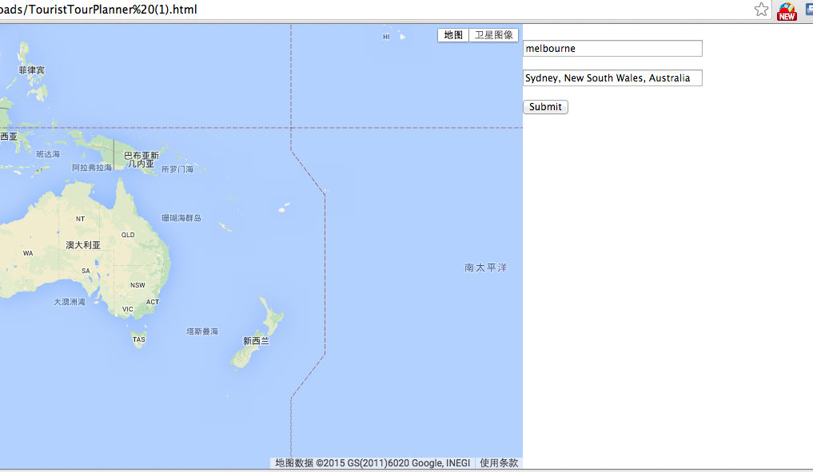
Mapping API Investigation
We have tested the Google maps API by creating a simple A to B demo
Provides a comprehensive mapping solution
Good error handling

Slide 4
Existing Web Frameworks
Bootstrap
Does most of the legwork to create usable responsive websites
jQuery and AngularJS
Extends Javascript in helpful ways, allowing expressive manipulation of the DOM
Allows for dynamic views in single page web-apps

Slide 5
Methodology
Waterfall Method of Software Development
Work is split into stages
Content reviews between each stage
Each review marks a decision point for further reiteration or continuation
This process is orderly and has clear goal posts for each stage.

Slide 6
Requirements
Reviews after each stage
Design
Implementation
Verification
Implementation

Slide 7
Additional Technology Requirements
Code Sharing through Github
Utilises git and cross-platform native apps
Allows group members to choose their own IDE to work on up to date code.
Helps us to handle merge-conflicts
Native Code requires certain IDEs
Objective-C requires a machine running Xcode (Mac OS only)
Java can be written in any IDE that supports Java, preferred IDE is Eclipse for Android development

Slide 8
Resources
Software Development Methodology http://hyperthot.com/pm_sdm.htm
A Software Design Specification Template http://bradapp.com/docs/sdd.html

Slide 9
Thank you

