Slide 1
第六次作业答案
赵泽安

Slide 2
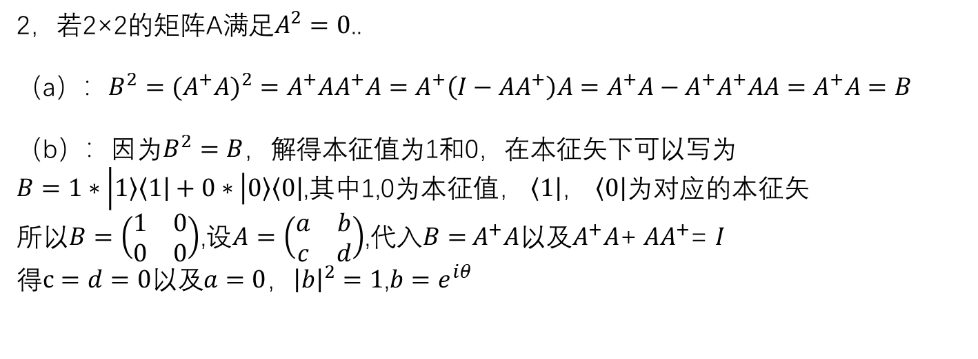
1，设矩阵A,B,C均为2×2的厄密矩阵，从而..
[B,C]=BC-CB=iA
左乘B得BBC-BCB=iBA=C-BCB
右乘B得BCB-CBB=iAB=BCB-C
两式相加得i（AB+BA）=0
即AB+BA=0,同理可得AC+CA=0
2，若2×2的矩阵A满足$A^{2}=0$..
（a）：$B^{2}=(A^{+}A)^{2}=A^{+}AA^{+}A=A^{+}\left(I−{AA}^{+}\right)A=A^{+}A−A^{+}A^{+}AA=A^{+}A=B$
（b）：因为$B^{2}=B$，解得本征值为1和0，在本征矢下可以写为
$B=1∗\left|\left.1\right\rangle \left\langle \left.1\right|\right.+0∗\left|\left.0\right\rangle \left\langle \left.0\right|\right.\right.\right.$,其中1,0为本征值， $\left\langle \left.1\right|\right.$， $\left\langle \left.0\right|\right.$为对应的本征矢
所以$B=\left(\begin{matrix}1 & 0 \\ 0 & 0\end{matrix}\right)$,设$A=\left(\begin{matrix}a & b \\ c & d\end{matrix}\right)$,代入$B=$ $A^{+}A$以及$A^{+}A$+ ${AA}^{+}$= $I$
得$c=d=0以及a=0$，${\left|b\right|}^{2}=1$,$b=e^{iθ}$

Slide 3
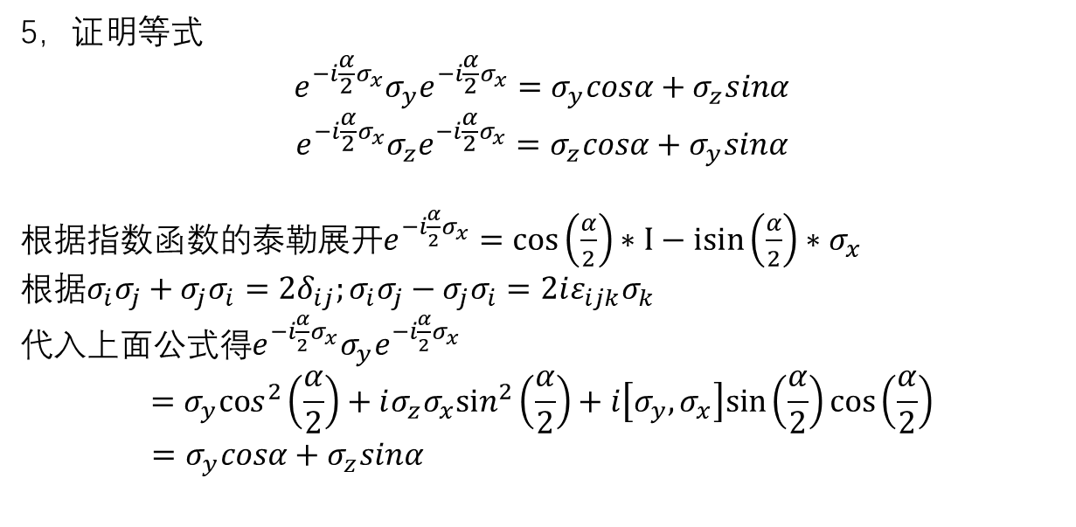
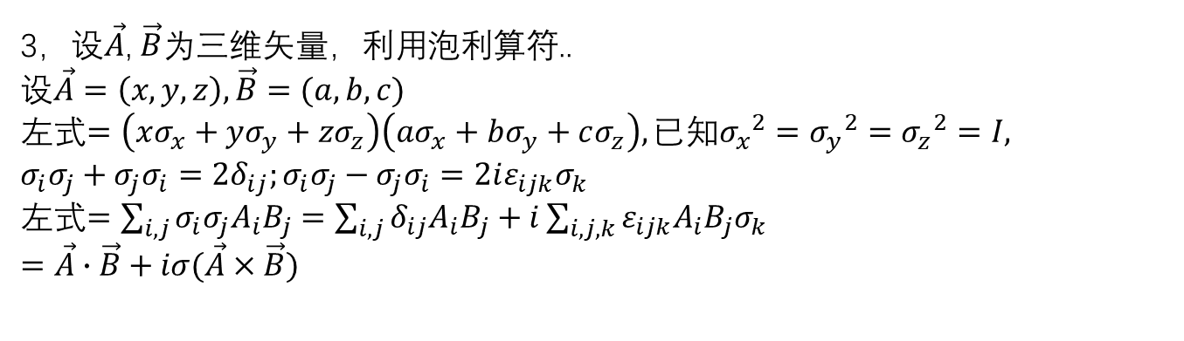
3，设$\vec{A}$, $\vec{B}$为三维矢量，利用泡利算符..
设$\vec{A}=\left(x,y,z\right),\vec{B}=(a,b,c)$
左式$=\left(xσ_{x}+yσ_{y}+zσ_{z}\right)\left(aσ_{x}+bσ_{y}+cσ_{z}\right),已知{σ_{x}}^{2}={σ_{y}}^{2}={σ_{z}}^{2}=I,$
$$σ_{i}σ_{j}+σ_{j}σ_{i}=2δ_{ij};σ_{i}σ_{j}−σ_{j}σ_{i}=2iε_{ijk}σ_{k}$$
左式$=\sum_{i,j}{σ_{i}σ_{j}A_{i}B_{j}=\sum_{i,j}{δ_{ij}A_{i}B_{j}+i}}\sum_{i,j,k}{ε_{ijk}{A_{i}B_{j}σ}_{k}}$
$$=\vec{A}∙\vec{B}+iσ(\vec{A}×\vec{B})$$
5，证明等式
$$e^{−i\frac{α}{2}σ_{x}}σ_{y}e^{−i\frac{α}{2}σ_{x}}=σ_{y}cosα+σ_{z}sinα$$
$$e^{−i\frac{α}{2}σ_{x}}σ_{z}e^{−i\frac{α}{2}σ_{x}}=σ_{z}cosα+σ_{y}sinα$$
根据指数函数的泰勒展开$e^{−i\frac{α}{2}σ_{x}}=cos\left(\frac{α}{2}\right)∗I−isin\left(\frac{α}{2}\right)∗σ_{x}$
根据$σ_{i}σ_{j}+σ_{j}σ_{i}=2δ_{ij};σ_{i}σ_{j}−σ_{j}σ_{i}=2iε_{ijk}σ_{k}$
代入上面公式得$e^{−i\frac{α}{2}σ_{x}}σ_{y}e^{−i\frac{α}{2}σ_{x}}$
$$=σ_{y}cos^{2}\left(\frac{α}{2}\right)+i{σ_{z}σ}_{x}sin^{2}\left(\frac{α}{2}\right)+i\left[σ_{y},σ_{x}\right]sin\left(\frac{α}{2}\right)cos\left(\frac{α}{2}\right)$$
$$=σ_{y}cosα+σ_{z}sinα$$

Slide 4
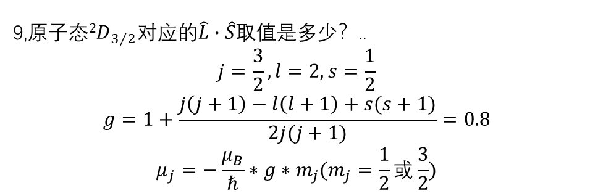
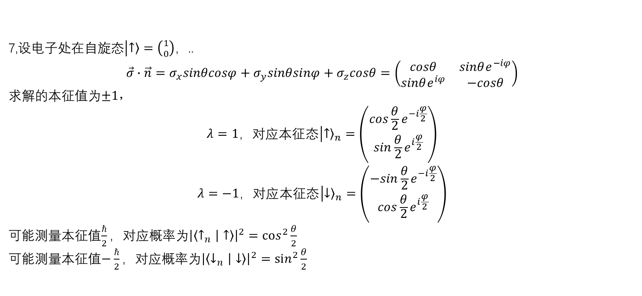
7,设电子处在自旋态$\left|\left.↑\right\rangle =\left({1 \atop 0}\right)\right.$，..
$$\vec{σ}∙\vec{n}=σ_{x}sinθcosφ+σ_{y}sinθsinφ+σ_{z}cosθ=\left(\begin{matrix}cosθ & sinθe^{−iφ} \\ sinθe^{iφ} & −cosθ\end{matrix}\right)$$
求解的本征值为$±1，$
$$λ=1，对应本征态\left|{\left.↑\right\rangle }_{n}\right.=\left({cos\frac{θ}{2}e^{−i\frac{φ}{2}} \atop sin\frac{θ}{2}e^{i\frac{φ}{2}}}\right)$$
$$λ=−1，对应本征态\left|{\left.↓\right\rangle }_{n}\right.=\left({−sin\frac{θ}{2}e^{−i\frac{φ}{2}} \atop cos\frac{θ}{2}e^{i\frac{φ}{2}}}\right)$$
可能测量本征值$\frac{ℏ}{2}，$对应概率为${\left|\left\langle ↑_{n} | ↑\right\rangle \right|}^{2}=cos^{2}\frac{θ}{2}$
可能测量本征值$−\frac{ℏ}{2}，$对应概率为${\left|\left\langle ↓_{n} | ↓\right\rangle \right|}^{2}=sin^{2}\frac{θ}{2}$
9,原子态${2D}_{3/2}$对应的$\hat{L}∙\hat{S}$取值是多少？..
$$j=\frac{3}{2},l=2,s=\frac{1}{2}$$
$$g=1+\frac{j\left(j+1\right)−l\left(l+1\right)+s(s+1)}{2j(j+1)}=0.8$$
$$μ_{j}=−\frac{μ_{B}}{ℏ}∗g∗m_{j}(m_{j}=\frac{1}{2}或\frac{3}{2})$$

Slide 5

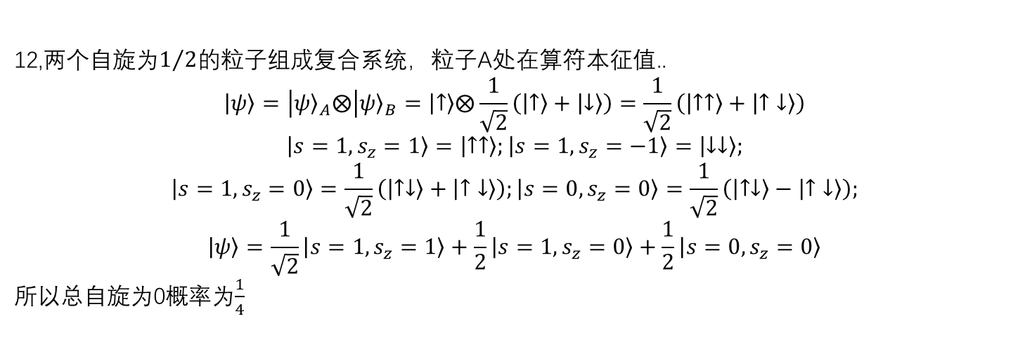

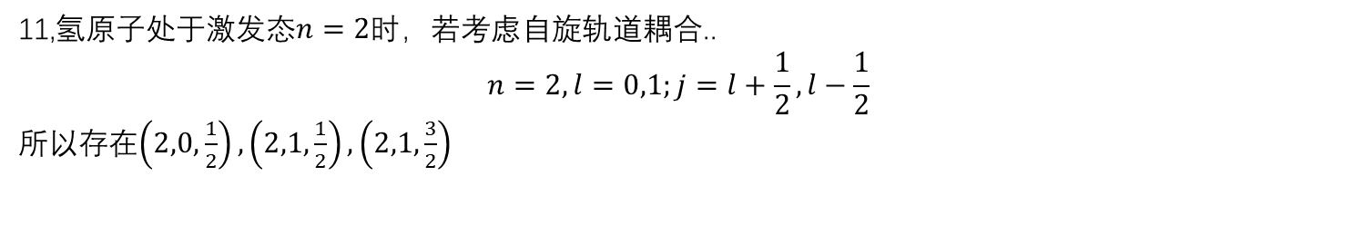



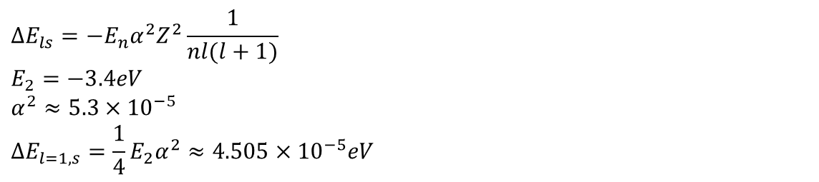
11,氢原子处于激发态$n=2时$，若考虑自旋轨道耦合..
$$n=2,l=0,1;j=l+\frac{1}{2},l−\frac{1}{2}$$
所以存在$\left(2,0,\frac{1}{2}\right),\left(2,1,\frac{1}{2}\right),\left(2,1,\frac{3}{2}\right)$
$$j=\frac{3}{2}$$
$$j=\frac{1}{2}$$
$$n=2,l=1$$
$$n=2,l=0$$
$$j=\frac{1}{2}$$
$$∆E_{ls}=−E_{n}α^{2}Z^{2}\frac{1}{nl(l+1)}$$
$$E_{2}=−3.4eV$$
$$α^{2}≈5.3×{10}^{−5}$$
$$∆E_{l=1,s}=\frac{1}{4}E_{2}α^{2}≈4.505×{10}^{−5}eV$$
12,两个自旋为$1/2$的粒子组成复合系统，粒子A处在算符本征值..
$$\left|\left.ψ\right\rangle \right.=\left|{\left.ψ\right\rangle }_{A}\right.⨂\left|{\left.ψ\right\rangle }_{B}\right.=\left|\left.↑\right\rangle \right.⨂\frac{1}{\sqrt{2}}\left(\left|\left.↑\right\rangle \right.+\left|\left.↓\right\rangle \right.\right)=\frac{1}{\sqrt{2}}\left(\left|\left.↑↑\right\rangle \right.+\left|↑\left.↓\right\rangle \right.\right)$$
$$\left|\left.s=1,s_{z}=1\right\rangle \right.=\left|\left.↑↑\right\rangle \right.;\left|\left.s=1,s_{z}=−1\right\rangle \right.=\left|\left.↓↓\right\rangle \right.;$$
$$\left|\left.s=1,s_{z}=0\right\rangle \right.=\frac{1}{\sqrt{2}}\left(\left|\left.↑↓\right\rangle \right.+\left|↑\left.↓\right\rangle \right.\right);\left|\left.s=0,s_{z}=0\right\rangle \right.=\frac{1}{\sqrt{2}}\left(\left|\left.↑↓\right\rangle \right.−\left|↑\left.↓\right\rangle \right.\right);$$
$$\left|\left.ψ\right\rangle \right.=\frac{1}{\sqrt{2}}\left|\left.s=1,s_{z}=1\right\rangle \right.+\frac{1}{2}\left|\left.s=1,s_{z}=0\right\rangle \right.+\frac{1}{2}\left|\left.s=0,s_{z}=0\right\rangle \right.$$
所以总自旋为0概率为$\frac{1}{4}$

Slide 6
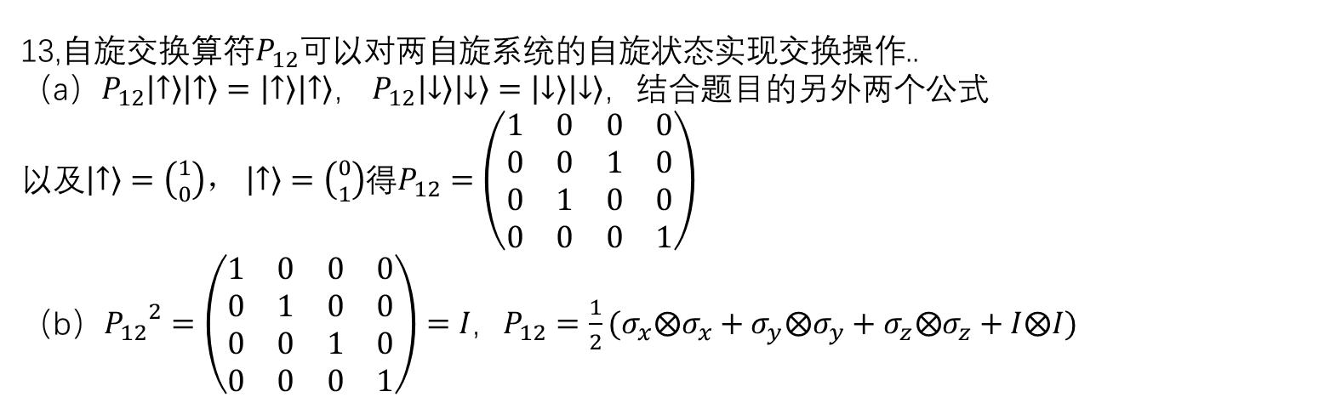
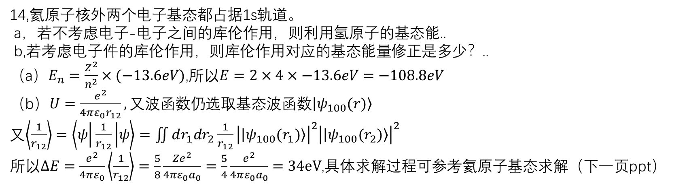
13,自旋交换算符$P_{12}$可以对两自旋系统的自旋状态实现交换操作..
（a）$P_{12}\left|\left.↑\right\rangle \right.\left|\left.↑\right\rangle \right.=\left|\left.↑\right\rangle \right.\left|\left.↑\right\rangle \right.$， $P_{12}\left|\left.↓\right\rangle \right.\left|\left.↓\right\rangle \right.=\left|\left.↓\right\rangle \right.\left|\left.↓\right\rangle \right.$，结合题目的另外两个公式
以及$\left|\left.↑\right\rangle \right.=\left({1 \atop 0}\right)，$ $\left|\left.↑\right\rangle \right.=\left({0 \atop 1}\right)$得$P_{12}=\left(\begin{matrix}1 & 0 & 0 & 0 \\ 0 & 0 & 1 & 0 \\ 0 & 1 & 0 & 0 \\ 0 & 0 & 0 & 1\end{matrix}\right)$
（b）${P_{12}}^{2}=\left(\begin{matrix}1 & 0 & 0 & 0 \\ 0 & 1 & 0 & 0 \\ 0 & 0 & 1 & 0 \\ 0 & 0 & 0 & 1\end{matrix}\right)=I，P_{12}=\frac{1}{2}(σ_{x}⨂σ_{x}+σ_{y}⨂σ_{y}+σ_{z}⨂σ_{z}+I⨂I)$
14,氦原子核外两个电子基态都占据1s轨道。
a，若不考虑电子-电子之间的库伦作用，则利用氢原子的基态能..
b,若考虑电子件的库伦作用，则库伦作用对应的基态能量修正是多少？..
（a）$E_{n}=\frac{Z^{2}}{n^{2}}×(−13.6eV)$,所以$E=2×4×−13.6eV=−108.8eV$
（b）$U=\frac{e^{2}}{4πε_{0}r_{12}},又波函数仍选取基态波函数\left|\left.ψ_{100}(r)\right\rangle \right.$
又$\left\langle \frac{1}{r_{12}}\right\rangle =\left\langle ψ | \frac{1}{r_{12}} | ψ\right\rangle =\iint{dr_{1}dr_{2}\frac{1}{r_{12}}{\left|\left|\left.ψ_{100}(r_{1})\right\rangle \right.\right|}^{2}{\left|\left|\left.ψ_{100}(r_{2})\right\rangle \right.\right|}^{2}}$
所以$∆E=\frac{e^{2}}{4πε_{0}}\left\langle \frac{1}{r_{12}}\right\rangle =\frac{5}{8}\frac{{Ze}^{2}}{4πε_{0}a_{0}}=\frac{5}{4}\frac{e^{2}}{4πε_{0}a_{0}}=34eV$,具体求解过程可参考氦原子基态求解（下一页ppt）

Slide 7
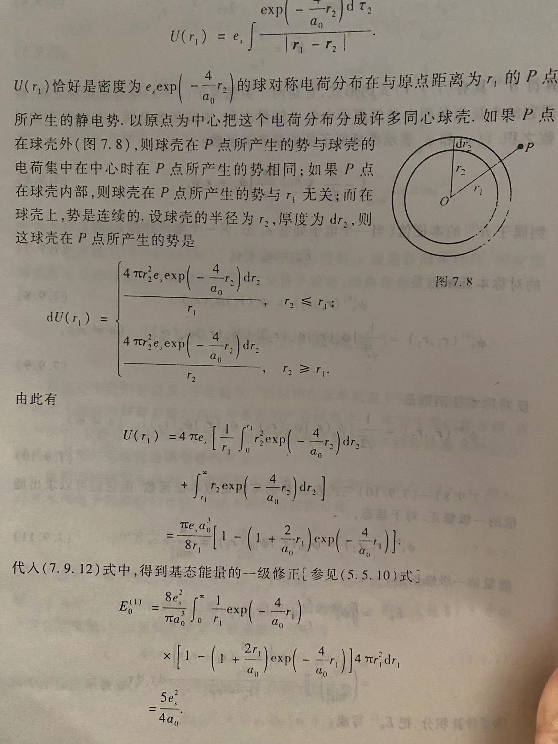
参考教材：量子力学教程
周世勋
高斯定理

