Slide 1
Computer vision: models, learning and inference
Chapter 4
Fitting Probability Models

Slide 2
Structure
Fitting probability distributions
Maximum likelihood
Maximum a posteriori
Bayesian approach
Worked example 1: Normal distribution
Worked example 2: Categorical distribution
Computer vision: models, learning and inference. ©2011 Simon J.D. Prince
2

Slide 3
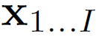
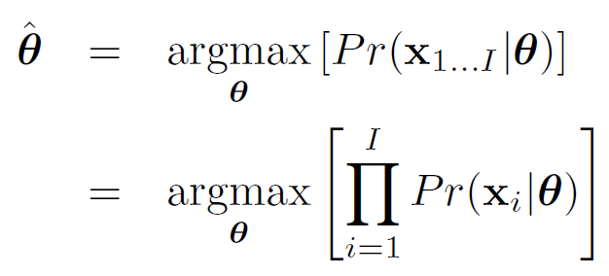
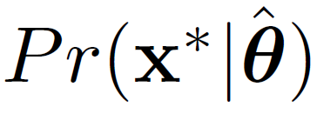
Maximum Likelihood
Fitting: As the name suggests: find the parameters under which the data are most likely:
We have assumed that data was independent (hence product)
Predictive Density:
Evaluate new data point under probability distribution
with best parameters

Slide 4

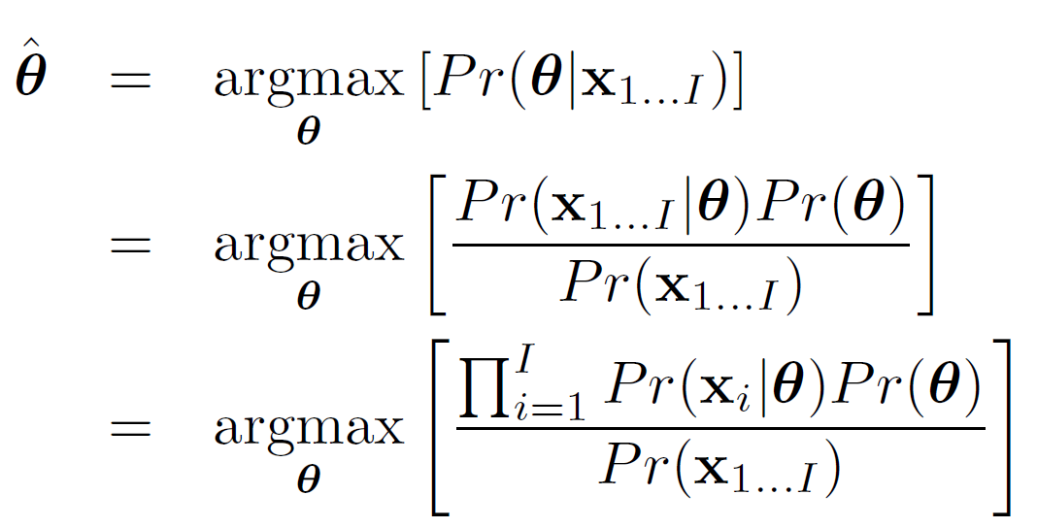
Maximum a posteriori (MAP)
Fitting
As the name suggests we find the parameters which maximize the posterior probability .
Again we have assumed that data was independent

Slide 5
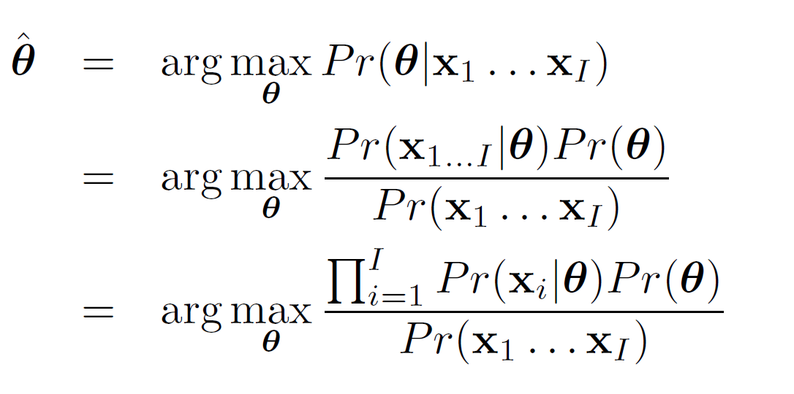
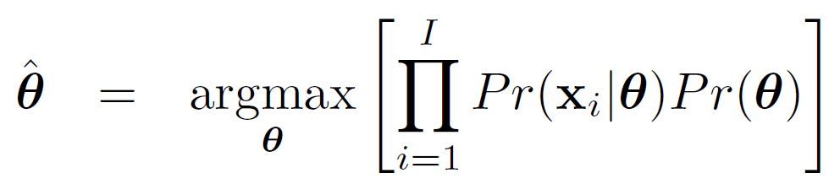
Maximum a posteriori (MAP)
Fitting
As the name suggests we find the parameters which maximize the posterior probability .
Since the denominator doesn’t depend on the parameters we can instead maximize

Slide 6
Maximum a posteriori (MAP)
Fitting
As the name suggests we find the parameters which maximize the posterior probability .
Since the denominator doesn’t depend on the parameters we can instead maximize

Slide 7
Maximum a posteriori (MAP)
Predictive Density:
Evaluate new data point under probability distribution
with MAP parameters

Slide 8
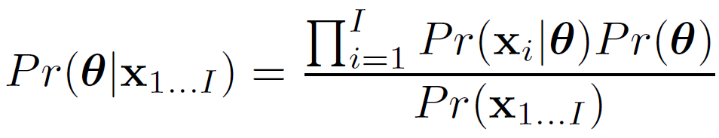
Bayesian Approach
Fitting
Compute the posterior distribution over possible parameter values using Bayes’ rule:
Principle: why pick one set of parameters? There are many values that could have explained the data. Try to capture all of the possibilities

Slide 9
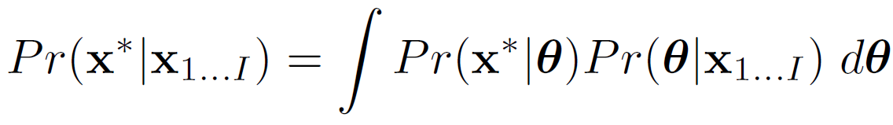
Bayesian Approach
Predictive Density
Each possible parameter value makes a prediction
Some parameters more probable than others
Make a prediction that is an infinite weighted sum (integral) of the predictions for each parameter value, where weights are the probabilities

Slide 10
Predictive densities for 3 methods
Maximum likelihood:
Evaluate new data point under probability distribution
with ML parameters
Maximum a posteriori:
Evaluate new data point under probability distribution
with MAP parameters
Bayesian:
Calculate weighted sum of predictions from all possible values of parameters

Slide 11
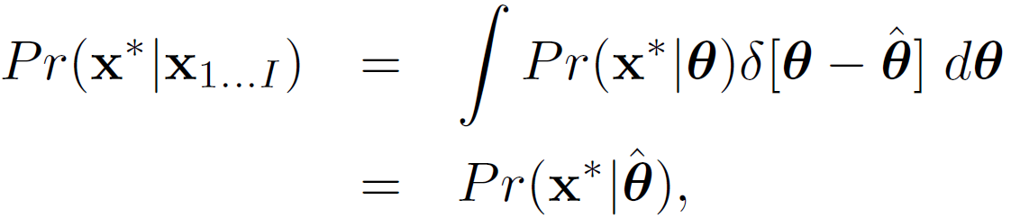
Predictive densities for 3 methods
How to rationalize different forms?
Consider ML and MAP estimates as probability distributions with zero probability everywhere except at estimate (i.e. delta functions)

Slide 12
Structure
Fitting probability distributions
Maximum likelihood
Maximum a posteriori
Bayesian approach
Worked example 1: Normal distribution
Worked example 2: Categorical distribution
Computer vision: models, learning and inference. ©2011 Simon J.D. Prince
12

Slide 13
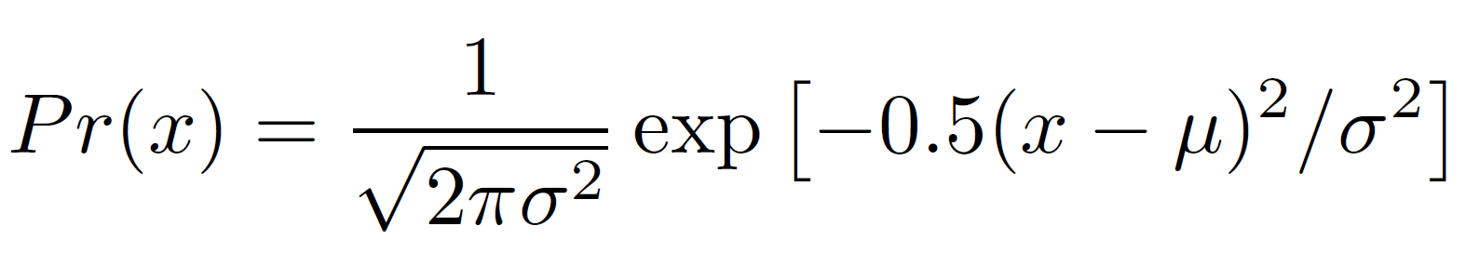
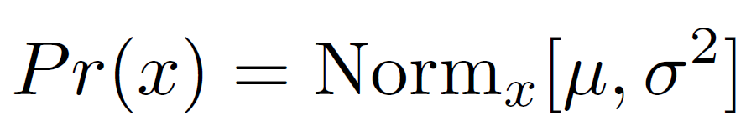
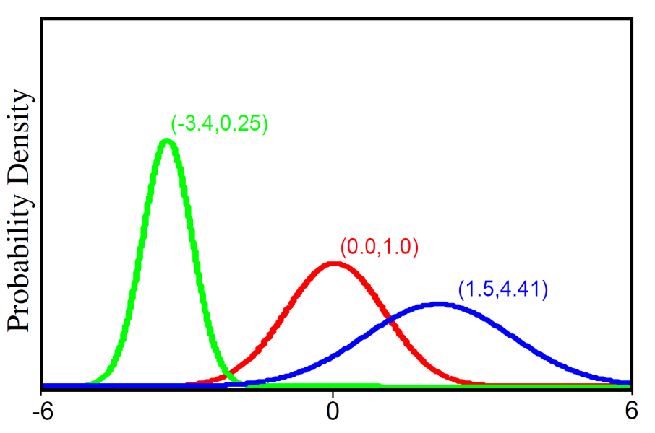
Univariate Normal Distribution
For short we write:
Univariate normal distribution describes single continuous variable.
Takes 2 parameters μ and σ²>0

Slide 14
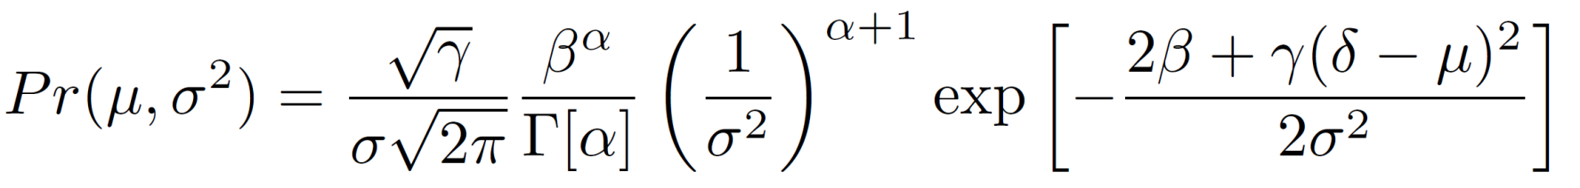
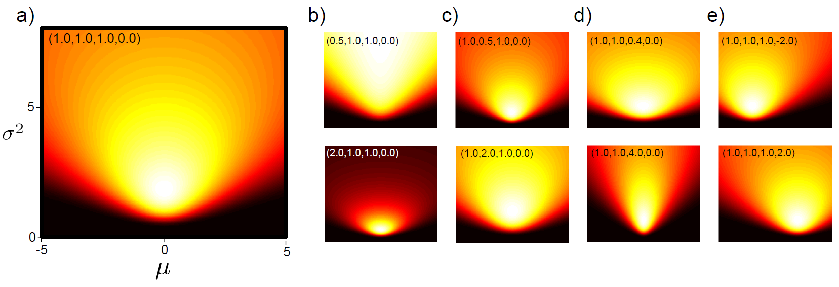
Normal Inverse Gamma Distribution
Defined on 2 variables μ and σ²>0
or for short
Four parameters α,β,γ > 0 and δ.

Slide 15
Ready?
Approach the same problem 3 different ways:
Learn ML parameters
Learn MAP parameters
Learn Bayesian distribution of parameters
Will we get the same results?

Slide 16
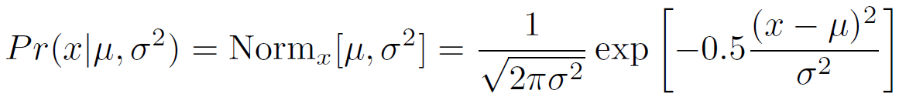
Fitting normal distribution: ML
As the name suggests we find the parameters under which the data is most likely.
Likelihood given by pdf

Slide 17
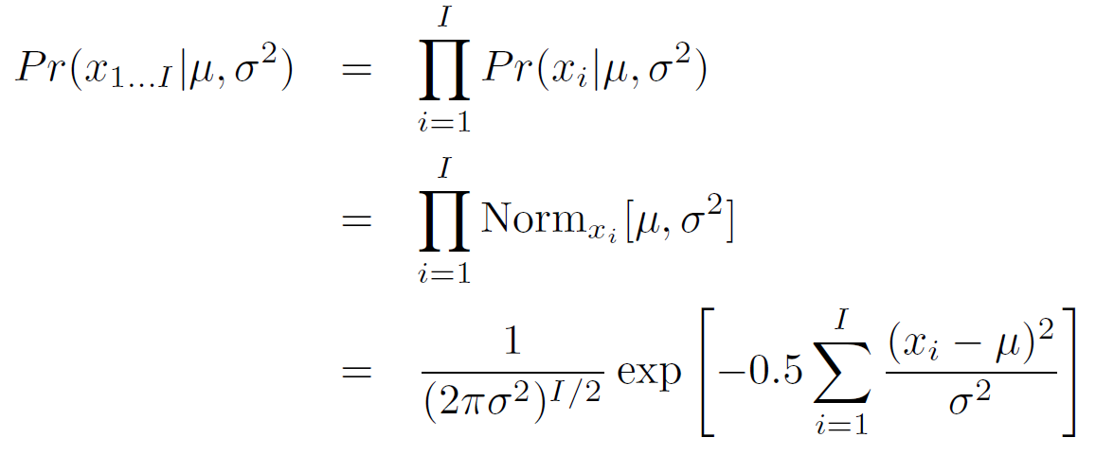
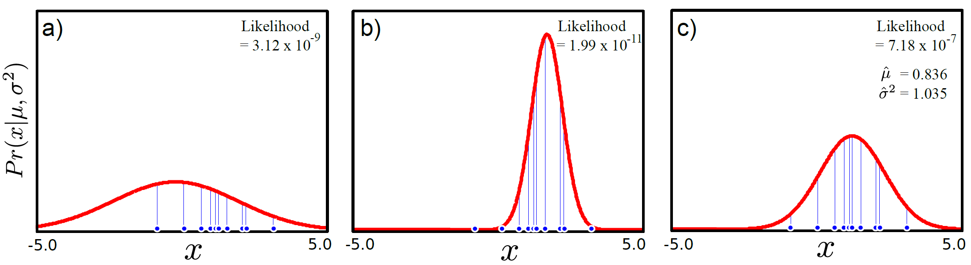
Fitting normal distribution: ML

Slide 18
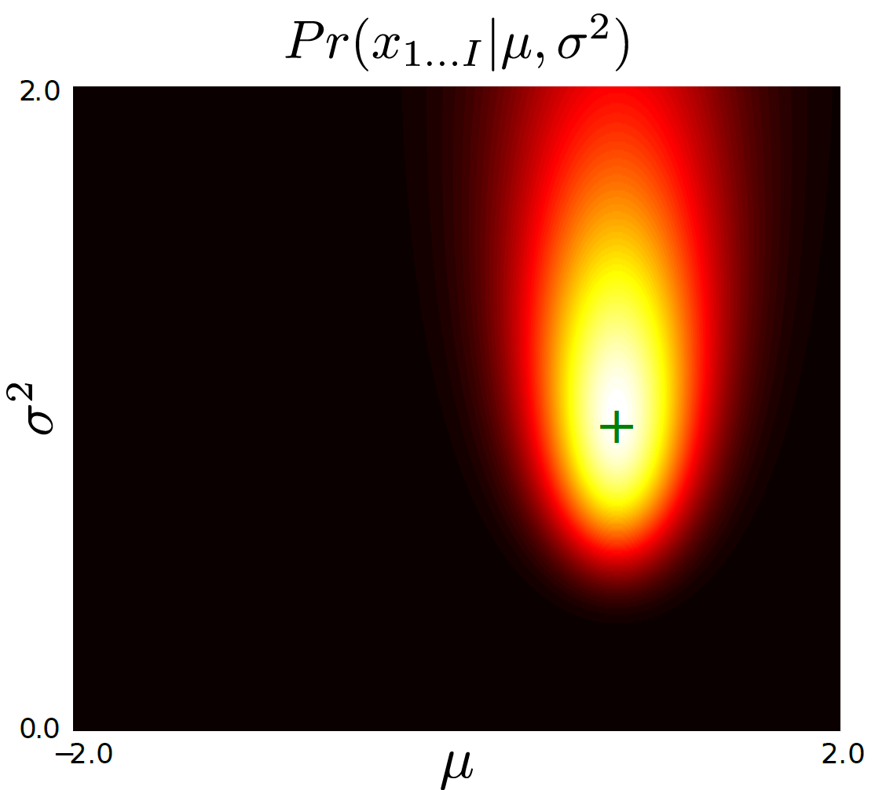
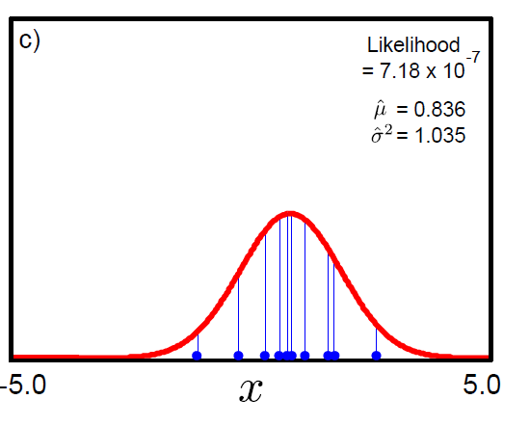
Fitting a normal distribution: ML
Plotted surface of likelihoods as a function of possible parameter values
ML Solution is at peak

Slide 19
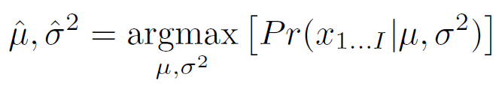
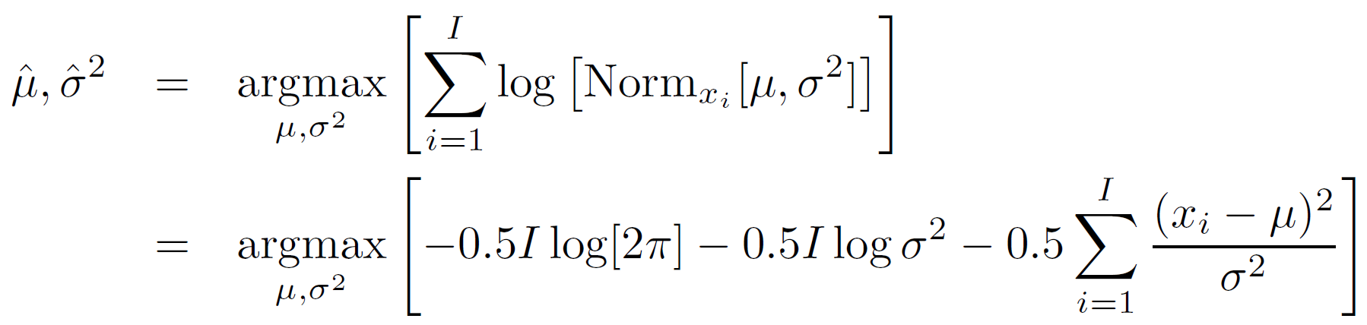
Fitting normal distribution: ML
Algebraically:
where:
or alternatively, we can maximize the logarithm

Slide 20
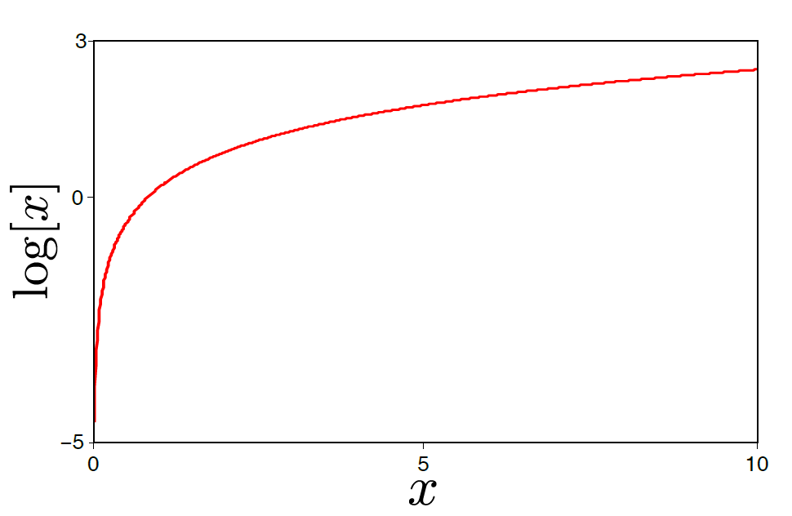
Why the logarithm?
The logarithm is a monotonic transformation.
Hence, the position of the peak stays in the same place
But the log likelihood is easier to work with

Slide 21
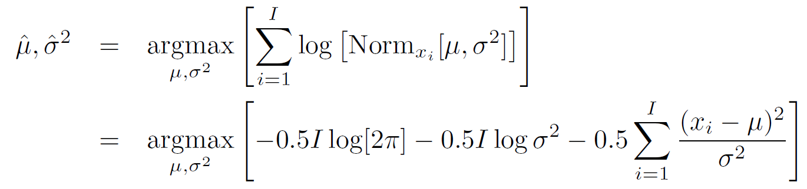
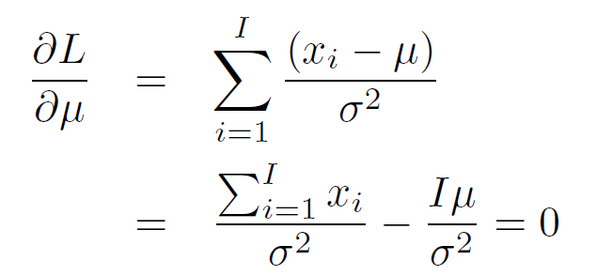
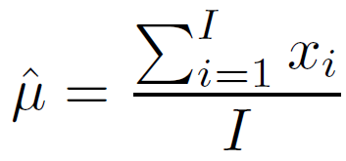
Fitting normal distribution: ML
How to maximize a function? Take derivative and equate to zero.
Solution:

Slide 22
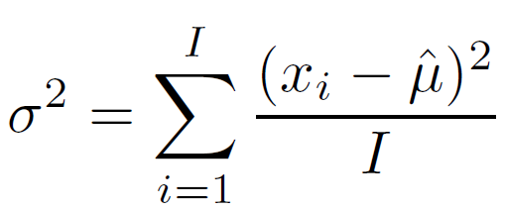
Fitting normal distribution: ML
Maximum likelihood solution:
Should look familiar!
Notes:
.

Slide 23
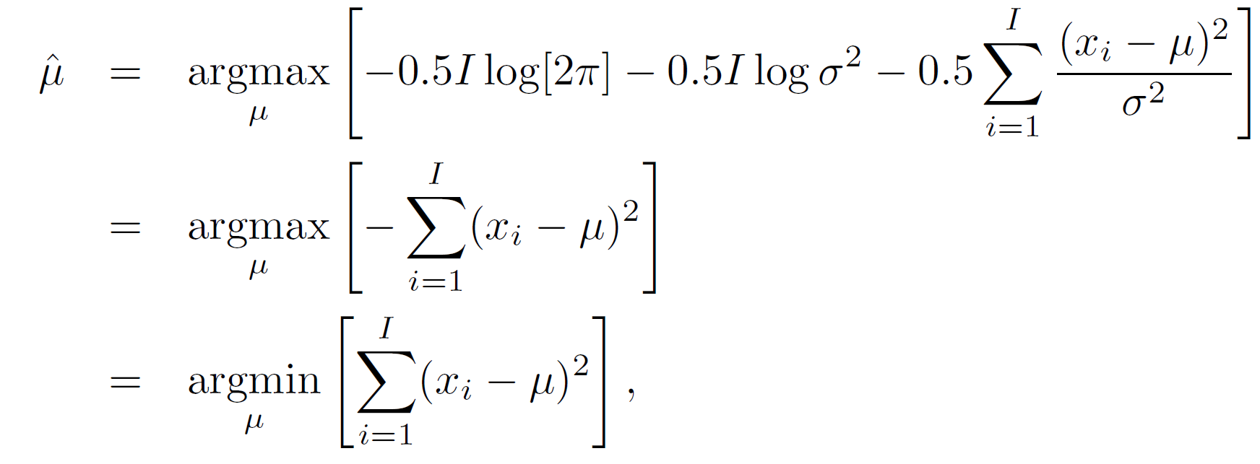
Least Squares
Maximum likelihood for the normal distribution...
...gives `least squares’ fitting criterion.
Computer vision: models, learning and inference. ©2011 Simon J.D. Prince
23

Slide 24
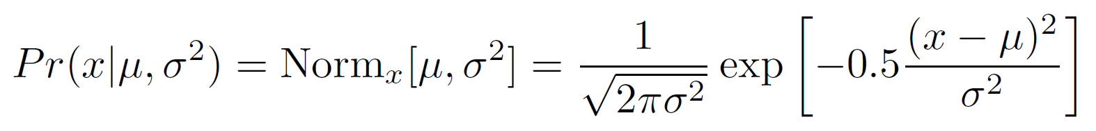
Fitting normal distribution: MAP
Fitting
As the name suggests we find the parameters which maximize the posterior probability ..
Likelihood is normal PDF

Slide 25
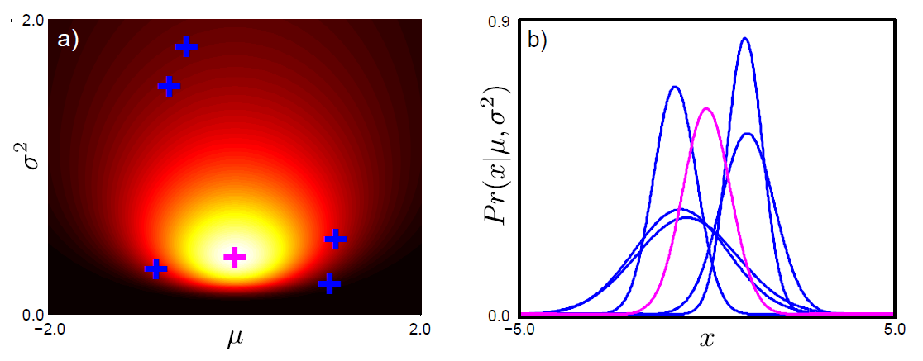
Fitting normal distribution: MAP
Prior
Use conjugate prior, normal scaled inverse gamma.
Notes:
alpha = beta = gamma= 1;
delta = 0.

Slide 26
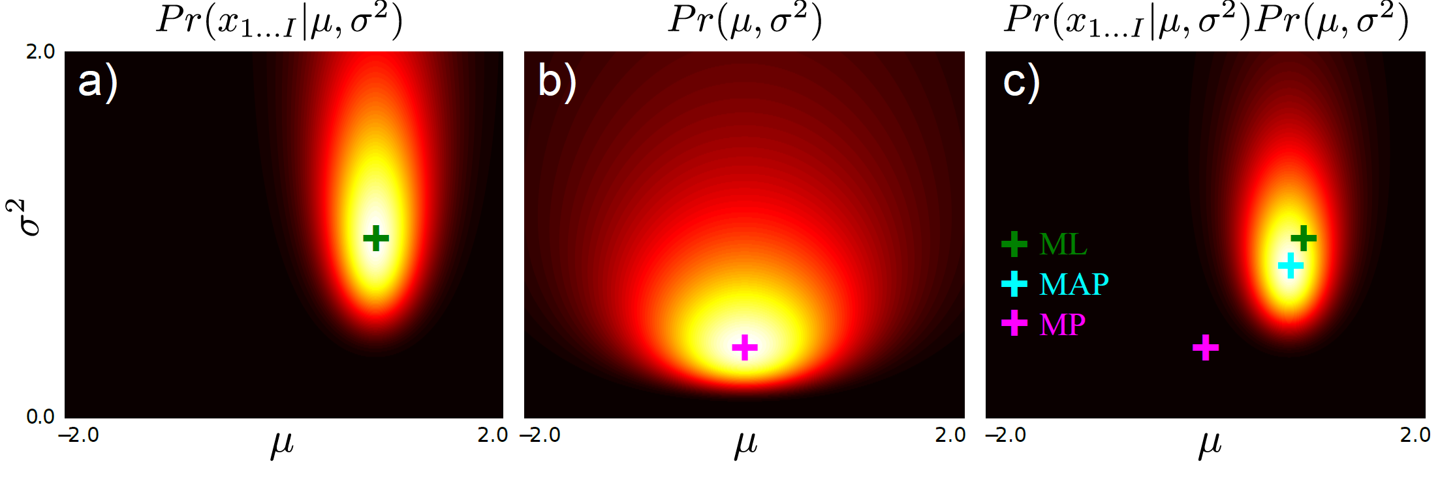
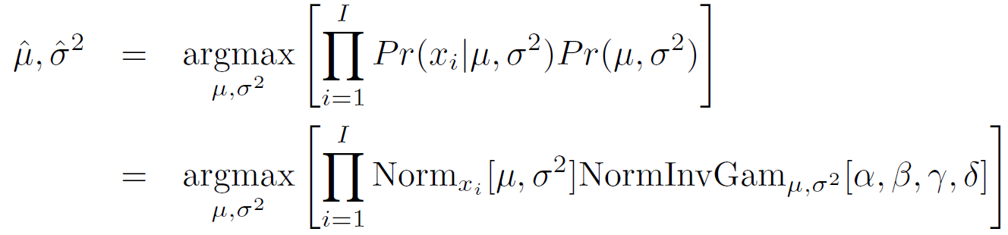
Fitting normal distribution: MAP
Likelihood
Prior
Posterior

Slide 27
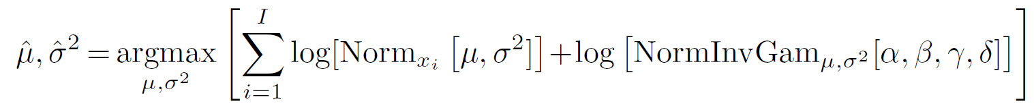
Fitting normal distribution: MAP
Again maximize the log – does not change position of maximum

Slide 28
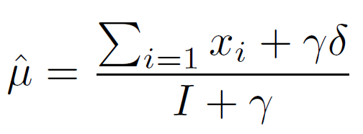
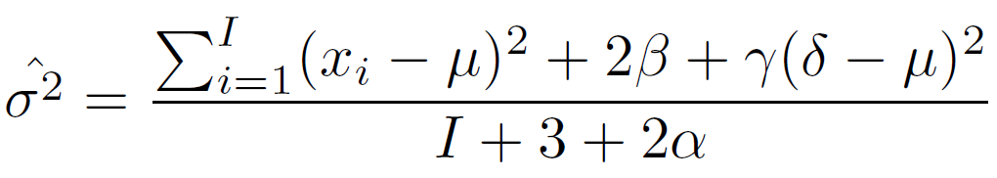
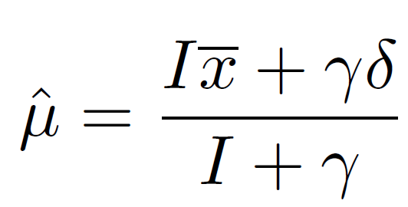
Fitting normal distribution: MAP
MAP solution:
Mean can be rewritten as weighted sum of data mean and prior mean:

Slide 29
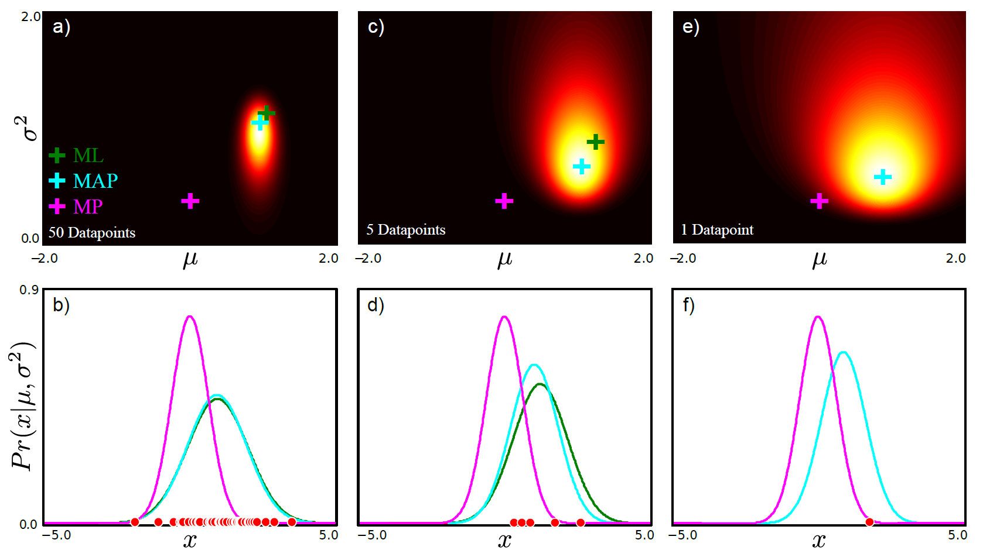
Fitting normal distribution: MAP
50 data points
5 data points
1 data points

Slide 30
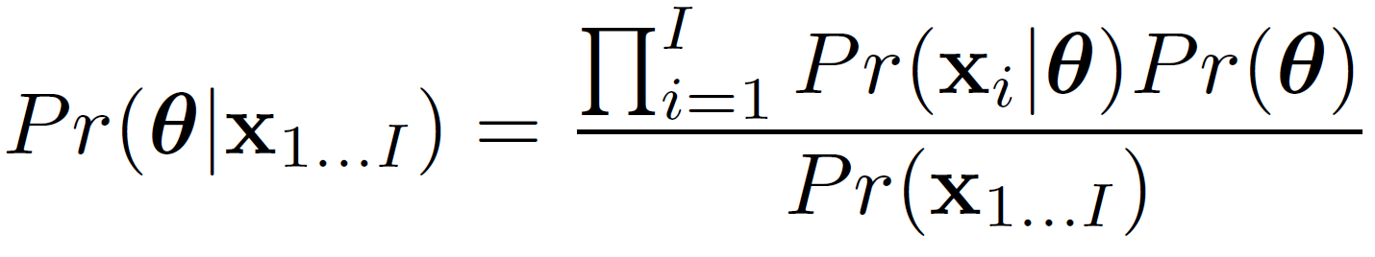
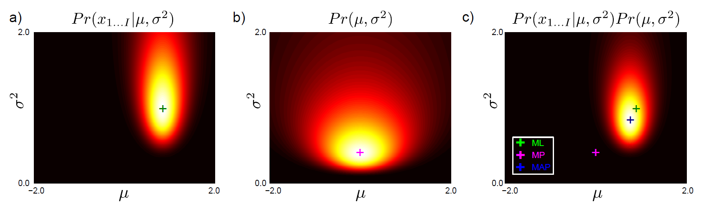
Fitting normal: Bayesian approach
Fitting
Compute the posterior distribution using Bayes’ rule:

Slide 31
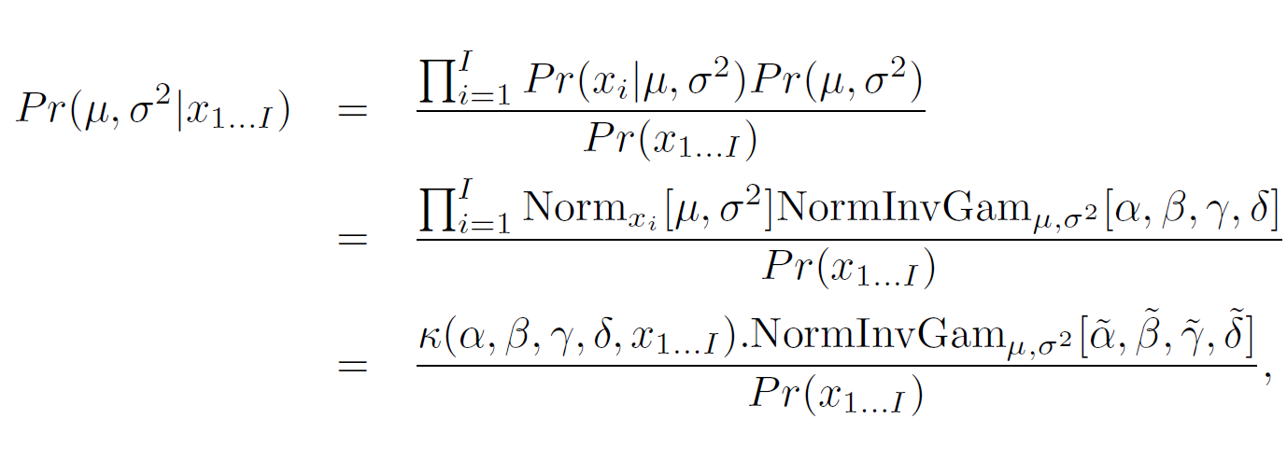
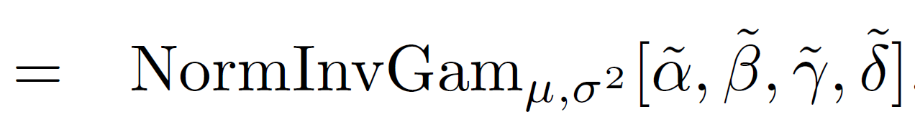
Fitting normal: Bayesian approach
Fitting
Compute the posterior distribution using Bayes’ rule:
Two constants MUST cancel out or LHS not a valid pdf

Slide 32
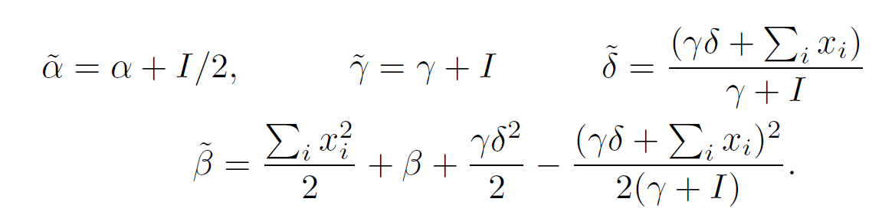
Fitting normal: Bayesian approach
Fitting
Compute the posterior distribution using Bayes’ rule:
where

Slide 33
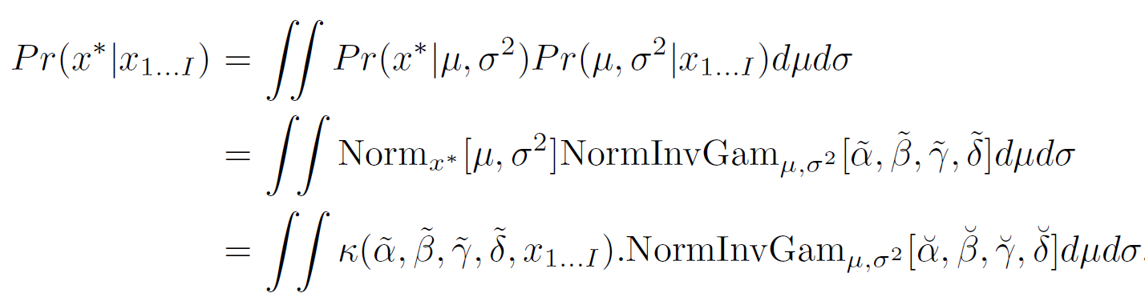
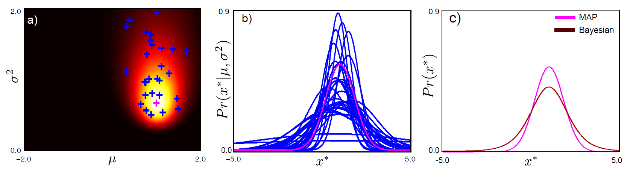
Fitting normal: Bayesian approach
Predictive density
Take weighted sum of predictions from different parameter values:
Posterior
Samples from posterior

Slide 34

Fitting normal: Bayesian approach
Predictive density
Take weighted sum of predictions from different parameter values:

Slide 35
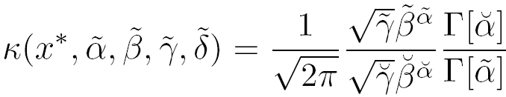
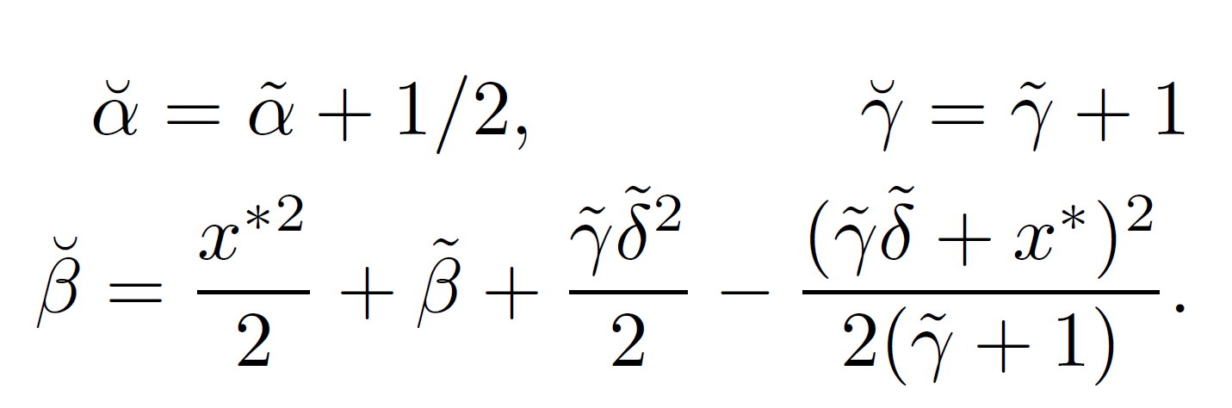
Fitting normal: Bayesian approach
Predictive density
Take weighted sum of predictions from different parameter values:
where
Notes:
(replaced stale version of kappa with correct version in book 4.25)

Slide 36
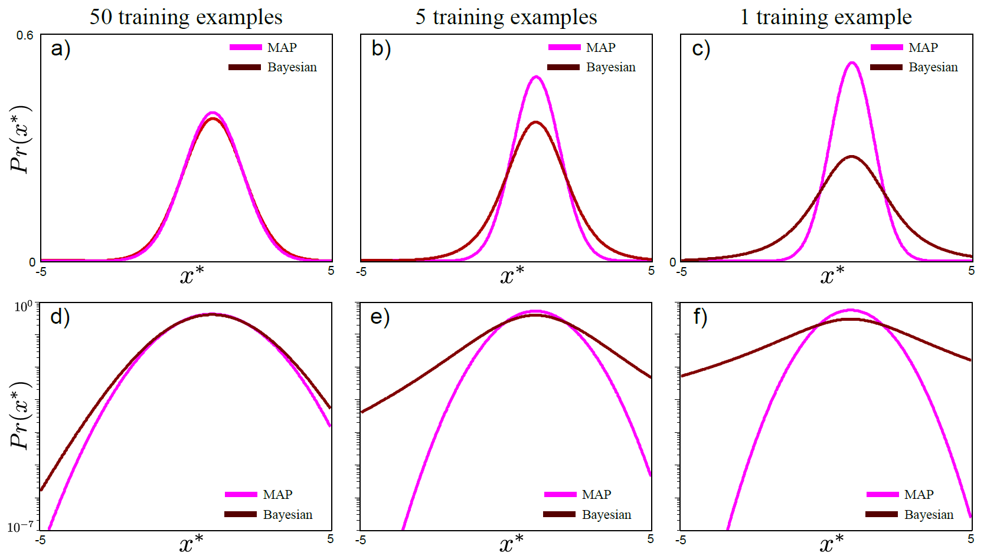
Fitting normal: Bayesian Approach
50 data points
5 data points
1 data points

Slide 37
Structure
Fitting probability distributions
Maximum likelihood
Maximum a posteriori
Bayesian approach
Worked example 1: Normal distribution
Worked example 2: Categorical distribution
Computer vision: models, learning and inference. ©2011 Simon J.D. Prince
37

Slide 38
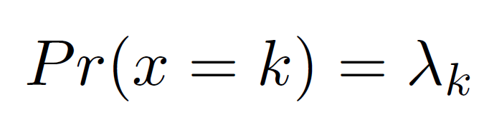
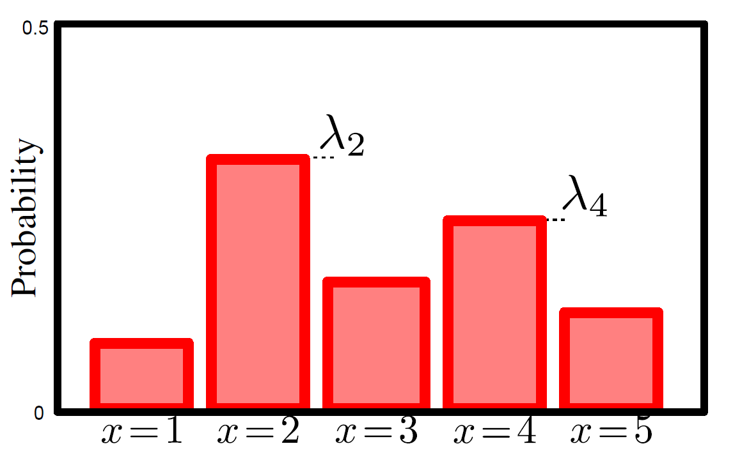
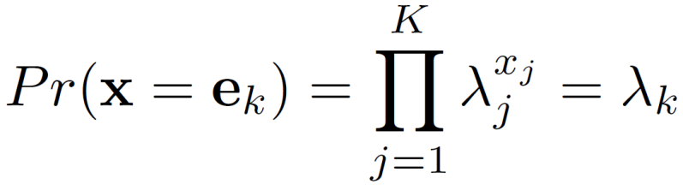
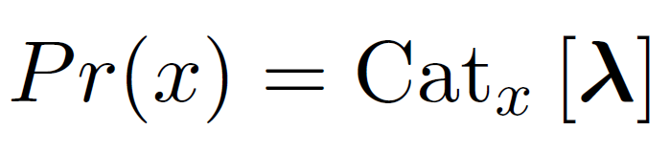


Categorical Distribution
or can think of data as vector with all elements zero except k^{th} e.g. e₄ = [0,0,0,1,0]
(so x_{j} is the j^{th} element of x, i.e. a 0 or 1)
For short we write:
Categorical distribution describes situation where K possible outcomes y=1… y=k.
Takes K parameters where

Slide 39


Dirichlet Distribution
Defined over K values where
Or for short:
Has k
parameters α_{k}>0

Slide 40


Categorical distribution: ML
Maximize product of individual likelihoods
N_{k} = # times we
observed bin k
(remember, P(x) = )

Slide 41


Categorical distribution: ML
Instead maximize the log probability
Lagrange multiplier to ensure that params sum to one
Log likelihood
Take derivative, set to zero and re-arrange:

Slide 42

Categorical distribution: MAP
MAP criterion:

Slide 43

Categorical distribution: MAP
Take derivative, set to zero and re-arrange:
With a uniform prior (α_{1..K}=1), gives same result as maximum likelihood.

Slide 44


Categorical Distribution
Five samples from prior
Observed data
Five samples from posterior

Slide 45

Categorical Distribution: Bayesian approach
Compute posterior distribution over parameters:
Two constants MUST cancel out or LHS not a valid pdf

Slide 46


Categorical Distribution: Bayesian approach
Compute predictive distribution:
Two constants MUST cancel out or LHS not a valid pdf

Slide 47


ML / MAP vs. Bayesian
MAP/ML
Bayesian

Slide 48
Conclusion
Three ways to fit probability distributions
Maximum likelihood
Maximum a posteriori
Bayesian Approach
Two worked example
Normal distribution (ML→ least squares)
Categorical distribution

