Slide 1
Machine Vision:
Understanding Deep Learning
Chapter 8
Measuring Network Performance

Slide 2
Measuring and improving test error
A model trained with I pairs of {x_{i},w_{i}} can seem misleadingly good, or even perfect
How do we measure if the model is good?
What can we do to make a better model?

Slide 3
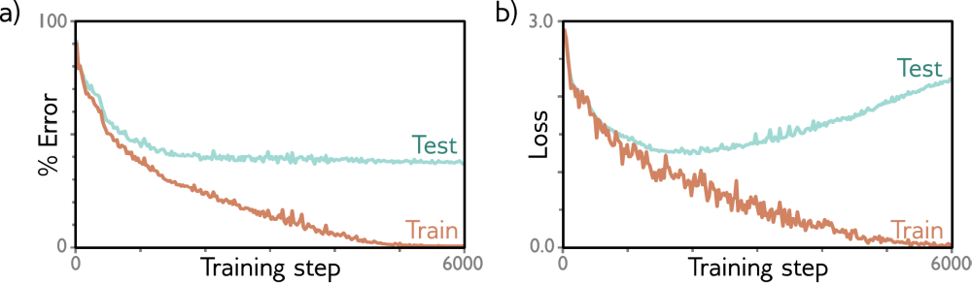
Training error vs test error
A model trained with I pairs of {x_{i},y_{i}} can seem misleadingly good, or even perfect
Experiment testing separate MNIST-1D datasets: I=4000 Training examples vs 1000 Testing examples. Network has 40D input, 2 layers of 100x hidden units, 10D output passed through softmax to return y ϵ {0..9}.
This work is subject to a Creative Commons CC-BY-NC-ND license. (C) MIT Press.

Slide 4
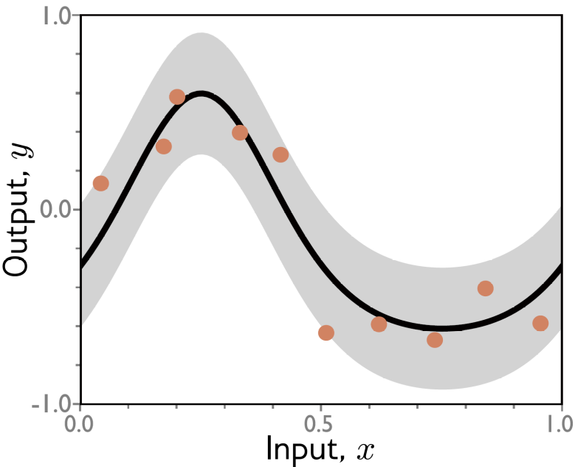
Why do test errors arise?
Test data could come from a different source than training data. Example: synthetic rendering
Test data points x_{i} may leave gaps in spectrum of possible inputs
More…
Ground truth function to regress
Data generator computes function at each x_{i} and adds Gaussian noise (+/- 2 standard deviations shown in gray)

Slide 5
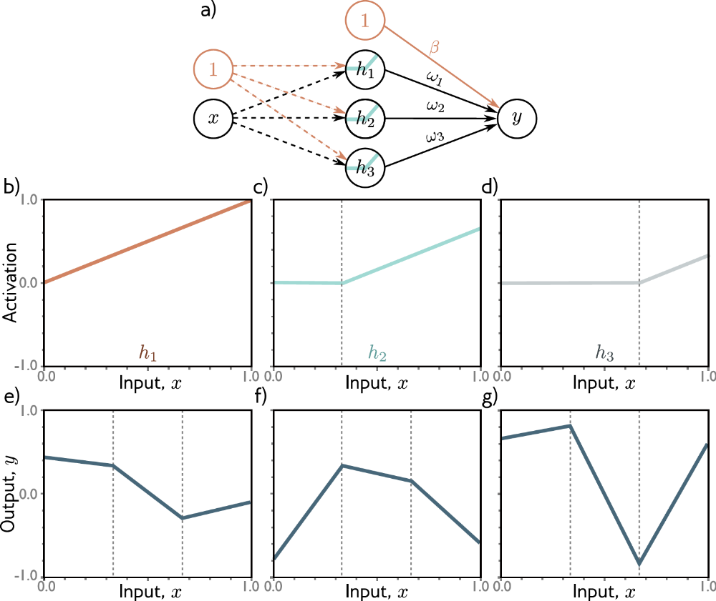
Test errors: linear regression example, with least square loss
Frozen weights and biases up to hidden units

Slide 6
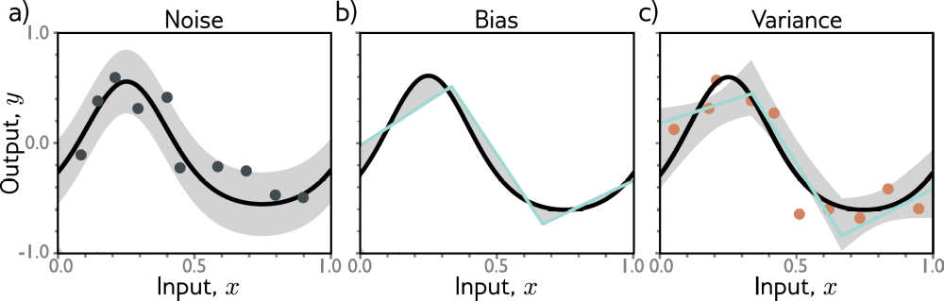
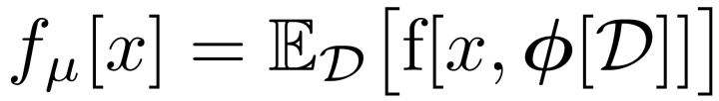
Test errors: linear regression example, with least square loss
Noise means two identical x’s could give different outputs
Bias means the underlying function is more complex than our model can handle
Variance means the model is only as good as the available training samples
This work is subject to a Creative Commons CC-BY-NC-ND license. (C) MIT Press.

Slide 7
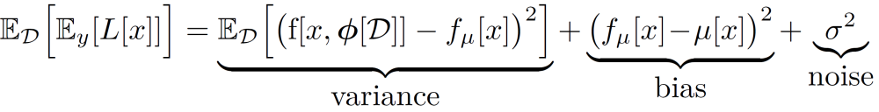

Test errors: linear regression example, with least square loss
In such a toy problem, we have privileged access to the true function f[x] and noise σ²
Expected loss after accounting for (known) uncertainty in training data & in test data:
Least square loss

Slide 8
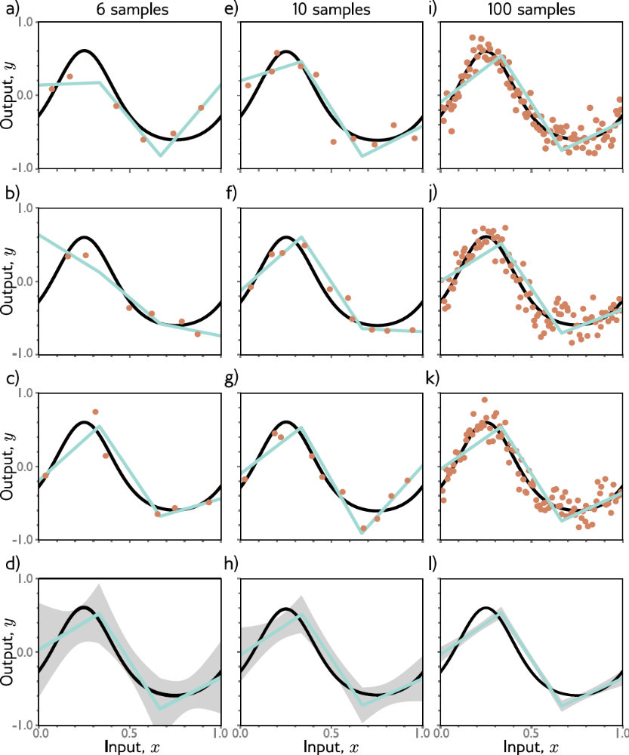
How to reduce variance
This work is subject to a Creative Commons CC-BY-NC-ND license. (C) MIT Press.

Slide 9
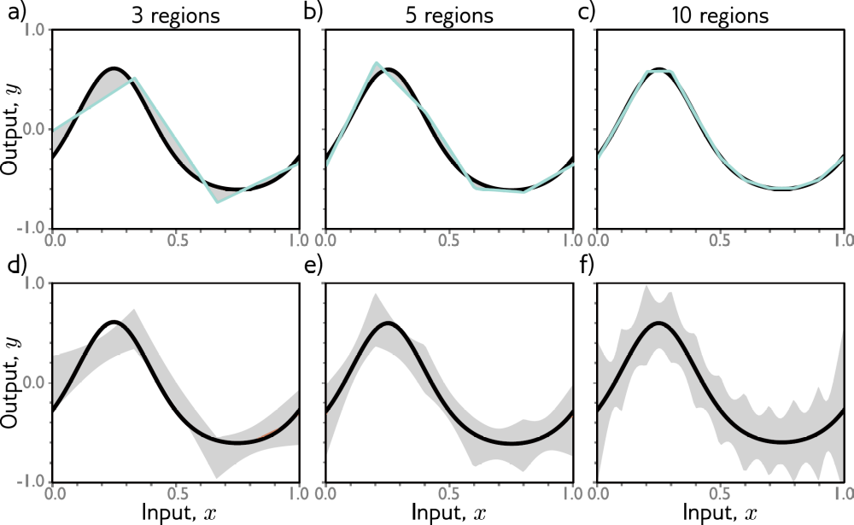
How to reduce bias
Capacity
This work is subject to a Creative Commons CC-BY-NC-ND license. (C) MIT Press.

Slide 10
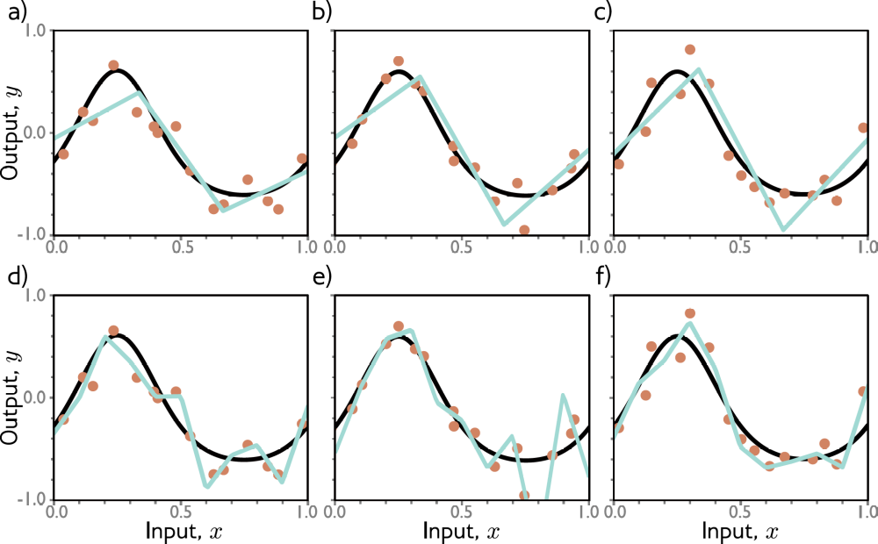
Overfitting
Least square loss
3 regions, i.e. units
10 regions
This work is subject to a Creative Commons CC-BY-NC-ND license. (C) MIT Press.
Notes:
15 Points, different in each column. Top row shows low variance.

Slide 11
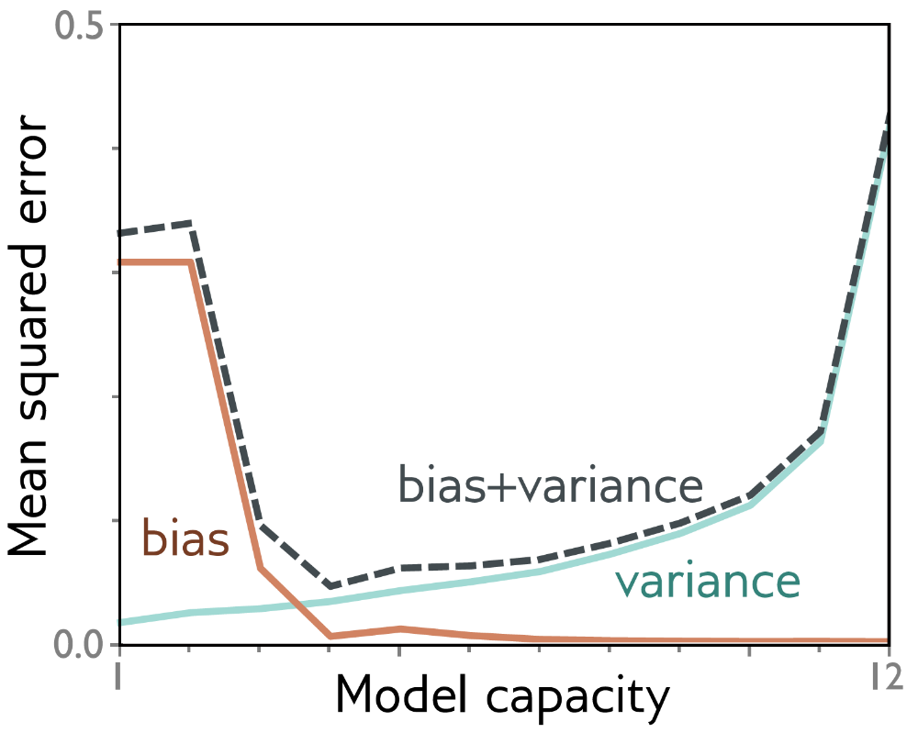
Variance vs bias “sweet spot”
For a simple model, sweep capacity (# hidden units) and compute both variance and bias
Training data can be memorized
This work is subject to a Creative Commons CC-BY-NC-ND license. (C) MIT Press.

Slide 12
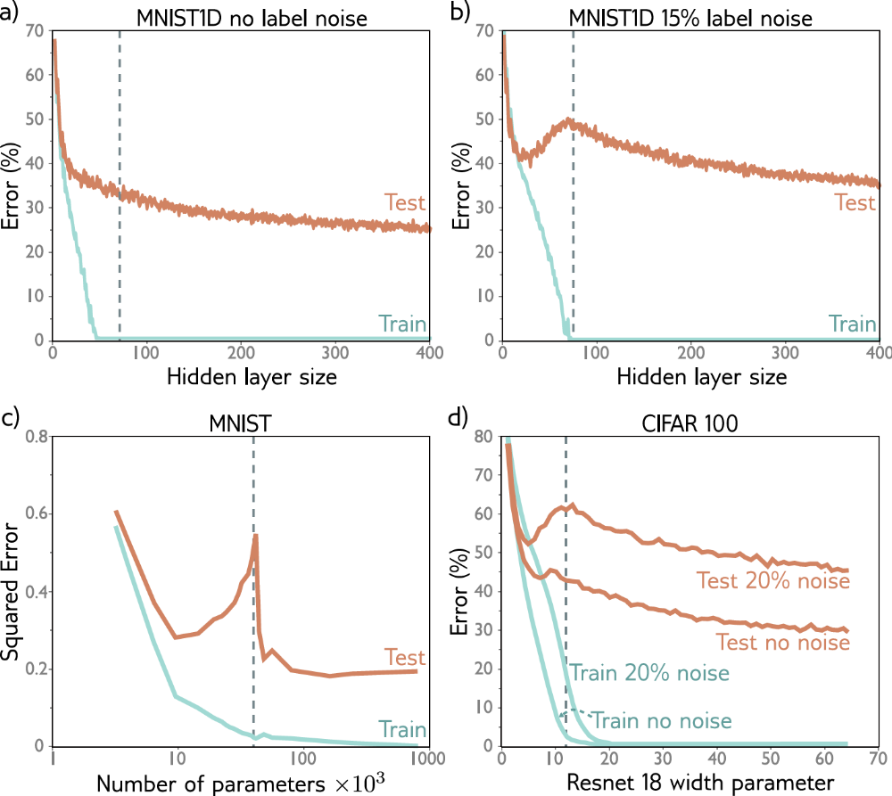
Unusual double descent phenomenon
Same model with 2 hidden layers
Classical or under-parameterized regime
Critical
Modern or over-parameterized regime
This work is subject to a Creative Commons CC-BY-NC-ND license. (C) MIT Press.

Slide 13
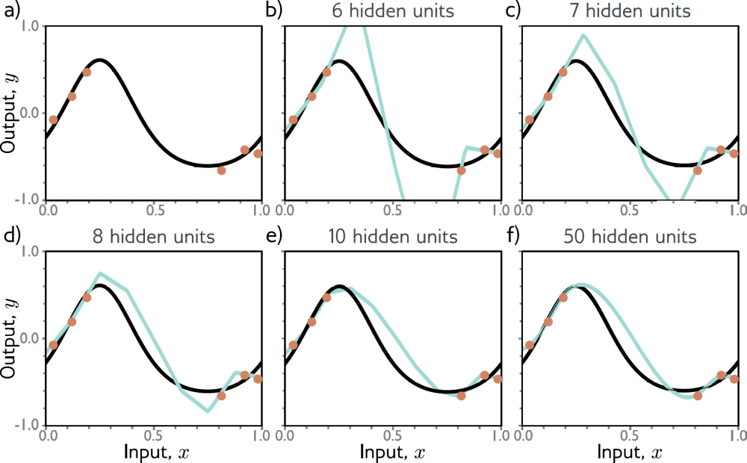
Inductive bias to extrapolate smoothly?
This work is subject to a Creative Commons CC-BY-NC-ND license. (C) MIT Press.
Notes:
Any change must be occurring between the training points. The tendency of a model to prioritize one solution over another as
it extrapolates between data points is known as its inductive bias.

Slide 14
Key Points
Use a Validation Set to determine hyperparameters
  Much like Training Set for finding parameters
  Because true function x → y is unknown
Bias-variance trade-off is affected by # parameters vs model complexity
Regularization needed to generalize better, especially in higher dimensions
Test
Test
Train.
Train.
Val.
This work is subject to a Creative Commons CC-BY-NC-ND license. (C) MIT Press.

