Slide 1

Team Garden State
LaunchGate
Give Mastercard's own engineers the promise it already makes to customers.
Presented by
Event
Customer
Team Garden State
LEAD ASPIRE 2026, Microsoft Times Square
Mastercard, with EY

Slide 2
The team
Azra Bano
Where we have worked
Engagement lead · API, rules and readiness model
[Logo 1]
[Logo 2]
Melanie
Product and front end · portal and deployment
Jayden
[Logo 3]
[Logo 4]
Cloud · Azure Static Web Apps and delivery
Adrian
AI · Azure AI Foundry agent, risk memo, Bicep
[Logo 5]
[Logo 6]
[Name 5]
[Role]

Slide 3



Money moves in a second.
Ideas wait 6 to 8 months.
< 1 second
15 days
6 to 8 months
to authorize a cardholder's transaction, billions of times a year
Product Express promise to fintechs: a card program live, status visible to every party
12 handoffs before an internal team can start building. Reported in Discovery.
Product Express: mastercard.com (15 days after due diligence and contract) · Discovery with Mastercard Business Development, 12 Oct 2026

Slide 4





Agents prepare. Rules decide. People approve.
1 Ask once
2 Rules decide
3 Agent prepares
4 People approve
5 All logged
A business owner or engineer answers a few plain questions. Secure defaults applied.
A deterministic readiness model scores risk; every rule names the control it cites and the fix.
Azure AI Foundry agent on an open model drafts the Bicep and a risk memo. Read-only.
Only the approvals that must stay human, in parallel. A GitHub gate enforces it.
Append-only audit trail; the evidence pack a partner bank asks for is already written.
Twelve handoffs become one request plus only the human approvals policy requires. Eight steps automated, three merged into the request. Nothing deploys without a person.

Slide 5
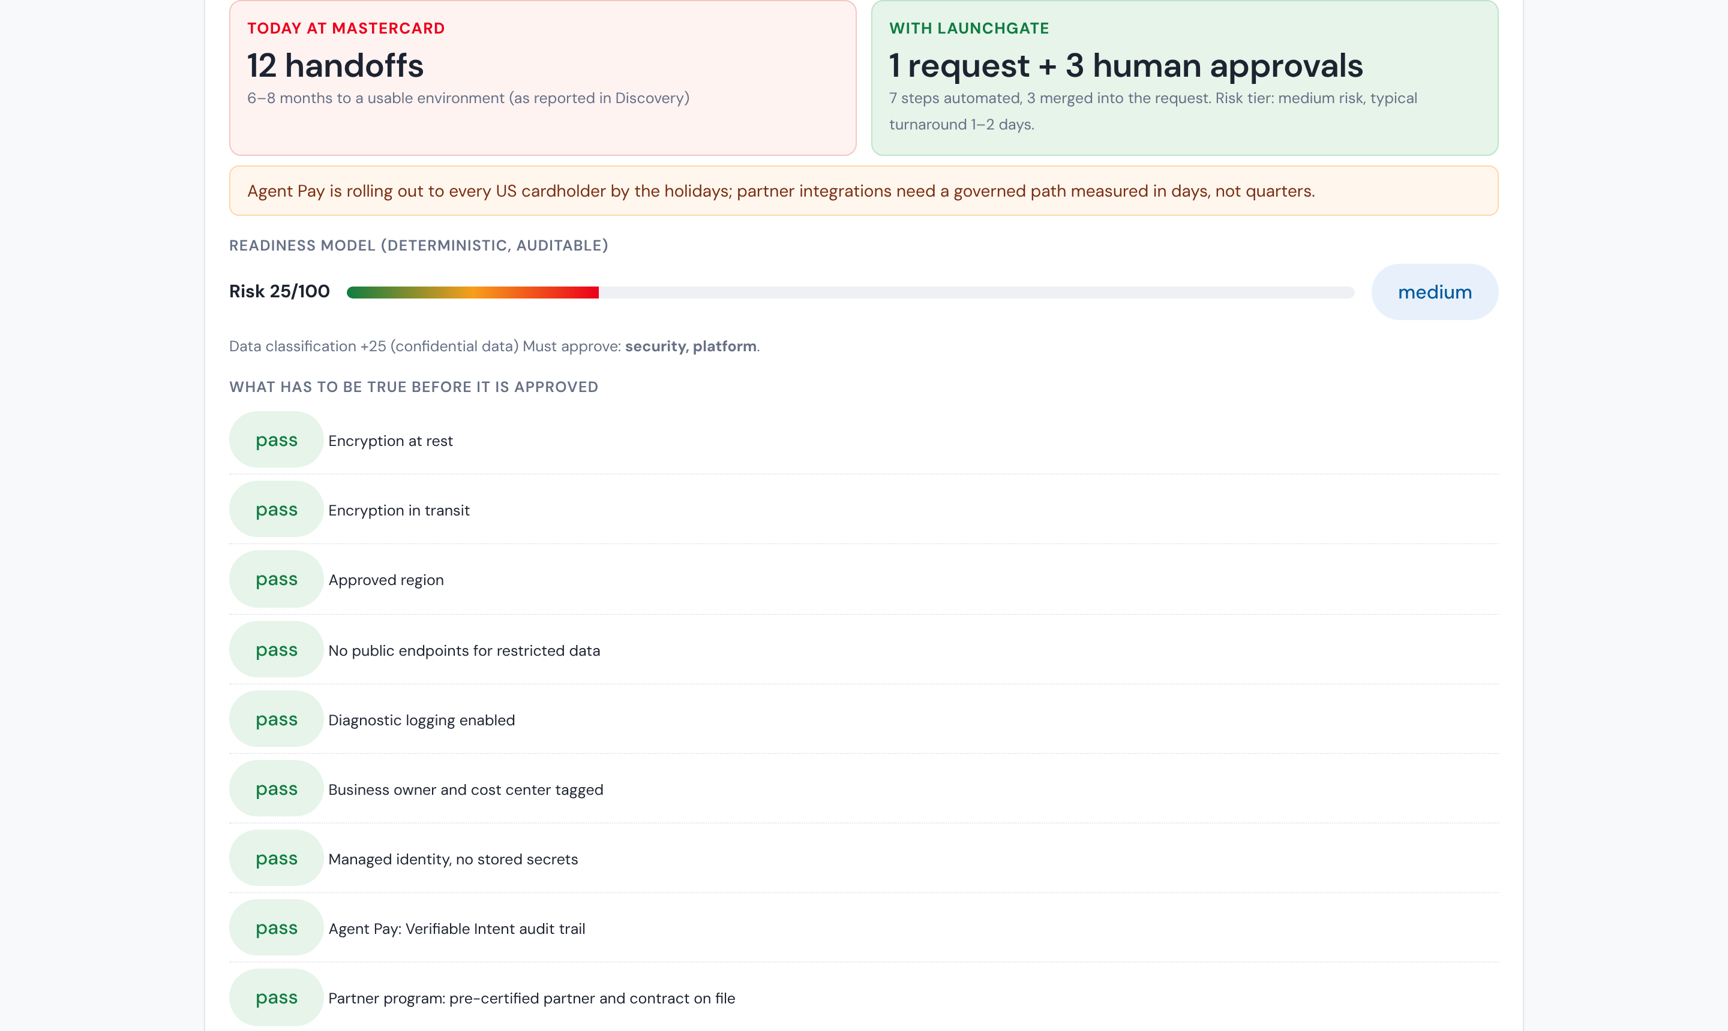
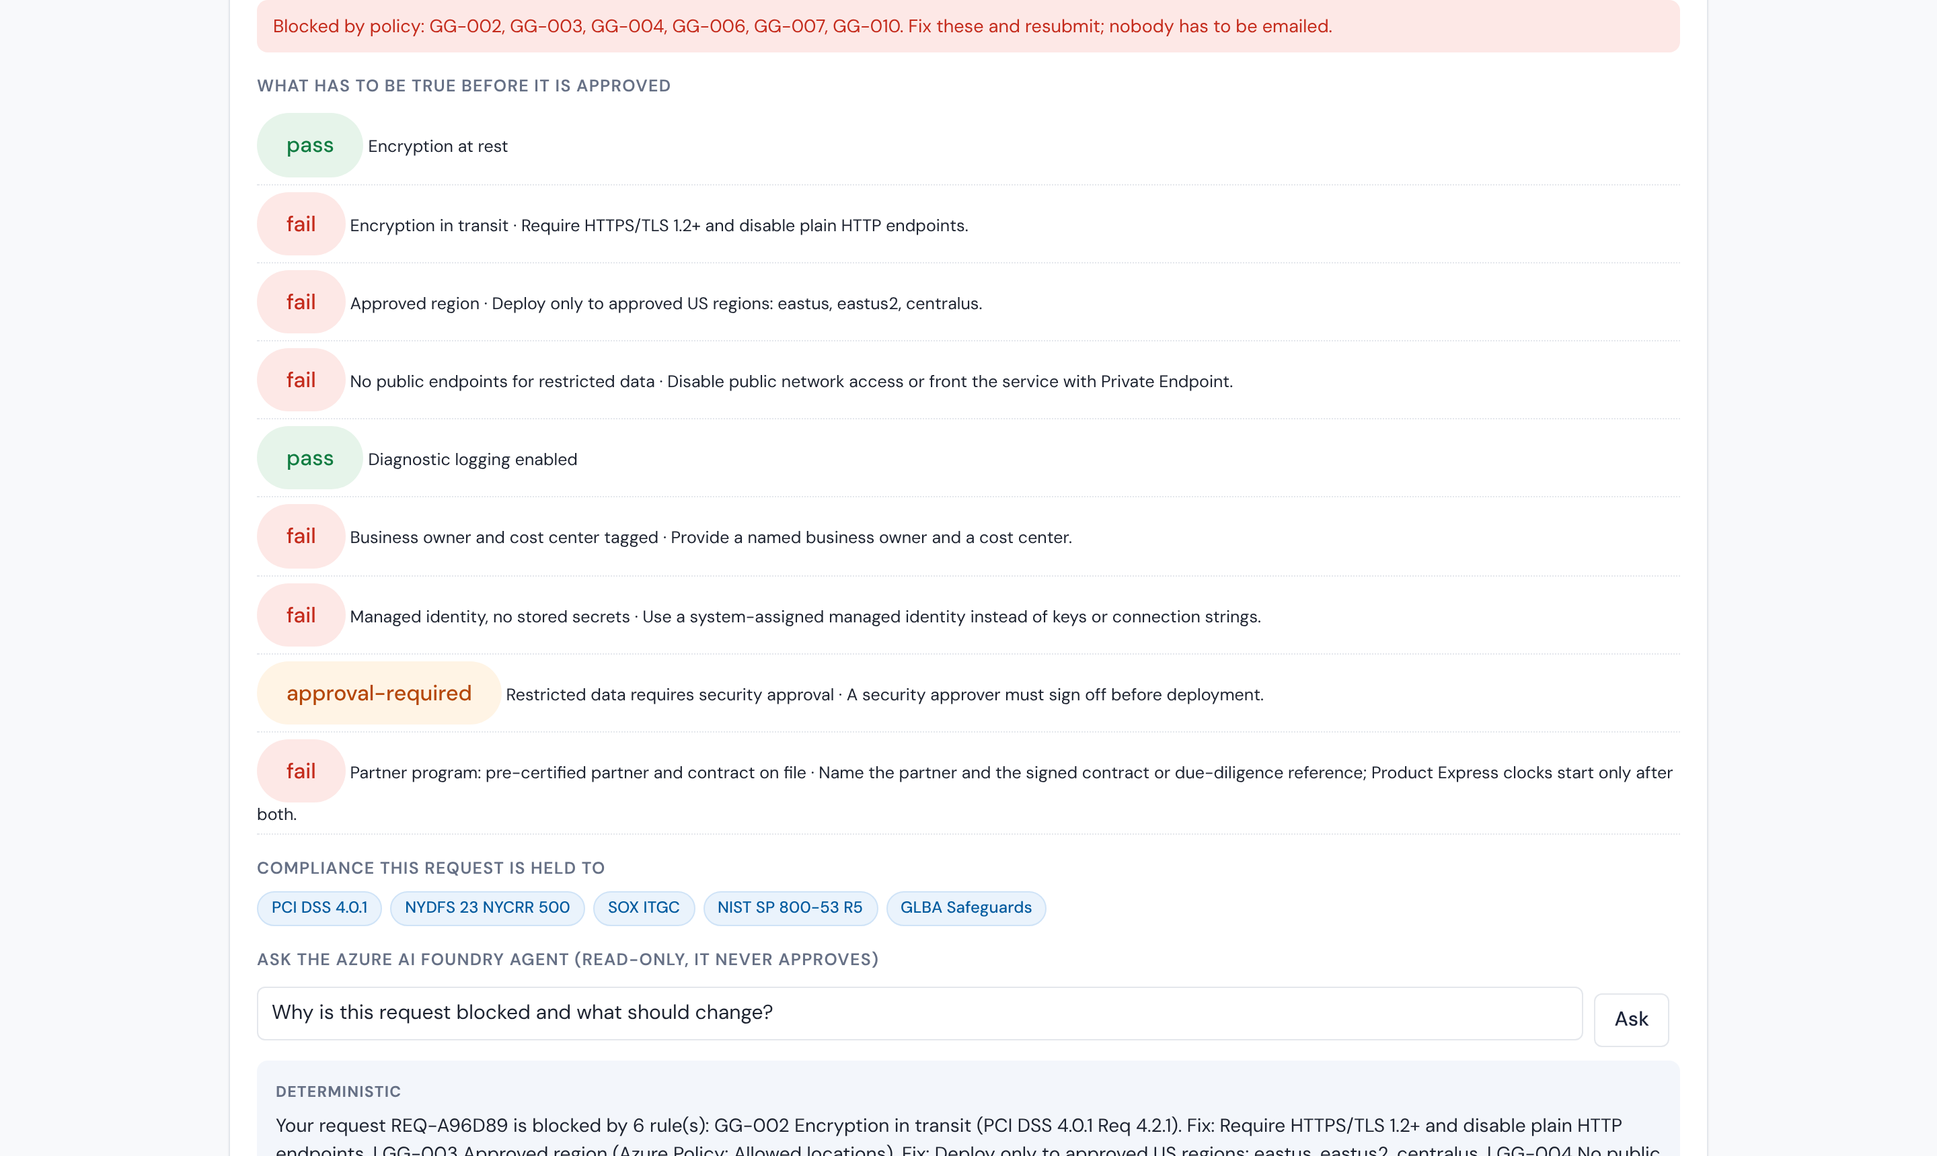
Governed go-live, in minutes
Business owner view: today versus LaunchGate, risk tier, who must approve, and what has to be true.
Misconfigured program: blocked with the exact rules and controls, and the Foundry agent explains the fix.
Scenarios: fintech card program · Agent Pay airline integration · internal service · misconfigured program

Slide 6






Six steps, all on Microsoft
1 Portal
2 Rule engine
3 AI agent
4 Approval
5 Deploy gate
6 Audit log
One plain-language request; secure defaults applied
Deterministic rules pass or fail and name the control
Drafts the Bicep and risk memo; explains blocks. Read-only
Required humans approve in parallel; no self-approval
Nothing ships until approval is recorded
Every step, actor and rule, append-only
Static Web Apps · React
Azure Functions · Azure Policy schema
Azure AI Foundry · open model
Microsoft Entra ID roles
GitHub Actions environment rule
Azure Cosmos DB
Built with GitHub Copilot
Multicloud by design
Copilot encoded the rule schema and scaffolded modules; GitHub Actions deploys every change.
Rules are cloud-neutral, Defender for Cloud assesses AWS accounts, and deployment sits behind a swappable provider.
Built today on synthetic data. Pilot adds Teams approvals, Defender for Cloud scoring, a Fabric dashboard and real provisioning via Azure Deployment Environments.

Slide 7




An illustrative $6M a year
The model, with inputs labelled
Time
Months of waiting per program become days. Capital One: 3 months to minutes.
Reported: 6 to 8 month cycle, ~12 handoffs per request
Assumed: N programs per year; most of the cycle is waiting, not work
Value per program = months saved × (partner revenue brought forward + reviewer time + engineer idle time)
Illustration: 25 programs/yr × 4 months saved = 100 program-months a year
In dollars (assumed): 5-person team × $150K loaded cost × 4 months idle ≈ $250K per program; × 25 programs ≈ $6M a year
Benchmark: 58 working days per quarter on compliance audits (Telos)
Cost
Repeat reviewer work and idle engineering time removed; evidence written once.
Revenue timing
Partner programs and Agent Pay integrations go live sooner; BD quotes dates it can keep.
Risk
Same answer every time, full audit trail, no process restart on attrition.
The prototype counts handoffs removed and minutes per request so a 90-day pilot can price the real savings. Request volume is the first number a pilot confirms.

Slide 8

Our ask: a 90-day pilot
Days 1 to 30
Days 31 to 60
Days 61 to 90
Load Mastercard's rule catalogue into the schema with the Policy Copilot; security owns the rules.
Entra ID Governance approvals in Teams; GitHub environment gate; Defender for Cloud scoring.
Real provisioning through Azure Deployment Environments; Fabric dashboard reports cycle time per program.
The ask
A sponsor in Business Development and one in Platform Security, one business unit, and the number Discovery could not give us: programs per year. Target in pilot: 12 handoffs to 1 request plus required approvals; readiness from months to days.
Thank you: Microsoft, Mastercard and EY. Team Garden State: Azra Bano, Melanie, Jayden, Adrian, [Name 5]

