Slide 1
LEAD ASPIRE 2026 · MICROSOFT TIMES SQUARE · TEAM GARDEN STATE
LaunchGate
Give Mastercard's own engineers the promise it already makes to partners.
A policy-aware deployment control plane. Agents prepare. Rules decide. People approve.
Customer: Mastercard · Consulting partner: EY · Built on Microsoft Azure and GitHub

Slide 2



THE HOOK
Money moves in under a second. Ideas wait eight months.
< 1 second
15 days
6 to 8 months
to authorize a cardholder's transaction, billions of times a year
Product Express promise to fintechs: a card program live, status visible to every party
12 handoffs before an internal team can start building. Reported in Discovery.
Same company. Same guardrails. The difference is whether the path is designed or inherited.
Product Express: mastercard.com (15 days after due diligence and contract) · Discovery with Mastercard Business Development, 12 Oct 2026

Slide 3
TEAM GARDEN STATE
Five builders, one brief
Azra Bano
WHERE WE HAVE WORKED
Engagement lead · API, rules and readiness model
[Logo 1]
[Logo 2]
Melanie
Product and front end · portal and Vercel deployment
Jayden
[Logo 3]
[Logo 4]
Cloud · Azure Static Web Apps and delivery
Adrian
AI · Azure AI Foundry agent, risk memo, Bicep
[Logo 5]
[Logo 6]
[Name 5]
[Role]
Replace with employer or university logos (two per row).

Slide 4



THE PROBLEM, IN MASTERCARD'S NUMBERS
Compliance is re-proven by hand, twelve times in a row
12
6 to 8
1
0
handoffs to get a development environment
months from request to a usable environment
handoff is the ideal state, in the customer's words
tolerance for skipping a guardrail
"Deployment is not enough. It also includes policy and orchestration."
"Redo the whole process if someone leaves the company."
"Security guardrails. We can't come up with an idea and just ship it out."
Discovery interview with Maria, Business Development, Mastercard, 12 Oct 2026. The 6 to 8 month figure is treated as the end-to-end readiness cycle, to confirm in a pilot.

Slide 5
VALIDATED OUTSIDE THE ROOM
Approval chains, not servers, are the delay
78%
of engineering teams wait a day or more for DevOps help; 16% wait a week or more
81
steps, 3 tickets and a change request to ship one line of code at Morgan Stanley
Port, State of Internal Developer Portals 2025
Team Topologies, Jan 2026 (Gus Paul, Morgan Stanley)
90%+
of major changes approved by change boards; some firms rejected none all year
58
working days per quarter spent on compliance audits; 3 days per evidence request
UK FCA, Implementing Technology Change, 2021
Telos / Vanson Bourne survey, 2020
Gartner: 80% of large software engineering organizations will have platform engineering teams by 2026.

Slide 6
WHAT COMPETITORS AND PEERS ALREADY DID
Regulated banks fixed this with policy as code
Capital One
JPMorgan Chase
Visa
Deutsche Bank
3 months → minutes
6 to 18 months → codified
4 weeks
350+ policies as code
average development environment build time; built Cloud Custodian because every new cloud service needed its certs signed off by hand
per cloud service approval before controls became standard questions, Terraform and tests; TrueCD targets any change live in under an hour
Fintech Fast Track onboarding by reducing onboarding conditions; Trusted Agent Protocol for agentic commerce
3,000+ developers consuming cloud autonomously, 500,000+ Terraform runs
AWS case study; InfoWorld 2024
FINOS 2019; VentureBeat 2025
Visa newsroom 2018, 2025
HashiCorp case study
Amex: new platforms enter a Landing Zone then a Target Zone with enterprise controls as code (americanexpress.io, Sep 2026).

Slide 7


THE INSIGHT
Mastercard already runs this model. Just not for itself.
Externally: Product Express
Internally: twelve handoffs
One governed request
Pre-certified partners, fewer onboarding conditions
Status visible to all parties, across all phases
Card program live in as fast as 15 days
Twelve people, in sequence, each re-checking policy
Knowledge lives in people; attrition restarts the chain
No single view of what is blocking a program
6 to 8 months before a partner program can start
"Trust cannot be implied. It must be proven." Mastercard, Verifiable Intent, March 2026. We apply the same standard to infrastructure changes.

Slide 8





OUR SOLUTION: LAUNCHGATE
Agents prepare. Rules decide. People approve.
1 Ask once
2 Rules decide
3 Agent prepares
4 People approve
5 Everything logged
›
›
›
›
A business owner or engineer answers a few plain questions. Secure defaults applied.
A deterministic readiness model scores risk; every rule names the control it cites and the fix.
Azure AI Foundry agent on an open model drafts the Bicep and a risk memo. Read-only.
Only the approvals that must stay human, in parallel. A GitHub gate enforces it.
Append-only audit trail; the evidence pack a partner bank asks for is already written.
Twelve handoffs become one request plus one or two human approvals. Eight steps automated, three merged into the request. Nothing deploys without a person.

Slide 9
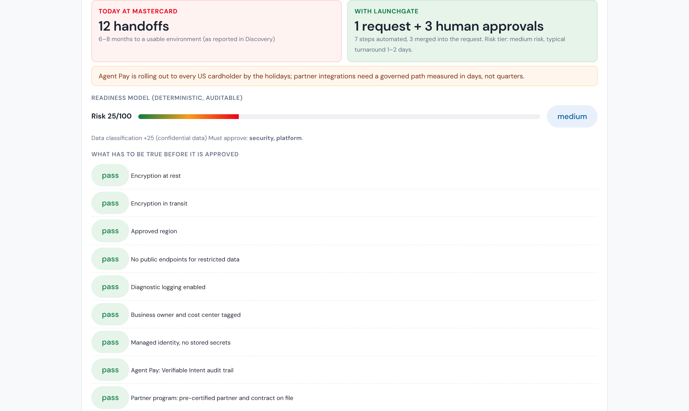
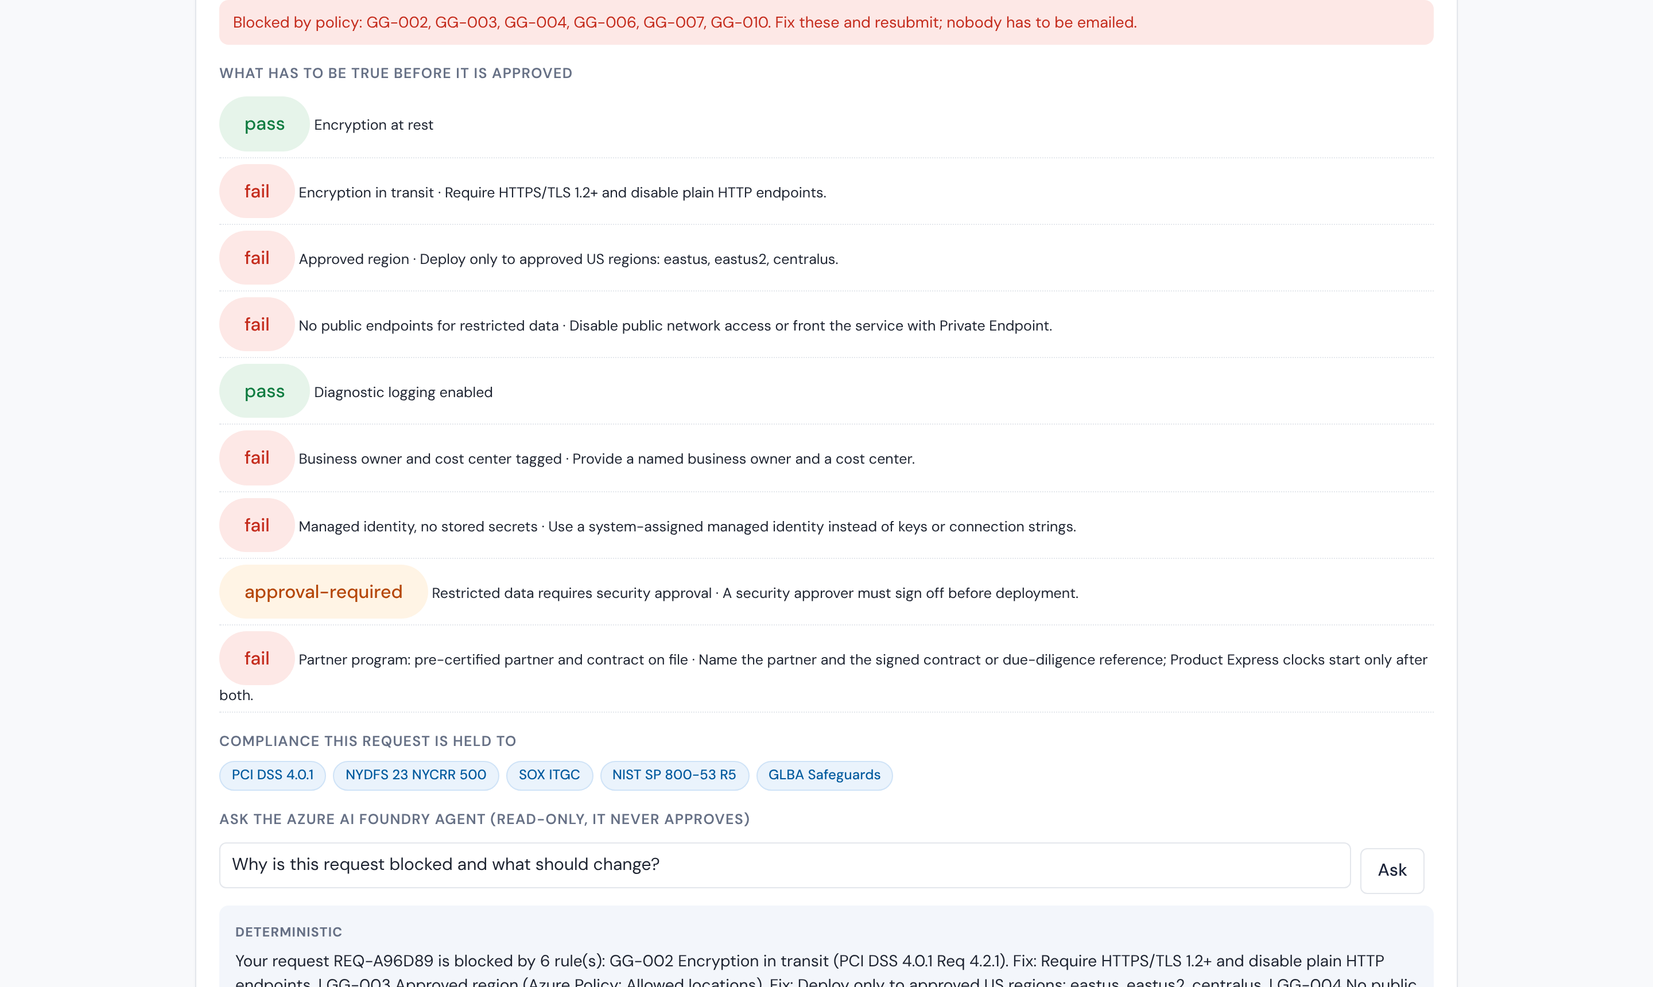
LIVE DEMO
Partner program to governed go-live, in minutes
Business owner view: today versus LaunchGate, risk tier, who must approve, and what has to be true.
Misconfigured program: blocked with the exact rules and controls, and the Foundry agent explains the fix.
Scenarios: fintech card program · Agent Pay airline integration · internal service · misconfigured program

Slide 10
UNDER THE HOOD
A transparent model sets the human review
Readiness model
Six weighted factors (data class, exposure, credentials, residency, transport, observability) give a 0 to 100 score and a tier. Every point is auditable.
Rule engine
Ten rules as code in the Azure Policy schema. Same input, same result. Each cites PCI DSS 4.0.1, NIST 800-53, CIS Azure or a Mastercard standard.
Foundry agent
Open model (Phi-4) on Azure AI Foundry writes the risk memo and answers "why am I blocked". It cannot approve or deploy.
Agent Pay pack
Verifiable Intent audit trail required; agent governance review added as a thirteenth, human, step.

Slide 11




SECURITY AND RESPONSIBLE AI
Zero Trust by design
Identity
Secrets and data
Observability
Roles from Microsoft Entra ID. Requester, security, platform, compliance. A requester can never approve their own request.
No stored credentials: managed identity and DefaultAzureCredential. Synthetic data only; no cardholder data enters LaunchGate. Purview labels pick the rule pack.
Append-only audit of every transition, actor and rule, with export. No secrets in logs. Defender for Cloud scores the deployed environment.
AI guardrails
Human accountability
Governance
Agent is read-only, grounded on the request and rule results, refuses off-topic questions, cites rule IDs. Deterministic fallback if the model is down.
Pass or fail comes from versioned rules, never a model. Only humans approve. Only approved requests can deploy; a GitHub environment rule enforces it.
Rules cite PCI DSS 4.0.1, NYDFS 500, SOX ITGC, NIST 800-53 R5, GLBA. Changing a rule is itself a reviewed change in a pilot.

Slide 12






MICROSOFT TECHNOLOGY, AND HOW WE USED IT
Built on Azure and GitHub, with Copilot at the keyboard
Azure AI Foundry + Azure OpenAI
Azure Functions + Static Web Apps + Cosmos DB
Agent Service running an open model (Phi-4) for the risk memo and explainer. Swappable to Llama 3.3 or Mistral Large.
Serverless API behind a stateless core, React portal, append-only audit store. Same code also runs on Vercel.
Azure Policy + Defender for Cloud
Microsoft Entra ID + Teams
Rule format borrowed from Azure Policy definitions; Defender's regulatory standards (PCI DSS 4, NIST 800-53 R5) for the pilot, including multicloud.
Role model and separation of duties; adaptive-card approvals and Entra ID Governance access packages in the pilot.
GitHub Copilot, Actions, Advanced Security
Microsoft Fabric + Purview + Azure Deployment Environments
Copilot instructions in the repo encode the rule schema; coding agent scaffolded modules; Actions deploy; environment protection rules enforce the human gate.
Pilot path: readiness dashboard, sensitivity labels, real governed provisioning from a Bicep catalog.
Prototype uses synthetic data. Rules are illustrative and cite public standards; a pilot loads Mastercard's own catalogue into the same schema.

Slide 13




RETURN ON INVESTMENT
Saving money, by Maria's own test
The model, with inputs labelled
Time
Months of waiting per program become days. Capital One: 3 months to minutes.
Reported: 6 to 8 month cycle, ~12 handoffs per request
Assumed: N programs per year; most of the cycle is waiting, not work
Value per program = months saved × (partner revenue brought forward + reviewer time + engineer idle time)
Illustration: 25 programs/yr × 4 months saved = 100 program-months recovered per year
Industry benchmark for evidence effort: 58 working days per quarter on audits (Telos)
Cost
Repeat reviewer work and idle engineering time removed; evidence written once.
Revenue timing
Partner programs and Agent Pay integrations go live sooner; BD quotes dates it can keep.
Risk
Same answer every time, full audit trail, fewer audit findings and no process restart on attrition.
The prototype counts handoffs removed and minutes per request so a 90-day pilot can price the real savings. Request volume is the first number a pilot confirms.

Slide 14
WHERE IT APPLIES
Start with partner programs, then every change
TAM
TAM
Every environment and program change at Mastercard: tens of thousands of workloads on OpenShift, AWS and Azure; every partner launch
SAM
SOM
SAM
Partner card programs and Agent Pay integrations in North America: 170+ fintech partners in Engage; Agent Pay to all US cardholders
SOM
90-day pilot: one business unit, the real rule catalogue, Teams approvals, Azure Deployment Environments
Beyond Mastercard: Gartner expects 80% of large engineering organizations to run platform teams by 2026; the same control plane pattern applies to any regulated enterprise.

Slide 15

WHAT HAPPENS NEXT
A 90-day pilot that measures the real number
Days 1 to 30
Days 31 to 60
Days 61 to 90
Load Mastercard's rule catalogue into the schema with the Policy Copilot; security owns the rules.
Entra ID Governance approvals in Teams; GitHub environment gate; Defender for Cloud scoring.
Real provisioning through Azure Deployment Environments; Fabric dashboard reports cycle time per program.
The ask
A sponsor in Business Development and one in Platform Security, one business unit, and the number Discovery could not give us: programs per year. Target in pilot: 12 handoffs to 1 request plus required approvals; readiness from months to days.

Slide 16
Thank you
Microsoft, for the platform and the room. Mastercard, for a real problem and a straight answer. EY, for making us earn the scope.
Team Garden State · Azra Bano, Melanie, Jayden, Adrian, [Name 5]
Agents prepare. Rules decide. People approve.

