Slide 1
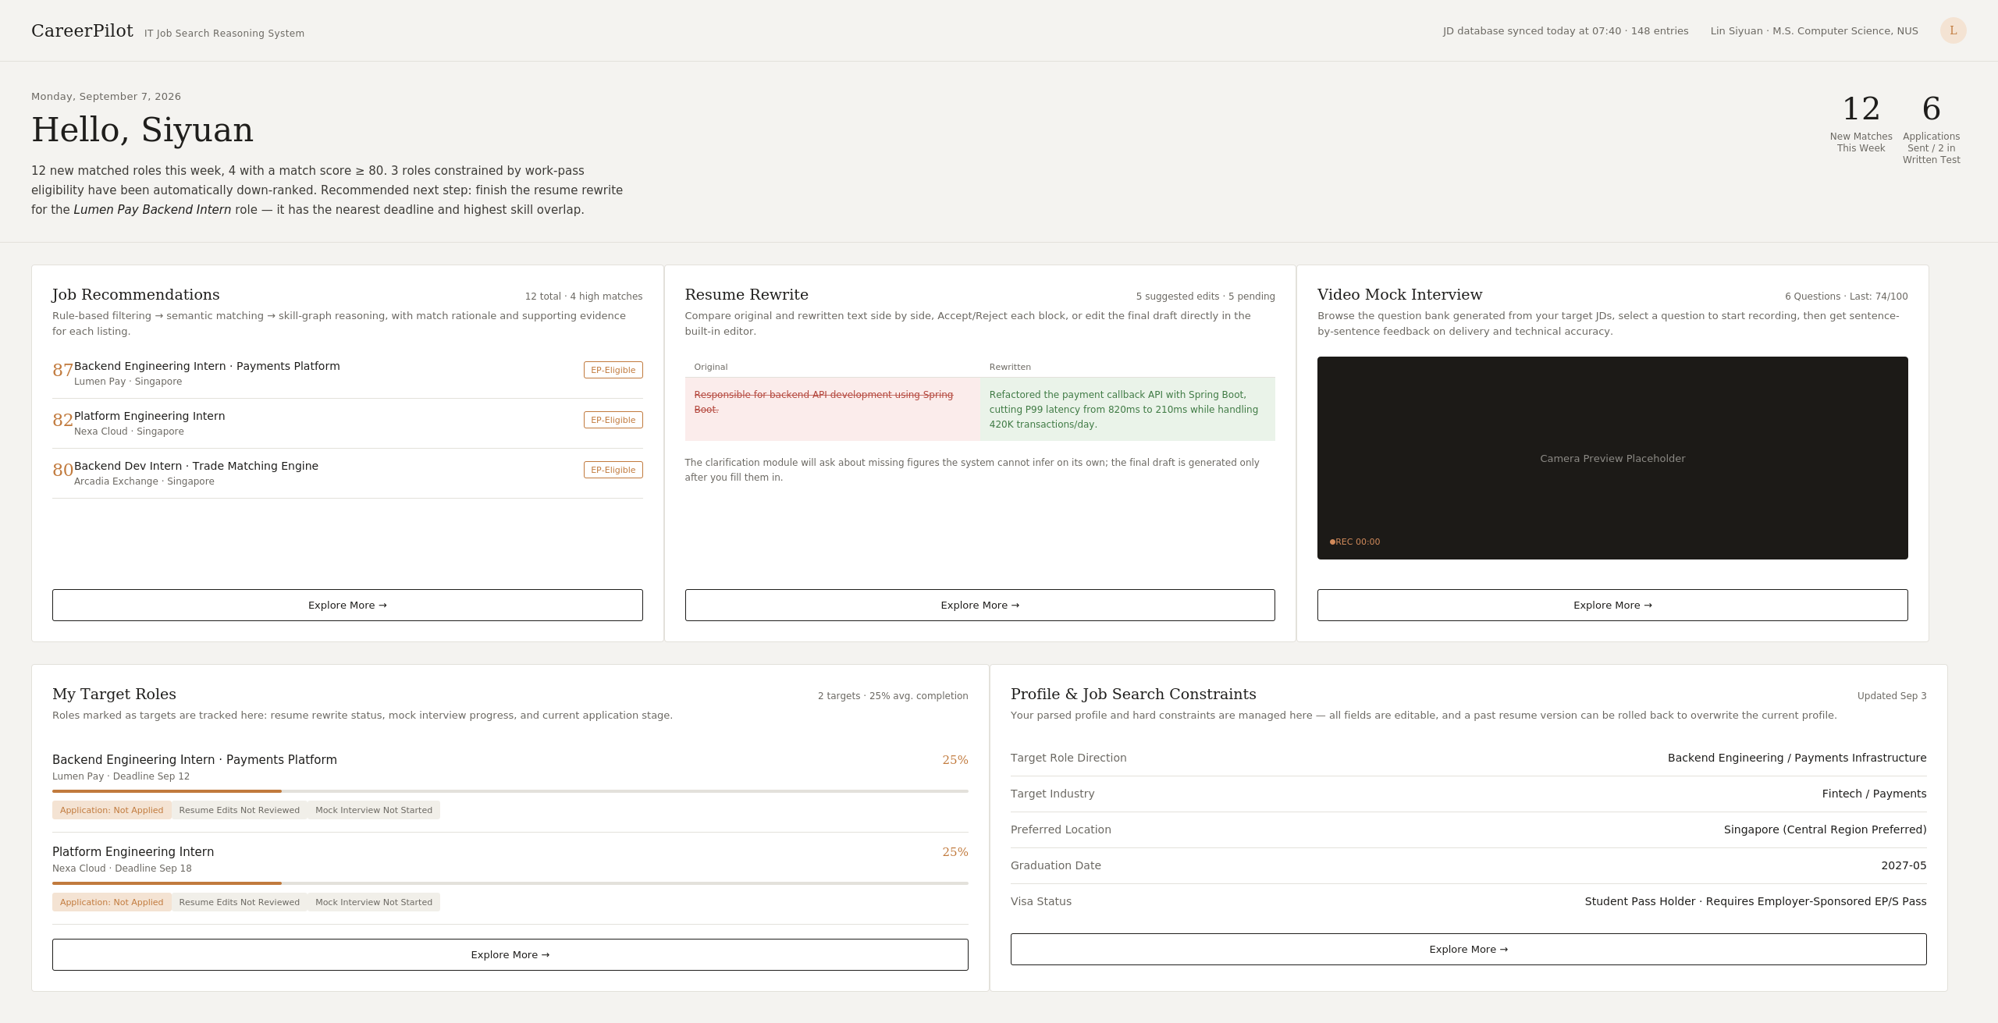
CareerPilot
IT JOB-SEARCH REASONING SYSTEM · PROJECT PROPOSAL
NUS ISS · PRACTICE MODULE
Every application,
better grounded
An explainable hybrid reasoning system for IT students’ internship and graduate job search
Job discovery and matching
JD-targeted résumé optimisation
Mock interviews and application tracking
Current interactive prototype
A0326610N Sun Wenjing
A0329873M Zhao Jiayi
Group 28
Recommendations · Résumé rewriting · Mock interview · Target roles
Notes:
[EN]
Good morning everyone. We are Group 28, Sun Wenjing and Zhao Jiayi, and our project is CareerPilot. CareerPilot is an explainable hybrid reasoning system that helps IT students choose better-fitting roles and prepare targeted applications, so that every application is better grounded in evidence. On the right is our current interactive prototype, with job recommendations, résumé rewriting, mock interview and target roles. Today we will walk through the problem, our solution, the system architecture and what we expect to deliver. (About 45 seconds)
[中文]
大家好，我们是第 28 组，孙文静和赵佳怡，项目名称是 CareerPilot。CareerPilot 是一个可解释的混合推理系统，帮助 IT 专业的学生选择更合适的岗位，并准备有针对性的申请材料，让每一次申请都更有依据。右侧是我们目前的交互原型，包含岗位推荐、简历改写、模拟面试和目标岗位。接下来我们会依次介绍问题背景、解决方案、系统架构以及预期交付成果。（约 45 秒）

Slide 2
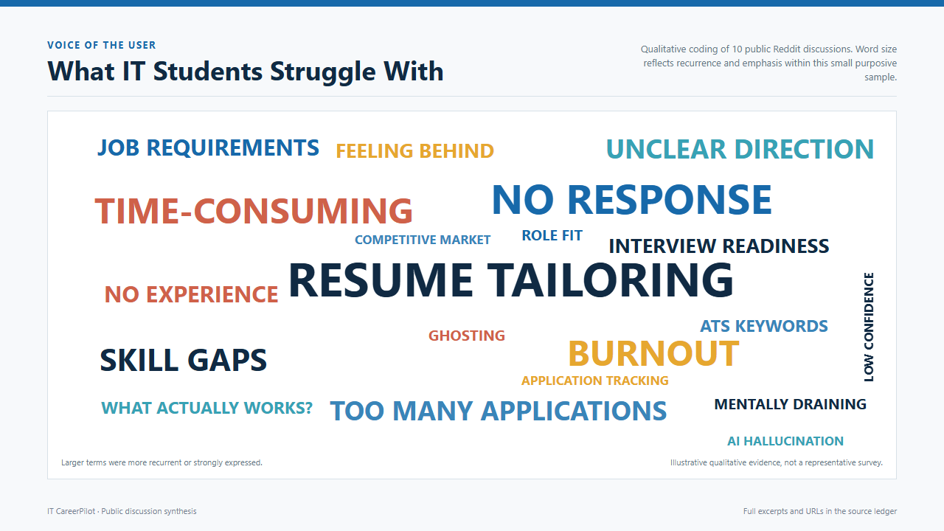
CareerPilot
PROBLEM
What IT students struggle with
02
Notes:
[EN]
Let us start with the problem. We did a small qualitative scan of ten public student and early-career discussions and coded the pain points that kept coming back. The biggest words are résumé tailoring, no response, and time-consuming. Around them we see skill gaps, unclear direction, too many applications, burnout and interview readiness. To be clear, this is illustrative qualitative evidence from a small sample, not a representative survey. But it shows a pattern: students spend a lot of effort on each application, get little feedback, and are not sure what to fix. (About 60 seconds)
[中文]
先来看问题。我们对 10 个公开的学生和职场新人讨论帖做了一次小规模的定性梳理，并对反复出现的痛点进行了编码。字最大的是简历定制、没有回复和耗时。周围还有技能差距、方向不清、投递过多、职业倦怠和面试准备不足。需要说明的是，这只是小样本的定性参考，不是有代表性的问卷调查。但它反映出一个规律：学生在每次申请上花很多精力，得到的反馈很少，也不确定该改进什么。（约 60 秒）

Slide 3
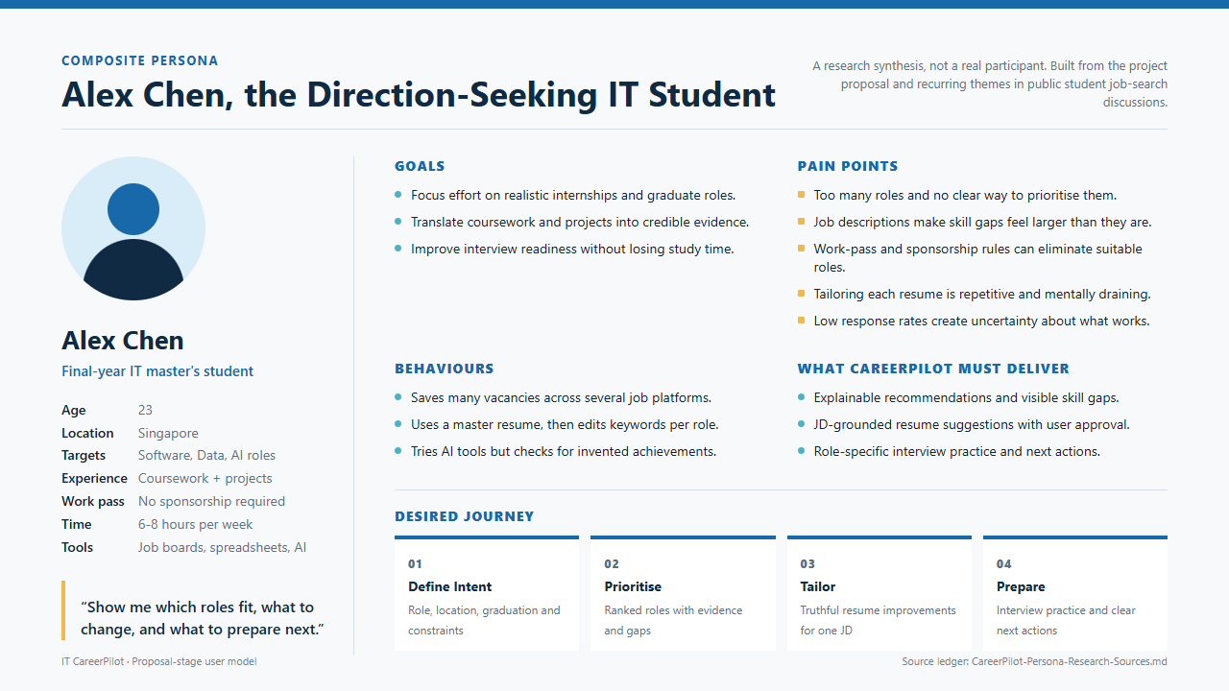
CareerPilot
PROBLEM
Meet Alex, a direction-seeking IT student
03
Notes:
[EN]
To make these findings concrete we built a composite persona, Alex Chen, a final-year IT master's student in Singapore. Alex is not a real participant; the persona is a synthesis of our target users and the recurring themes we just saw. Alex wants to focus on realistic internships and graduate roles, turn coursework into credible evidence, and improve interview readiness within six to eight hours a week. The pain points are too many roles with no way to prioritise, skill gaps that feel bigger than they are, tedious résumé tailoring, and low response rates. At the bottom is the journey Alex wants: define intent, prioritise, tailor, and prepare. Alex's own words sum it up: show me which roles fit, what to change, and what to prepare next. (About 60 seconds)
[中文]
为了让这些发现更具体，我们构建了一个综合画像：Alex Chen，一名在新加坡就读的 IT 硕士毕业年级学生。Alex 并不是真实的受访者，而是我们对目标用户和刚才那些反复出现的主题的综合提炼。Alex 希望把精力集中在现实可行的实习和毕业生岗位上，把课程和项目转化为可信的证据，并在每周六到八小时的时间内提升面试准备度。痛点包括：岗位太多却没有优先级、技能差距被夸大、逐个定制简历既重复又消耗精力、回复率低。底部是 Alex 期望的流程：明确意向、排序、定制、准备。Alex 的原话总结得很好：告诉我哪些岗位适合我、该改什么、下一步准备什么。（约 60 秒）

Slide 4
CareerPilot
MARKET GAP
Existing tools cover only part of the journey
Job boards, résumé tools and auto-apply tools each solve one problem; none offers an explainable, student-centred loop
Job discovery
Match explanation
Résumé tailoring
Interview prep
Progress advice
Job boards
Résumé tools
Auto-apply tools
CareerPilot
The gap
Connects role choice, explanation, tailoring and interview prep; the student keeps final submission.
No auto-apply, and no promise of interviews or offers
04
Notes:
[EN]
Now the market gap. Existing tools are strong in one place each. Job boards help with discovery, résumé tools help with keyword optimisation, and auto-apply tools help with volume. But none of them connects role selection, match explanation, résumé tailoring, interview preparation and progress advice in one loop. That is the gap CareerPilot targets: the full row is filled, and the final submission always stays with the student. We deliberately do not offer auto-apply, and we do not promise interviews or offers. (About 60 seconds)
[中文]
再看市场空白。现有工具各有所长：招聘平台负责岗位发现，简历工具负责关键词优化，自动申请工具负责提高投递数量。但没有一个工具把岗位选择、匹配解释、简历定制、面试准备和进度建议连接成一个完整闭环。这正是 CareerPilot 要填补的空白：我们覆盖整整一行，并且最终提交权始终留给学生。我们有意不做自动投递，也不承诺面试或 offer。（约 60 秒）

Slide 5
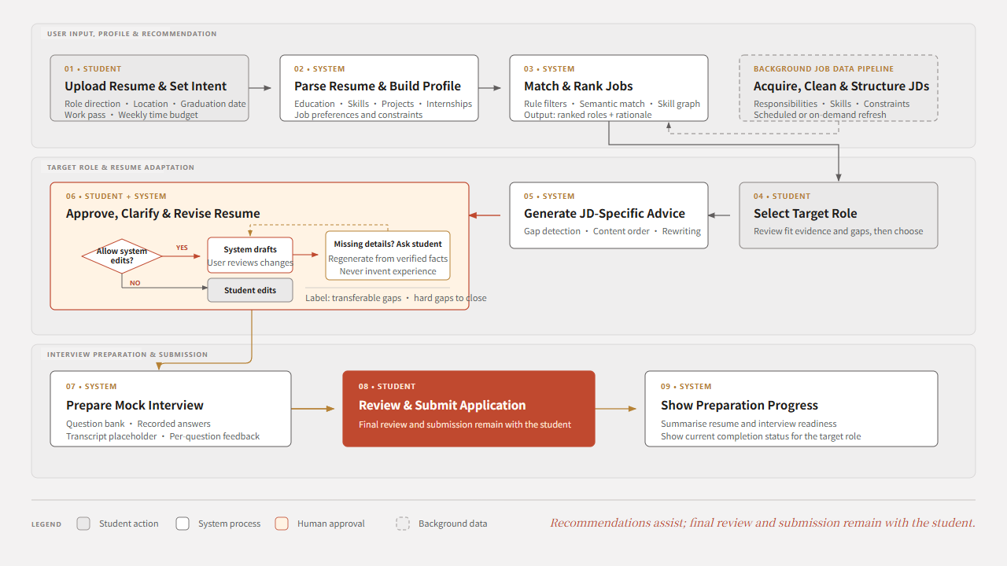
CareerPilot
USER JOURNEY
User journey: from profile to submission
05
Notes:
[EN]
This diagram shows the user journey. Read it in three bands. First, the student uploads a résumé and sets intent; the system parses the profile, matches and ranks jobs, while a background pipeline keeps job descriptions fresh. Second, the student selects a target role, the system generates JD-specific advice, and the student approves, clarifies and revises the résumé. If details are missing, the system asks rather than inventing experience. Third, the system prepares a mock interview, the student reviews and submits the application, and the system shows preparation progress. The red box is the key design choice: final review and submission stay with the student. (About 70 seconds)
[中文]
这张图展示用户使用流程，可以分三个层次来看。第一层：学生上传简历并设置意向，系统解析学生画像、匹配并排序岗位，同时后台的数据管道持续更新岗位描述。第二层：学生选择目标岗位，系统生成针对该 JD 的建议，学生审阅、补充并修改简历；如果信息缺失，系统会向学生询问，而不是编造经历。第三层：系统准备模拟面试，学生复核并提交申请，系统展示准备进度。红色方框是关键的设计选择：最终复核与提交由学生完成。（约 70 秒）

Slide 6
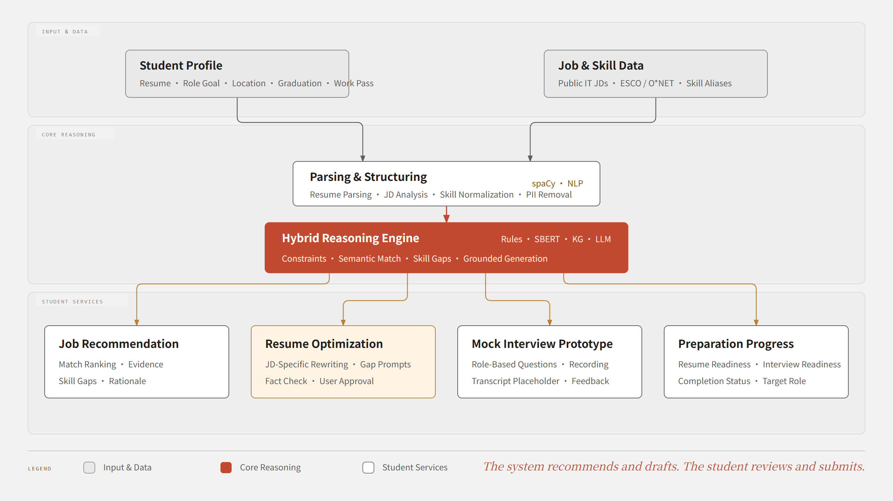
CareerPilot
CORE EXPERIENCE
Core functions around one target JD
06
Notes:
[EN]
This is the core function map. Two inputs feed the system: the student profile, meaning résumé, role goal, location, graduation date and work pass, and job and skill data from public IT job descriptions, ESCO and O*NET. Parsing and structuring turns both into comparable structures. The hybrid reasoning engine in the middle combines rules, sentence embeddings, a knowledge graph and an LLM. It then powers four student-facing services: job recommendation, résumé optimisation, the mock interview prototype, and preparation progress. Every output depends on the student profile and the target role requirements, not on generic templates. The system recommends and drafts; the student reviews and submits. (About 70 seconds)
[中文]
这是核心功能图。系统有两类输入：一是学生画像，包括简历、岗位目标、地点、毕业时间和工作准证；二是岗位与技能数据，来自公开的 IT 岗位 JD、ESCO 和 O*NET。解析与结构化模块把两类输入转换成可以比较的结构。中间的混合推理引擎结合了规则、句向量、知识图谱和大语言模型，并支撑四项面向学生的服务：岗位推荐、简历优化、模拟面试原型和准备进度。所有输出都基于学生画像和目标岗位要求，而不是通用模板。系统负责推荐和起草，学生负责审阅和提交。（约 70 秒）

Slide 7
CareerPilot
SCOPE
Proposal scope and boundaries
Deliver a demonstrable student job-search loop first; keep data, domain and automation risk under control
In scope
Out of scope
Job matching & explanation
IT internships and graduate roles
Auto-submitting applications
JD-based résumé tailoring
Rewrites existing facts only
Guaranteeing interviews or offers
Fabricating student experience
Mock interview prototype
Question bank, recording, feedback
Non-IT and senior roles
Progress & basic planning
Deadline and time-budget hints
Large-scale scraping of commercial sites
Chinese résumés and JDs in v1
MVP principle
Depth over industry coverage; explainable advice over full automation
07
Notes:
[EN]
Because this is a proposal-stage project, we set clear boundaries. In scope are job matching and explanation for IT internships and graduate roles, JD-based résumé tailoring that rewrites existing facts only, a mock interview prototype with question bank, recording and feedback, and progress tracking with deadline and time-budget hints. Out of scope are auto-submitting applications, guaranteeing interviews or offers, fabricating experience, non-IT and senior roles, large-scale scraping of commercial platforms, and Chinese-language résumés and JDs in the first version. Our MVP principle is depth over industry coverage, and explainable advice over full automation. (About 60 seconds)
[中文]
由于目前处于提案阶段，我们明确划定了范围。范围内包括：面向 IT 实习和毕业生岗位的岗位匹配与解释；只改写已有事实的、基于 JD 的简历定制；包含题库、录制和反馈的模拟面试原型；以及带有截止日期和时间预算提示的申请进度管理。范围外包括：自动提交申请、保证面试或 offer、虚构经历、非 IT 及中高级岗位、大规模抓取商业招聘平台，以及首版中的中文简历和 JD。我们的 MVP 原则是：深度优先于行业覆盖面，可解释的建议优先于全自动执行。（约 60 秒）

Slide 8
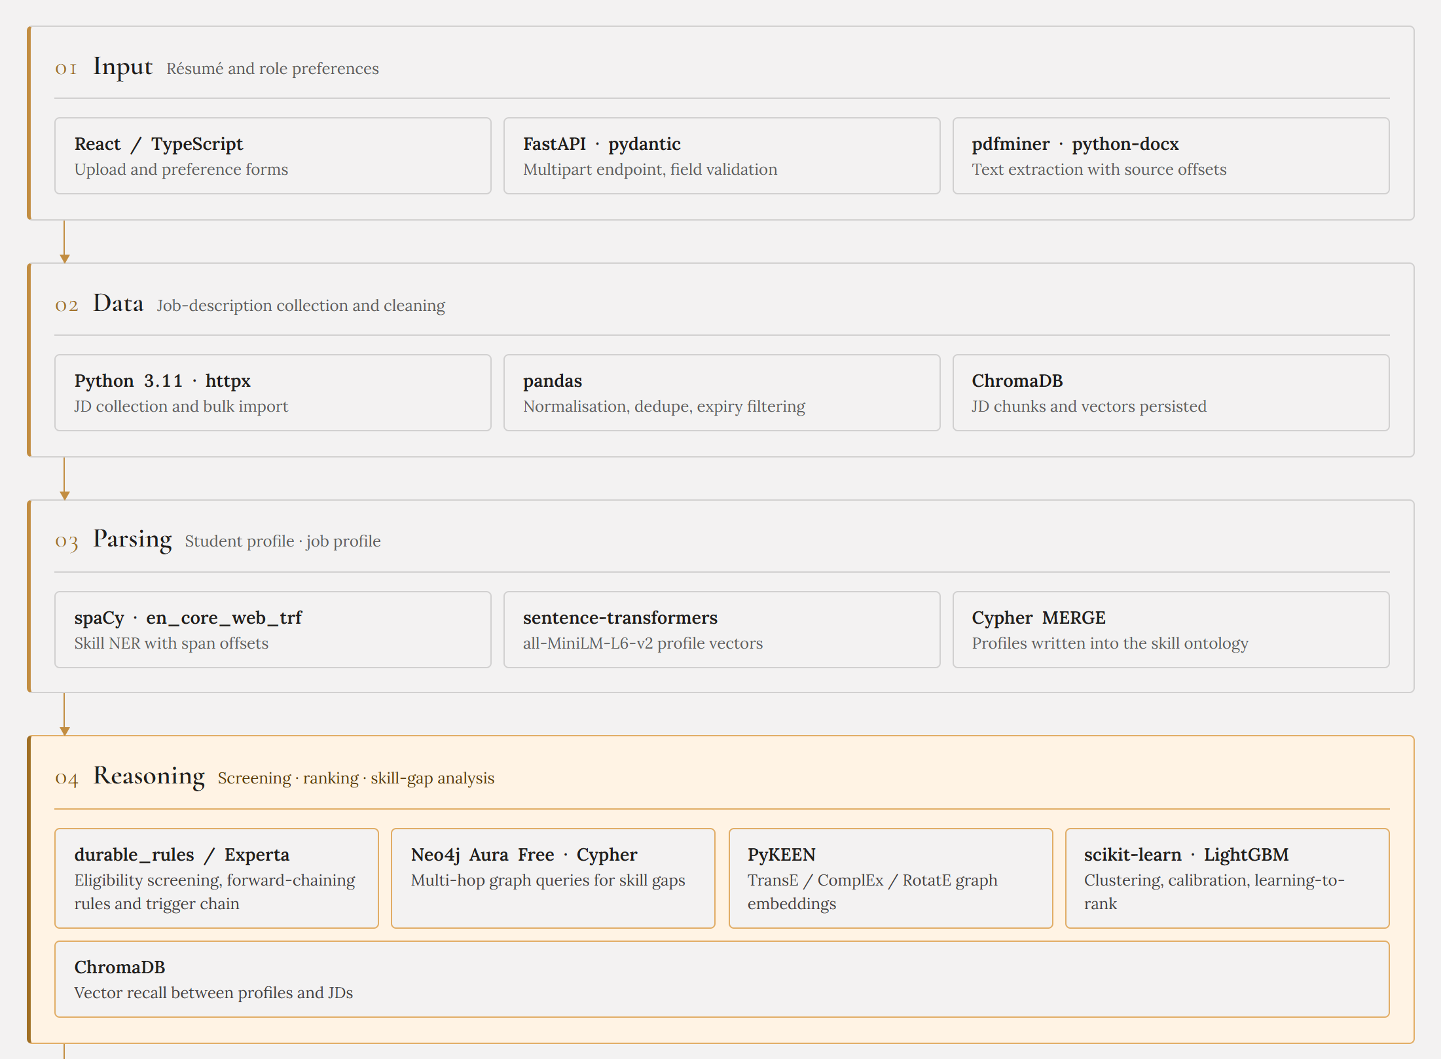
CareerPilot
SYSTEM ARCHITECTURE
Architecture · Input to reasoning
08
Notes:
[EN]
Now the system architecture, in two parts. This first part shows layers one to four. Layer one is input: a React and TypeScript front end, FastAPI with pydantic, and PDF and Word text extraction. Layer two is data: Python collection scripts, pandas for normalisation and de-duplication, and ChromaDB for job description chunks and vectors. Layer three is parsing: spaCy for skill entities, sentence-transformers for profile vectors, and Cypher writes into the skill ontology. Layer four, highlighted, is reasoning: a rules engine with Experta for eligibility screening, Neo4j graph queries for skill gaps, PyKEEN embeddings, scikit-learn and LightGBM for ranking, and ChromaDB for vector recall. The design is modular, so every recommendation can be traced back to its evidence. (About 90 seconds)
[中文]
下面介绍系统架构，分为两页。这一页展示第一到第四层。第一层是输入层：React 与 TypeScript 前端、FastAPI 与 pydantic 接口，以及 PDF 和 Word 文本抽取。第二层是数据层：Python 采集脚本、用于规范化和去重的 pandas，以及保存 JD 片段和向量的 ChromaDB。第三层是解析层：用 spaCy 做技能实体识别，用 sentence-transformers 生成画像向量，并通过 Cypher 写入技能本体。高亮的第四层是推理层：基于 Experta 的规则引擎做资格筛选，Neo4j 图查询分析技能差距，PyKEEN 图嵌入，scikit-learn 与 LightGBM 负责排序，ChromaDB 负责向量召回。整体设计是模块化的，因此每条推荐都可以追溯到对应的证据。（约 90 秒）

Slide 9
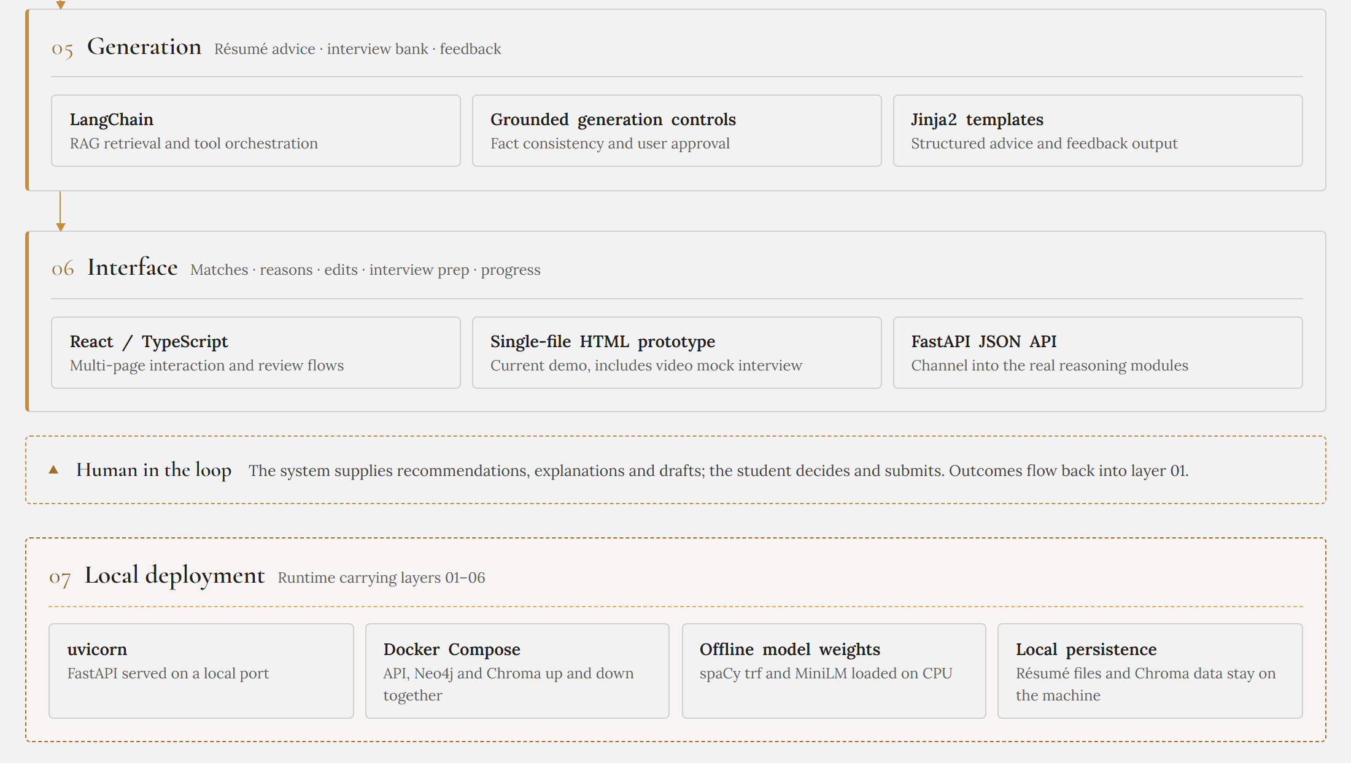
CareerPilot
SYSTEM ARCHITECTURE
Architecture · Generation to deployment
09
Notes:
[EN]
This second part covers layers five to seven. Layer five is generation: LangChain for retrieval and tool orchestration, grounded generation controls that enforce fact consistency and user approval, and Jinja2 templates for structured advice. Layer six is the interface: the React front end, our current single-file HTML prototype with a video mock interview, and a FastAPI JSON channel into the real reasoning modules. Below that, the human-in-the-loop band: the system supplies recommendations, explanations and drafts, the student decides and submits, and outcomes flow back to layer one. Finally, layer seven is local deployment: uvicorn, Docker Compose, offline model weights on CPU, and local persistence so résumé files stay on the student's machine. (About 60 seconds)
[中文]
这一页介绍第五到第七层。第五层是生成层：用 LangChain 做检索和工具编排，用受约束的生成控制来保证事实一致性和用户确认，并用 Jinja2 模板生成结构化建议。第六层是界面层：React 前端、目前包含视频模拟面试的单文件 HTML 原型，以及连接真实推理模块的 FastAPI JSON 接口。下面的人在环节表示：系统提供推荐、解释和草稿，学生做出决定并提交，结果再回流到第一层。最后第七层是本地部署：uvicorn、Docker Compose、在 CPU 上运行的离线模型权重，以及本地持久化，让简历文件保留在学生自己的设备上。（约 60 秒）

Slide 10
CareerPilot
REASONING DESIGN
Why hybrid reasoning fits IT job search
Different problems need different methods; one similarity score cannot cover them all
01
02
03
04
05
Rule screening
Semantic match
Skill graph
Grounded generation
Planning rules
Location, degree, work pass, deadlines
Fit between projects and role duties
Synonyms, hierarchy, transferable gaps
Explanations, résumé edits, question bank
Role status, deadlines, time budget
Explainable output
Eligibility
Evidence
Skill gaps
Grounded draft
Next action
Why
Hard constraints cannot be offset by similarity; generated content must trace back to résumé and JD facts.
10
Notes:
[EN]
Why hybrid reasoning? Because different problems need different methods, and a single similarity score cannot cover them all. Rule screening handles hard constraints such as location, degree, work pass and deadlines. Semantic matching compares the student's projects with role duties. The skill graph captures synonyms, hierarchies and transferable gaps. Grounded generation writes explanations, résumé edits and interview questions. Planning rules turn role status, deadlines and time budget into next actions. Together they produce explainable output: eligibility, evidence, skill gaps, a grounded draft and a next action. The reason is simple: hard constraints must never be offset by similarity, and generated content must trace back to facts in the résumé and the JD. (About 90 seconds)
[中文]
为什么选择混合推理？因为不同类型的问题需要不同的方法，单一的相似度分数无法同时覆盖。规则筛选处理地点、学历、工作准证和截止日期等硬性条件；语义匹配比较学生项目经历与岗位职责的相关性；技能图谱刻画同义技能、上下位关系和可迁移的差距；受约束生成负责写推荐解释、简历修改和面试题；计划规则把岗位状态、截止日期和时间预算转化为下一步行动。这些模块共同产生可解释的输出：是否符合资格、匹配证据、技能差距、事实一致的草稿和下一步行动。原因很简单：硬性条件不能被相似度抵消，生成的内容也必须能追溯到简历和 JD 中的事实。（约 90 秒）

Slide 11
CareerPilot
DATA & EVALUATION
Data preparation and evaluation path
Each data type has a clear purpose; key modules are checked through manual sample review
Data sources
Processing and use
Evaluation questions
Public IT job JDs
Cleaning and extraction
Is extraction accurate?
ESCO / O*NET
Skill aliases and relations
Is the ranking reasonable?
De-identified résumés
Student profiles and evidence
Are gap explanations credible?
Public interview materials
Question bank, feedback rules
Do rewrites stay factual?
Team relevance judgments
Ranking weight tuning
Are interview and plan tips useful?
Privacy and trust
De-identify before external calls; keep sources and evidence; no outcome claims without real application results.
11
Notes:
[EN]
Finally, data and evaluation. Our data comes from public IT job descriptions, ESCO and O*NET, de-identified résumé samples, public interview materials, and team relevance judgments. These are cleaned and structured, turned into skill aliases and relations, student profiles with evidence, question banks and feedback rules, and ranking weights. We evaluate mainly through manual sample review: is extraction accurate, is the ranking reasonable, are gap explanations credible, do rewrites stay factual, and are the interview and plan tips useful. On privacy and trust, we de-identify before any external call, keep sources and evidence, and we do not claim improved outcomes because we have no real application results at this stage. (About 75 seconds)
[中文]
最后是数据与评估。数据来源包括公开的 IT 岗位 JD、ESCO 和 O*NET、脱敏的简历样本、公开的面试材料，以及团队的相关性判断。这些数据会经过清洗和结构化，整理成技能别名与关系、带证据的学生画像、题库与反馈规则，以及排序权重。评估以人工样例检查为主：抽取是否准确、推荐顺序是否合理、差距解释是否可信、改写是否保持事实，以及面试和计划建议是否实用。在隐私与可信度方面，我们在任何外部调用之前先做脱敏，保存来源和证据，并且由于现阶段没有真实的申请结果，我们不会声称效果有所提升。（约 75 秒）

Slide 12
CareerPilot
EXPECTED OUTCOME
Expected deliverables
A demonstrable, explainable,
reviewable job-search loop
Q&A
Thank you
01
02
03
04
Recommend
Materials
Prepare
Engineering
Ranked roles with traceable match evidence
Fact-consistent résumé edits for the target JD
Role-specific questions, feedback and progress hints
Modular prototype, evaluation log and project repo
The system suggests; the student decides
NUS ISS · Practice Module · 2026
Notes:
[EN]
To summarise, we expect to deliver a demonstrable, explainable and reviewable job-search loop with four parts. Recommend: ranked roles with traceable match evidence. Materials: fact-consistent résumé edits for the target JD. Prepare: role-specific questions, feedback and progress hints. Engineering: a modular prototype, an evaluation log and a project repository. The system suggests; the student decides. Thank you, and we are happy to take your questions. (About 45 seconds)
[中文]
总结一下，我们预期交付一条可演示、可解释、可审阅的求职闭环，包含四个部分。推荐：带有可追溯匹配依据的岗位排序。材料：围绕目标 JD、保持事实一致的简历修改建议。准备：岗位相关的题库、反馈和进度提示。工程：模块化原型、评估记录和项目仓库。系统提出建议，学生作出决定。谢谢大家，欢迎提问。（约 45 秒）

