Slide 1
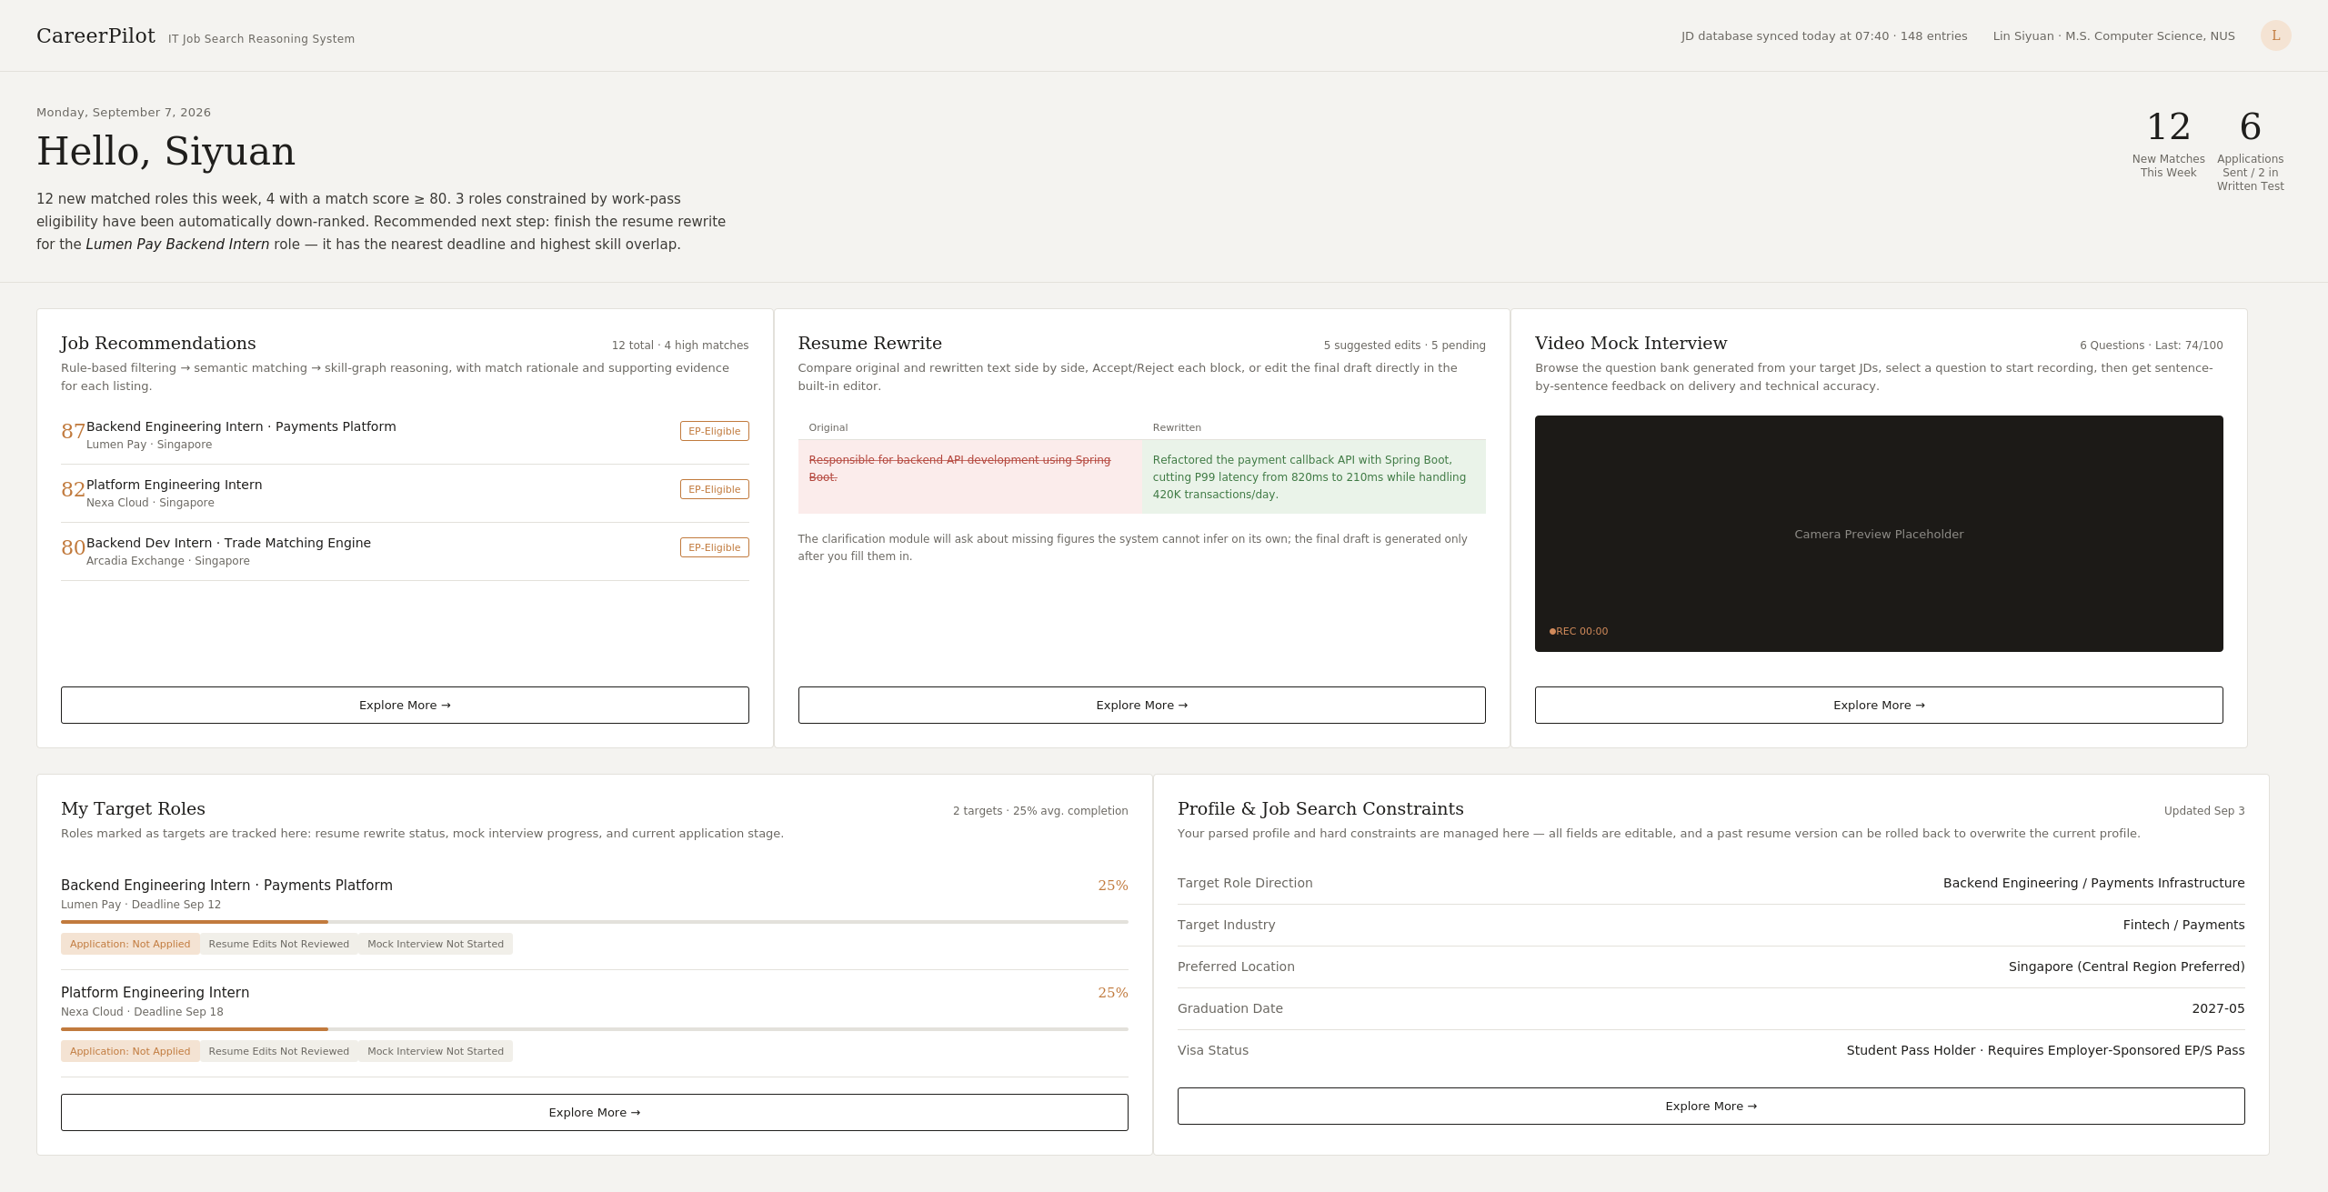
CareerPilot
IT JOB-SEARCH REASONING SYSTEM · PROJECT PROPOSAL
IT-CareerPilot
An explainable hybrid reasoning system for IT students’ internship and graduate job search
Job discovery and matching
JD-targeted résumé optimisation
Mock interviews and application tracking
Current interactive prototype
A0326610N Sun Wenjing
A0329873M Zhao Jiayi
Group 28
Recommendations ·Resume rewriting · Mock interview · Target roles
Notes:
[EN]
Good morning everyone. We are Group 28, and our project is CareerPilot, an explainable hybrid reasoning system forIT students looking for internships and graduate jobs in Singapore
. We will focus on four things: why we chose this problem, the pain points behind it, how our solution addresses those pain points, and the technical architecture that makes it work. On the right is our current interactive prototype.
[中文]
大家好，我们是第 28 组，孙文静和赵佳怡，项目是 CareerPilot，一个面向 IT 学生实习与校招求职的可解释混合推理系统。接下来的十五分钟，我们聚焦四件事：为什么选择这个题目、背后的痛点是什么、我们的方案如何解决这些痛点，以及支撑它运行的技术架构。右侧是我们目前的交互原型。（约 40 秒）

Slide 2
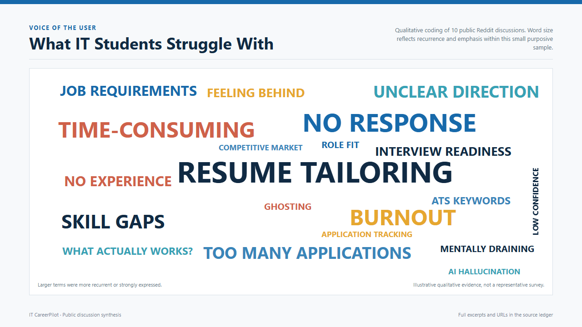
CareerPilot
PROBLEM
What IT students struggle with
02
Notes:
[EN]
This is why we chose this topic. We did a small qualitative scan of ten public student and early-career discussions and coded the pain points that kept coming back: résumé tailoring, no response, time-consuming, skill gaps, unclear direction, too many applications, burnout and interview readiness. This is illustrative evidence from a small sample, not a representative survey, but it shows a clear pattern worth solving: heavy effort per application, little feedback, and no clarity on what to fix. (About 60 seconds)
[中文]
这是我们选择这个题目的原因。我们对 10 个公开的学生和职场新人讨论帖做了小规模定性梳理，反复出现的痛点包括：简历定制、没有回复、耗时、技能差距、方向不清、投递过多、职业倦怠和面试准备不足。这只是小样本的定性参考，不是有代表性的问卷，但它反映出一个值得解决的规律：每次申请投入很大精力，反馈很少，也不知道该改什么。（约 60 秒）

Slide 3
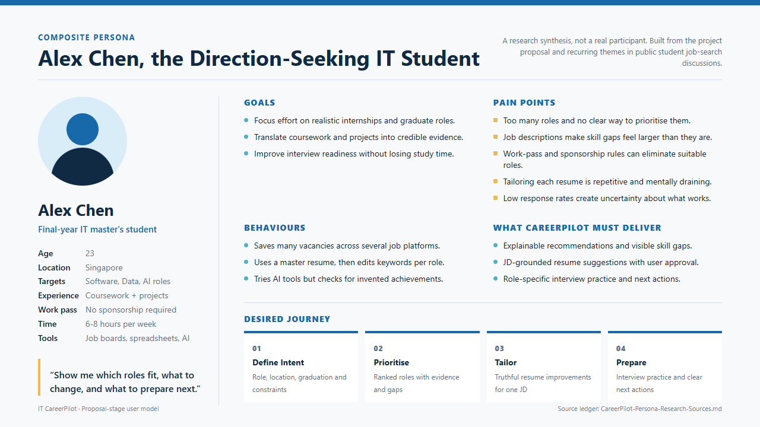
CareerPilot
PROBLEM
Meet Alex, a direction-seeking IT student
03
Notes:
[EN]
To make the pain points concrete, we built a composite persona, Alex Chen, a final-year IT master's student in Singapore. Alex is not a real participant; the persona synthesises our target users and the themes we just saw. Alex's pain points are too many roles with no way to prioritise, skill gaps that feel bigger than they are, tedious résumé tailoring, and low response rates. In one line: show me which roles fit, what to change, and what to prepare next. That line defines what CareerPilot must deliver. (About 55 seconds)
[中文]
为了让痛点更具体，我们构建了一个综合画像：Alex Chen，一名在新加坡就读的 IT 硕士毕业年级学生。Alex 并非真实受访者，而是对目标用户和上述主题的综合提炼。Alex 的痛点是：岗位太多却没有优先级、技能差距被夸大、简历定制繁琐重复、回复率低。一句话总结：告诉我哪些岗位适合我、该改什么、下一步准备什么——这也是 CareerPilot 必须交付的能力。（约 55 秒）

Slide 4
CareerPilot
MARKET GAP
Existing tools cover only part of the journey
Job boards, résumé tools and auto-apply tools each solve one problem; none offers an explainable, student-centred loop
Job discovery
Match explanation
Résumé tailoring
Interview prep
Progress advice
Job boards
Résumé tools
Auto-apply tools
CareerPilot
The gap
Connects role choice, explanation, tailoring and interview prep; the student keeps final submission.
No auto-apply, and no promise of interviews or offers
04
Notes:
[EN]
Now, how our solution addresses these pain points. Existing tools each cover one piece: job boards help discovery, résumé tools help keyword optimisation, auto-apply tools help volume. None connects role choice, match explanation, résumé tailoring, interview prep and progress advice in one loop. CareerPilot fills that full row, directly answering Alex's pain points, while keeping submission with the student. We do not auto-apply, and we do not promise interviews or offers. (About 55 seconds)
[中文]
接下来看我们的方案如何解决这些痛点。现有工具各解决一块：招聘平台负责发现，简历工具负责关键词优化，自动申请工具负责提高投递量。但没有一个能把岗位选择、匹配解释、简历定制、面试准备和进度建议连接成闭环。CareerPilot 补齐了整条能力链，直接回应 Alex 的痛点，同时把提交权留给学生。我们不做自动投递，也不承诺面试或 offer。（约 55 秒）

Slide 5
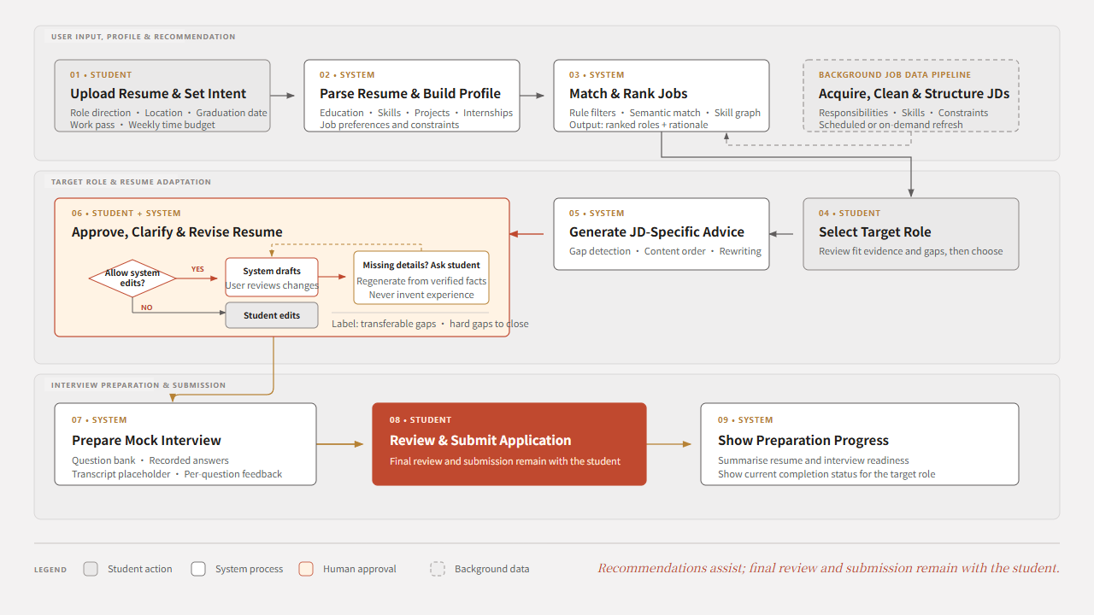
CareerPilot
USER JOURNEY
User journey: from profile to submission
05
Notes:
[EN]
This is the user journey that puts those capabilities to work. The student uploads a résumé and sets intent; the system parses the profile, matches and ranks jobs. The student selects a target role, the system generates JD-specific advice, and the student approves, clarifies and revises the résumé — if details are missing, the system asks rather than inventing experience. Finally the system prepares a mock interview, the student reviews and submits, and progress is shown. The red box is the key design choice: final review and submission stay with the student. (About 65 seconds)
[中文]
这是把上述能力落地的用户旅程。学生上传简历并设置意向，系统解析画像、匹配并排序岗位。学生选择目标岗位，系统生成针对性建议，学生审阅、补充并修改简历——信息缺失时系统会询问，而不是编造经历。最后系统准备模拟面试，学生复核并提交，并展示准备进度。红色方框是关键设计：最终复核与提交由学生完成。（约 65 秒）

Slide 6
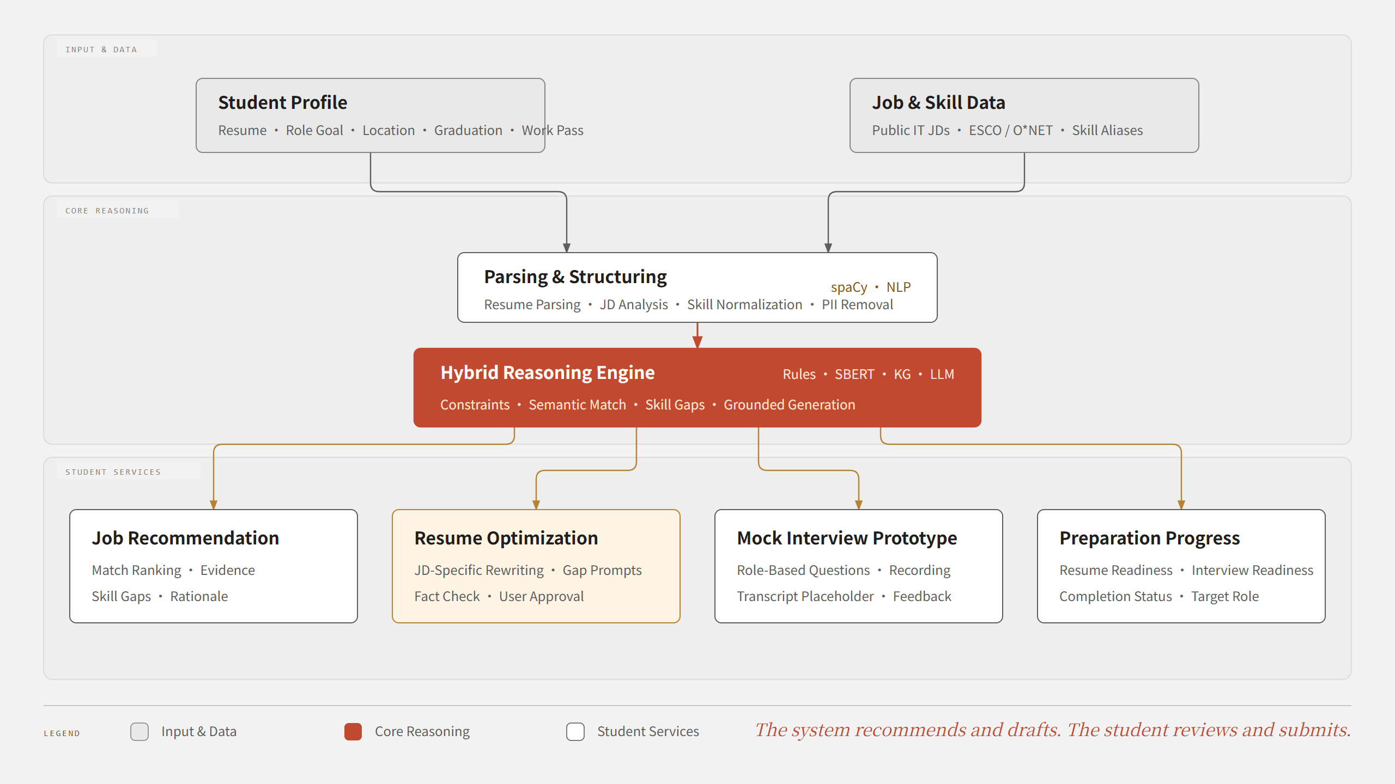
CareerPilot
CORE EXPERIENCE
Core functions around one target JD
06
Notes:
[EN]
This core function map shows the same capabilities from a systems view. Two inputs, student profile and job and skill data, feed parsing and structuring, then the hybrid reasoning engine, which powers four services: job recommendation, résumé optimisation, mock interview, and preparation progress. Every output is grounded in the student's own profile and the target role, not generic templates. This is the bridge into the architecture we'll show next. (About 55 seconds)
[中文]
核心功能图从系统视角展示同样的能力。学生画像和岗位技能数据两类输入，经过解析结构化后进入混合推理引擎，支撑四项服务：岗位推荐、简历优化、模拟面试和准备进度。所有输出都基于学生自身画像和目标岗位，而非通用模板。这也是通向接下来技术架构介绍的过渡。（约 55 秒）

Slide 7
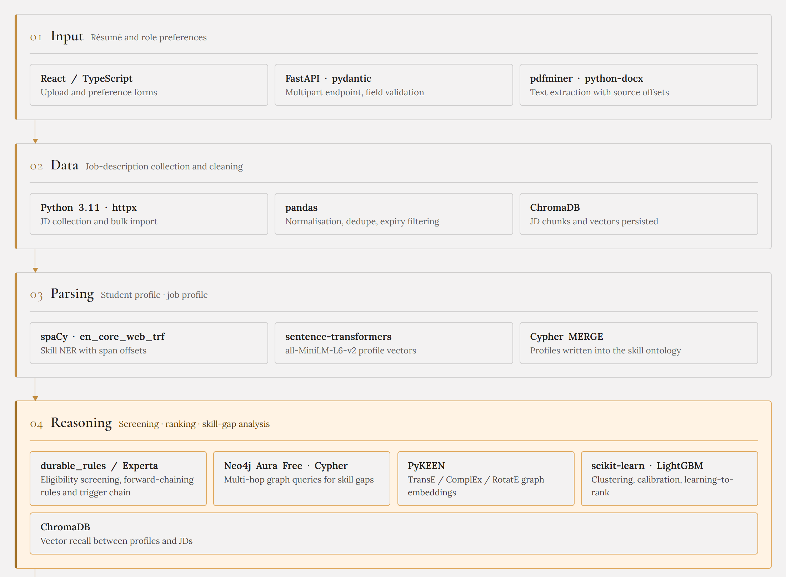
CareerPilot
SYSTEM ARCHITECTURE
Architecture · Input to reasoning
07
Notes:
[EN]
Now the technical architecture, in two parts. This first part covers layers one to four. Layer one is input: React and TypeScript, FastAPI with pydantic, and PDF and Word text extraction. Layer two is data: Python collection, pandas for cleaning, and ChromaDB for job description chunks. Layer three is parsing: spaCy for skill entities and sentence-transformers for profile vectors, written into a skill ontology via Cypher. Layer four, highlighted, is reasoning: an Experta rules engine for eligibility, Neo4j graph queries for skill gaps, PyKEEN embeddings, and scikit-learn and LightGBM for ranking. Every recommendation can be traced back to its evidence. (About 75 seconds)
[中文]
下面介绍技术架构，分两部分。第一部分是第一到第四层。第一层输入层：React/TypeScript、FastAPI 与 pydantic、以及 PDF 和 Word 文本抽取。第二层数据层：Python 采集、pandas 清洗，以及保存 JD 片段的 ChromaDB。第三层解析层：spaCy 做技能实体识别，sentence-transformers 生成画像向量，并通过 Cypher 写入技能本体。高亮的第四层是推理层：Experta 规则引擎做资格筛选，Neo4j 图查询分析技能差距，PyKEEN 图嵌入，scikit-learn 与 LightGBM 负责排序。每条推荐都可以追溯到对应证据。（约 75 秒）

Slide 8
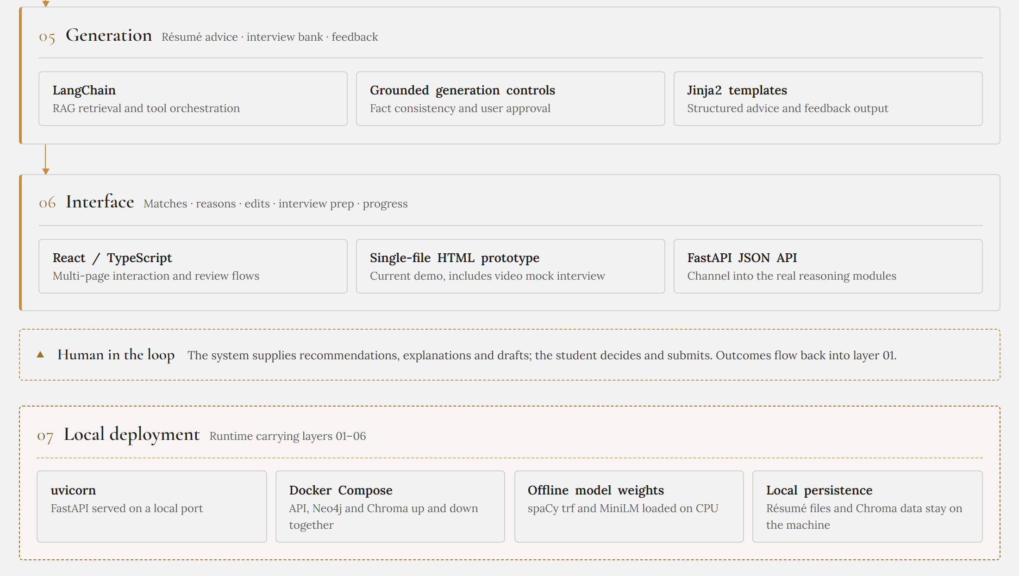
CareerPilot
SYSTEM ARCHITECTURE
Architecture · Generation to deployment
08
Notes:
[EN]
This second part covers layers five to seven. Layer five is generation: LangChain for retrieval, grounded generation controls for fact consistency and user approval, and Jinja2 templates for structured output. Layer six is the interface: React, our current single-file HTML prototype, and a FastAPI JSON channel into the real reasoning modules. The human-in-the-loop band underneath is the core principle: the system recommends and drafts, the student decides and submits. Layer seven is local deployment: Docker Compose, offline model weights on CPU, and local persistence so résumé files stay on the student's machine. (About 60 seconds)
[中文]
第二部分是第五到第七层。第五层生成层：LangChain 检索，受约束的生成控制保证事实一致性和用户确认，Jinja2 模板输出结构化内容。第六层界面层：React 前端、目前的单文件 HTML 原型，以及连接真实推理模块的 FastAPI JSON 接口。下方的人在环节是核心原则：系统负责推荐和起草，学生负责决定和提交。第七层是本地部署：Docker Compose、CPU 上运行的离线模型权重，以及让简历文件留在学生本地设备的持久化方案。（约 60 秒）

Slide 9
CareerPilot
REASONING DESIGN
Why hybrid reasoning fits IT job search
Different problems need different methods; one similarity score cannot cover them all
01
02
03
04
05
Rule screening
Semantic match
Skill graph
Grounded generation
Planning rules
Location, degree, work pass, deadlines
Fit between projects and role duties
Synonyms, hierarchy, transferable gaps
Explanations, résumé edits, question bank
Role status, deadlines, time budget
Explainable output
Eligibility
Evidence
Skill gaps
Grounded draft
Next action
Why
Hard constraints cannot be offset by similarity; generated content must trace back to resume and JD facts.
09
Notes:
[EN]
One more layer of the architecture: why hybrid reasoning specifically. Different problems need different methods — rule screening for hard constraints like location and work pass, semantic matching for project-to-role fit, the skill graph for transferable gaps, grounded generation for explanations and drafts, and planning rules for deadlines and time budget. Together they produce explainable output: eligibility, evidence, skill gaps, a grounded draft, and a next action. Hard constraints can never be offset by similarity, and generated content must always trace back to real facts. (About 65 seconds)
[中文]
架构的最后一层：为什么specifically选择混合推理。不同问题需要不同方法——规则筛选处理地点、工作准证等硬性条件，语义匹配衡量项目经历与岗位的契合度，技能图谱刻画可迁移的差距，受约束生成负责解释与草稿，计划规则处理截止日期和时间预算。它们共同产生可解释的输出：资格、证据、技能差距、有依据的草稿和下一步行动。硬性条件不能被相似度抵消，生成内容也必须始终可追溯到真实事实。（约 65 秒）

Slide 10
CareerPilot
Q&A
Thank you
Notes:
[EN]
To summarise: we chose this topic because the pain points are real and unaddressed by existing tools; our solution directly answers them with an explainable job-search loop; and the architecture — from parsing through hybrid reasoning to grounded generation — makes every recommendation traceable. The system suggests, the student decides. Thank you, and we're happy to take your questions. (About 40 seconds)
[中文]
总结一下：我们选择这个题目，是因为痛点真实存在，且现有工具没有解决；我们的方案用一个可解释的求职闭环直接回应这些痛点；而从解析到混合推理再到受约束生成的架构，让每一条推荐都可以追溯。系统提出建议，学生做出决定。谢谢大家，欢迎提问。（约 40 秒）

