Slide 1
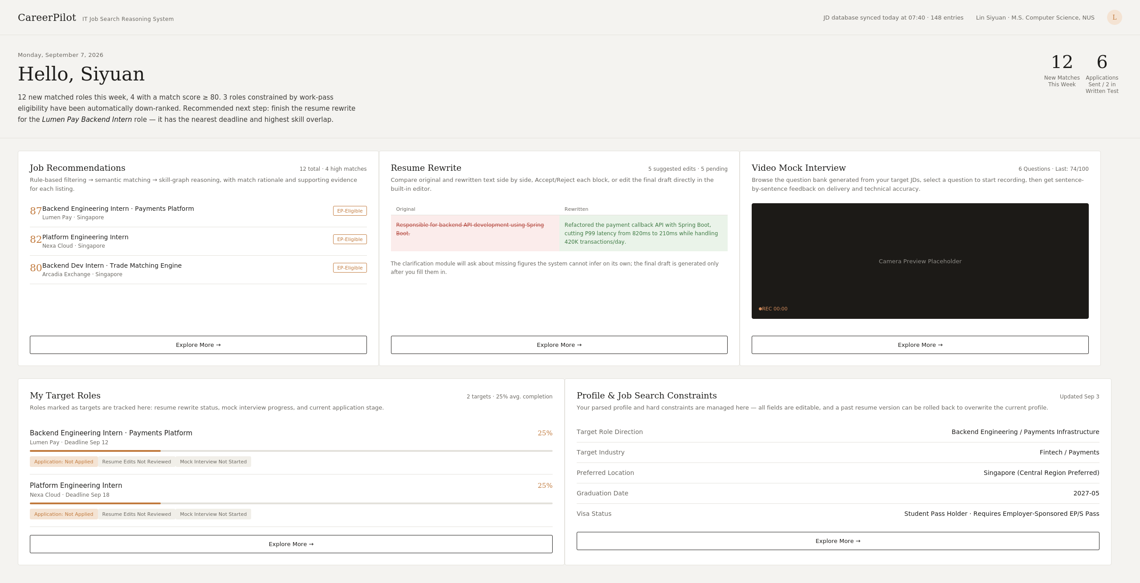
CareerPilot
IT JOB-SEARCH REASONING SYSTEM · PROJECT PROPOSAL
IT-CareerPilot
An explainable hybrid reasoning system for IT students’ internship and graduate job search
Current interactive prototype
Recommendations ·Resume rewriting · Mock interview · Target roles
A0326610N Sun Wenjing
A0329873M Zhao Jiayi
Group 28
Notes:
【Speaker 1 · Sun Wenjing】约 45 秒 ｜ 累计 0:45
[EN]
Hello everyone. We are Group 28. I’m Zhao Jiayi, and this is Sun Wenjing. Our project is IT-CareerPilot. It helps IT students in Singapore with one problem: they send many applications, but they don't know which roles fit them and what to improve. On the right is our interactive prototype. It has five main functions: Profile, Job Recommendations, Resume Rewrite, Video Mock Interview, and My Target Roles. We will explain each of them later.
[中文]
大家好，我们是第 28 组，我是孙文静，这位是赵佳怡。我们的项目是 IT-CareerPilot，帮助新加坡的 IT 学生解决一个问题：投了很多申请，却不知道哪些岗位适合自己、该改进什么。右边是我们的交互原型，有五个主要功能：Profile（个人画像）、Job Recommendations（岗位推荐）、Resume Rewrite（简历改写）、Video Mock Interview（视频模拟面试）和 My Target Roles（目标岗位与投递管理），后面会逐一介绍。

Slide 2
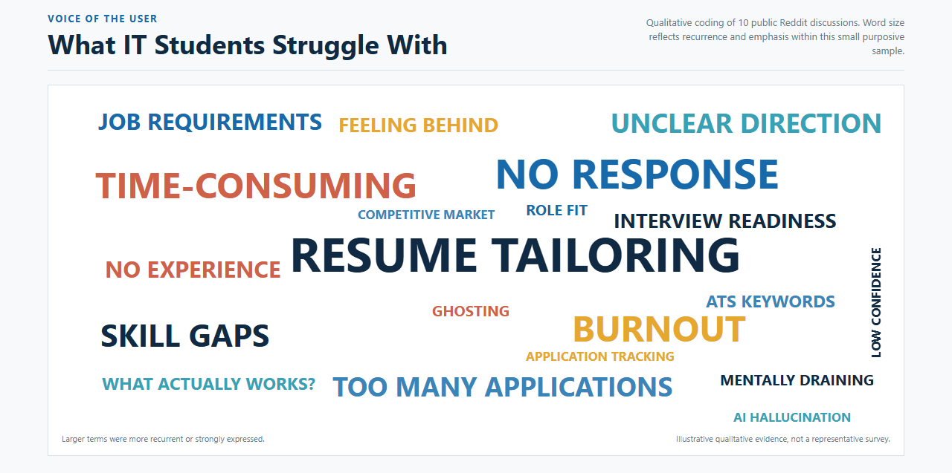
CareerPilot
PROBLEM
Word Cloud
02
Notes:
【Speaker 1 · Sun Wenjing】约 50 秒 ｜ 累计 1:35
[EN]
This is a word cloud of common complaints from IT students and new graduates. The biggest words are resume tailoring, no response, time-consuming, skill gaps and too many applications. They show three main pain points for IT students looking for jobs in Singapore. First, tailoring a resume for every role takes too much time. Second, most applications get no response, so students don't know what to fix. Third, students are not sure which skills they are missing, or which roles really fit them.
[中文]
这是一张词云图，来自 IT 学生和应届生的求职讨论。最突出的词是：简历定制、没有回复、耗时、技能差距和投递太多。它反映了 IT 学生在新加坡求职的三个主要痛点：第一，每个岗位都要改简历，太耗时间；第二，大部分申请没有回复，学生不知道问题出在哪；第三，学生不清楚自己缺什么技能，也不确定哪些岗位真正适合自己。

Slide 3
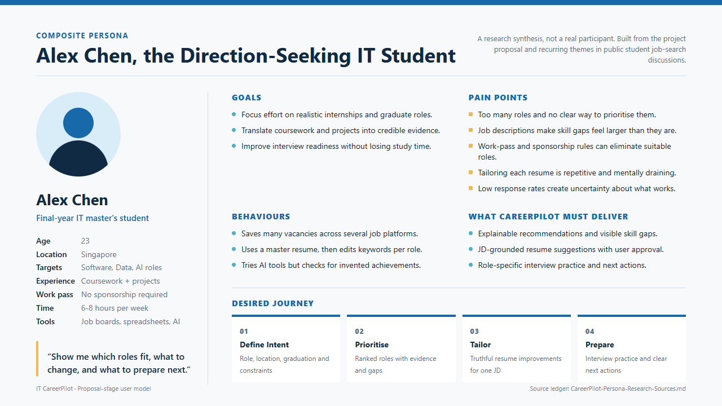
CareerPilot
PROBLEM
Persona
03
Notes:
【Speaker 1 · Sun Wenjing】约 45 秒 ｜ 累计 2:20
[EN]
This is our user persona, Alex Chen, a final-year IT master's student in Singapore. Alex has four pain points. There are too many roles, and no way to prioritise them. Job descriptions make skill gaps look bigger than they are. Tailoring every resume is repetitive. And the response rate is low. What Alex needs is simple: show me which roles fit, what to change, and what to prepare next. CareerPilot is designed around these three needs.
[中文]
这是我们的用户画像 Alex Chen，在新加坡读 IT 硕士的毕业年级学生。Alex 有四个痛点：岗位太多，无法排优先级；JD 让技能差距显得比实际更大；每份简历都要重复修改；回复率低。Alex 的需求很简单：告诉我哪些岗位适合我、该改什么、下一步准备什么。CareerPilot 就是围绕这三个需求设计的。

Slide 4
CareerPilot
MARKET GAP
Existing tools cover only part of the journey
Job boards, resume tools and auto-apply tools each solve one problem; none offers an explainable, student-centred loop
Job discovery
Match explanation
Résumé tailoring
Interview prep
Progress advice
Job boards
Résumé tools
Auto-apply tools
CareerPilot
The gap
Connects role choice, explanation, tailoring and interview prep; the student keeps final submission.
No auto-apply, and no promise of interviews or offers
04
Notes:
【Speaker 1 · Sun Wenjing】约 55 秒 ｜ 累计 3:15
[EN]
Today, each tool solves only one part of the problem. Job boards help students find jobs. Resume tools help with keywords. Auto-apply tools help send more applications. But no tool connects job discovery, match explanation, resume tailoring, interview prep and progress advice in one loop. CareerPilot covers the whole row. The last line on this slide is our safety principle: CareerPilot does not auto-apply, so no wrong or unchecked application is ever sent in the student's name. Every application is reviewed and submitted by the student. We also do not promise interviews or offers.
[中文]
现有工具各自只解决一部分：招聘网站帮学生找岗位，简历工具优化关键词，自动投递工具帮学生多投。但没有一个工具能把找岗位、匹配解释、简历定制、面试准备和进度建议连成闭环，CareerPilot 覆盖了整一行。最后一行是我们的安全性原则：CareerPilot 不做自动投递，绝不会以学生的名义发出错误或未经检查的申请，每一份申请都由学生本人审核并提交；我们也不承诺面试或 offer。

Slide 5
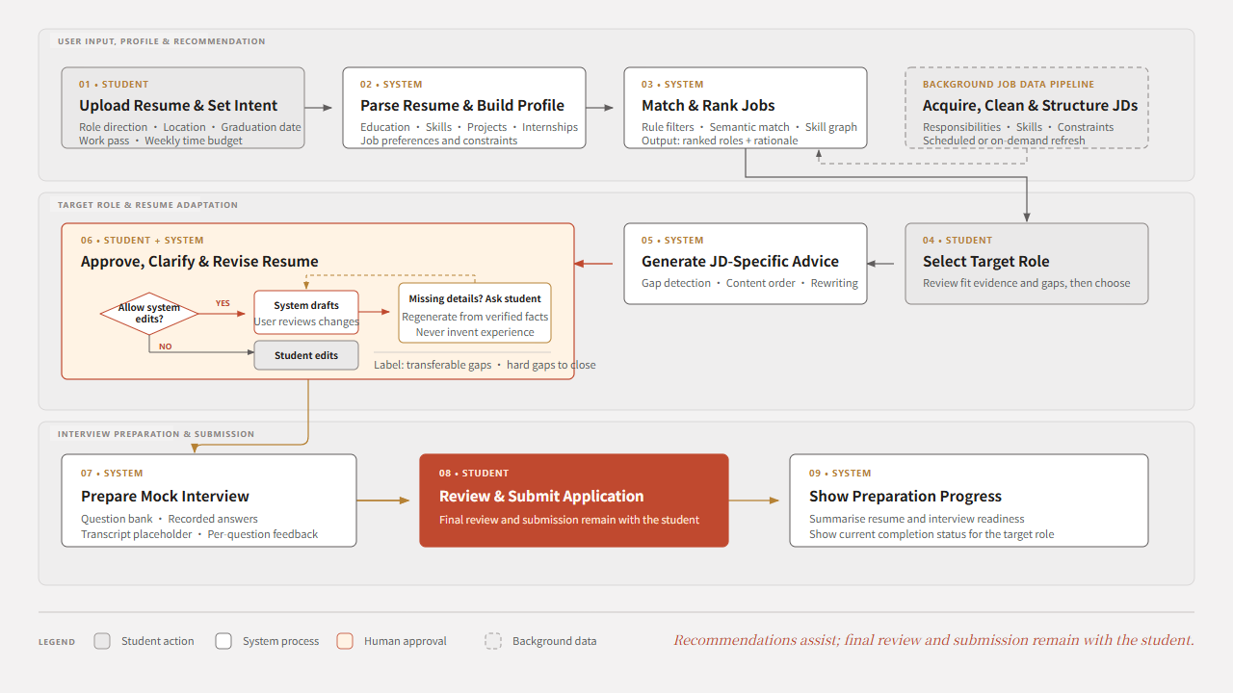
CareerPilot
USER JOURNEY
User journey: from profile to submission
05
Notes:
【Speaker 1 · Sun Wenjing】（上半段结束）约 75 秒 ｜ 累计 4:30
[EN]
This is the user journey. It has five stages. Stage one: the student uploads a resume and sets up the user profile, such as target role, location and work pass. Stage two: the system matches and ranks JDs based on the profile. Stage three: the student selects a JD, and the system suggests resume changes for that JD. If some information is missing, it asks the student instead of making it up. Stage four: the system generates mock interview questions from the JD. Stage five: the student manages the application progress, and the system takes them to the right application page. The final submission, in the red box, is always done by the student.
[Transition → Speaker 2 · 转场]
That is CareerPilot from the user's side. Now I'll hand over to Wenjing, who will show you how the system works inside.
[中文]
这是用户旅程，分五个阶段。第一阶段：学生上传简历，设定个人画像，比如目标岗位、地点和工作准证。第二阶段：系统根据画像匹配 JD 并排序。第三阶段：学生选择一个 JD，系统针对这个 JD 给出简历修改建议；如果信息不全，系统会询问学生，而不是编造。第四阶段：系统根据 JD 生成模拟面试题。第五阶段：管理投递进度，系统跳转到对应的投递页面。红框里的最终提交始终由学生本人完成。
【转场】以上是从用户角度看 CareerPilot。接下来交给，由她介绍系统内部是怎么运作的。

Slide 6
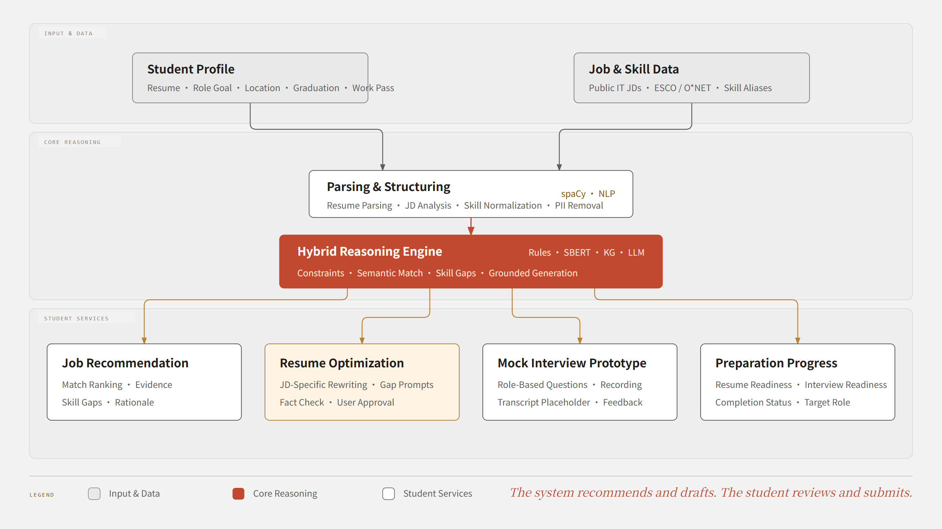
CareerPilot
CORE EXPERIENCE
Core functions around one target JD
06
Notes:
【Speaker 2 · Zhao Jiayi】（下半段开始）约 50 秒 ｜ 累计 5:20
[EN]
Thank you, Jiayi. This slide shows the same functions from the system side. There are two inputs: the student profile, and job and skill data from public IT JDs, ESCO and O*NET. After parsing and structuring, the data goes into the hybrid reasoning engine, which combines rules, SBERT, a knowledge graph and an LLM. The engine supports four services: job recommendation, resume optimisation, mock interview, and preparation progress. Every output is based on the student's own profile and the target JD, not on a general template.
[中文]
谢谢。这一页从系统角度展示同样的功能。有两类输入：学生画像，以及来自公开 IT JD、ESCO 和 O*NET 的岗位与技能数据。解析和结构化之后，数据进入混合推理引擎，它结合了规则、SBERT、知识图谱和 LLM，支撑四项服务：岗位推荐、简历优化、模拟面试和准备进度。所有输出都基于学生自己的画像和目标 JD，而不是通用模板。
发音提示：ESCO “ES-ko”；O*NET “oh-net”；SBERT “S-bert”

Slide 7
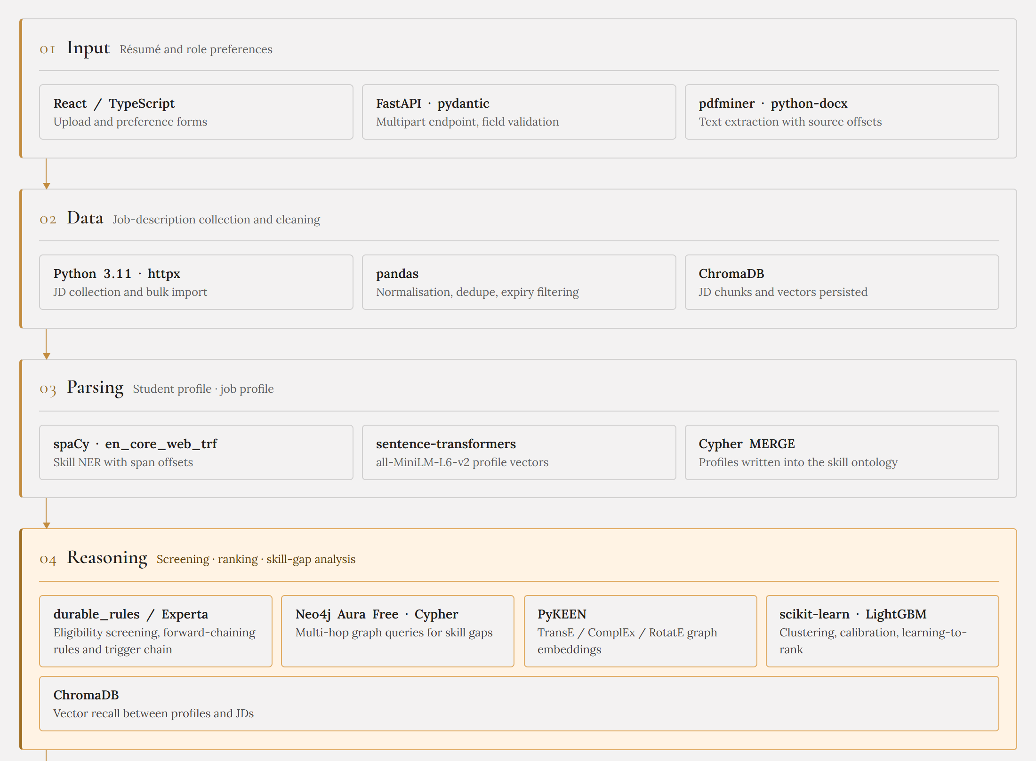
CareerPilot
SYSTEM ARCHITECTURE
Architecture · Input to reasoning
07
Notes:
【Speaker 2 · Zhao Jiayi】约 75 秒 ｜ 累计 6:35
[EN]
Now the architecture. It has seven layers. I will not go through every tool, but explain why we chose the key ones.
The first three layers prepare the data. ChromaDB stores JD chunks as vectors. It is light and runs locally. spaCy extracts skills, and MiniLM from sentence-transformers turns profiles into vectors. It is small enough to run on CPU.
Layer four, Reasoning, is the core. For hard limits like work pass and degree, we use a rules engine, Experta, because rules are transparent: we can show exactly which rule a job fails. For skills, we use a Neo4j knowledge graph. IT skills are a limited field with clear relations, like synonyms and parent skills, so a graph can represent them well and find related skills. Finally, LightGBM combines all these signals into one ranking.
[中文]
下面看技术架构，一共七层。我不逐一介绍每个工具，而是讲清楚关键技术为什么这样选。前三层负责准备数据：ChromaDB 把 JD 片段存成向量，它很轻量，可以本地运行；spaCy 抽取技能，sentence-transformers 的 MiniLM 模型把画像变成向量，模型小，CPU 就能跑。第四层推理层是核心：工作准证、学历这类硬性条件用规则引擎 Experta，因为规则是透明的，能明确指出岗位没通过哪一条；技能用 Neo4j 知识图谱，因为 IT 技能是一个有限的领域，同义词、上下级技能等关系很清晰，适合用图谱表示，也能找到相关技能；最后由 LightGBM 综合这些信号给岗位排序。
发音提示：spaCy “SPAY-see”；MiniLM “mini-L-M”；Experta “ex-PER-ta”；Neo4j “NEE-oh-four-jay”；LightGBM “light-G-B-M”

Slide 8
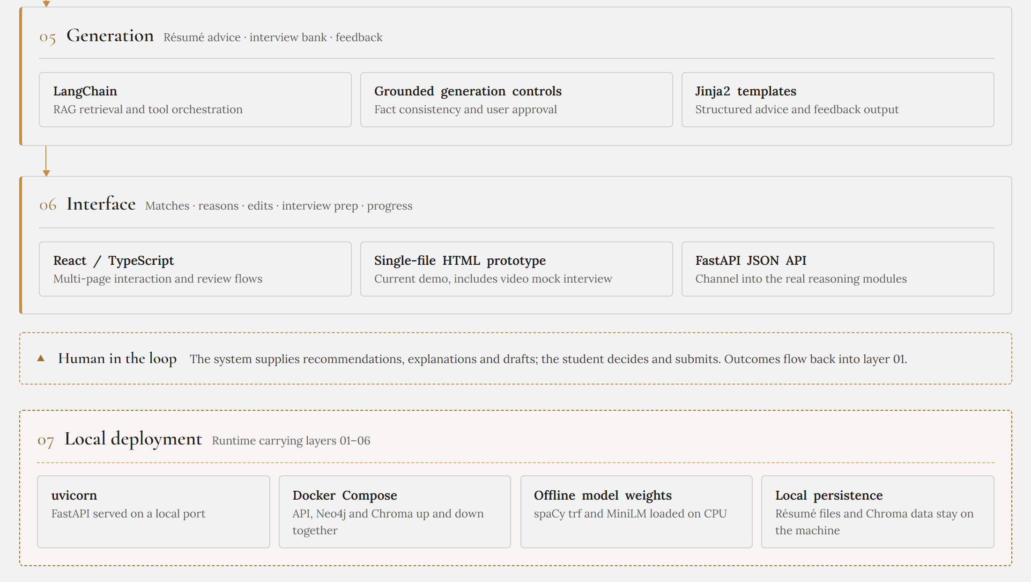
CareerPilot
SYSTEM ARCHITECTURE
Architecture · Generation to deployment
08
Notes:
【Speaker 2 · Zhao Jiayi】约 75 秒 ｜ 累计 7:50
[EN]
This slide covers layers five to seven.
For resume suggestions, the Generation layer uses RAG with LangChain. We chose RAG because it first finds the exact JD requirement and the related resume line. So the system can tell the student why each change is needed, not only what to change. Our grounded generation controls also make sure every sentence comes from real facts.
The Interface layer shows these results in React, through FastAPI.
The dotted box is Human in the loop: the system just recommends and drafts, user will decides and submits.
Layer seven is Local deployment. We use Docker Compose and offline models on CPU, so the whole system runs on the student's own machine. This gives two benefits. First, data security: resumes are personal data, and they never leave the machine. Second, customisation: students can add their own target JDs and build their own interview questions, and keep them private. Job search is a competition, and nobody wants their favourite roles shared on a public platform.
[中文]
这一页是第五到第七层。生成层用 LangChain 做 RAG 来生成简历修改建议。选 RAG 是因为它会先检索到具体的 JD 要求和相关的简历内容，所以系统不仅能说改什么，还能告诉学生为什么要改；grounded generation controls（受约束生成控制）还会确保每一句话都来自真实事实。界面层用 React 展示结果，通过 FastAPI JSON API 连接推理模块。虚线框是 Human in the loop（人在回路）：系统负责推荐和起草，学生负责决定和提交。第七层本地部署用 Docker Compose 和 CPU 上的离线模型，因为简历是个人数据，所有数据都留在学生自己的电脑上，而且一条命令就能启动整个系统。
发音提示：RAG 读 “rag”（一个词）；LangChain “LANG-chain”

Slide 9
CareerPilot
REASONING DESIGN
Why hybrid reasoning fits IT job search
Different problems need different methods; one similarity score cannot cover them all
01
02
03
04
05
Rule screening
Semantic match
Skill graph
Grounded generation
Planning rules
Location, degree, work pass, deadlines
Fit between projects and role duties
Synonyms, hierarchy, transferable gaps
Explanations, résumé edits, question bank
Role status, deadlines, time budget
Explainable output
Eligibility
Evidence
Skill gaps
Grounded draft
Next action
Why
Hard constraints cannot be offset by similarity; generated content must trace back to resume and JD facts.
09
Notes:
【Speaker 2 · Zhao Jiayi】约 45 秒 ｜ 累计 8:35
[EN]
So why hybrid reasoning? Because job search is not one kind of problem. Some decisions are strict yes-or-no rules. Some need fuzzy matching. Some need structured knowledge. And some need natural language. No single method is good at all of them. So we use each method where it works best, and combine the results into one explainable output. The key principle is simple: similarity can never override a hard rule, and every generated sentence must trace back to real facts.
[中文]
为什么要用混合推理？因为求职不是单一类型的问题：有的是严格的是/否规则，有的需要模糊匹配，有的需要结构化知识，有的需要自然语言生成。没有一种方法能同时做好所有这些。所以我们让每种方法做它最擅长的事，再把结果整合成一个可解释的输出。核心原则很简单：相似度永远不能推翻硬性规则，每一句生成的内容都必须能追溯到真实事实。

Slide 10
CareerPilot
Q&A
Thank you
Notes:
【Speaker 2 · Zhao Jiayi】约 30 秒 ｜ 累计 9:05
[EN]
To sum up: the pain points are real, and today's tools do not solve them together. CareerPilot answers them with one explainable job-search loop, and our hybrid architecture makes every recommendation traceable. The system suggests, and the uesr decides.
Thank you for listening.
[中文]
总结一下：这些痛点真实存在，现有工具没能一起解决。CareerPilot 用一个可解释的求职闭环来回应它们，混合推理架构让每一条推荐都可以追溯。系统给建议，学生做决定。谢谢大家，欢迎提问。
Q&A（5 分钟）

