Slide 1
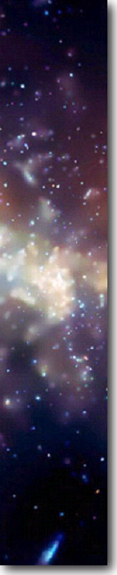
The Milky Way Galaxy part 2
Unit:

Slide 2
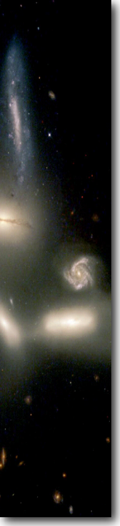
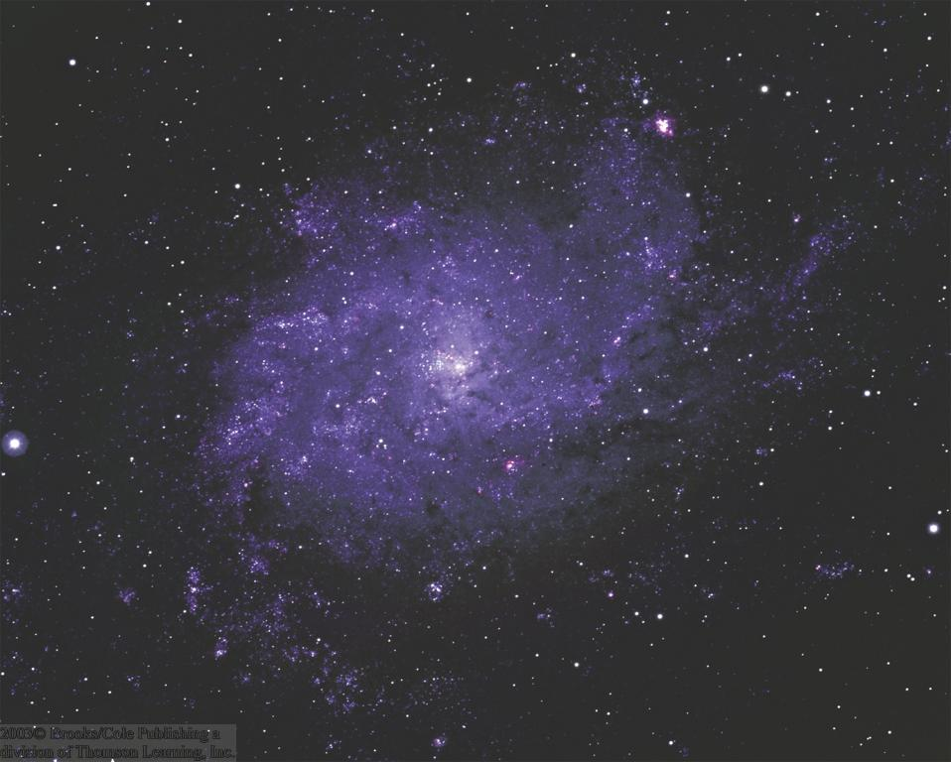
Galaxies
Star systems like our Milky Way
Contain a few thousand to tens of billions of stars.
Large variety of shapes and sizes

Slide 3
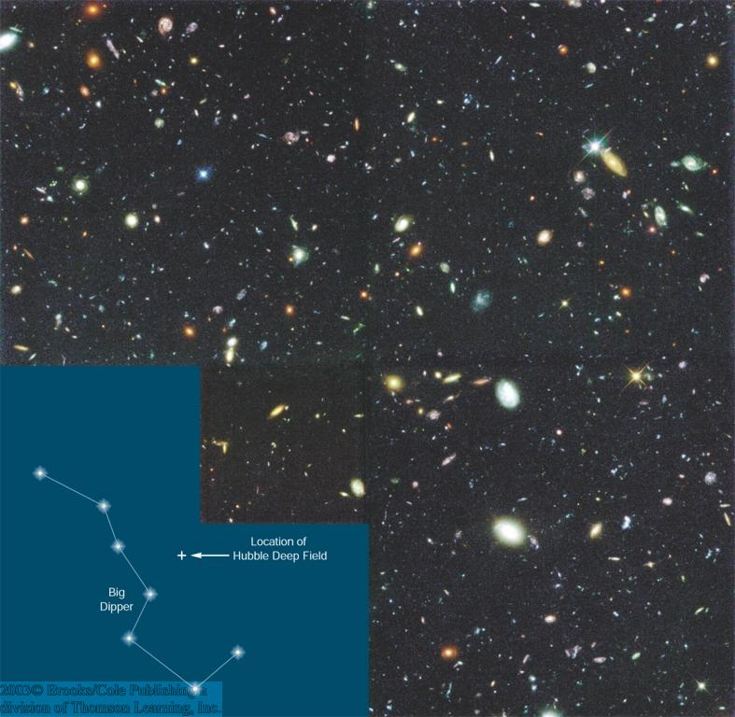
Galaxy Diversity
Even seemingly empty regions of the sky contain thousands of very faint, very distant galaxies
Large variety of galaxy morphologies:
Spirals
Ellipticals
Irregular
(some interacting)
The Hubble Deep Field:
10-day exposure on an apparently empty field in the sky

Slide 4
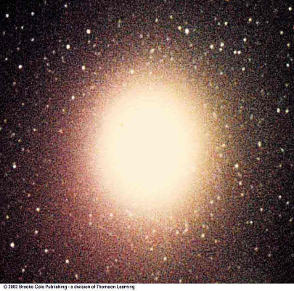
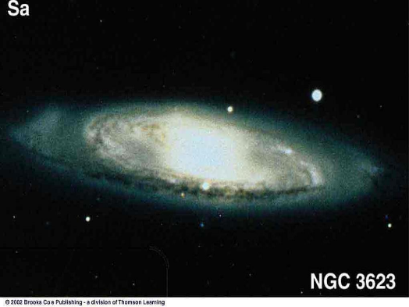
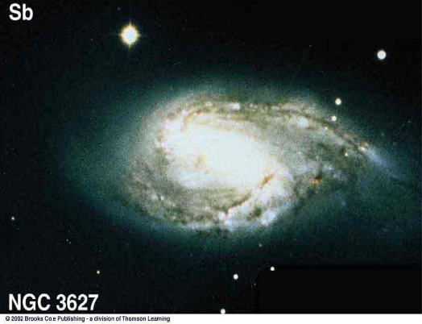
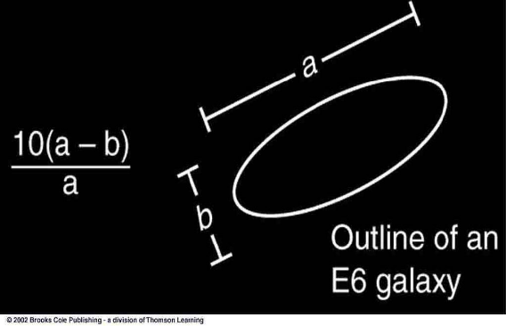
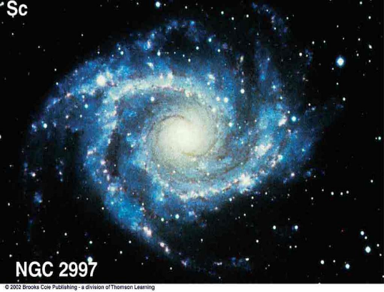
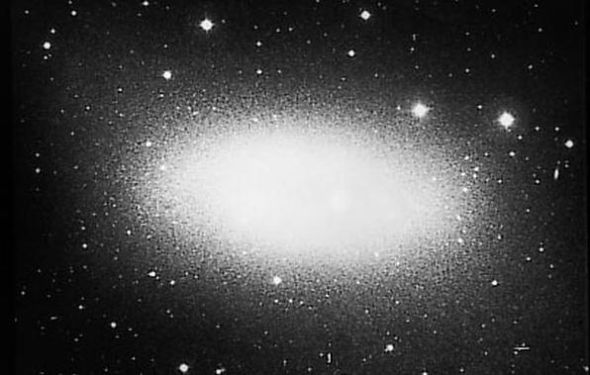
Galaxy Classification
E0, …, E7
Sa
Large nucleus; tightly wound arms
E0 = Spherical
E1
Sb
Sc
Small nucleus; loosely wound arms
E7 = Highly elliptical
E6

Slide 5
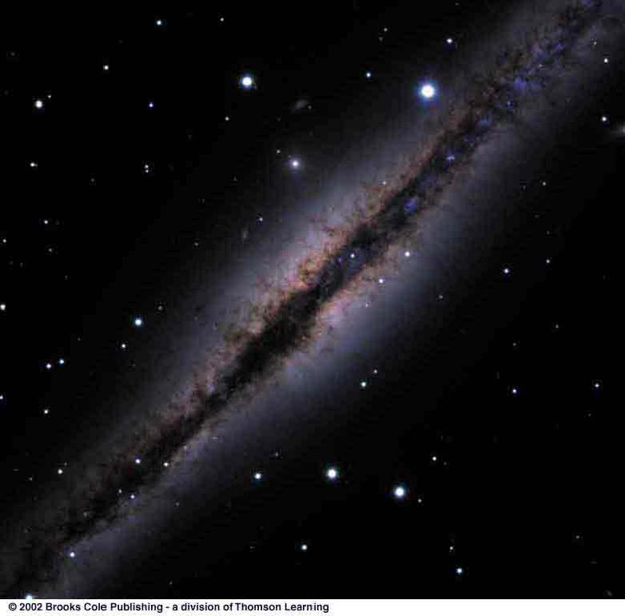
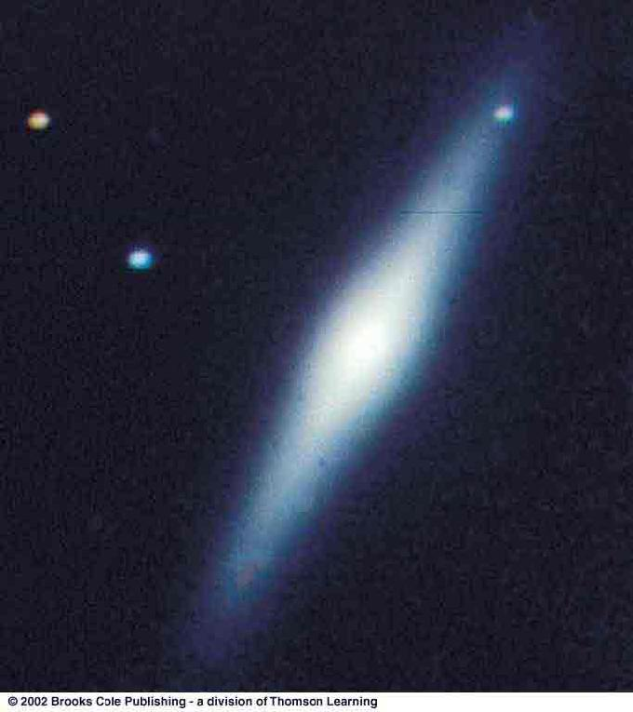
Gas and Dust in Galaxies
Spirals are rich in gas and dust
Ellipticals are almost devoid of gas and dust
Galaxies with disk and bulge, but no dust are termed S0

Slide 6
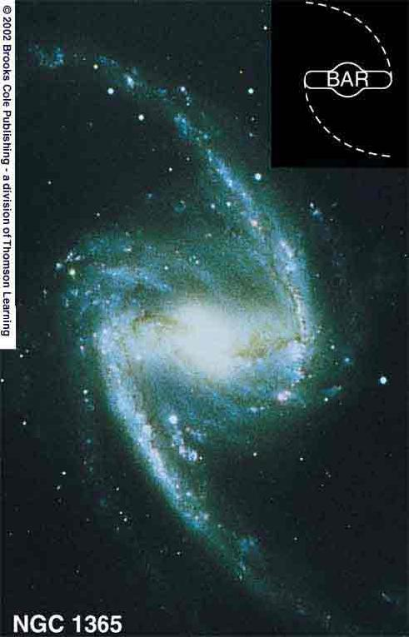
Barred Spirals
Some spirals show a pronounced bar structure in the center
They are termed barred spiral galaxies
Sequence:
SBa, …, SBc,
analogous to regular spirals

Slide 7
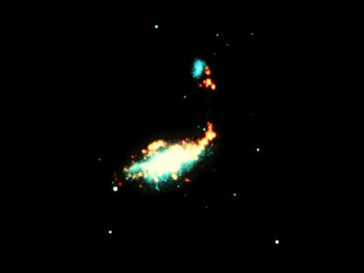
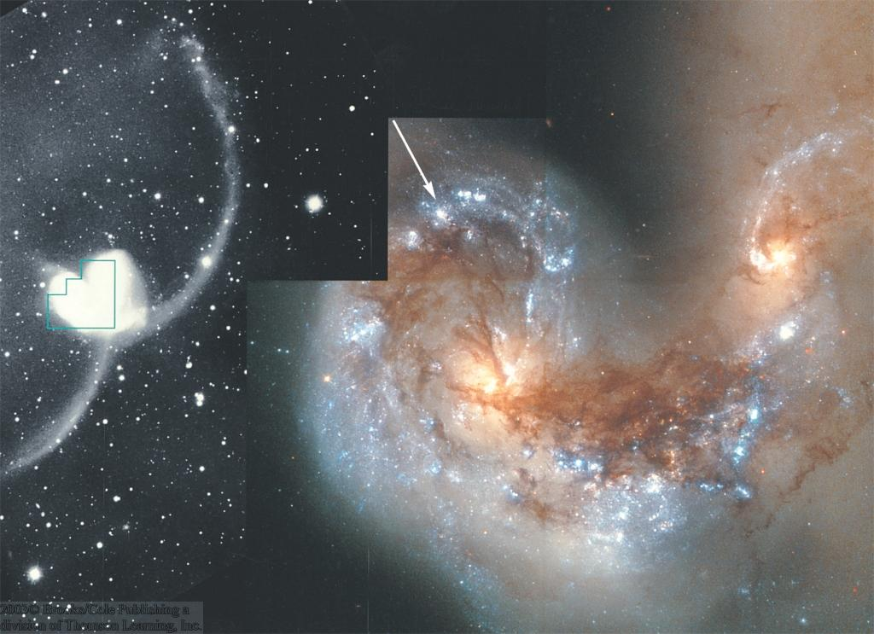
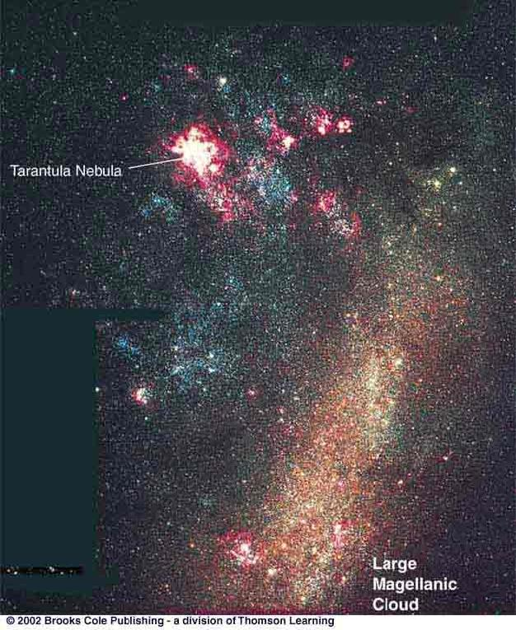
Irregular Galaxies
Often: result of galaxy collisions / mergers
Often: Very active star formation (“Starburst galaxies”)
The Cocoon Galaxy
NGC 4038/4039
Some: Small (“dwarf galaxies”) satellites of larger galaxies
(e.g., Magellanic Clouds)
Large Magellanic Cloud

Slide 8
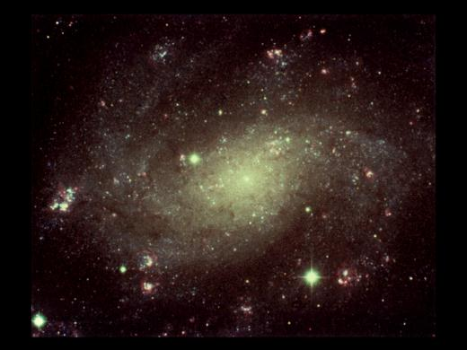
Distance Measurements to Other Galaxies (1)
Cepheid Method: Using Period – Luminosity relation for classical Cepheids:
Measure Cepheid’s Period → Find its luminosity → Compare to apparent magnitude → Find its distance
b) Type Ia Supernovae (collapse of an accreting white dwarf in a binary system):
Type Ia Supernovae have well known standard luminosities → Compare to apparent magnitudes → Find its distances
Both are “Standard-candle” methods:
Know absolute magnitude (luminosity) → compare to apparent magnitude → find distance.

Slide 9
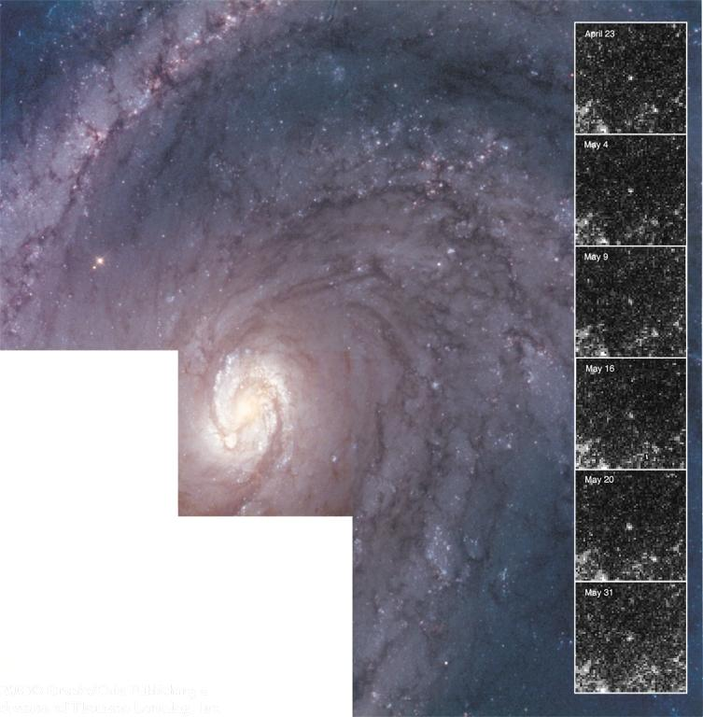
Cepheid Distance Measurement
Repeated brightness measurements of a Cepheid allow the determination of the period and thus the absolute magnitude.
→ Distance

Slide 10
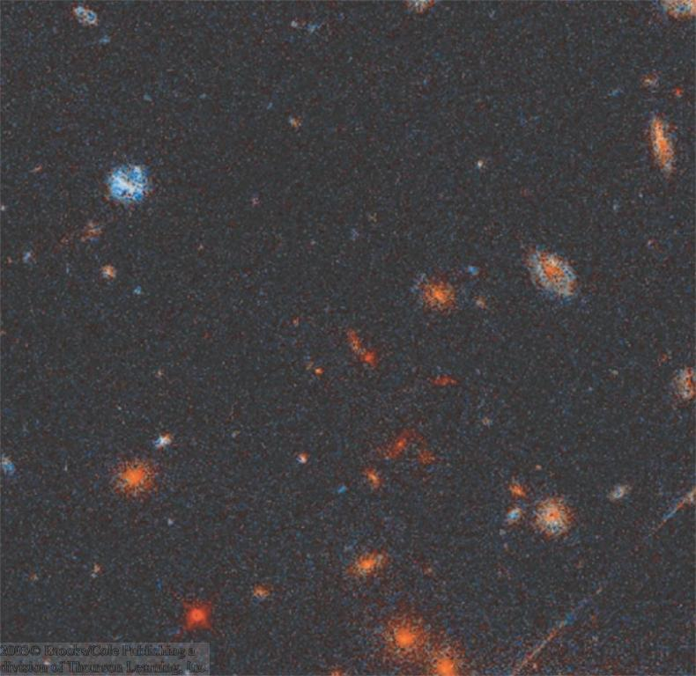
The Most Distant Galaxies
At very large distances, only the general characteristics of galaxies can be used to estimate their luminosities → distances.
Cluster of galaxies at ~ 4 to 6 billion light years

Slide 11
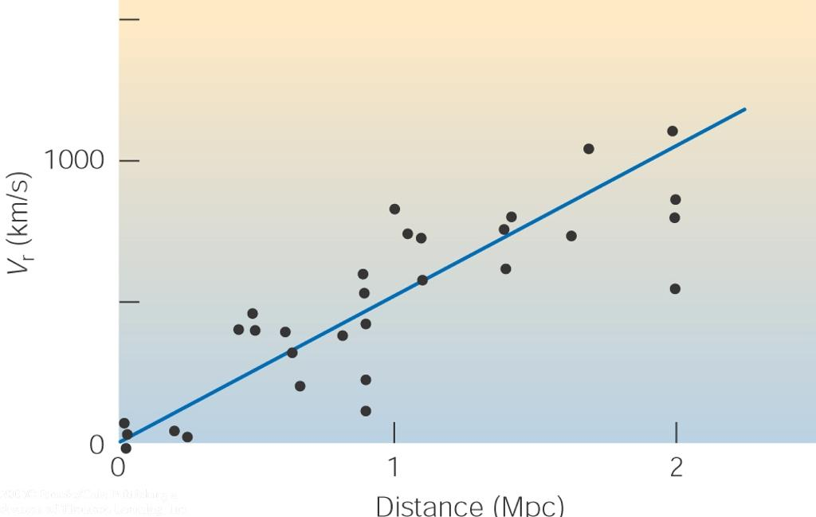
Distance Measurements to Other Galaxies (2): The Hubble Law
E. Hubble (1913):
Distant galaxies are moving away from our Milky Way, with a recession velocity, v_{r}, proportional to their distance d:
v_{r} = H₀*d
H₀ ≈ 70 km/s/Mpc is the Hubble constant
Measure v_{r} through the Doppler effect → infer the distance

Slide 12
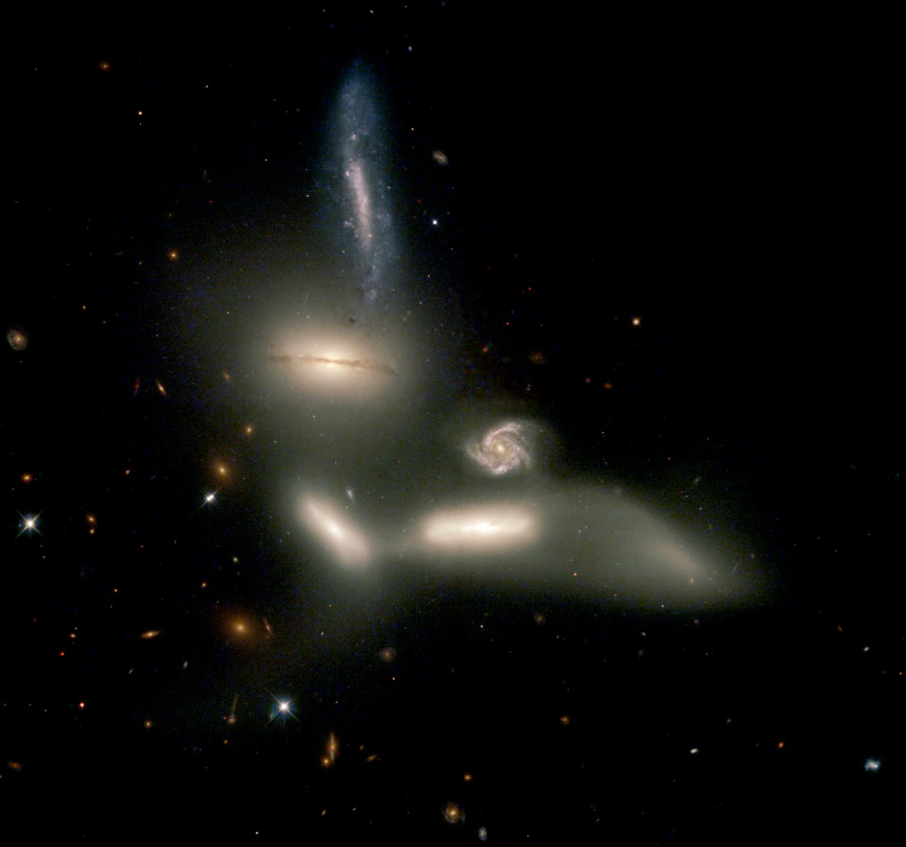
The Extragalactic Distance Scale
Many galaxies are typically millions or billions of parsecs from our galaxy.
Typical distance units:
Mpc = Megaparsec = 1 million parsec
Gpc = Gigaparsec = 1 billion parsec
Distances of Mpc or even Gpc ⬄ The light we see left the galaxy millions or billions of years ago!!
“Look-back times” of millions or billions of years

Slide 13
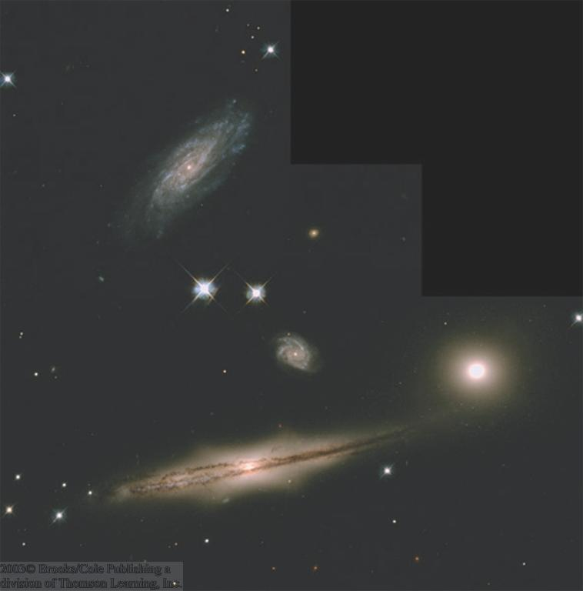
Galaxy Sizes and Luminosities
Vastly different sizes and luminosities:
From small, low-luminosity irregular galaxies (much smaller and less luminous than the Milky Way) to giant ellipticals and large spirals, a few times the Milky Way’s size and luminosity

Slide 14
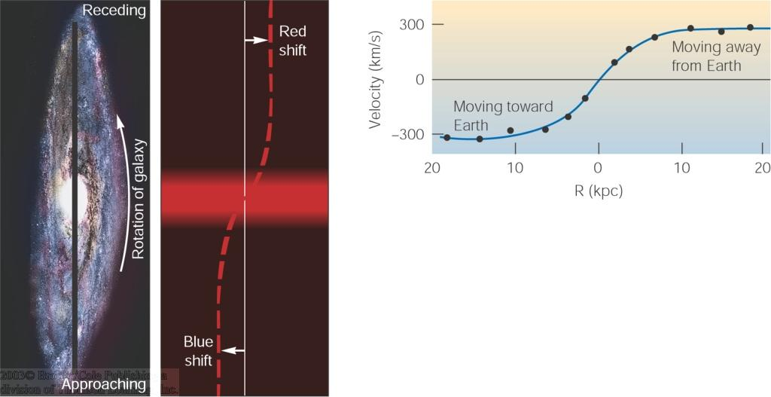
Rotation Curves of Galaxies
From blue / red shift of spectral lines across the galaxy
→ infer rotational velocity
Plot of rotational velocity vs. distance from the center of the galaxy: Rotation Curve
Observe frequency of spectral lines across a galaxy.

Slide 15
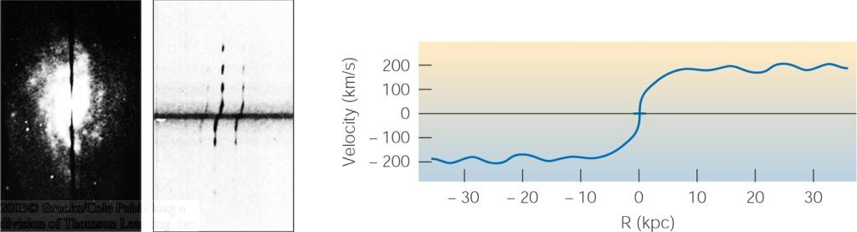
Determining the Masses of Galaxies
Based on rotation curves, use Kepler’s 3rd law to infer
masses of galaxies

Slide 16
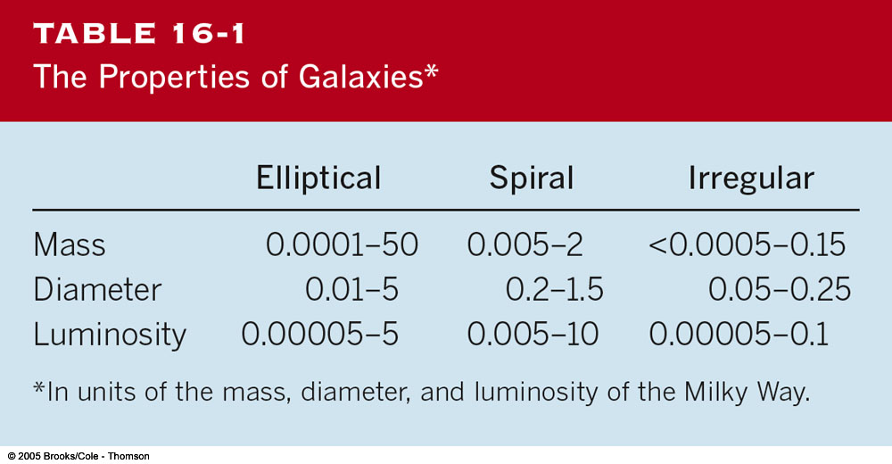
Masses and Other Properties of Galaxies

Slide 17
Supermassive Black Holes
From the measurement of stellar velocities near the center of a galaxy:
Infer mass in the very center → central black holes!
Several million, up to more than a billion solar masses!
→ Supermassive black holes

Slide 18
Dark Matter
Adding “visible” mass in:
stars,
interstellar gas,
dust,
…etc., we find that most of the mass is “invisible”!
The nature of this “dark matter” is not understood at this time.
Some ideas: brown dwarfs, small black holes, exotic elementary particles.

Slide 19
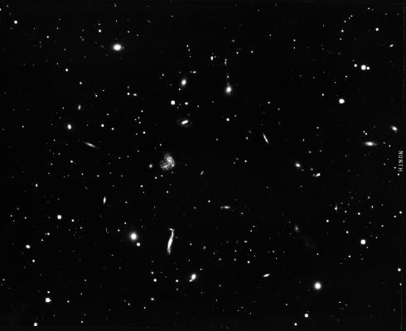
Clusters of Galaxies
Galaxies generally do not exist in isolation, but form larger clusters of galaxies.
Rich clusters:
1,000 or more galaxies, diameter of ~ 3 Mpc, condensed around a large, central galaxy
Poor clusters:
Less than 1,000 galaxies (often just a few), diameter of a few Mpc, generally not condensed towards the center

Slide 20
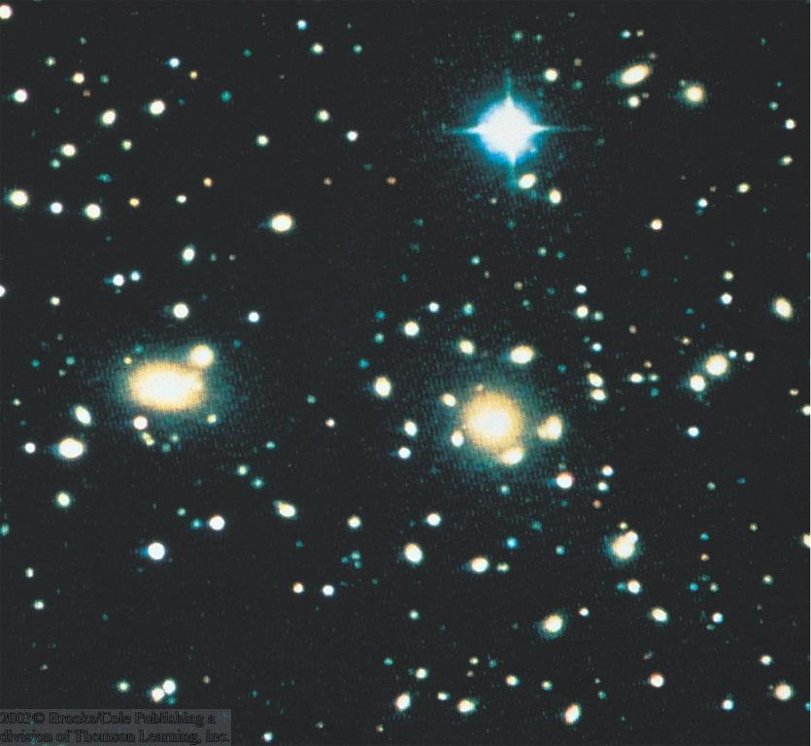
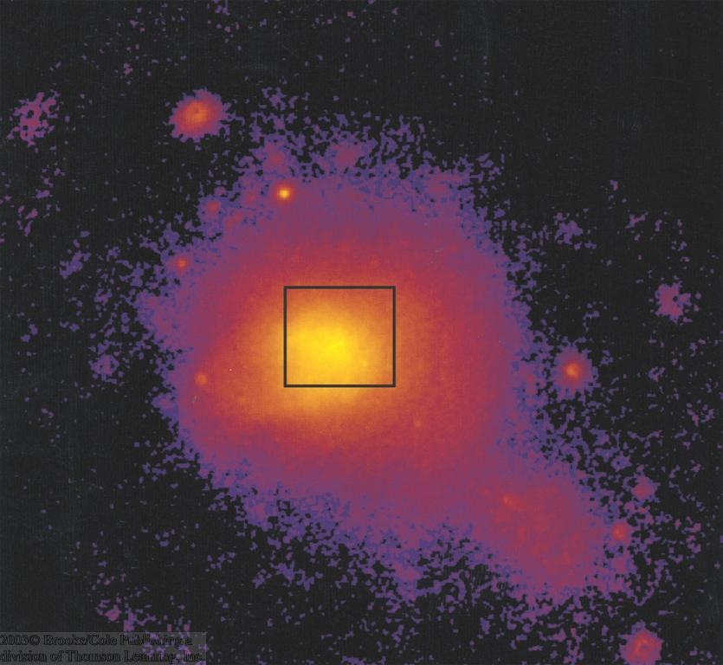
Hot Gas in Clusters of Galaxies
Space between galaxies is not empty, but filled with hot gas (observable in X-rays)
That this gas remains gravitationally bound provides further evidence for dark matter.
Visible light
X-rays
Coma Cluster of Galaxies

Slide 21
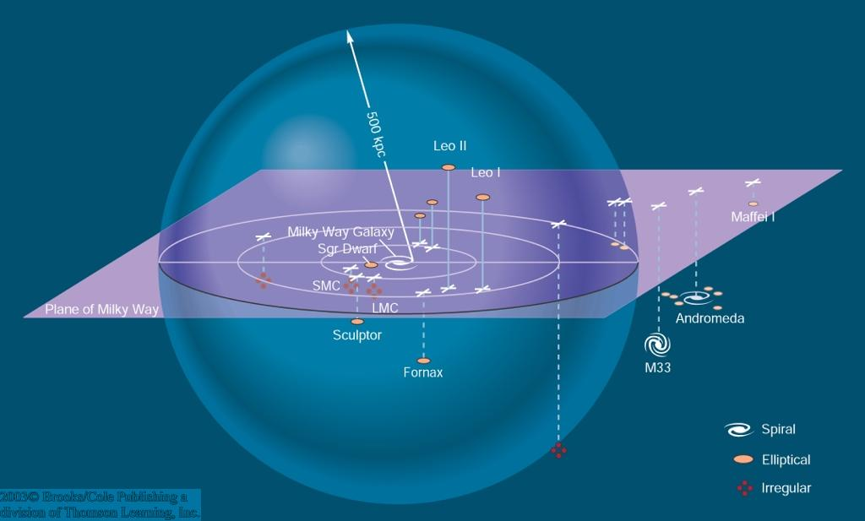
Our Galaxy Cluster: The Local Group
Milky Way
Andromeda galaxy
Small Magellanic Cloud
Large Magellanic Cloud

Slide 22
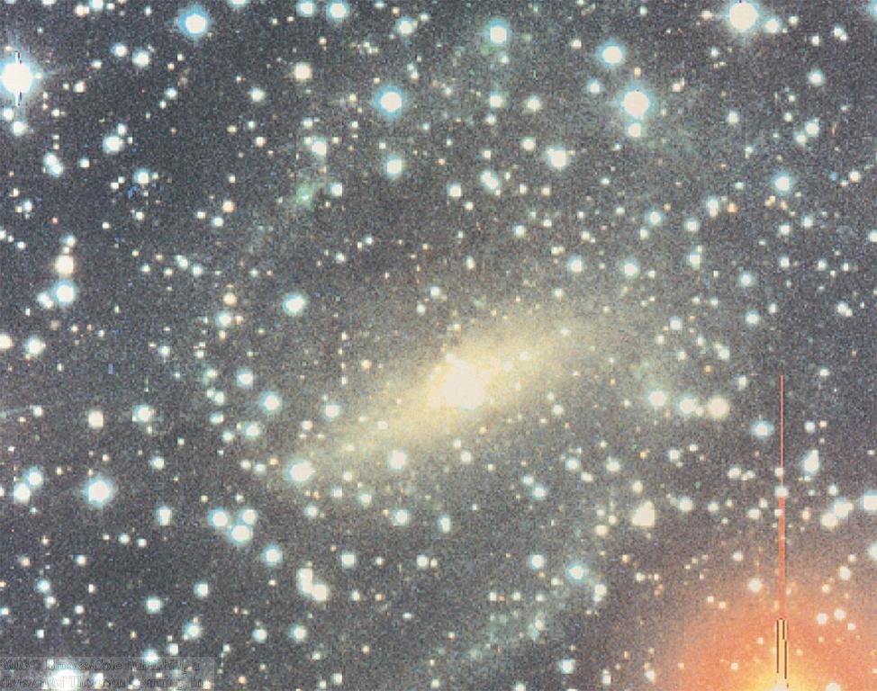
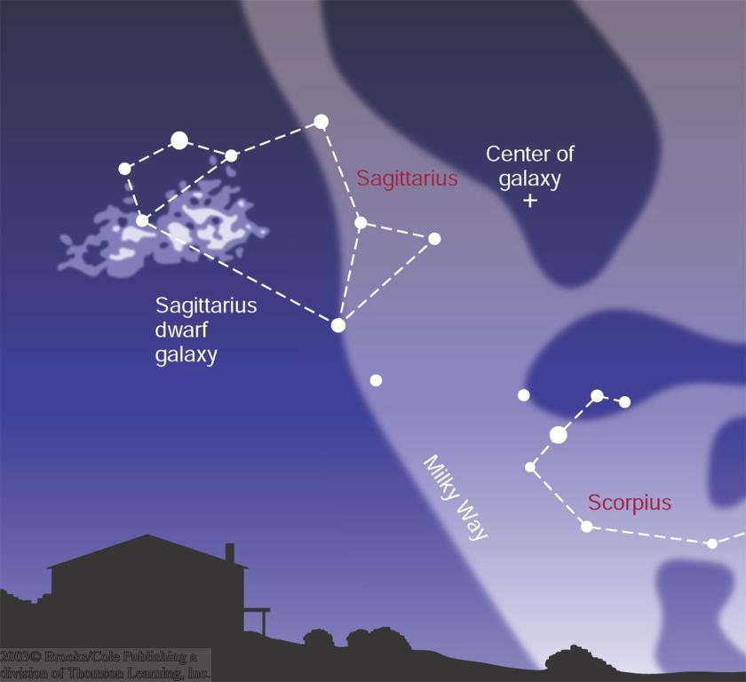
Neighboring Galaxies
Some galaxies of our local group are difficult to observe because they are located behind the center of our Milky Way, from our view point.
Spiral Galaxy Dwingeloo 1

Slide 23
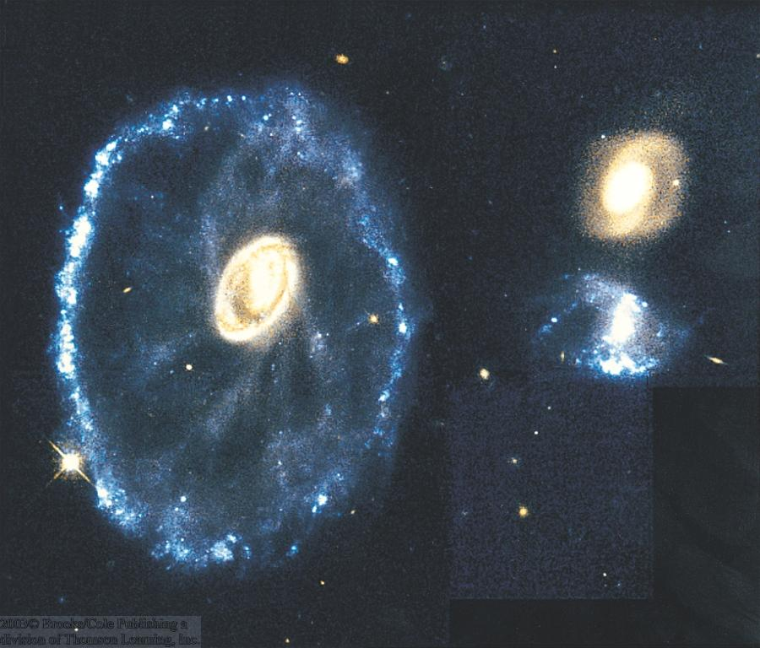
Interacting Galaxies
Cartwheel Galaxy
Particularly in rich clusters, galaxies can collide and interact.
Galaxy collisions can produce
ring galaxies and
tidal tails.
NGC 4038/4039
Often triggering active star formation: starburst galaxies

Slide 24
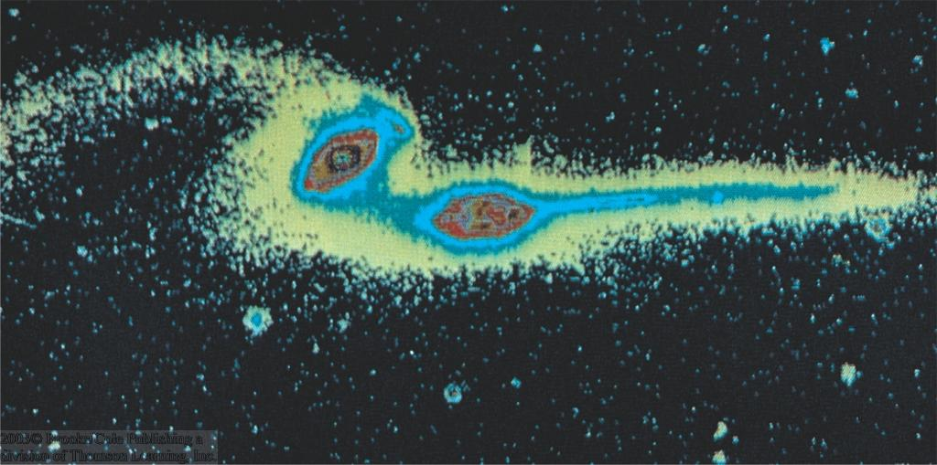
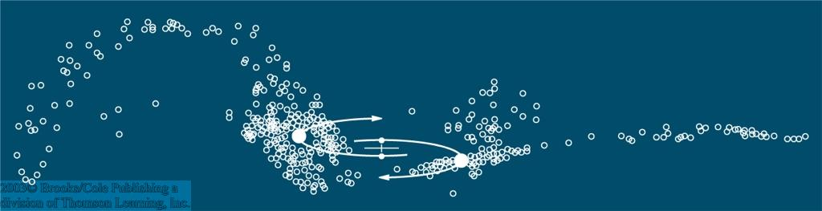
Tidal Tails
Example for galaxy interaction with tidal tails:
The Mice
Computer simulations produce similar structures.

Slide 25
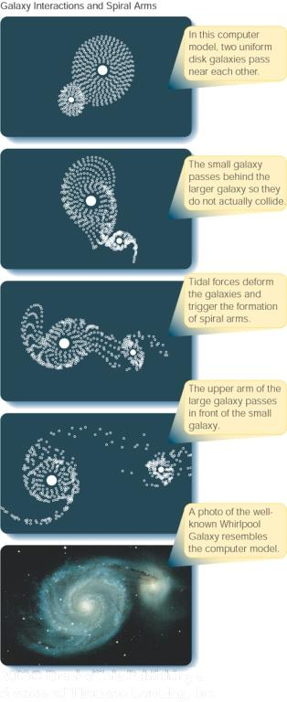
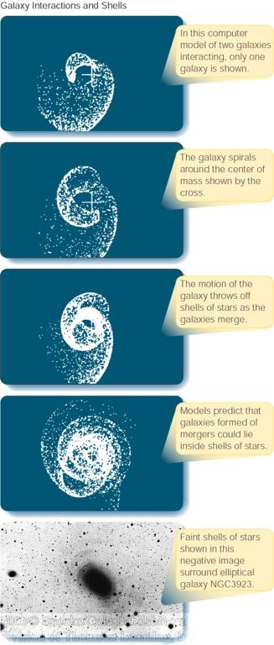
Simulations of Galaxy Interactions
Numerical simulations of galaxy interactions have been very successful in reproducing tidal interactions like bridges, tidal tails, and rings.

Slide 26
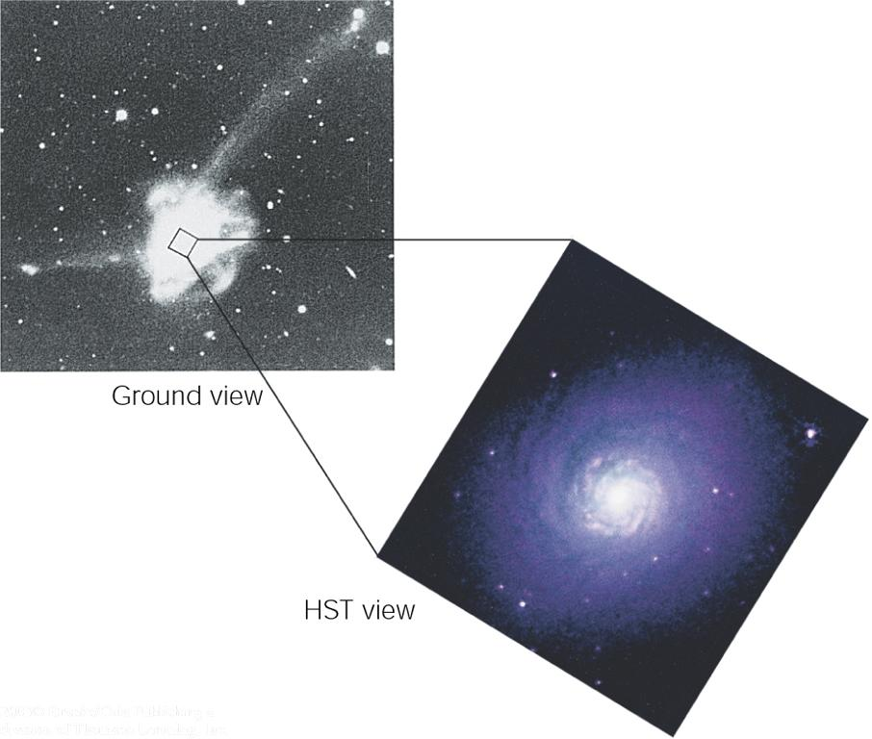
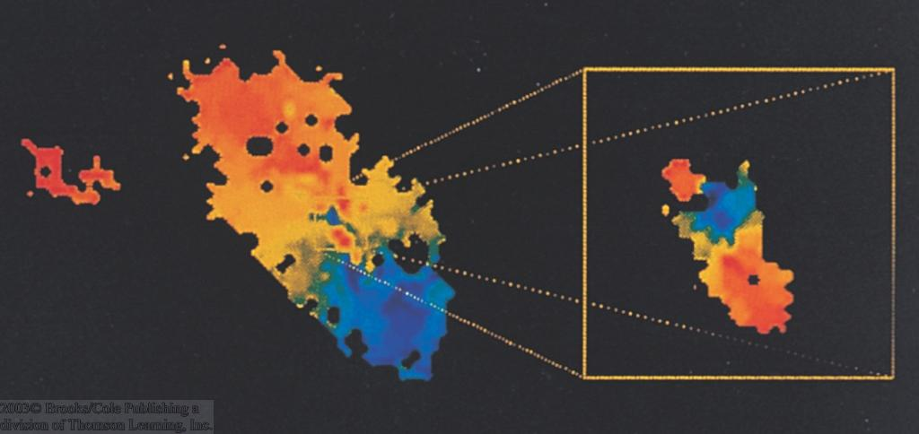
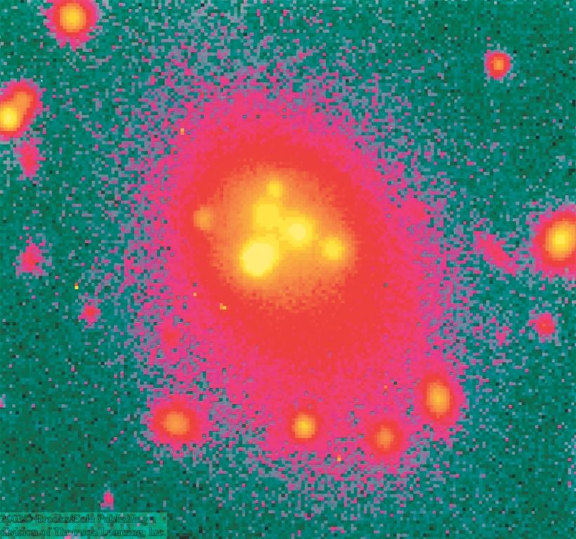
Mergers of Galaxies
Radio image of M 64: Central regions rotating backward!
NGC 7252: Probably result of merger of two galaxies, ~ a billion years ago:
Small galaxy remnant in the center is rotating backward!
Multiple nuclei in giant elliptical galaxies

Slide 27
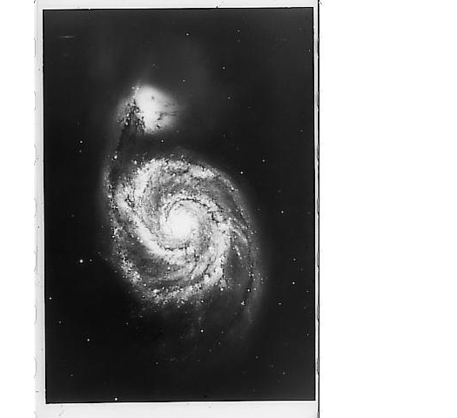
Galactic Cannibalism
NGC 5194
Collisions of large with small galaxies often result in complete disruption of the smaller galaxy.
Small galaxy is “swallowed” by the larger one.
This process is called “galactic cannibalism”

Slide 28
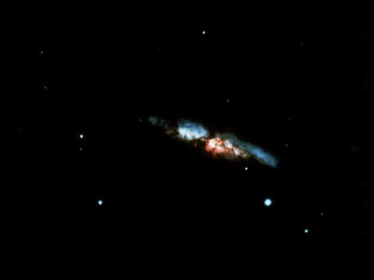
Starburst Galaxies
Starburst galaxies are often very rich in gas and dust; bright in infrared:
ultraluminous infrared galaxies
M 82
Cocoon Galaxy

Slide 29
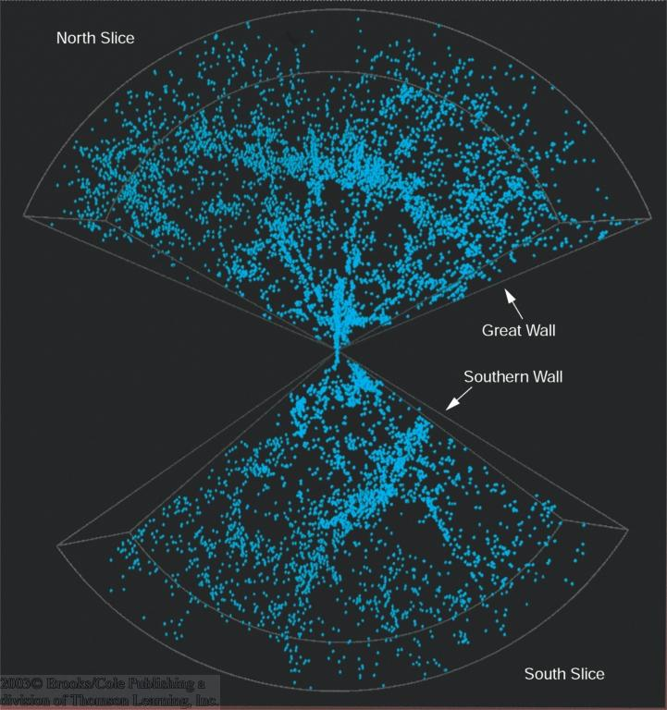
Large Scale Structure
Superclusters = clusters of clusters of galaxies
Superclusters appear aligned along walls and filaments.
Vast regions of space are completely empty:
“voids”

Slide 30
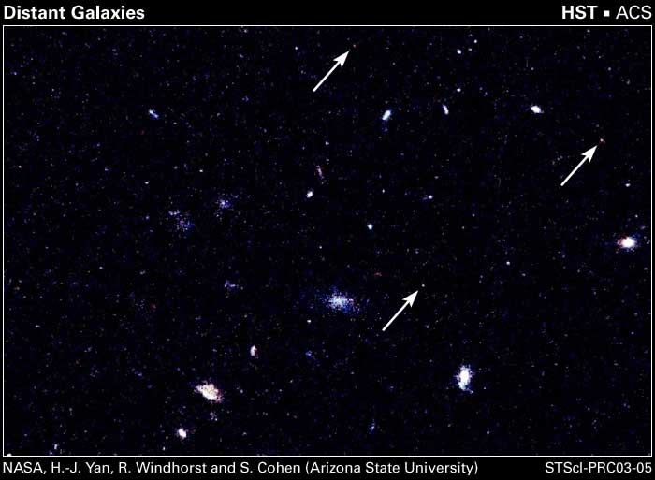
The Farthest Galaxies
The most distant galaxies visible by HST are seen at a time when the universe was only ~ 1 billion years old.

