Slide 1
Control tower (1)
Project n. 12

Slide 2
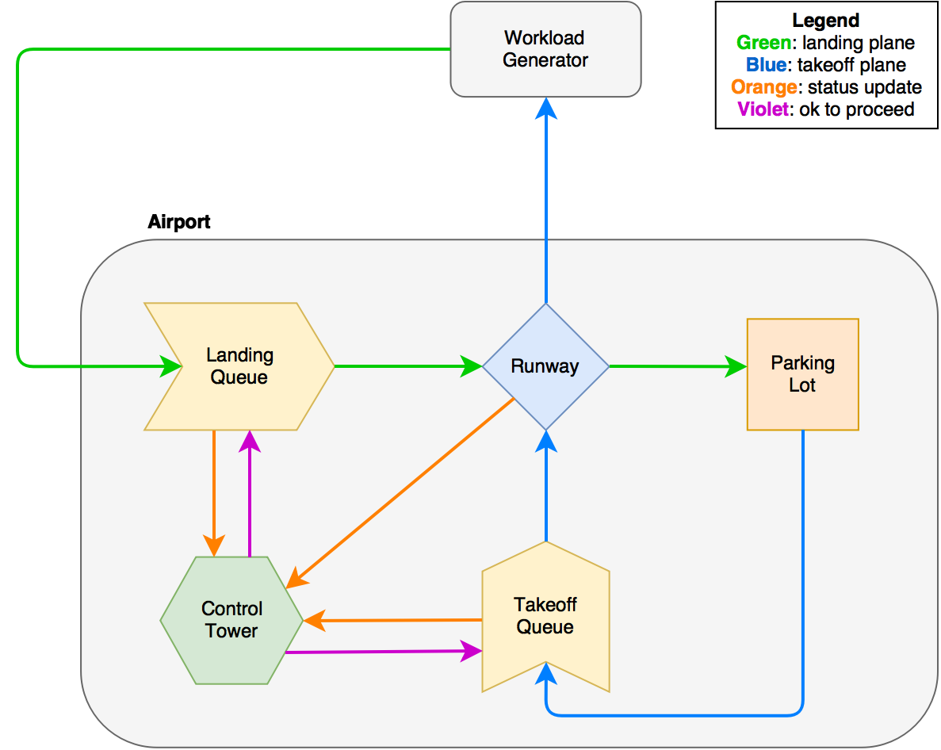
System description and modeling
Planes arrive at the landing queue
Planes leave from the take-off queue
Runway can serve one plane at a time
Policy for serving airplanes
Control tower manages the policy
Parking lot and queues are unlimited

Slide 3
Implementation
Implemented with OMNeT++
Queues implemented with C++ STD queue container
Parking Lot implemented with OMNeT++ scheduleAt() function
Control tower keeps trace of the state of the system
cMessage::setSchedulingPriority() to handle messages in the right order

Slide 4
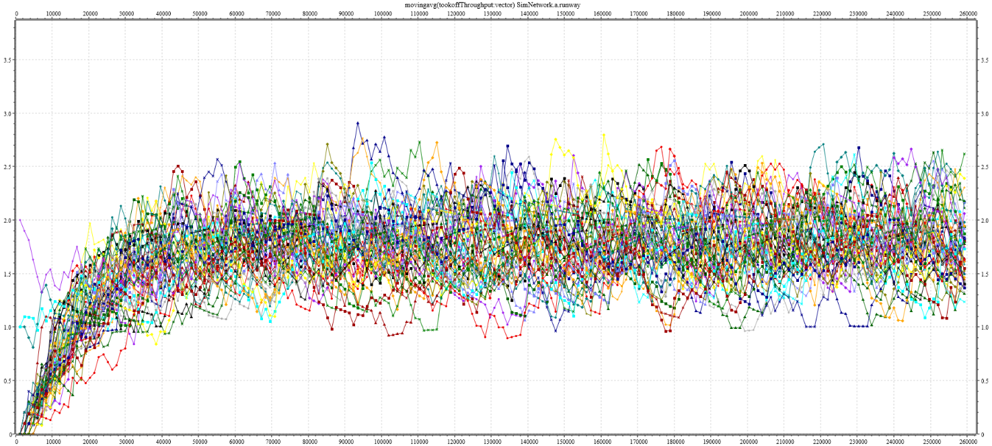
Warm-up
The system starts in a transient state
Throughput stabilizes around the mean arrival rate
The system is then in steady state.

Slide 5
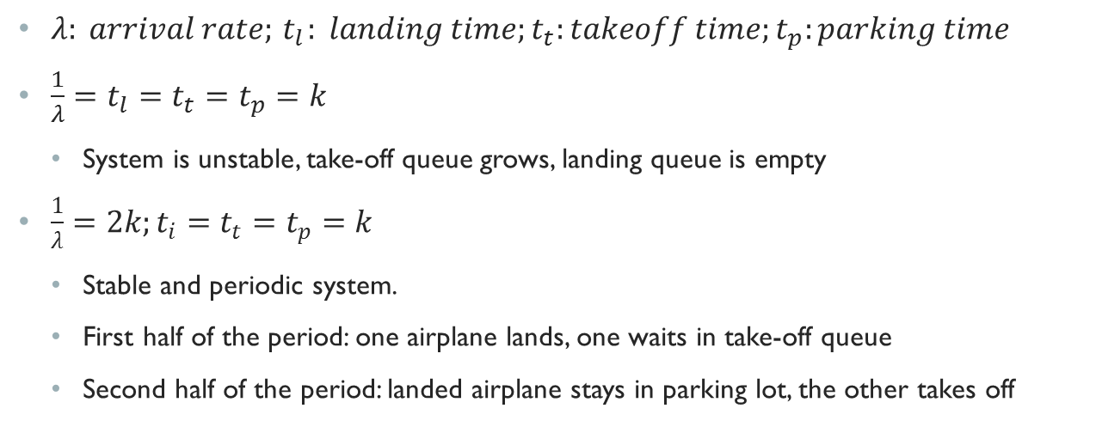
Validation – deterministic times
$λ: arrival rate;{ t}_{l}: landing time;t_{t}:takeoff time;t_{p}:parking time$
$\frac{1}{λ}=t_{l}=t_{t}=t_{p}=k$
System is unstable, take-off queue grows, landing queue is empty
$\frac{1}{λ}=2k;t_{i}=t_{t}=t_{p}=k$
Stable and periodic system.
First half of the period: one airplane lands, one waits in take-off queue
Second half of the period: landed airplane stays in parking lot, the other takes off

