Slide 1
INFOCENTER
Aggregated Social Updates in One Place
M3 Final Prototype Demo
Group 17 • ByteSquad
Introduction to Software Engineering | Mae Fah Luang University
Team:
Kunut Wongtidatorn - 6931503026
Anansit Inta - 6931503084
Htet Wai Yan - 6931503004
Swan Naing Aung - 6931503096
Aung Phone Pyae Oo - 6931503091
INFOCENTER | BYTE SQUAD
01

Slide 2
The Problem
Why did we build InfoCenter?
Information is scattered
Important updates get missed
Too much irrelevant content
Students and newcomers may need to check several social-media pages to find announcements.
When information is spread across different places, users can overlook announcements.
Finding one useful post among many updates can take time.
Our goal: help users find updates from selected sources in one place.
INFOCENTER | BYTE SQUAD
02

Slide 3
Our Solution: InfoCenter
One place to view updates from selected social-media sources
• Users add supported source links (Facebook, Instagram, or TikTok).
• InfoCenter brings available posts into one combined feed.
• Users can organize and find posts with tabs, tags, and keyword filters.
• Users can open the original post when they need more information.
Add source
→
View feed
→
Filter posts
Then open the original post if needed.
INFOCENTER | BYTE SQUAD
03

Slide 4
Functional Requirements
The four main functions described in our SRS
FR-1 Add & subscribe to sources
FR-2 View aggregated feed
Paste a supported source link to add it to the user's update list.
See updates from selected sources in one feed.
FR-3 Categorize and filter by tags
FR-4 Information sorting
Create labels and show posts from selected tagged sources.
Include or exclude posts using keywords.
These are the FRs listed in the team's SRS; confirm which ones are marked Must in the final project materials.
INFOCENTER | BYTE SQUAD
04

Slide 5
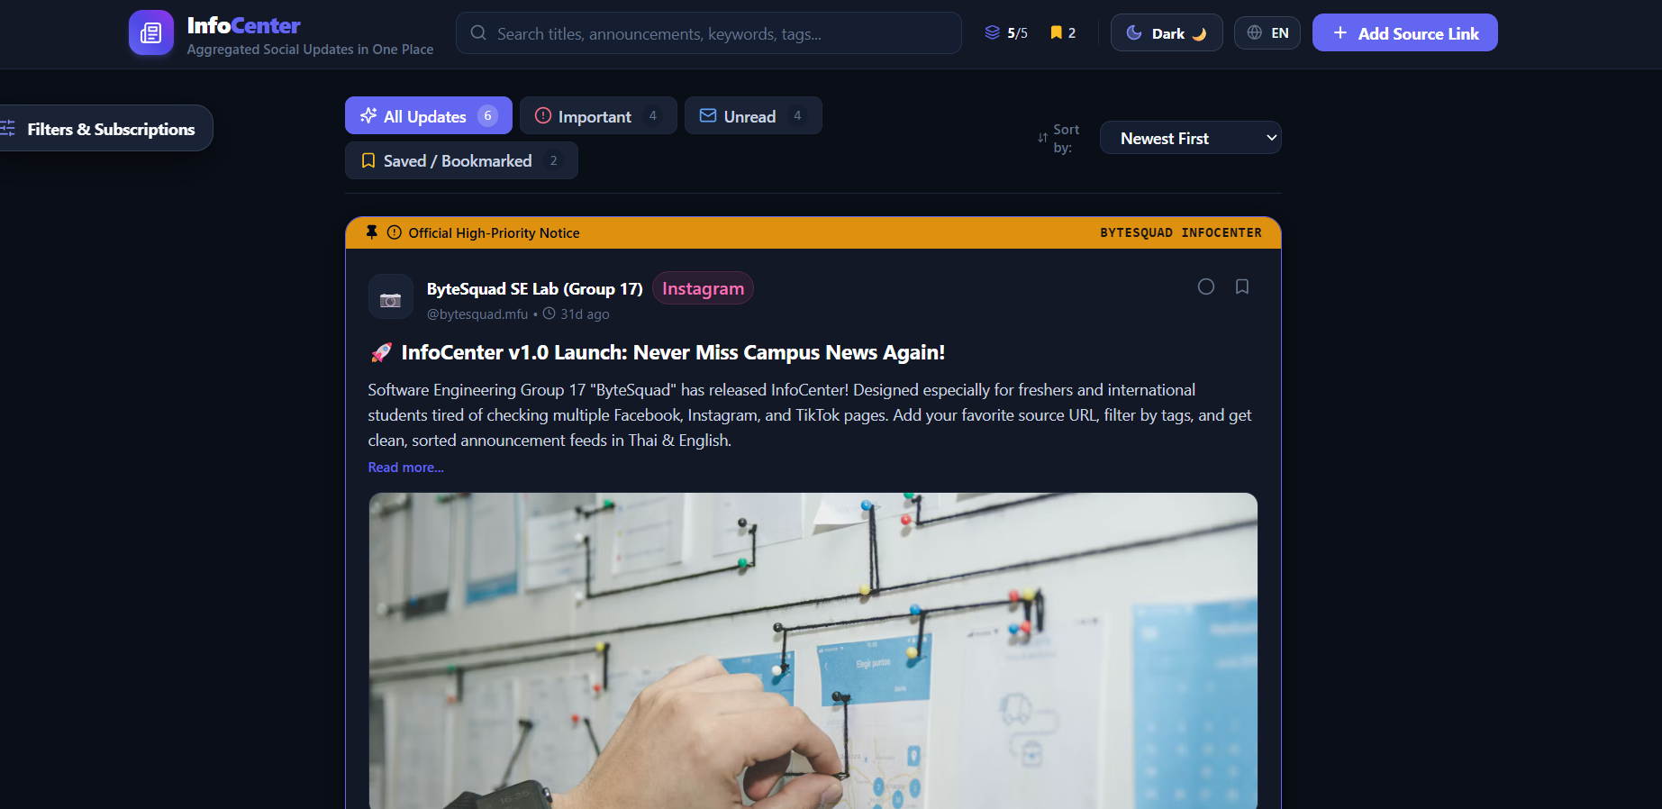
Prototype: Combined Feed
The main screen brings posts and feed controls together
Visible controls: All Updates • Important • Unread • Saved/Bookmarked • Sort order
INFOCENTER | BYTE SQUAD
05

Slide 6
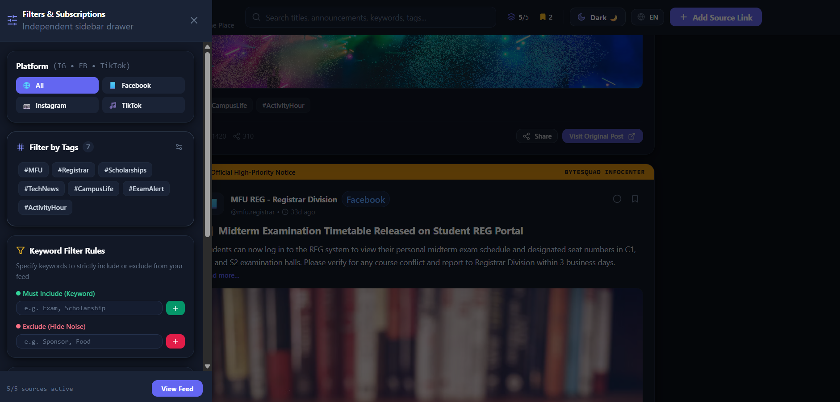
Prototype: Filters & Subscriptions
Users can narrow the feed to the sources and topics they want
• Choose a platform: All, Facebook, Instagram, or TikTok.
• Filter by tags such as #MFU or #TechNews.
• Include keywords to find relevant posts.
• Exclude keywords to hide unwanted posts.
INFOCENTER | BYTE SQUAD
06

Slide 7
Technology & Project Structure
Technology information from the project documentation
Frontend
Backend
React 18 • TypeScript • Vite 5 • Tailwind CSS 3 • lucide-react
The repository includes a C# backend project for reading and processing Apify dataset data.
API integration
Development approach
The frontend uses a REST API client for /api endpoints and includes mock-data fallbacks.
Reuse-Oriented Development: reuse and integrate existing components, libraries, APIs, and AI services where appropriate.
INFOCENTER | BYTE SQUAD
07

Slide 8
Scope & Current Limitations
• Supported source types in the prototype: Facebook, Instagram, and TikTok.
• The app links users back to the original post; it does not replace the social platforms.
• Some interface content may use sample (mock) data when a working backend is unavailable.
• Automatic updates depend on backend operation and platform/API data access.
• Notifications while the app is closed and built-in commenting are outside the project scope.
INFOCENTER | BYTE SQUAD
08

Slide 9
Live Demo Flow
Suggested order for showing the prototype
1
Show the combined feed
Point out posts from different sources.
2
Switch feed tabs
Show All Updates, Important, Unread, and Saved/Bookmarked.
3
Open Filters & Subscriptions
Show platform choices and tags.
4
Try keyword filters
Demonstrate include and exclude keyword controls.
5
Open an original post
Show how users can continue to the source.
INFOCENTER | BYTE SQUAD
09

Slide 10
Thank You
InfoCenter — Aggregated Social Updates in One Place
Questions?
Group 17 • ByteSquad
INFOCENTER | BYTE SQUAD
10

