Slide 1
ISIE 2020 3 June 2020
Challenges and Future Opportunities of Hairpin Technologies
Davide Barater

Slide 2
Main topics
Background
Round vs. Rectangular Conductors
Focus on fill factor
Focus on hairpin technologies
Current challenges and future opportunities

Slide 3
Power density knobs and enablers
Torque | Speed
Air gap flux density E.g. improved electromagnetic properties of materials Linear current density E.g. new cooling systems and improved thermal management Operating conditions E.g. innovative tools of analysis, optimal control | Mechanical properties of materials E.g. increased yield strength with no impact on magnetic properties Optimal machine design E.g. optimal pole pair Number Parasitic effects E.g. compensation for skin effect, increased reliability
Winding technologies
Decrease winding resistance (larger wire diameters, reduced end winding lengths) Decrease AC parasitic effects (multi-stranded and optimal end winding shape) Increase fill factor

Slide 4
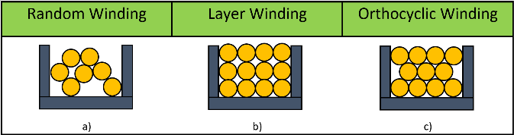
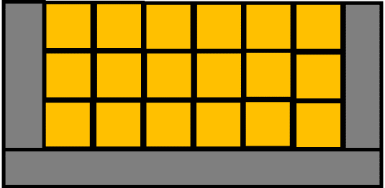
Round vs. Rectagular
Winding patterns
Round conductors do not have an optimal fill factor
Rectangular conductors perfectly match the slot shape when this features parallel sides

Slide 5
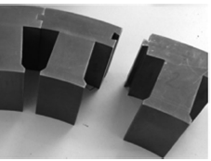
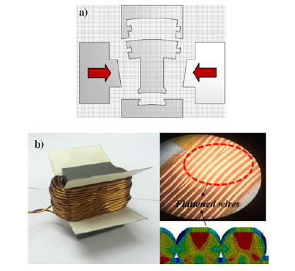
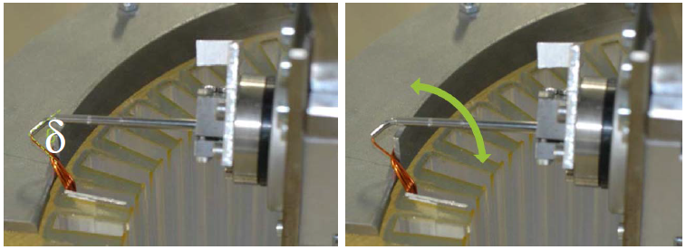
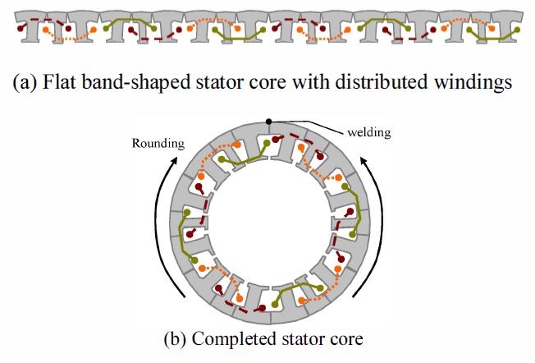
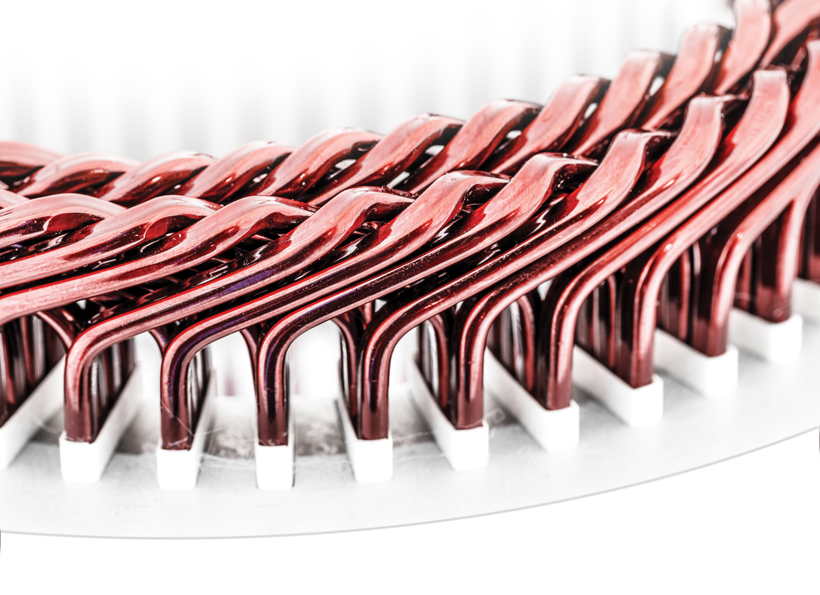
Focus on the fill factor
Fill factor
Segmented stator
Pressed coils
Needle winding
Innovative geometries
Hairpin
Only for concentrated windings
Process repeatability (high risk of insulation damages)
Not suitable for mass production
Needs complex machinery to obtain ordered layers
Still under investigation

Slide 6
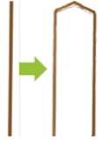
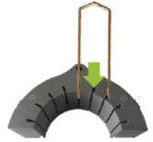
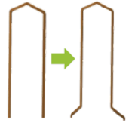
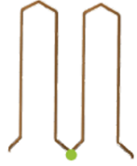
Manufacturing process
Preparatory phase: straightening, stripping and cutting
Manufacturing process: Shaping of the rectangular conductors, assembly in the stator, mechanical twisting, contacting
Shaping | Assembly | Twisting | Contacting
Contacting phase changes for mass production and prototyping

Slide 7
Contacting techniques
Mass production requires low cycle time, high reliability, automation of the process → Laser welding
Prototyping phase accepts high cycle time saving costs → soldering

Slide 8
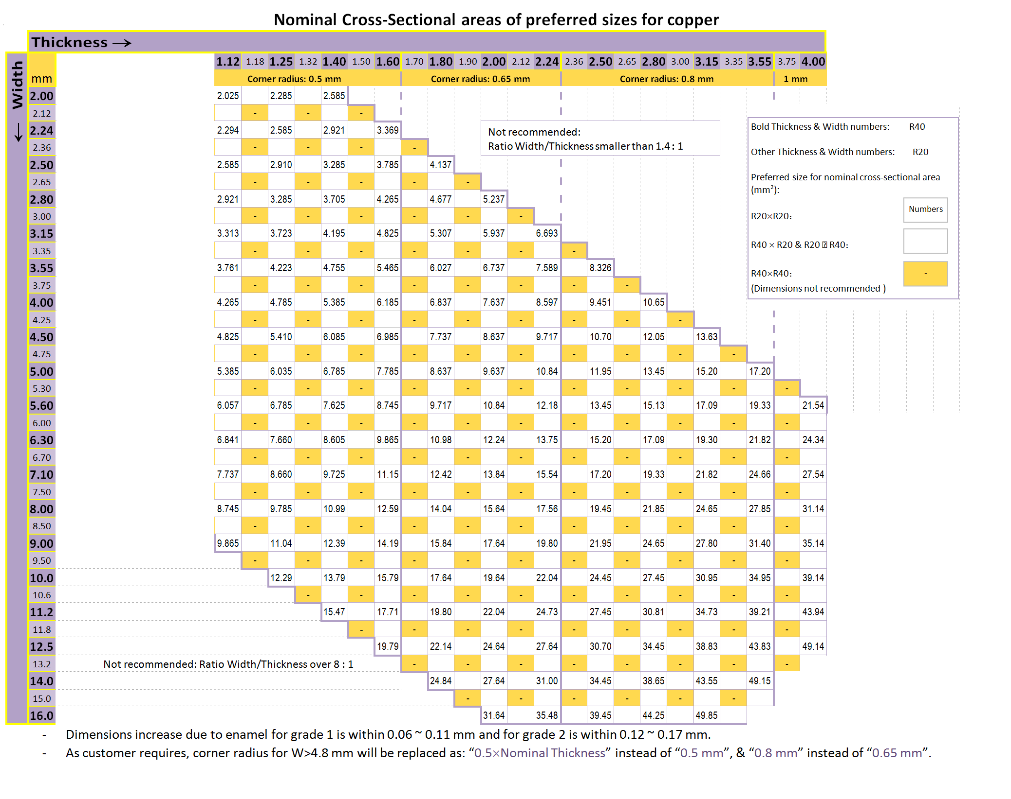
Dimensional challenges
The hairpin dimensional ratios (width vs. heigth) represent a bottleneck for AC losses reduction and bending/transposition purposes
IEC60317-0-2

Slide 9
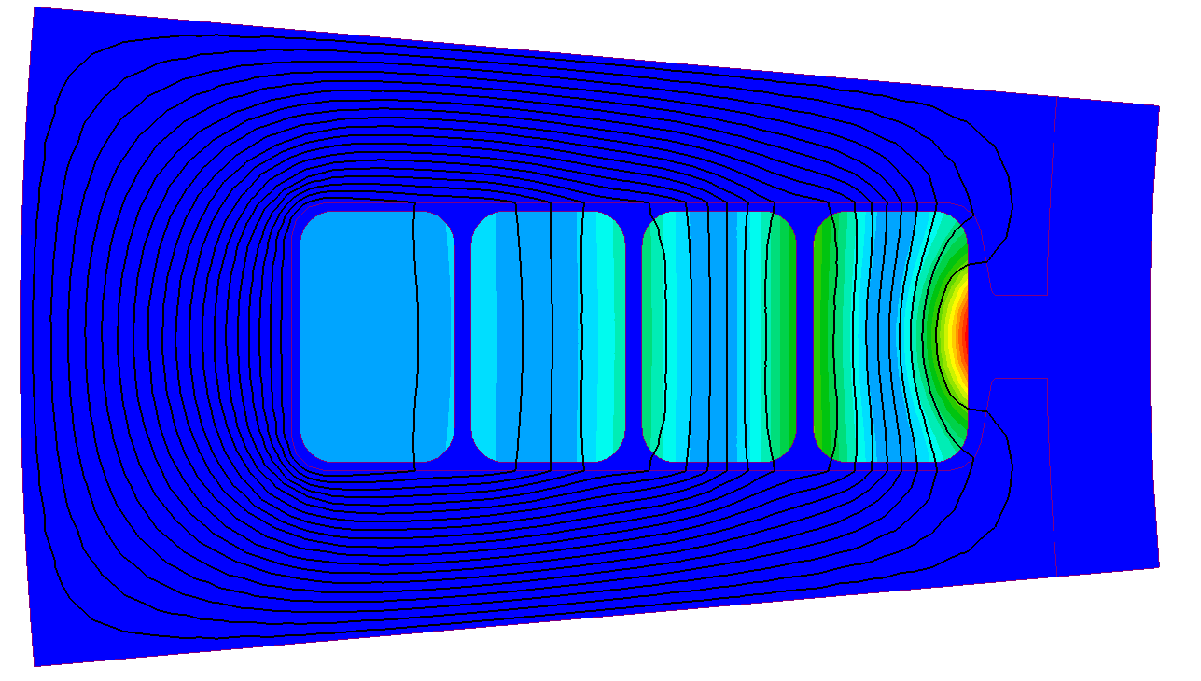
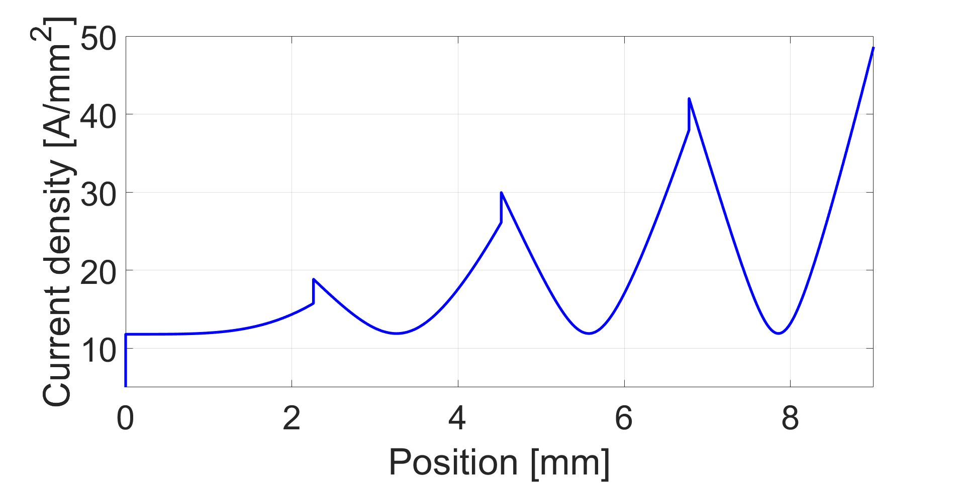
Standard hairpin windings
EM-related challenges
Non-uniform current density distribution within each conductor
Skin and proximity effects cause high AC losses

Slide 10
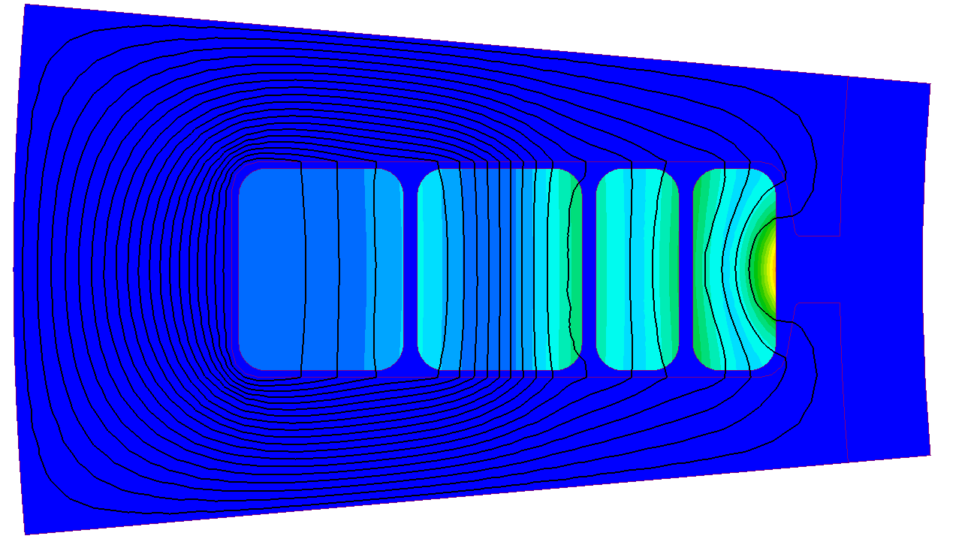
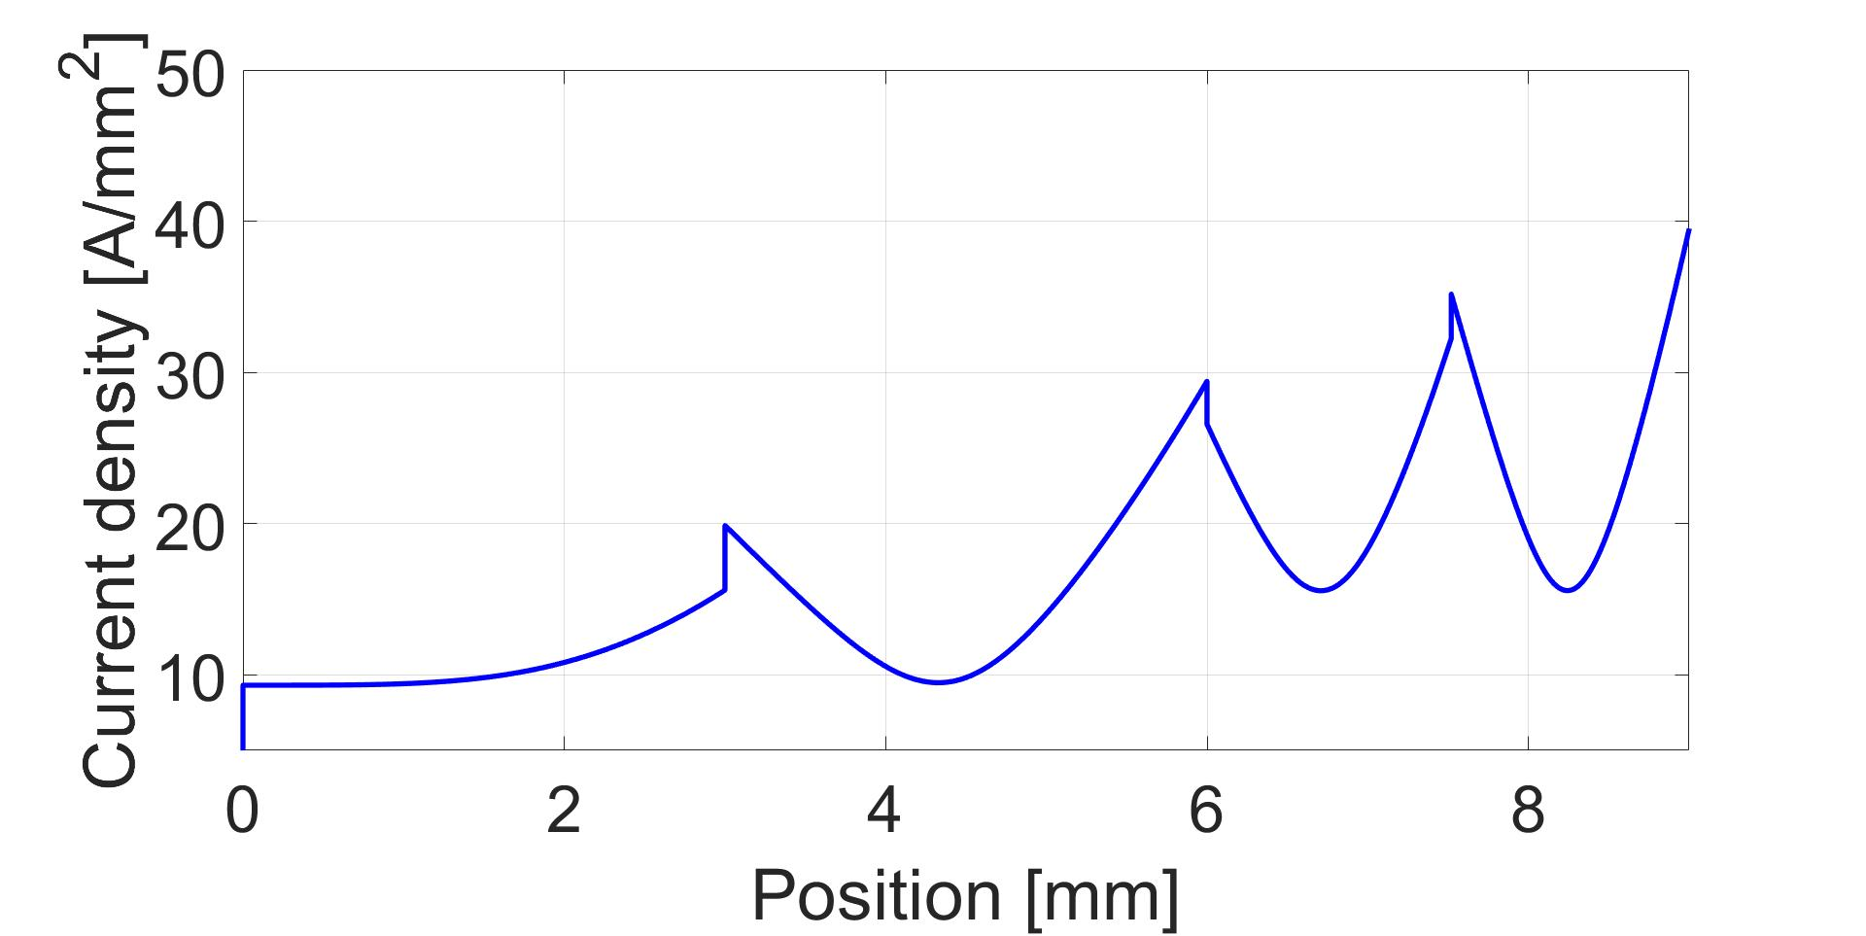
Future opportunities
Asymmetric windings height reduction of conductors across the slot (smallest hairpin near to the slot opening)
Benefit:
Current density peaks reduction
Drawback:
It requires conductors of different size

Slide 11
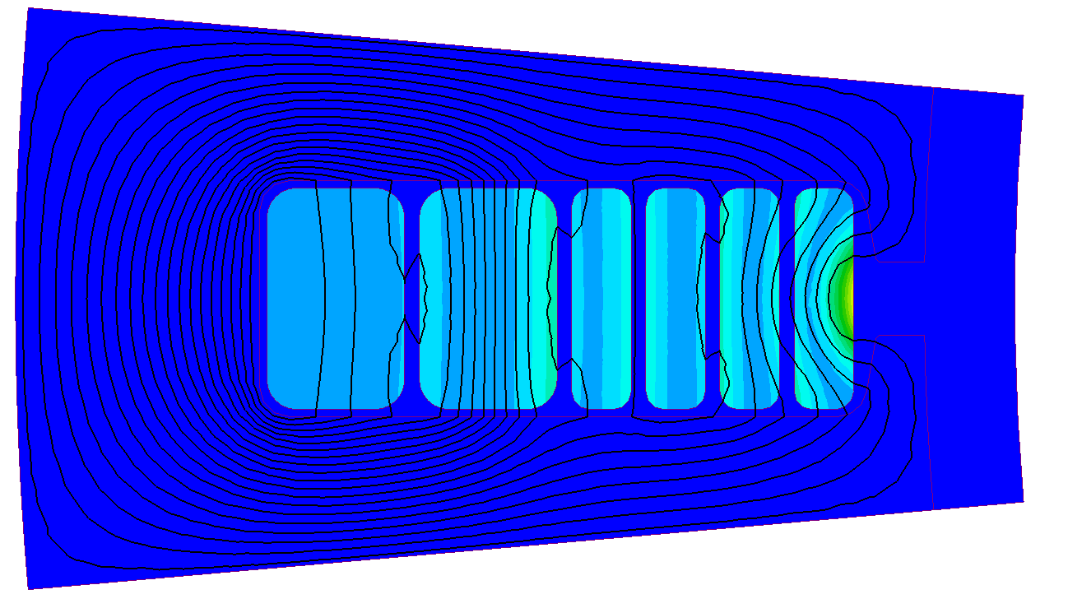
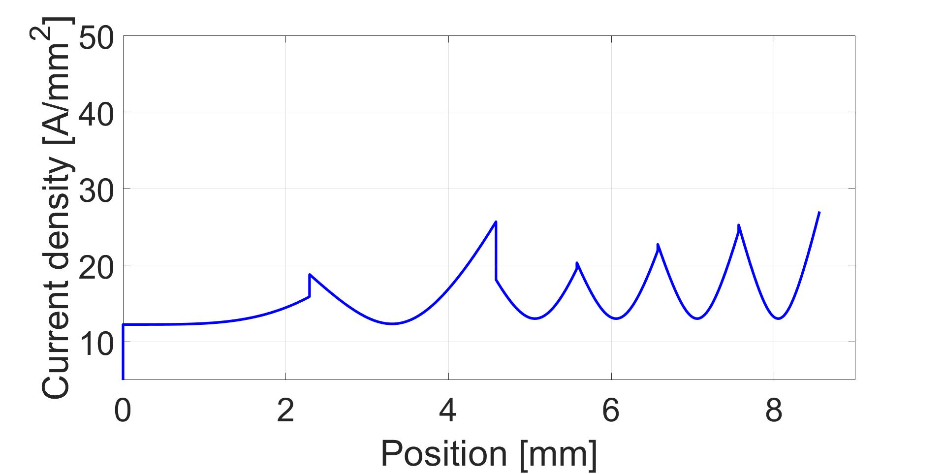
Future opportunities
Segmented hairpins
Last conductors consist of 2 or more parallel paths
Benefit:
Further reduction of current density peaks with respect to asymmetric solution
Drawback:
Complex manufacturing

Slide 12
Conclusions
Hairpin windings represent potential enablers for power density enhancements in electrical machines
A review of methods to enhance the fill factor was performed, highlighting the benefits of hairpins
The hairpin manufacturing processes, the contacting techniques, the dimensional limits and the challenges related the AC losses were discussed
Unconventional hairpin layouts were proposed as possible future opportunities and developments

Slide 13


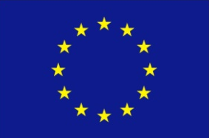

The AUTO-MEA project
AUTO-MEA
AUTOmated Manufacturing of wound components for next generation Electrical mAchines
IX call Clean Sky 2
UniMore:
Prof. Davide Barater (Coordinator) davide.barater@unimore.it
Dr. Stefano Nuzzo
Stefano.nuzzo@unimore.it
Coppering:
Mr. Pier Vai
Pier.Vai@coppering.com
Mr. David Gossen
David.Gossen@gehring-group.com

Slide 14
Thanks for
your attention

