Slide 1
CSE7000 - INTERNSHIP A Presentation on VisualSeek AI AI-Powered Natural Language Video Search & Intelligent Surveillance Analytics
Under the Supervision of,
Ms. Shaik Salma Begum
Assistant Professor
Presidency School of Computer Science and Engineering
Presidency University
Student Details
Name | Melvin James
Roll No | 20241CSE0847
Section | 5CSE12
Name of the Program: AI GPU Summer Internship Program
Name of the HoD: Dr. Asif Mohammed H.B
Name of the Program Internship Coordinator: Dr. Balakrishnan Raju
Name of the School Internship Coordinators: Dr. Bhuvaneshwari Patil

Slide 2
Content
About Company or Organization
Working domain or the Technology
Objectives of the work
System Architecture
Methodology Used / Course Description
Results (Optional)
Conclusion

Slide 3
About Company or Organization
Industry-oriented internship focused on Artificial Intelligence and GPU-Accelerated Computing.
Provided hands-on training using the NVIDIA H200 Tensor Core GPU through a cloud-based server environment.
Covered modern AI technologies including Machine Learning, Deep Learning, Computer Vision, Generative AI, and Large Language Models (LLMs).
Combined theoretical learning with practical implementation through coding sessions and AI development tools.
Concluded with the development and presentation of an AI-based capstone project.

Slide 4
About Company or Organization
Covered modern AI domains including Machine Learning, Deep Learning, Computer Vision, Large Language Models (LLMs), and Generative AI.
Included practical exposure to Kubernetes, JupyterLab, PyTorch, CUDA, OpenCV, YOLO, and Prompt Engineering.
Focused on developing industry-ready skills through hands-on exercises and real-world AI workflows.
Emphasized cloud-based GPU computing, model development, and AI application deployment.

Slide 5
Working domain or the technology
Worked in the domain of Artificial Intelligence (AI) with emphasis on GPU-Accelerated Computing using the NVIDIA H200 Tensor Core GPU.
Explored Machine Learning, Deep Learning, Computer Vision, Large Language Models (LLMs), and Generative AI through hands-on sessions.
Gained practical experience with PyTorch, CUDA, Kubernetes, OpenCV, YOLO, and Prompt Engineering for developing AI applications.
Learned cloud-based AI development, GPU programming, model optimization, and deployment workflows.
Applied these technologies to solve real-world AI problems through practical implementation and project development.

Slide 6
Objectives of the work
Apply Artificial Intelligence and GPU-Accelerated Computing concepts to solve real-world surveillance challenges.
Develop an intelligent surveillance platform capable of real-time object detection and natural language-based video search.
Integrate modern AI technologies including Computer Vision, Large Language Models (LLMs), and Semantic Search into a unified solution.
Enhance practical skills in PyTorch, CUDA, OpenCV, YOLO, and cloud-based AI development through hands-on implementation.
Build a scalable and user-friendly system that improves security monitoring, event retrieval, and surveillance analytics.

Slide 7
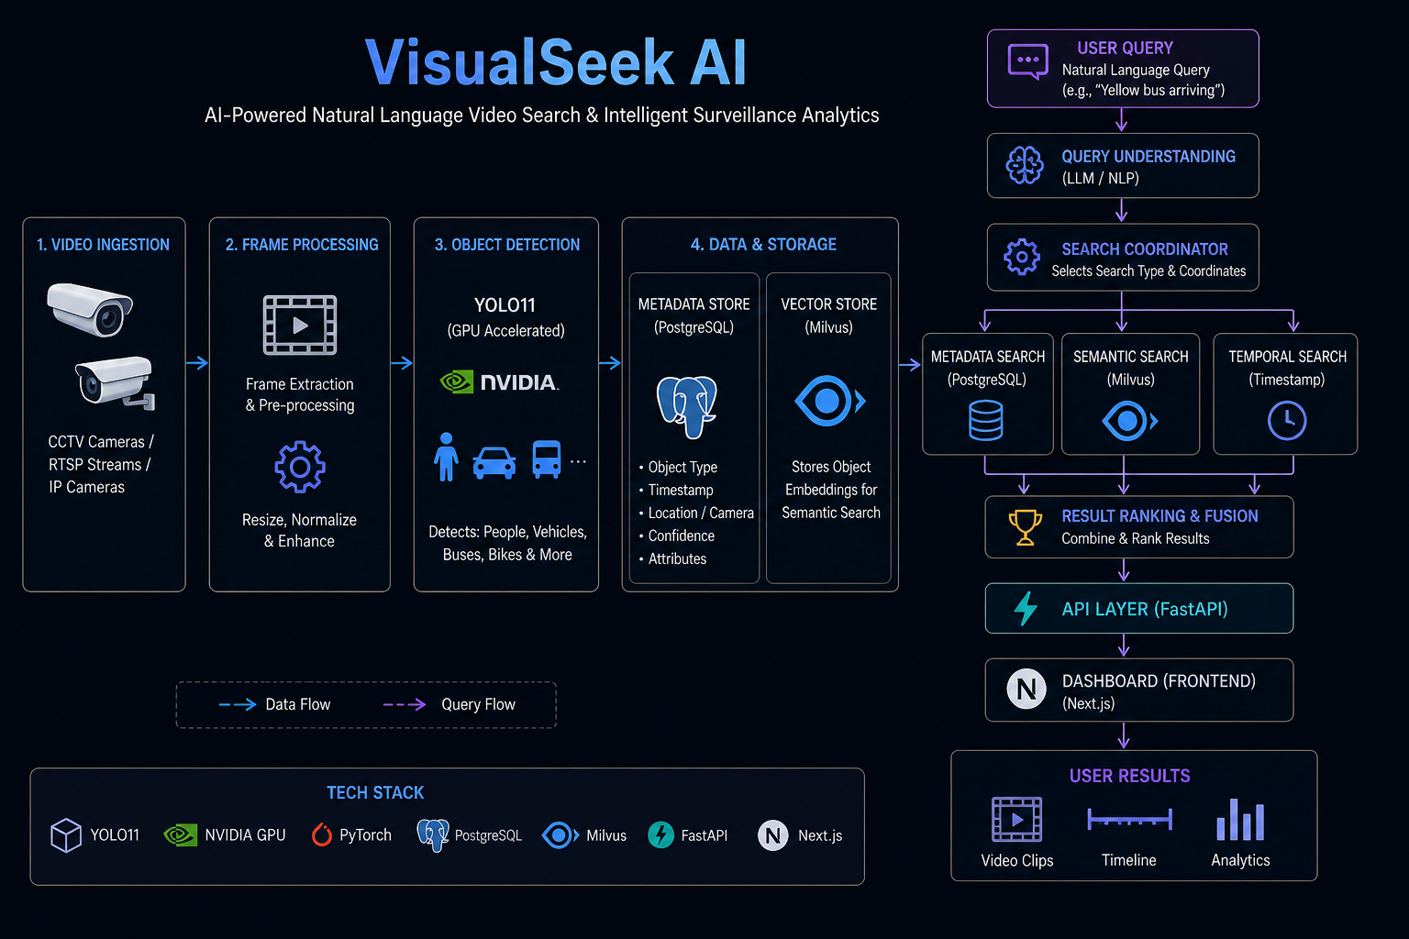
System Architecture

Slide 8
Methodology Used / Course Description
AI Processing Pipeline:
The VisualSeek AI system uses an AI-based pipeline to convert CCTV footage into intelligent and searchable surveillance data.
Workflow
1. Video Capture
CCTV cameras continuously send video streams to the system.
2. Frame Processing
The video is divided into individual frames for analysis.
3. Object Detection
YOLO11 detects people, vehicles, and other objects in each frame.

Slide 9
Methodology Used / Course Description
Data Processing & Storage:
4. Attribute Extraction
The system extracts details such as object type, colour, clothing, and timestamps.
5. Metadata & Embedding Generation
Searchable metadata and AI embeddings are created for every detected object.
6. Data Storage
Metadata is stored in PostgreSQL, while embeddings are stored in Milvus for fast and accurate searching.

Slide 10
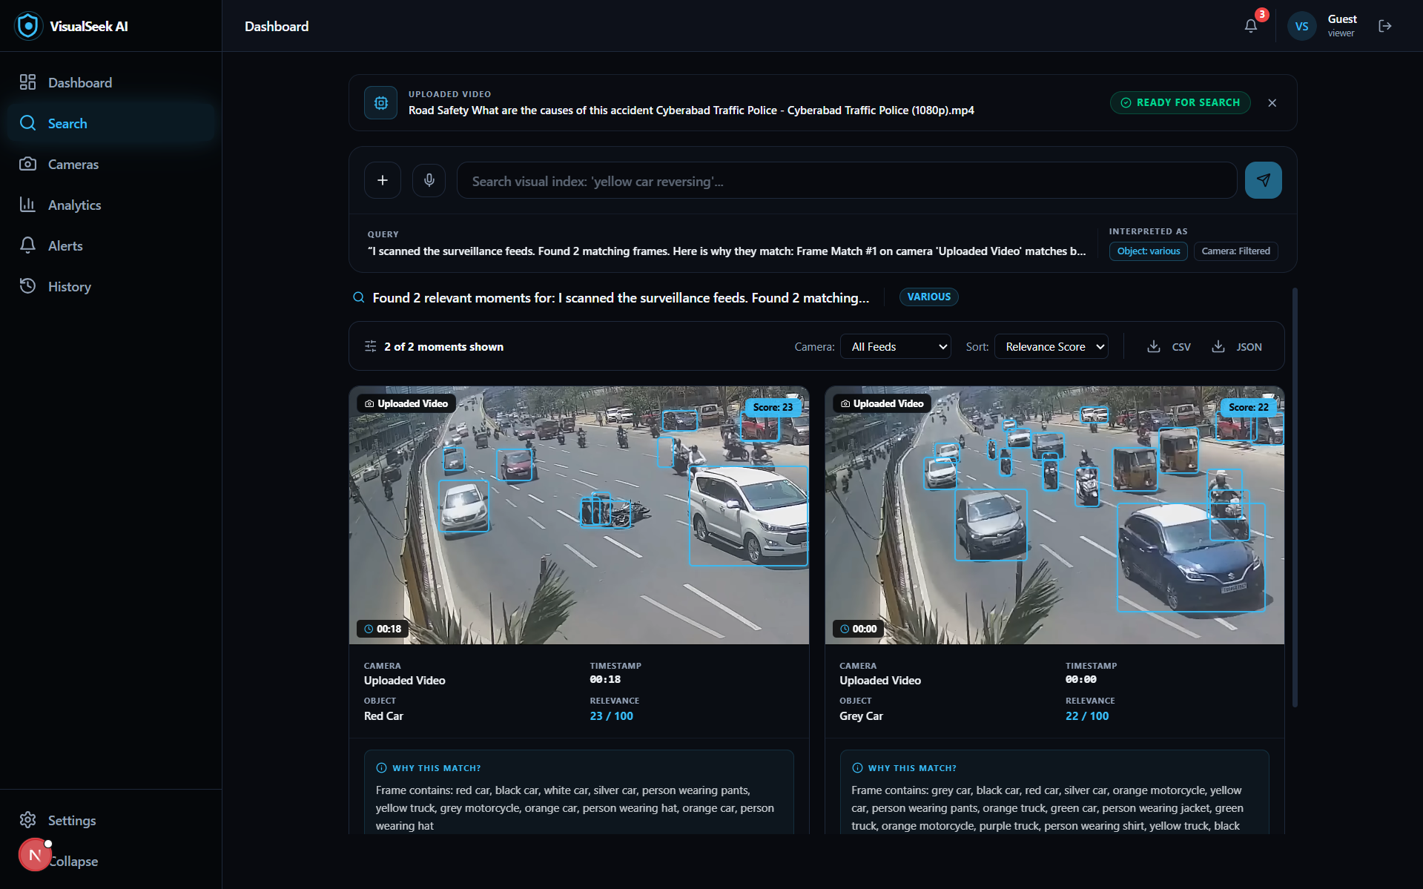
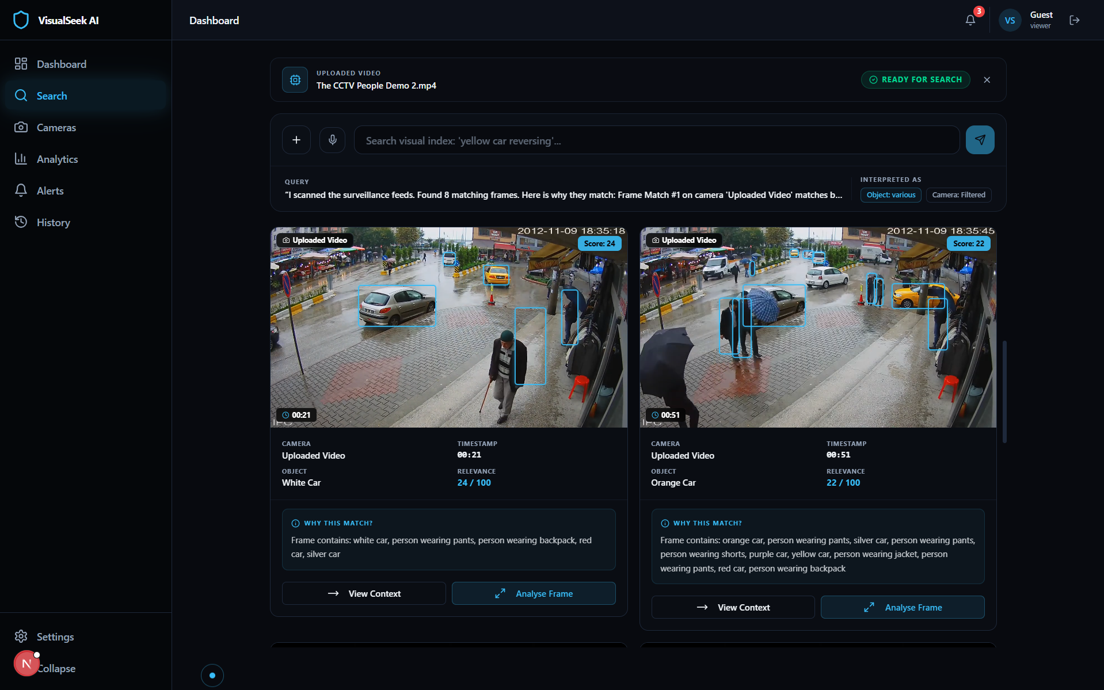
Results
Figure 1: Natural Language Search Interface
(Query: Bike accident)
Figure 2: Natural Language Search Interface
(Query: Yellow car reversing)

Slide 11
Conclusion
Successfully applied Artificial Intelligence and GPU-Accelerated Computing concepts to develop an intelligent surveillance system.
Gained practical experience in Computer Vision, Deep Learning, and Natural Language Search using modern AI technologies.
Developed VisualSeek AI, demonstrating real-time object detection, semantic video search, and an interactive surveillance dashboard.
The internship enhanced technical knowledge, problem-solving skills, and hands-on experience in building real-world AI applications.

Slide 12
Q&A

Slide 13
Thank you !!

