Slide 1
HCI
Melvin Mokhtari Amirreza Hosseini Sepehr Khodadadi
Software Engineering 1

Slide 2
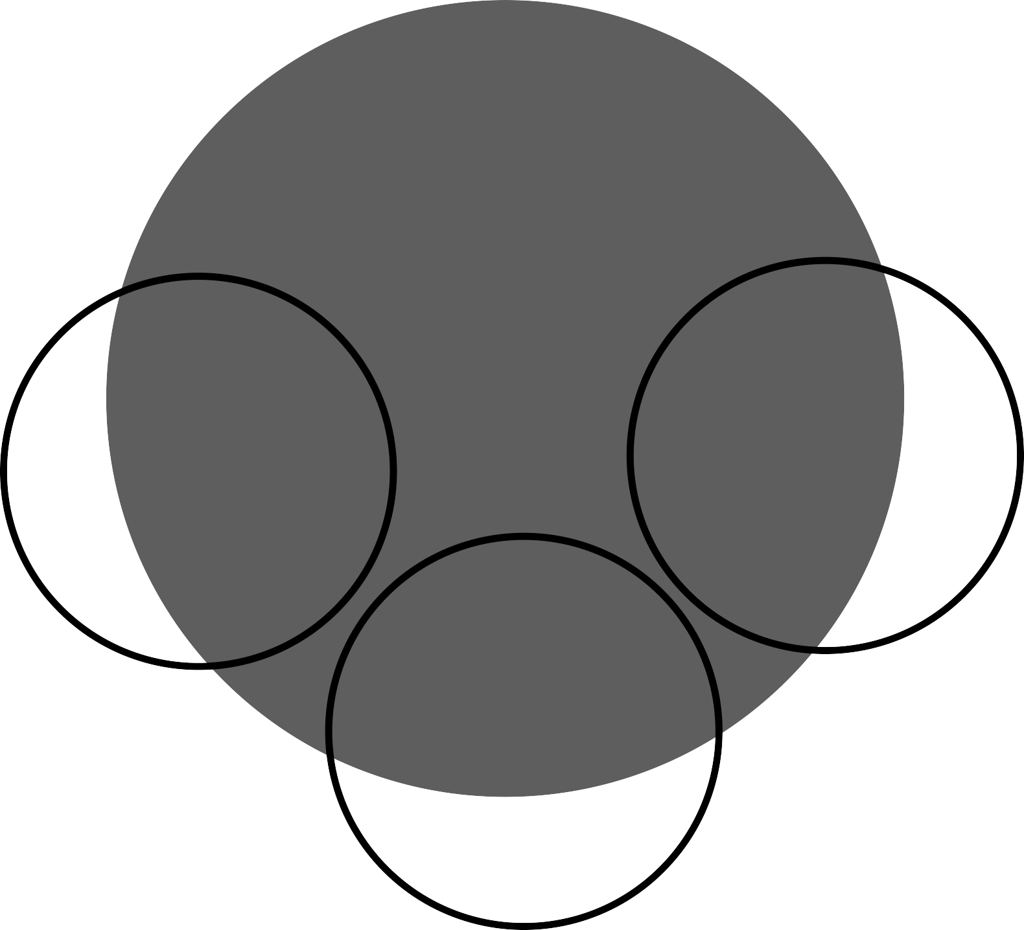
What is Human-Computer Interaction (HCI)?
HCI
HCI is a multidisciplinary field of study focusing on the design of computer technology and, in particular, the interaction between humans (the users) and computers.
Computer Science
human factor engineering
cognitive science

Slide 3
Computer systems with good usability
Developers must attempt to:
1
Understand the factors that determine how people use technology
2
Develop tools and techniques to enable building suitable systems
3
Achieve efficient, effective, and safe interaction
4 Put people first

Slide 4
Fields and Branches
Product Design
UI
Design
Interaction

Slide 5
What we are focusing on
UI/UX
UI
The “UI” in UI design stands for “user interface”. The user interface is the graphical layout of an application.
UX
“UX” stands for “user experience.” A user’s experience of the app is determined by how they interact with it.

Slide 6
Popular UI/UX design trends of the upcoming years
01
02
03
Animated illustrations
Micro interaction
Virtual Reality
04
Augmented Reality
05
Asymmetrical Layouts
06
Storytelling

Slide 7
Animated illustrations
Illustrations as very popular design elements add “natural feel” and “human touch” to the overall UX of our products.
Illustrations are also very strong attention grabbers
(by applying motion to these illustrations)
applying motion is capturing users’ attention and making users engage with your product.

Slide 8
Micro interaction
Micro-interactions
are the animations
and changes of the interface that happen once a user interacts with something.
the color change on button hover is an example for micro interaction.

Slide 9
Virtual Reality (VR)
VR is a simulated experience that can be similar to or completely different from the real world.
Applications of virtual reality can include entertainment (i.e. video games) and educational purposes (i.e. medical and so on).

Slide 10
Augmented Reality (AR)
AR can be defined as a
Real and
Feature 1
virtual worlds
system that fulfills three basic features
real-time interaction
accurate 3D registration of
Feature 3
Feature 2
virtual and real objects

Slide 11
Asymmetrical Layouts
There is a lot of room
for creativity as the
number of options and opportunities when creating asymmetrical layouts
are endless.
In design, asymmetry is often used to create visual tension.
Designers who master asymmetry have greater freedom of expression.

Slide 12
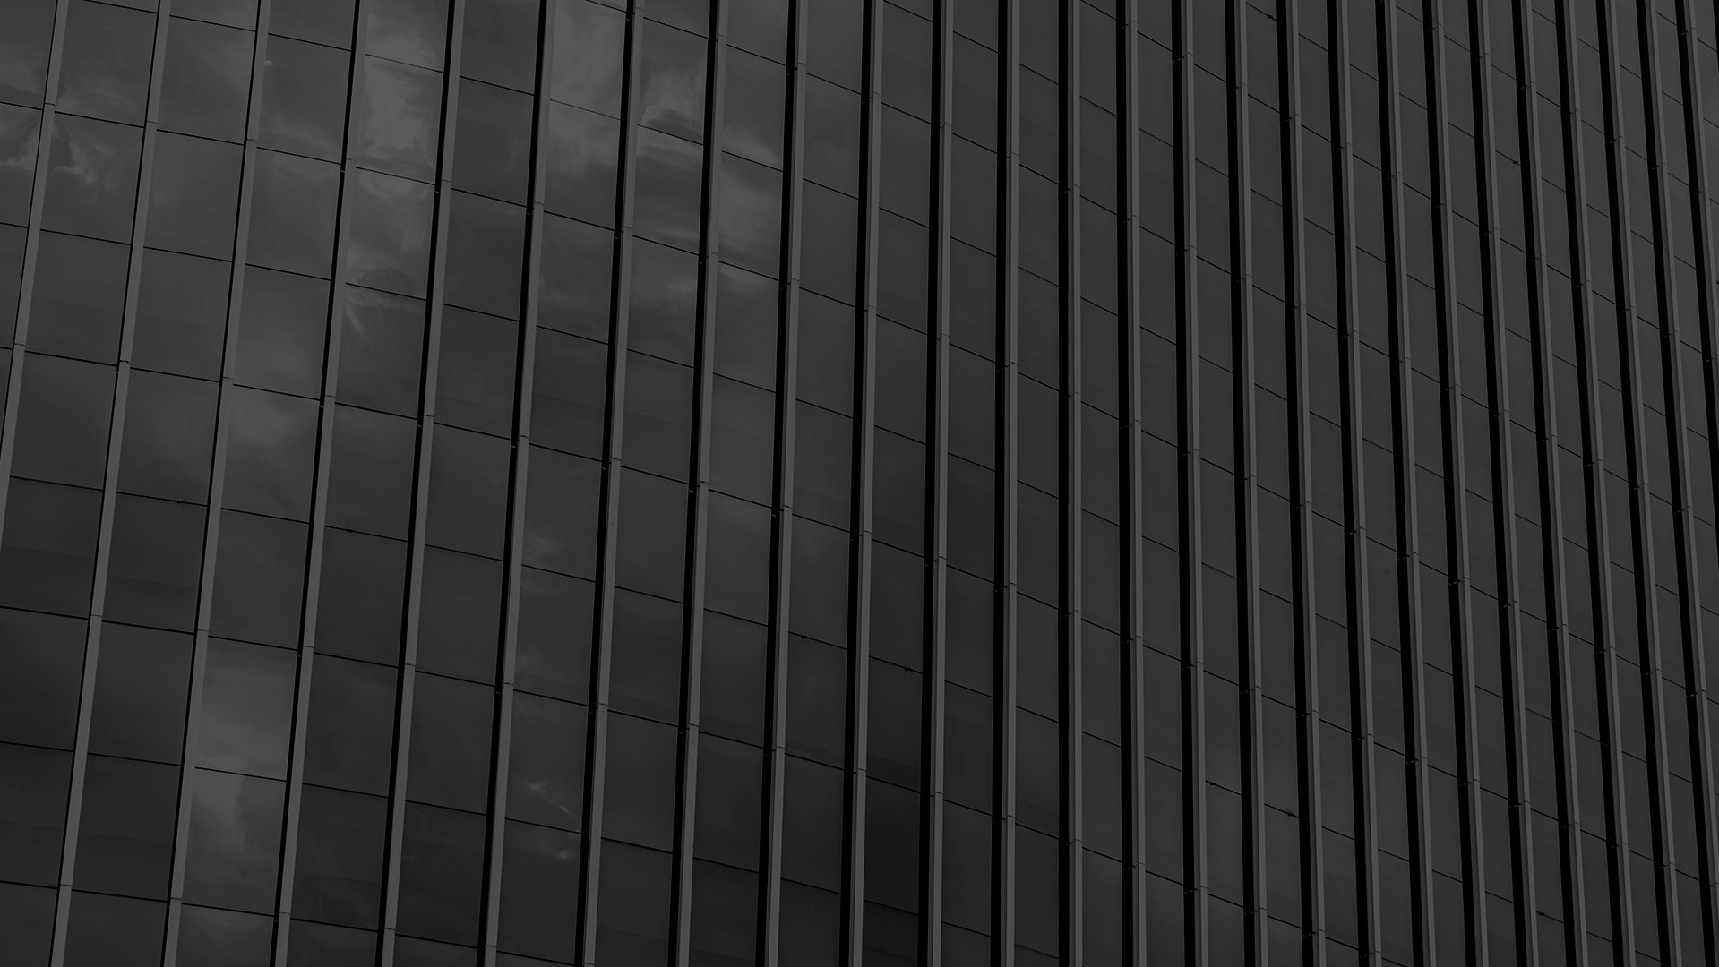
Storytelling
Stories play a very important role in overall UX in digital product design.
Storytelling is all about transferring data to the users in the best possible informative and creative way.
Storytelling helps to create positive emotions and relationships between your brand and users.

Slide 13
References
Chapter 10 of “SYSTEMS ANALYSIS
& DESIGN” book (5th edition)
01
02
“Human-Computer Interaction” book
03
04
https://medium.com/free-code-camp/how-facebook-designs- microinteractions-for-feature-discovery-c79cfe998a77
https://en.wikipedia.org/wiki/Virtual_reality
05
06
https://www.shopify.com/partners/ blog/asymmetrical-design
https://en.wikipedia.org/wiki/Augmented_reality
07
08
https://www.interaction-design.org/literature/ topics/human-computer-interaction
https://uxdesign.cc/8-ui-ux-design- trends-for-2020-68e37b0278f6

Slide 14
THANKS!
January 29, 2023

