Slide 1
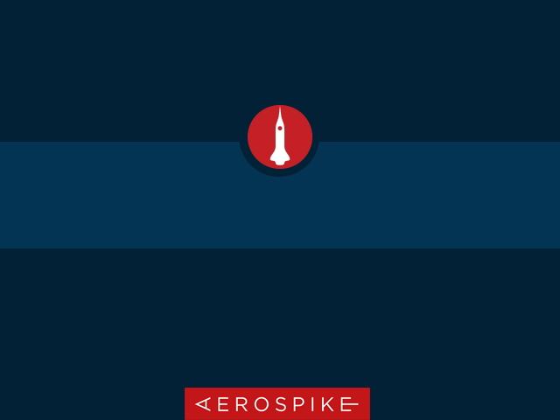
Aerospike Advanced Concepts
Geospatial

Slide 2
Objective
After successful completion of this module you should be able to:
Create Geospatial Indices
Perform Geospatial Queries
Understand
Basic GeoJSON
Throughput limitations
Code a solution in
C#
Java

Slide 3
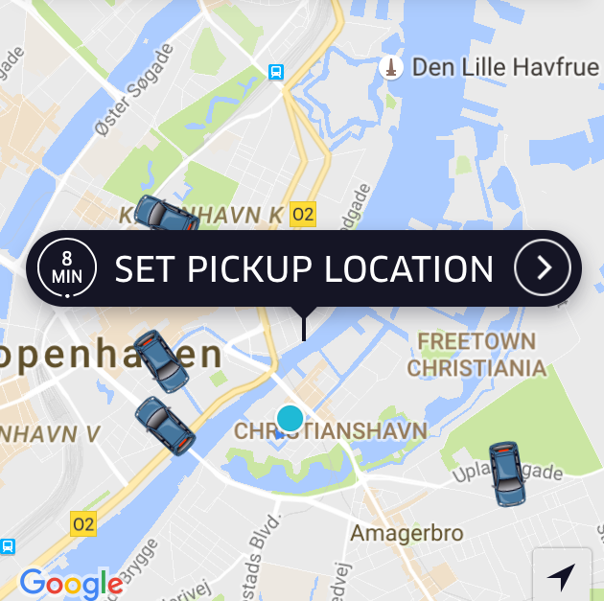
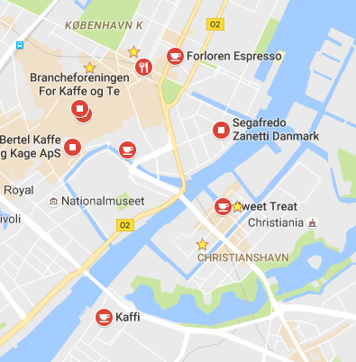

Use Cases
Vehicle tracking systems that require:
high throughput updates of vehicle location
frequently query vehicles within a region.
Find specific Retail within 500m of a shopper.
Location-targeted bidding by discovering persons or devices within the location of an active Ad campaign.

Slide 4
Geospatial terms
Line or LineString
Point
Region

Slide 5
Aerospike Geospatial
Aerospike provides geospatial storage and indexing to enable fast queries on:
points within a region
a region containing points
points within a radius.
Storage format is GeoJSON geometary objects
AeroCircle data type extends the GeoJSON format to store circles
GeoJSON geospatial data type

Slide 6
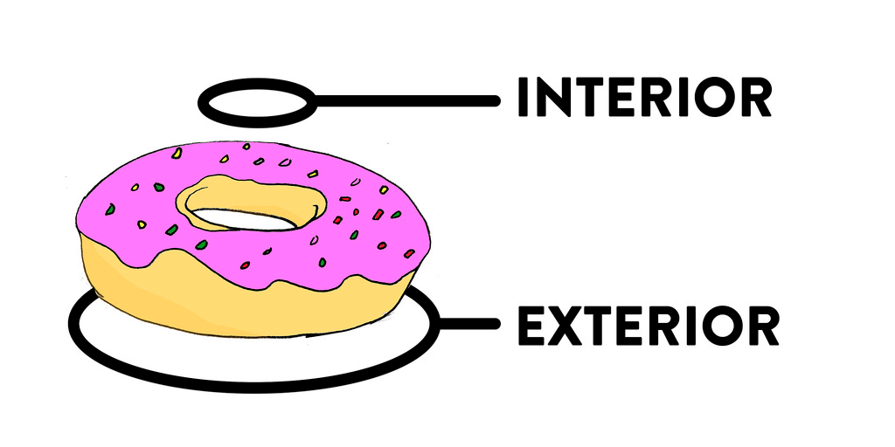
GeoJSON – quick overview
Point
LineString (line)
Polygon
Holes – (not supported by Aerospike)
Feature
Geometries - Points, LineStrings, Polygons
Properties – data about the feature
{ "type": "Point", "coordinates": [0, 0] }
{ "type": "LineString", "coordinates": [[0, 0], [10, 10]] }
{
"type": "Polygon",
"coordinates": [
[
[0, 0], [10, 10], [10, 0], [0, 0]
]
]
}
{
"type": "Feature",
"geometry": {
"type": "Point",
"coordinates": [0, 0]
},
"properties": {
"name": "null island"
}
}
See: http://www.macwright.org/2015/03/23/geojson-second-bite.html

Slide 7
AeroCircle – a GeoJSON Extension
Aerospike provides an extension type: AeroCircle. This type allows circles to be stored in addition to regular polygons.
Features:
Longitude
Latitude
Radius in meters
{
"type": ”AeroCircle",
"coordinates": [ [151.20732, -33.86785], 150000]
}

Slide 8

Creating a Geospatial Secondary Index
Before executing a query, a secondary index must be created.
A secondary index is created using:
Namespace (database)
Set (table)
Bin (column) name and type – GEO2DSPHERE
Index Collection Type (optional)
The easiest way to create an index is with aql, which is an SQL-like utility.
It can also be done with the Client API

Slide 9
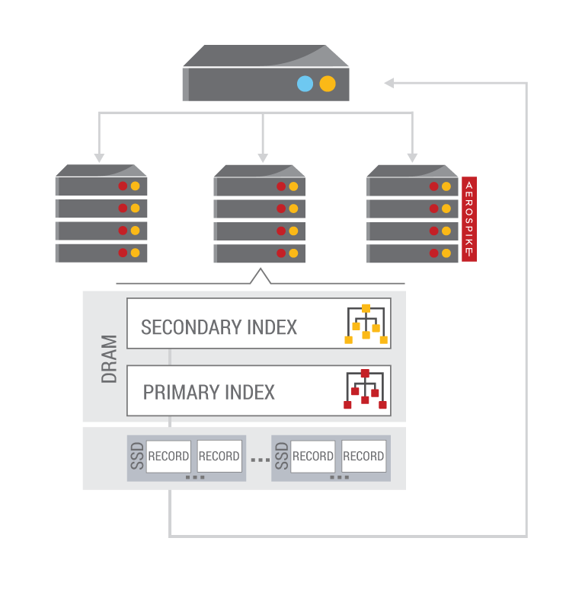
Steps to execute a Query
To execute a Query, perform the following steps:
Prepare a Statement
Namespace and Set
Bins to return
Single Filter
Execute Statement
Process results
Iterate through the results

Slide 10
Preparing a Geospatial Statement and Filter
Points within a region (including circle)
Region contains point
// Java
Statement stmt = new Statement();
stmt.setNamespace(ns);
stmt.setSetName(airportSet);
stmt.setBinNames("ICAO", "IATA", "name", "city", "country");
// Find all airports within 150km of Sydney Latitude: -33.86785, Longitude: 151.20732
stmt.setFilters(Filter.geoWithinRadius(locationBin,
151.20732d, // Longitude
-33.86785d, // Latitude
150000 // radius in meters
));
// C#
// Find all regions that contain this point stmt.SetName = regionSet; stmt.BinNames = new string[] { "name", "type" }; String point = String.Format("{{ \"type\": \"Point\", \"coordinates\": [{0}, {1}] }}", 151.20732d, // Longitude -33.86785d // Latitude ); stmt.SetFilters(Filter.GeoContains(regionBin, point));

Slide 11
Processing results
You process the results of your query by iterating through the RecordSet.
next() fetches the next element and will block until one is available
getRecord() or Record returns the Record from the current element
getKey() or Key returns the Key from the current element
Remember to close the RecordSet

Slide 12
Limitations
50k queries per second – regardless of cluster size
Duplicate records can be returned
records may in more that one region

Slide 13
Exercises: Geospatial

Slide 14
Exercises and Answers
Directory layout
csharp
answers
exercises
Java
answers
exercises
Java: Maven project
C#: Visual studio (and Xamarin) solution

Slide 15
Java: Geospatial
Find the GeoExercises.java file in the exercises directory. Replace the TODOs with working code
// TODO create a Radius filter using Sydney's location with a radius of 150km
// TODO create a filter to discover the regions containing this point

Slide 16
C#: Geospatial
Find the Program.cs file in the exercises directory. Replace the TODOs with working code
// TODO create a Radius filter using Sydney's location with a radius of 150km
// TODO create a filter to discover the regions containing this point

Slide 17


